Slide 1
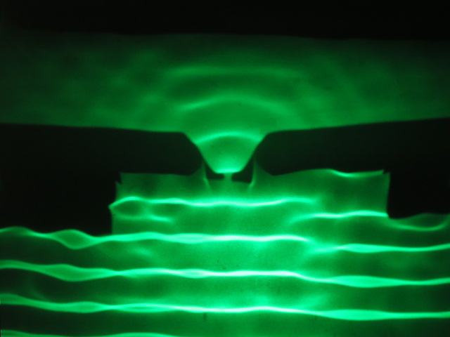
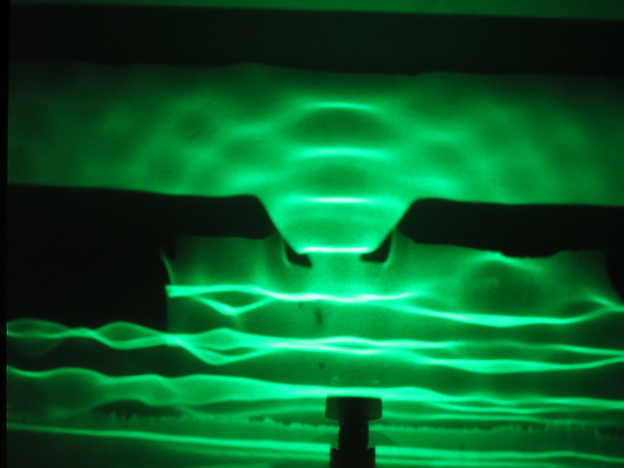
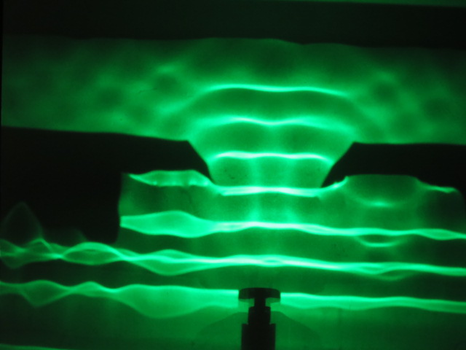
Maxima
Narrow Gap
Medium Size Gap
Large Gap
Minima
20 Hz
20 Hz
20 Hz

