Slide 1







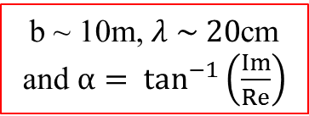
$$t$$
$$V_{1}=Ve^{iωt}$$
1
b
$$V_{1}V_{2}^{∗}={V^{2}e}^{iωΔt}$$
X
z
$$bcosz$$
2
$$ϕ_{0}$$
$$V_{2}=Ve^{iω(t−Δt)}$$
$$t−Δt$$
b ~ 10m, $λ \sim 20$cm and $α= \tan^{−1}\left(\frac{Im}{Re}\right)$

