Slide 1
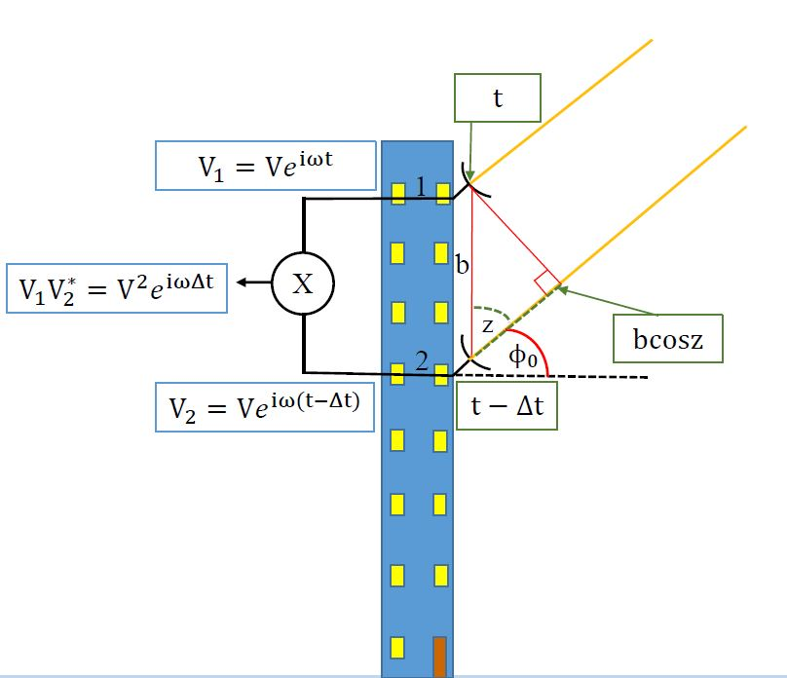
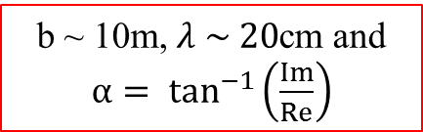
b ~ 10m, $λ \sim 20$cm and $α= \tan^{−1}\left(\frac{Im}{Re}\right)$

