Slide 1
Predicting the Weather by Watching Airplanes
Matt Evans
University of Exeter
College of Engineering, Mathematics and Physical Sciences
BSc Physics

Slide 2
Outline
Humidity and the importance of measuring humidity distributions in the lower atmosphere (troposphere).
Insights of how ADSB radio wave transmissions could be used to achieve this by using radio wave interferometry and refractive techniques.
Discussion of initial relative humidity refraction tests.
Further work and ideas.

Slide 3
Humidity
Humidity is an indicator of how much water vapour is present within the air.
Relative Humidity (RH) is a measure, in %, of how close the air is to being fully saturated:
RH = 100% → Fully Saturated
RH = 0% → Completely Dry
It is an important indicator to weather forecasting e.g. a higher RH means more likelihood of rain.
ADSB provides a much cheaper alternative to measuring humidity as opposed to e.g. AMDAR (Aircraft Meteorological DAta Relay).

Slide 4
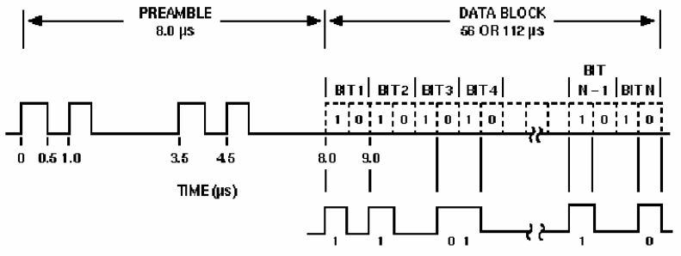
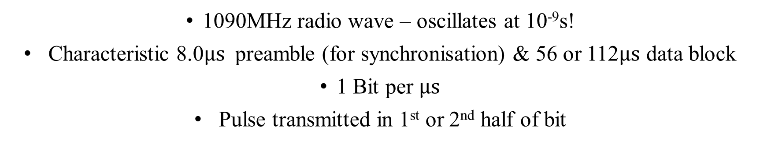
ADSB
Automatic Dependent Surveillance Broadcast
Image adapted from: https://www.sigidwiki.com/images/1/15/ADS-B_for_Dummies.pdf
1090MHz radio wave – oscillates at 10⁻⁹s!
Characteristic 8.0$μs$preamble (for synchronisation) & 56 or 112$μs$ data block
1 Bit per $μs$
Pulse transmitted in 1st or 2nd half of bit

Slide 5
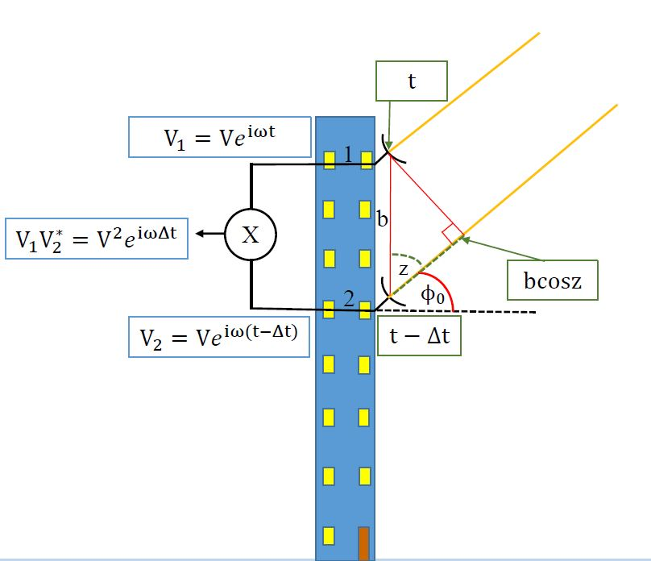
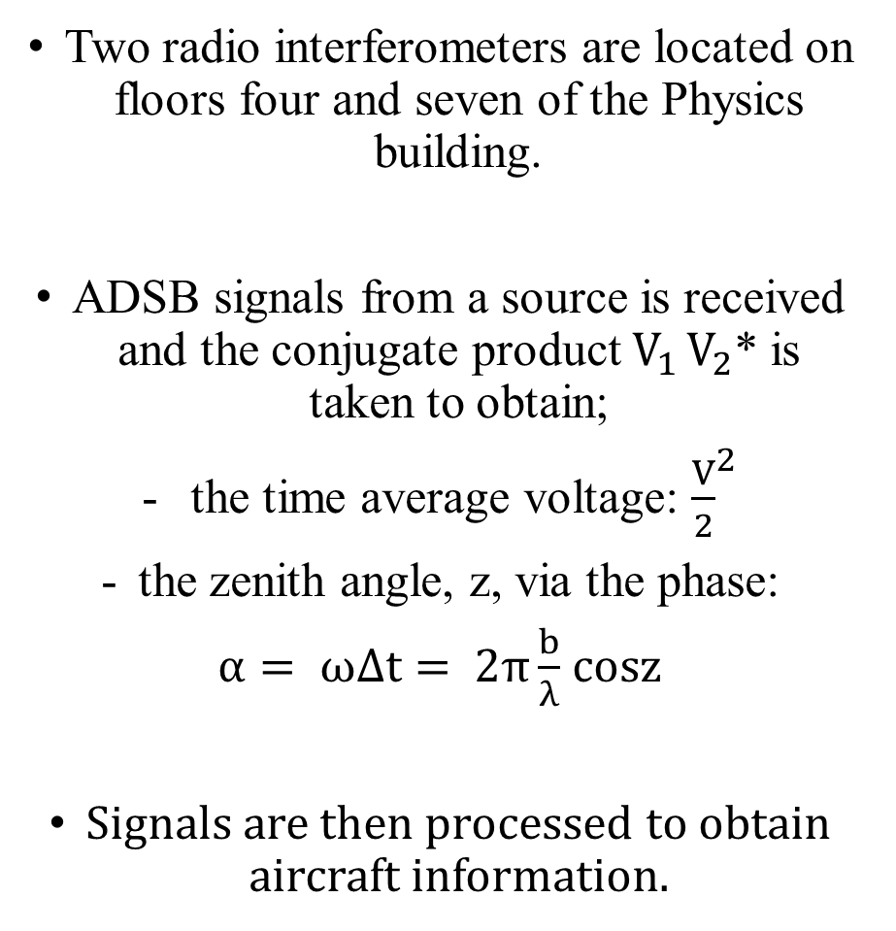
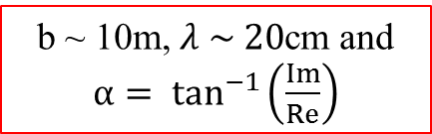
Radio Interferometry
Two radio interferometers are located on floors four and seven of the Physics building.
ADSB signals from a source is received and the conjugate product $V_{1 }V_{2}$* is taken to obtain;
the time average voltage: ${\frac{V}{2}}^{2}$
the zenith angle, z, via the phase:
$α= ωΔt=$ $2π\frac{b}{λ}$ $cosz$
Signals are then processed to obtain aircraft information.
b ~ 10m, $λ \sim 20$cm and $α= \tan^{−1}\left(\frac{Im}{Re}\right)$

Slide 6
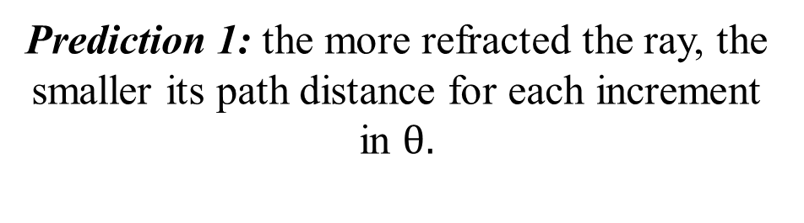






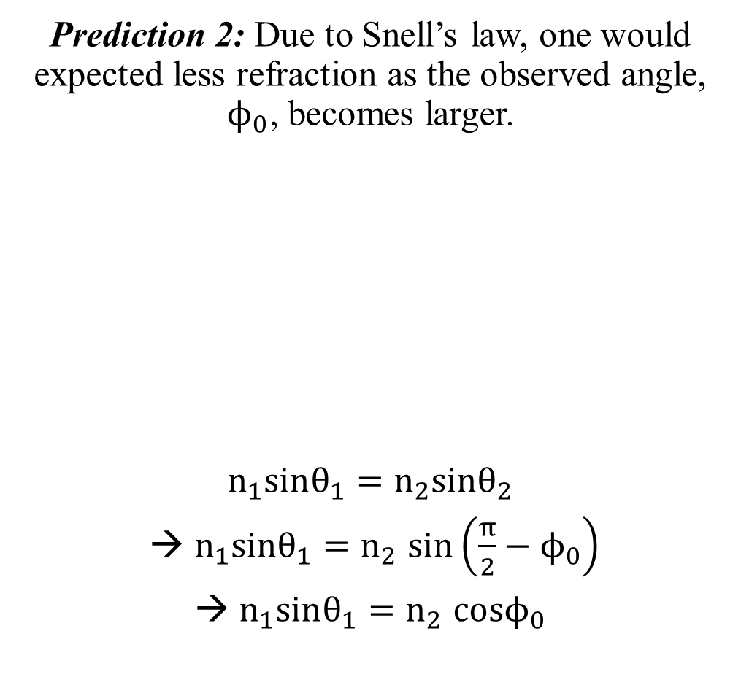

Refraction Predictions
Prediction 1: the more refracted the ray, the smaller its path distance for each increment in $θ.$
Prediction 2: Due to Snell’s law, one would expected less refraction as the observed angle, $ϕ_{0}$, becomes larger.
$$n_{1}sinθ_{1}=n_{2}sinθ_{2}$$
→ $n_{1}sinθ_{1}{=n}_{2}sin\left(\frac{π}{2}−ϕ_{0}\right)$
→ $n_{1}sinθ_{1}{=n}_{2}cosϕ_{0}$

Observed
Position

Actual
Position
n₁
$$θ_{1}$$
R_{obs}
$$θ_{2}$$
$$n_{2}>n_{1}$$
n₂
$$ϕ_{0}$$
$$ϕ_{0}$$
R_{ref}
$$θ$$
$$\frac{dR_{obs}}{dθ}>\frac{dR_{ref}}{dθ}$$

Slide 7
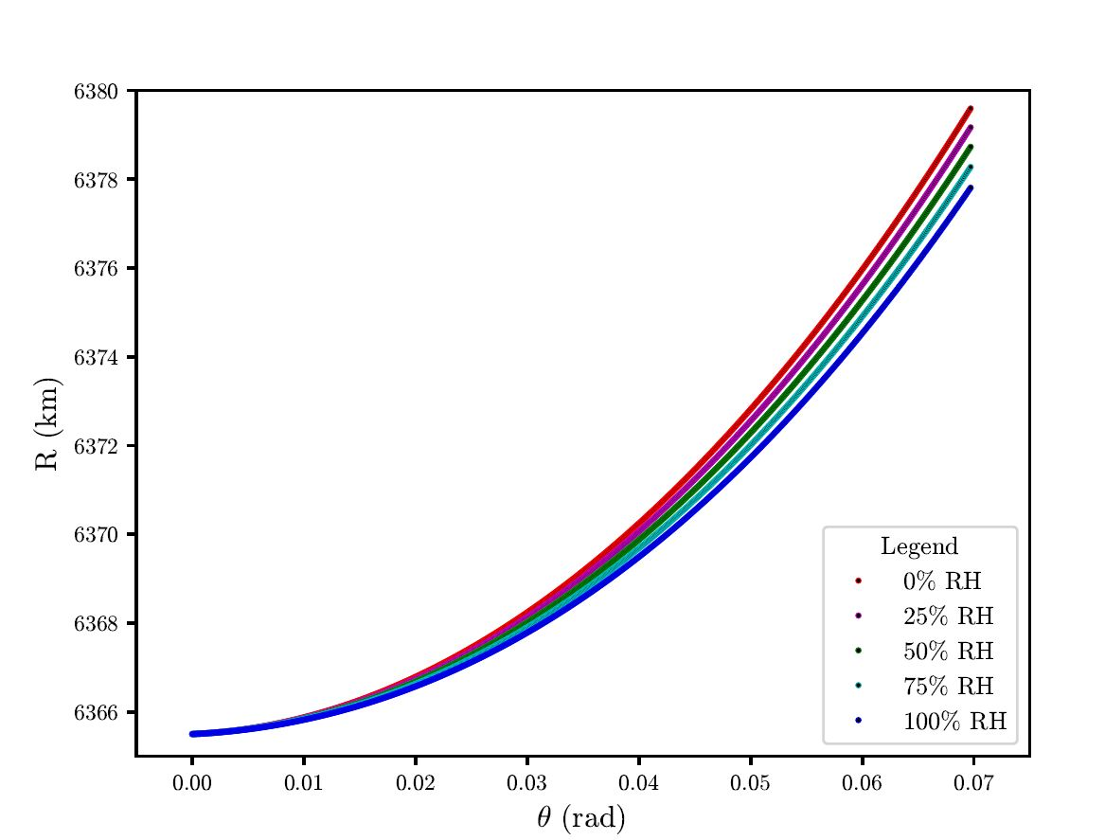
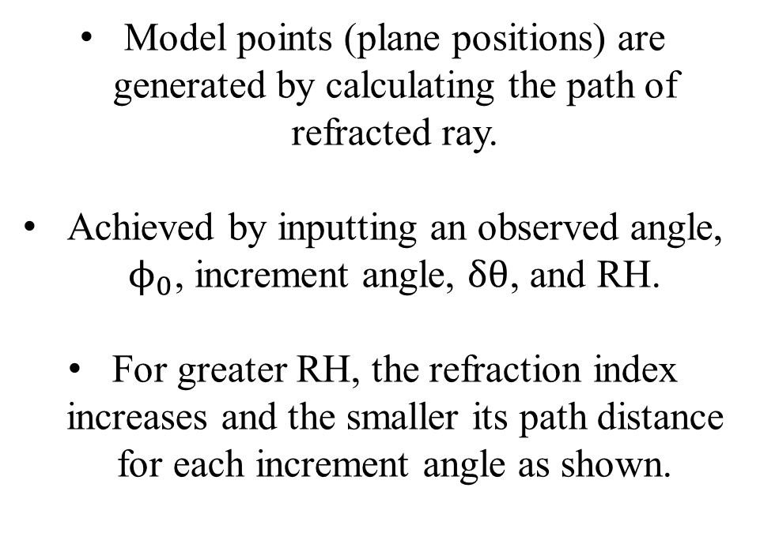
Refraction Test 1
Model points (plane positions) are generated by calculating the path of refracted ray.
Achieved by inputting an observed angle, $ϕ_{0}$, increment angle, $δθ$, and RH.
For greater RH, the refraction index increases and the smaller its path distance for each increment angle as shown.
$ϕ_{0}=$0.1°, $δθ$ = 10⁻⁴ rad
Prediction 1: the more refracted the ray, the smaller its path distance for each increment in $θ.$ $✓$

Slide 8
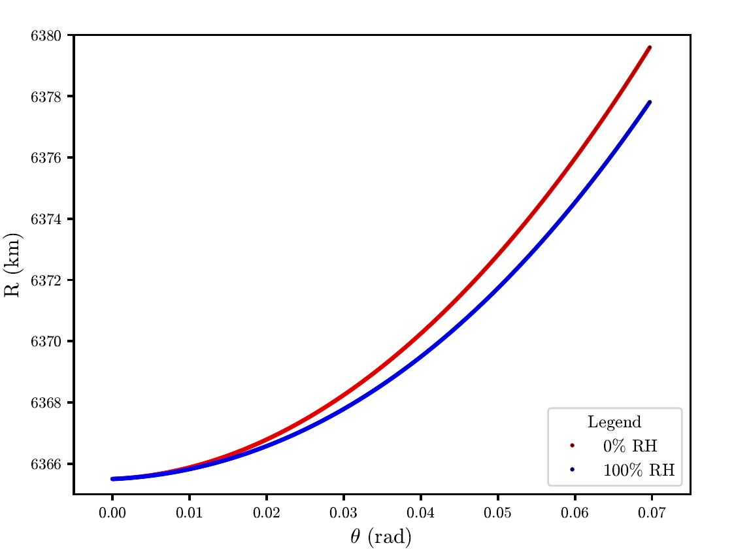
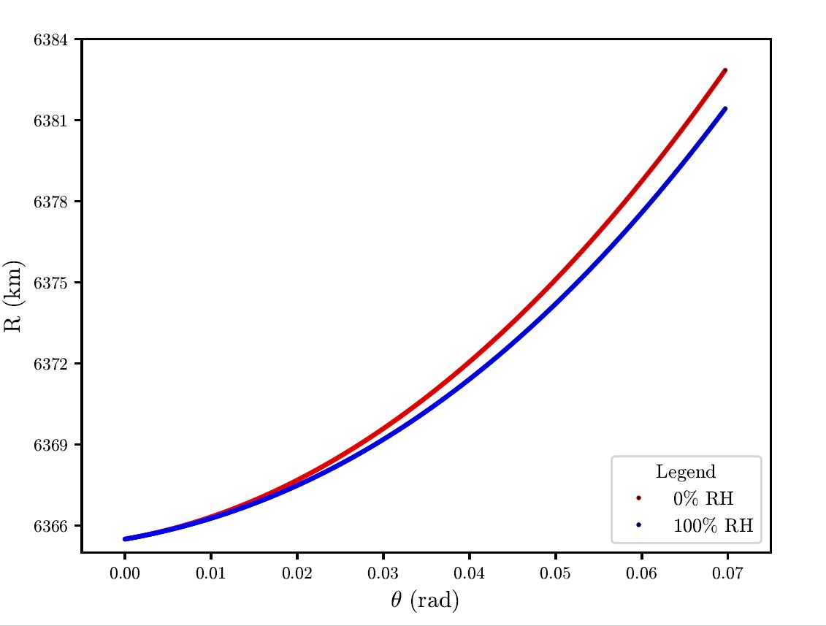


Refraction Test 2
$ϕ_{0}$= 0.1°, $δθ$ = 10⁻⁴ rad
$ϕ_{0}$= 0.5°, $δθ$ = 10⁻⁴ rad
Prediction 2: Due to Snell’s law, one would expected less refraction as the observed angle, $ϕ_{0}$, becomes larger. $✓$

Slide 9
Further Investigations and Ideas
Collect position measurements from airplanes and check that these measurements lie between the 0% and 100% RH curves.
Use interpolation techniques along with least squares between the data and models to determine RH values.
Compare these RH values with existing RH measurements from other devices, e.g. AMDAR.
Investigations into non-homogenous RH, i.e. humidities that vary with height.

Slide 10
Summary
Refraction of ADSB signals used for measuring water vapour distributions.
Preliminary refraction tests have confirmed initial predictions.
Collect aircraft position data to determine relative humidities.

Slide 11
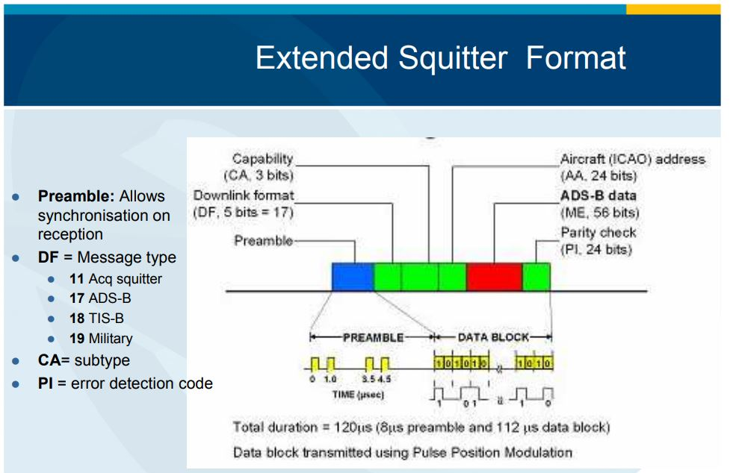
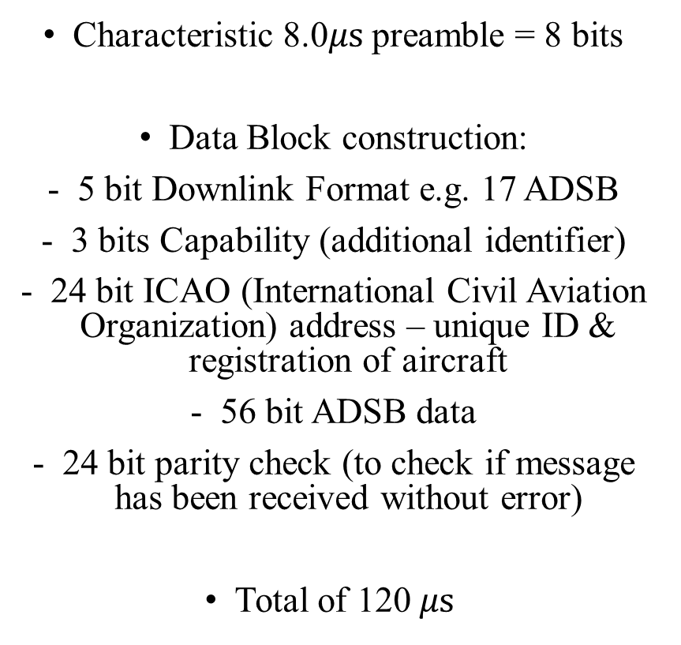

ADSB – Extended
$$λ=v/f$$
Characteristic 8.0$μs$preamble = 8 bits
Data Block construction:
5 bit Downlink Format e.g. 17 ADSB
3 bits Capability (additional identifier)
24 bit ICAO (International Civil Aviation Organization) address – unique ID & registration of aircraft
56 bit ADSB data
24 bit parity check (to check if message has been received without error)
Total of 120 $μs$
Image adapted from: https://www.sigidwiki.com/images/1/15/ADS-B_for_Dummies.pdf

Slide 12
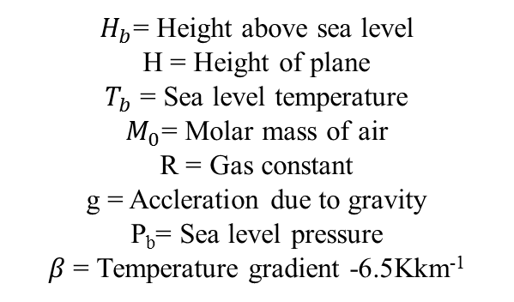
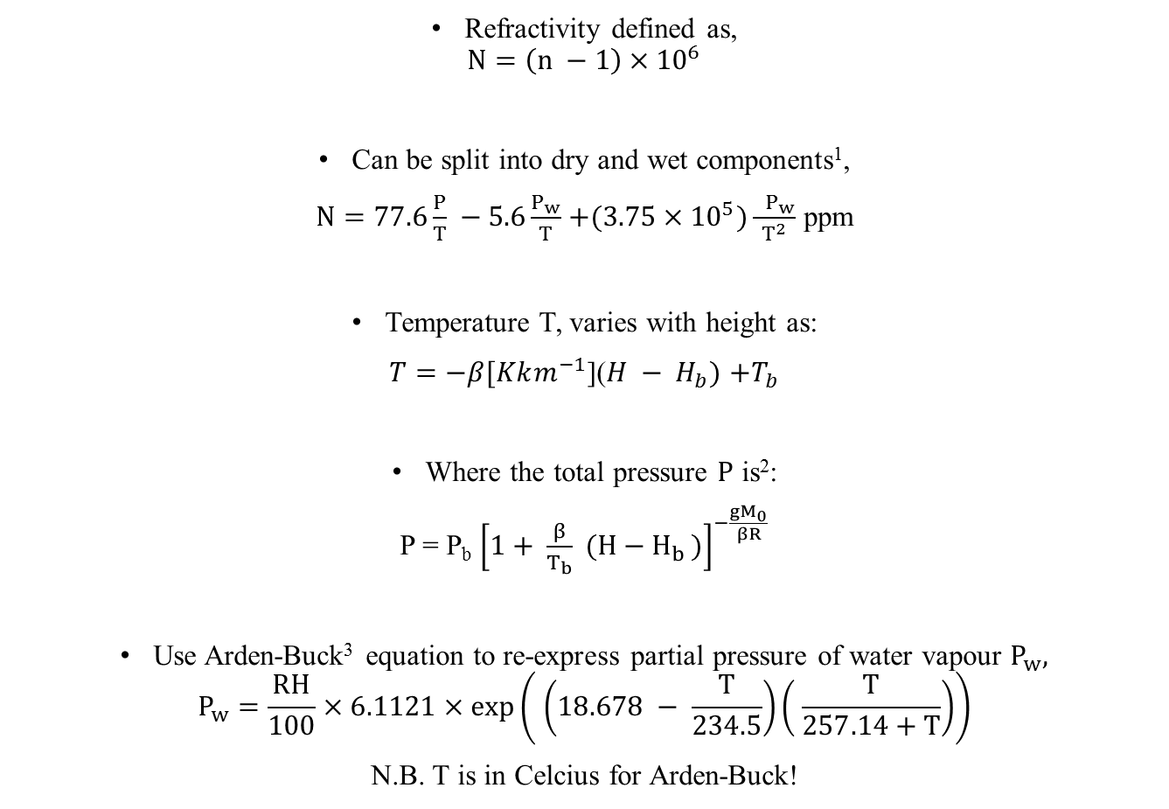
Refraction – Extended
Refractivity defined as,
$$N=\left(n −1\right){ ×10}^{6}$$
Can be split into dry and wet components¹,
$N=77.6\frac{P}{T} −5.6\frac{P_{w}}{T}$ $+(3.75×{10}^{5})\frac{ P_{w}}{T^{2}}$ ppm
Temperature T, varies with height as:
$T=−β[Kkm^{−1}$]($H − H_{b})$ $+T_{b}$
Where the total pressure $P$ is²:
P = P_{b} ${\left[1+ \frac{β}{T_{b}} (H−H_{b })\right]}^{−\frac{gM_{0}}{βR}}$
Use Arden-Buck³ equation to re-express partial pressure of water vapour $P_{w},$
$$P_{w}=\frac{RH}{100}×6.1121×exp\left( \left(18.678 − \frac{T}{234.5}\right)\left( \frac{T}{257.14+T}\right)\right)$$
N.B. T is in Celcius for Arden-Buck!
$H_{b}$= Height above sea level
H = Height of plane
$T_{b}$ = Sea level temperature
$M_{0}$= Molar mass of air
R = Gas constant
g = Accleration due to gravity
P_{b}= Sea level pressure
$β$ = Temperature gradient -6.5Kkm⁻¹

Slide 13
Refraction – References
¹ Mangum, J & Wallace, P, 2015, Atmospheric Refractive Electromagnetic Wave Bending and Propagation Delay, Publications of the Astronomical Society of the Pacific, Vol.127, pg 74 – 91.
² 1993 Manual of the ICAO Standard Atmosphere, Third Edition, pages 7 -14.
³ Buck, A.L, 1981, New Equations for Computing Vapor Pressure and Enhancement Factor, National Center for Atomspheric Research, Vol 20, pages 1527 – 1532.

