Slide 1
Palindromes in java
Project S1
Jack Crawford

Slide 2
The Problem
Write a program that uses a stack to test whether an input string is a palindrome.
A palindrome is a word that is spelled the same way forwards as it is backwards
Examples: Madam, racecar

Slide 3
What is a stack?
A stack is a data structure that follows the LIFO (Last in, First Out) principle.
Example: Think of a stack of books, the last book placed on top is the first one you take off.
Operations:
push: Adds an item to the stack.
pop: Removes the top item from the stack

Slide 4


Using stacks to solve the problem
Step 1: Clean the input string by removing spaces, punctuation, and converting it to lowercase.
Step 2: Push all characters from the cleaned string onto the stack
Step 3: Pop characters from the stack and compare them to the original string.
Step 4: If they match, the string is a palindrome

Slide 5
Conclusion
A stack is a simple yet powerful data structure for solving problems like palindrome checking
By reversing characters using a stack, we can efficiently check if a string reads the same forward and backward

Slide 6

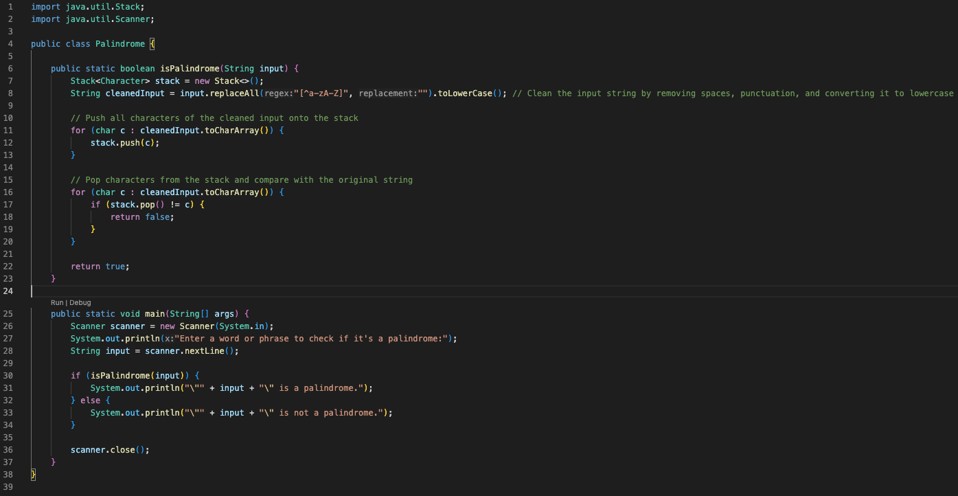

Slide 7
Github link
https://github.com/drummerjack03/palindrome-checker

