Slide 1
GIT

Slide 2
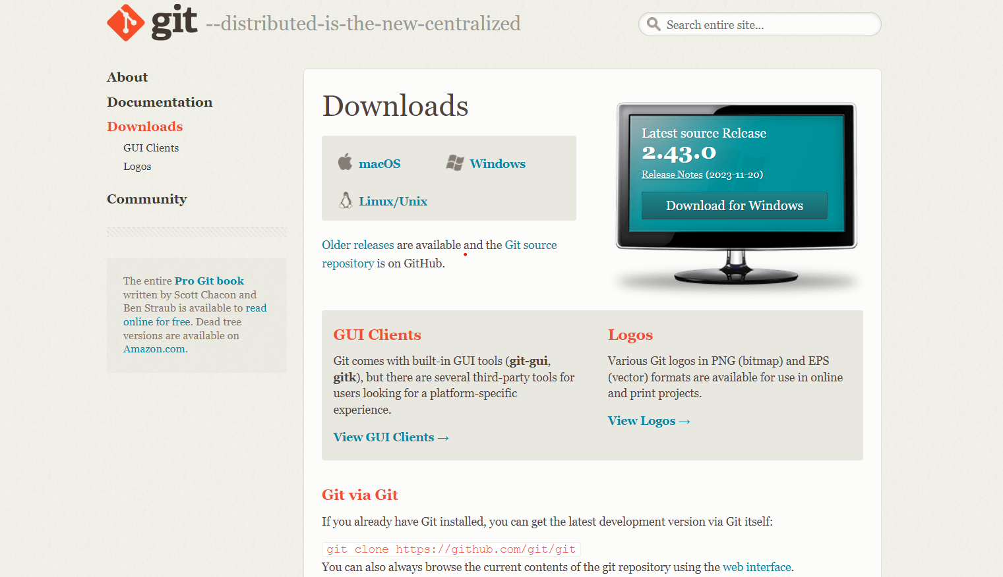
Install git bash -- https://git-scm.com/downloads

Slide 3

Install git-desktop -- https://desktop.github.com/

Slide 4
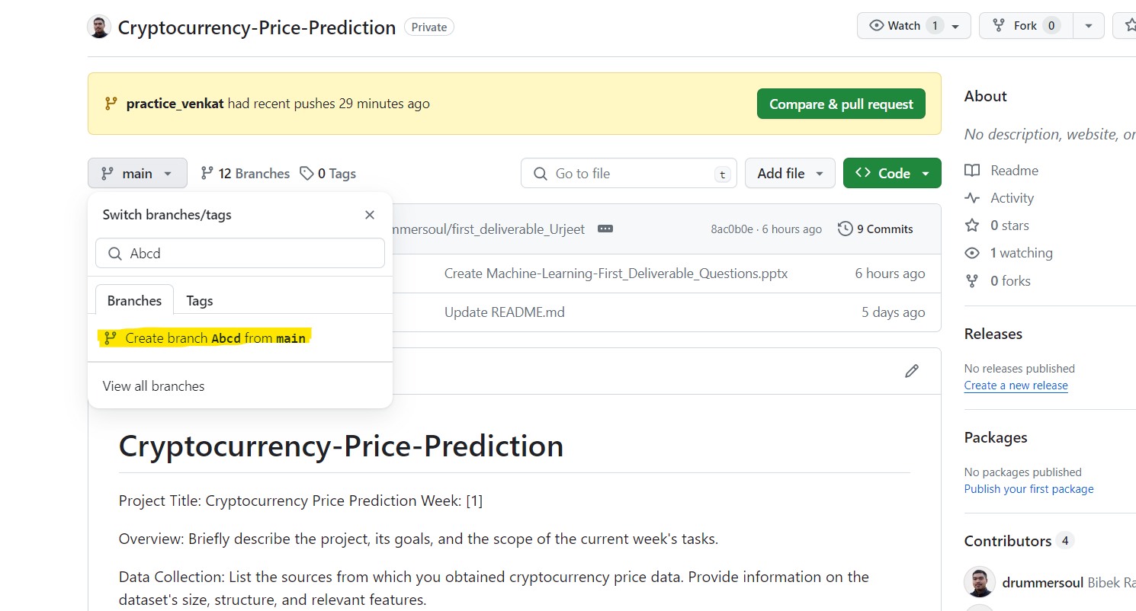
New branch creation in git-hub
Step1 : Go to respective repository and select a branch from which new branch need to be created
Fig :- in the figure Abcd is the new branch creating from main branch
Step2 : click on the highlighted area for creating new branch

Slide 5
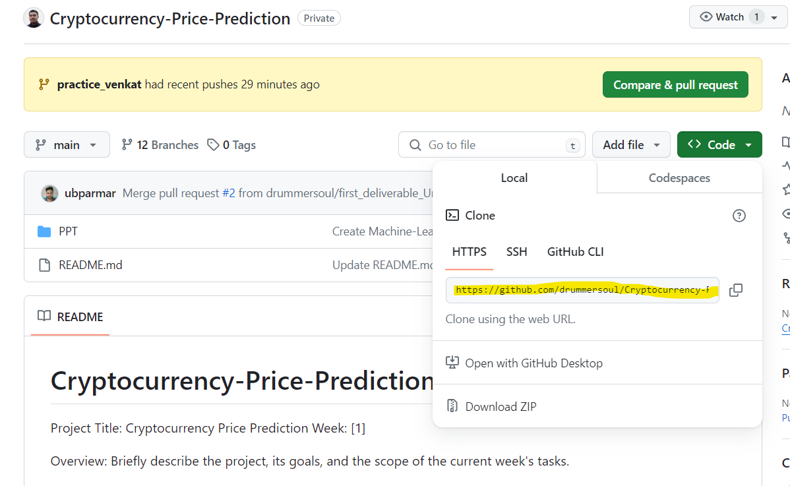
Local setup
Copy https url and run below command for local setup of repository in git bash
Cmd → Git clone [copied url]
It can be done through git desktop by selecting clone repository option

Slide 6
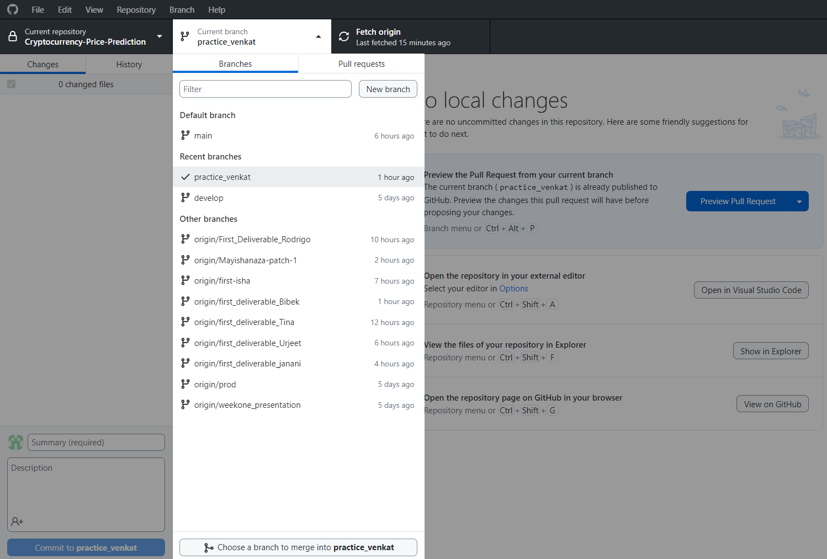
Completed setup of git-desktop
Changes :- any changes done in local repository
History :- shows history of the git commit in working branch
Current branch :- shows all branches in the repository
Fetch origin :- used to push and pull the commits
Commit [ blue button at left-bottom] :- used for committing the changes
Summary :- used for writing comments while committing the changes

Slide 7
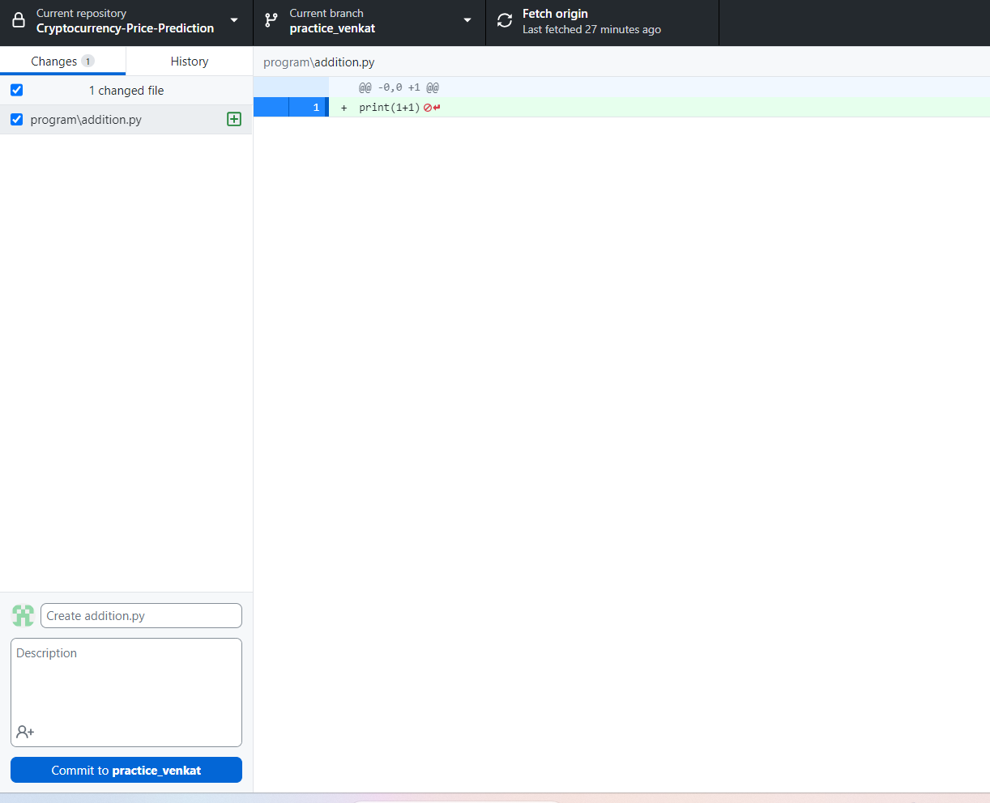
Adding, Deleting, Updating
Adding a file :- Green indication

Slide 8
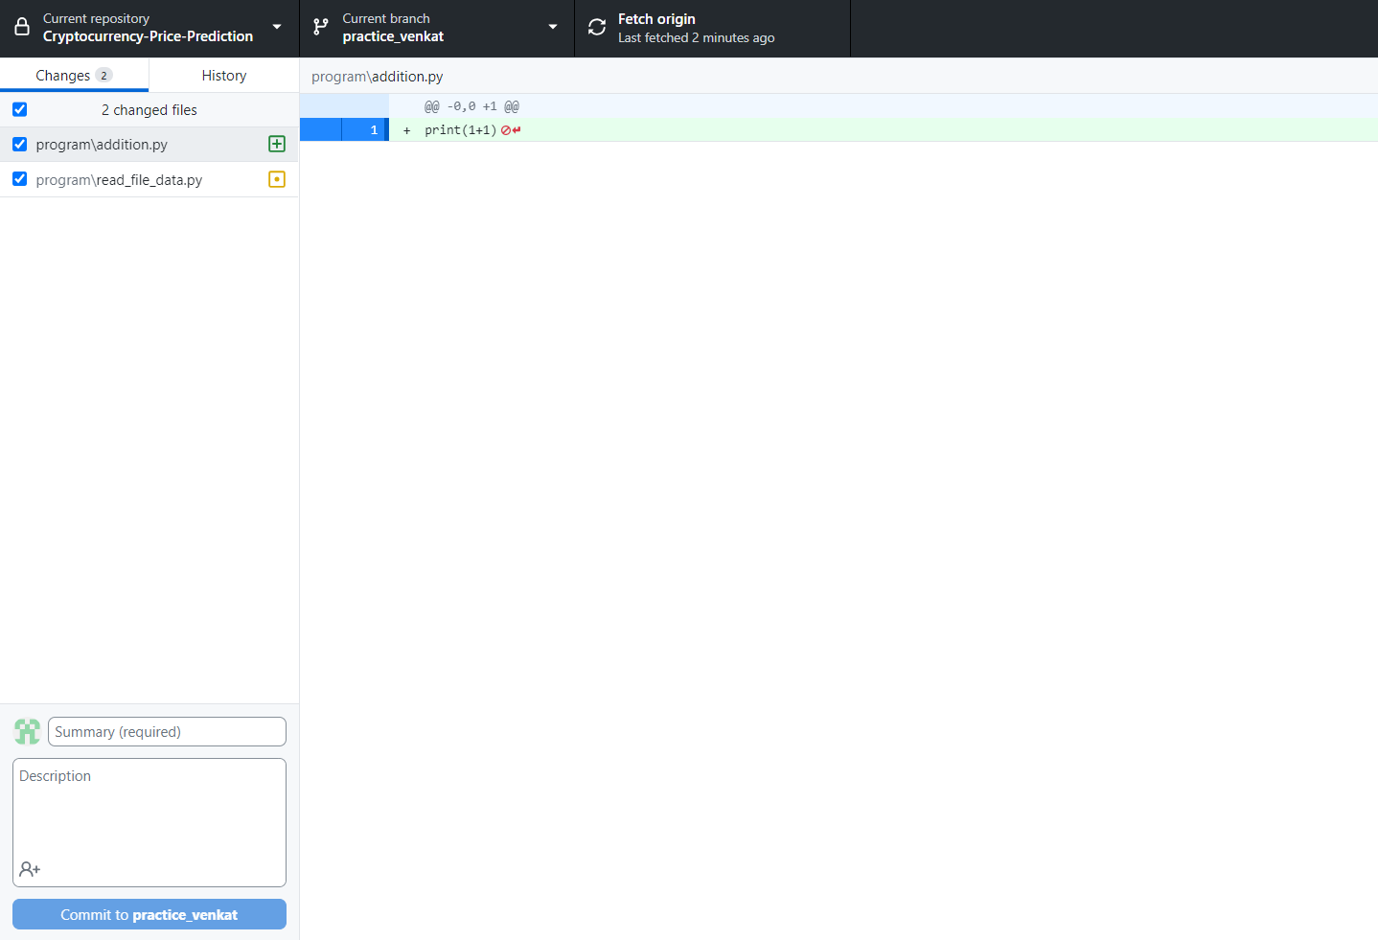
Updating a file:- Yellow indication

Slide 9
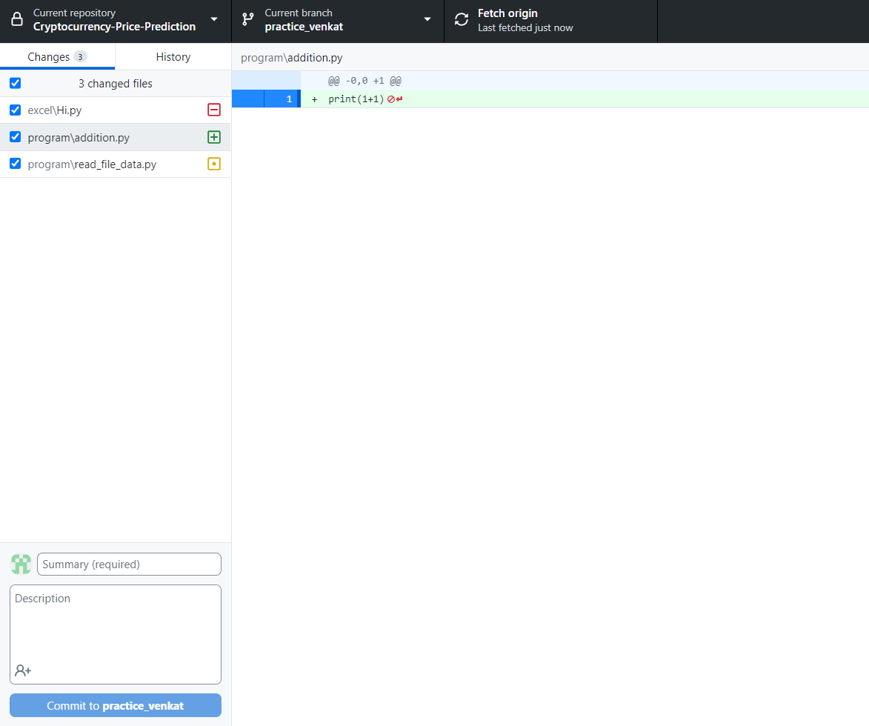
Deleting a file :- Red indication

Slide 10
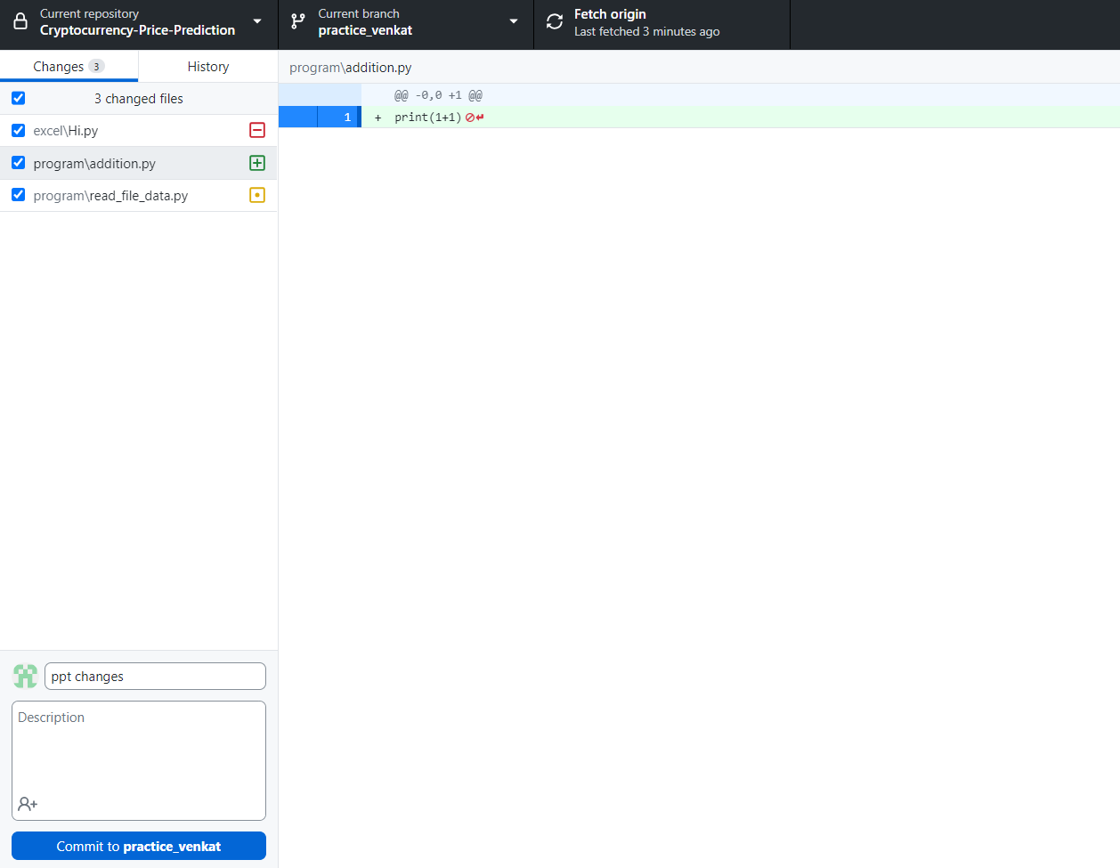
Committing changes
Changes can be committed by entering comments and clicking on the commit button below the comment section at left-bottom
Note :- user can remove changes that are not need to commit by un-selecting blue check boxes to the left side of every change in changes tab

Slide 11
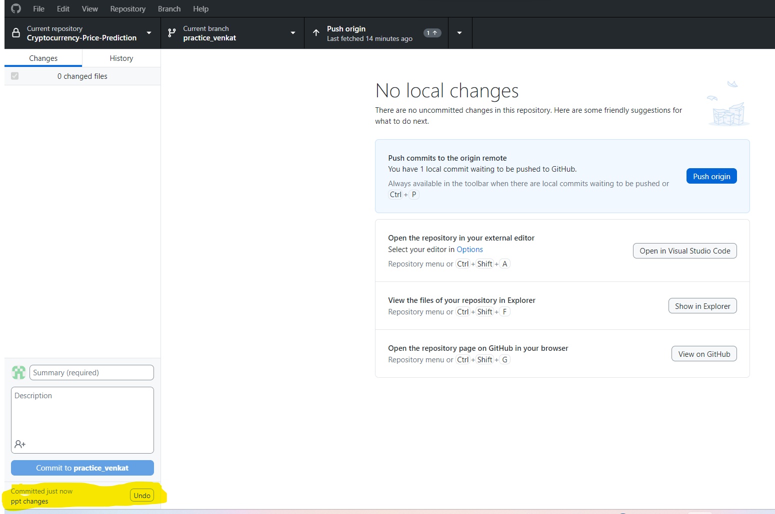
Pushing commits
After click on commit button
Click on push origin to move committed changes to git hub
Note :- commit changes can be reverted by selecting undo button in the highlighted area

Slide 12
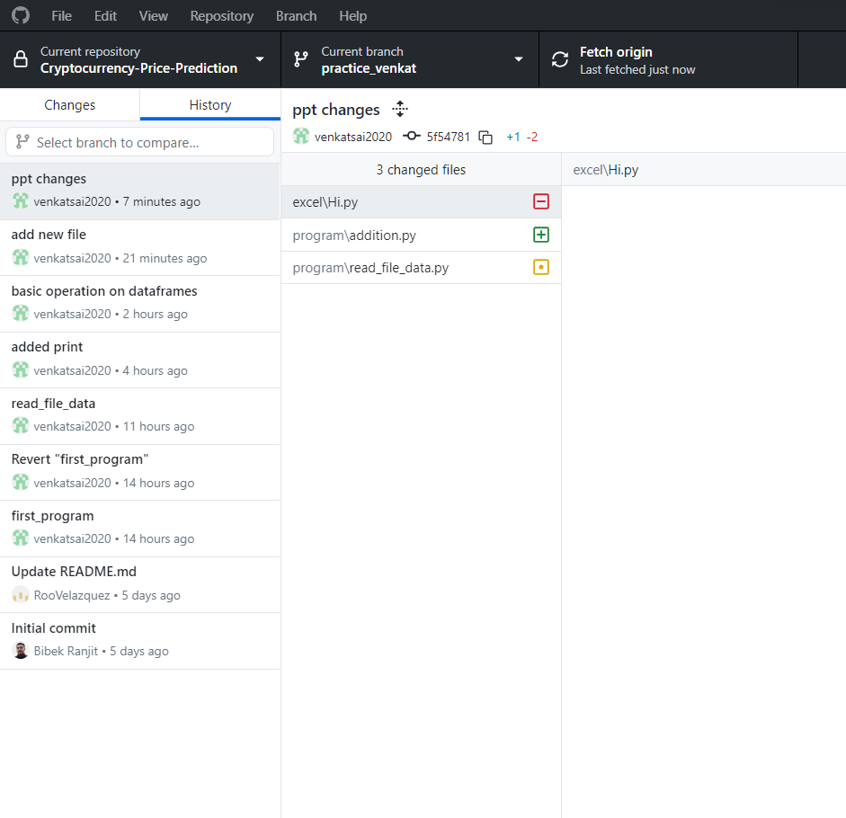
History check
Select history tab for checking commit history in git desktop
Initial history Is always latest commit moved to git hub

Slide 13
Questions
1-How do we obtain the marketcap column values?
2-Are we going to predict the open/close/ high -low price?
3-How many values do we have for each crypto?
4-Which crypto do we have on the database?
5-Whats our time frame of data (start-end)?
6-Is it possible to predict crypto price?
7-[List any challenges encountered during data exploration and how they were addressed.]

Slide 14
Answers
1.
2. Yes
3. There are different number of records of for each crypto_name example :- bitcoin :- 3248, Dogecoin :- 3024
4. There are 56 crypto_names in the given dataset
5. Start and end data was different for each crypto example :- Bitcoin 2013-05-05 2022-10-23, Dogecoin 2013-12-15 2022-10-23
6. yes

