Slide 1


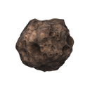



Slide 2
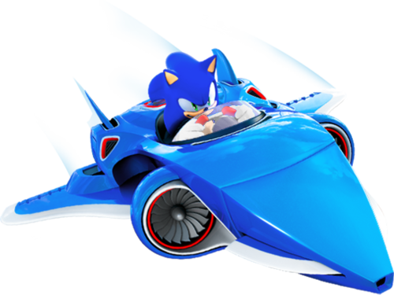

About Me
Thomas Sampson
Studied MComp Games Software Development at Sheffield Hallam University
Programmer at Sumo Digital since 2012
Most recently worked on:
Sonic All Stars Racing Transformed
LittleBigPlanet 3

Slide 3
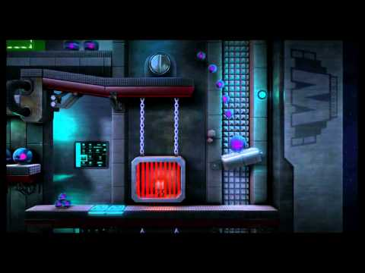

Slide 4


What Is Nebulous?
Last year I started working on a game prototyping framework, EngineJS
Nebulous was the first project to use this framework
Artwork by Griffin Warner
Used as a proving ground for the framework and runs on:
PC, Mac, Linux
iPhone / iPad
Android, Kindle Fire etc
Demo

Slide 5

Today’s Workshop
Aim is to make a stripped down version of the game
Starting from scratch
Aim is to go from an empty project to a playable game
Workshop broken into 7 bite-size exercises

Slide 6
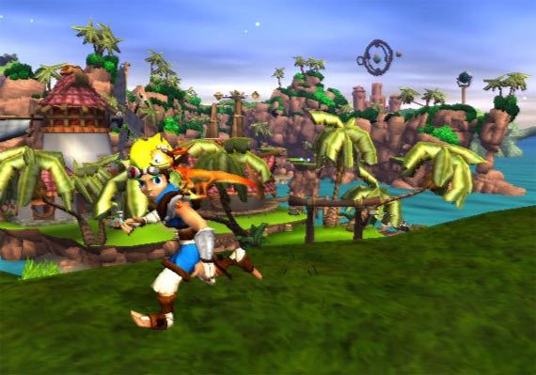
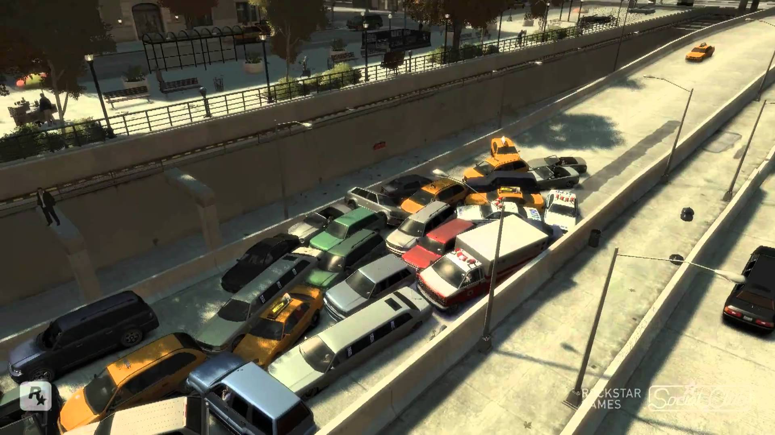
What Is A Game!?
What separates a game from a regular piece of software?

Slide 7
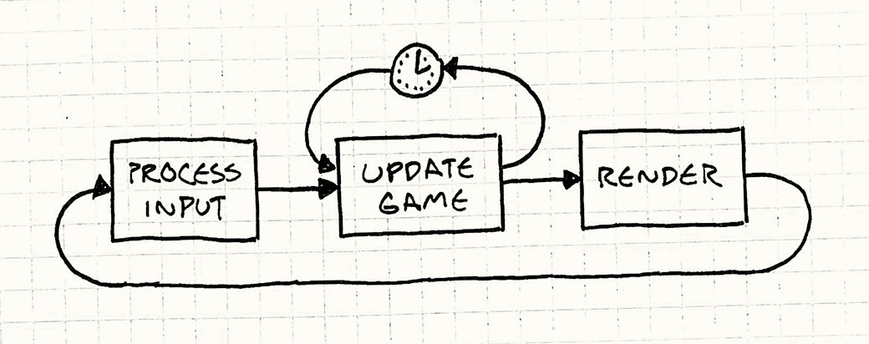
What Is A Game!?
What separates a game from a regular piece of software?

Slide 8
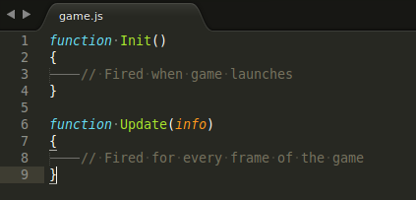
Exercise 1
[ Setting the scene ]
Open up game.js
This is the basic shell for our game
All the work for this session will be done in this file
Functions
Run the game

Slide 9
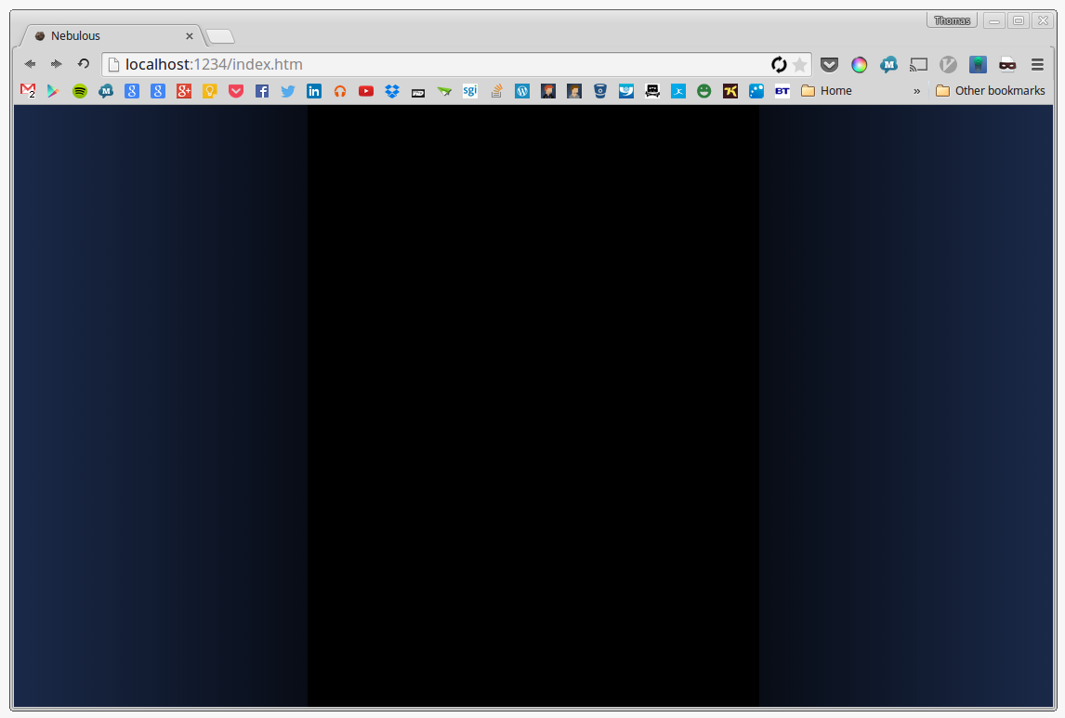
Exercise 1
[ Setting the scene ]

Slide 10
Exercise 1
[ Setting the scene ]
To get any work done we need to create a “Scene”
A “Scene” is a fundamental concept within EngineJS
Scene’s represent the world in which the game takes place (like a theatre stage on which the game unfolds)
Scene

Slide 11
Exercise 1
[ Setting the scene ]
To create the scene we must carry out two steps:
Create a new variable to “hold” the scene
Variables are names which we use to identify bits of data or information within our program
Variables are declared using the “var” keyword
Create the scene with the “new” keyword

Slide 12
Exercise 1
[ Setting the scene ]
[EDITOR]

Slide 13
Exercise 1
[ Setting the scene ]
RECAP
Games run an update loop which runs a series of operations continuously for each frame of the game
A “Scene” is required to contain our game world
Learned that variables are used to store information (numbers, text, colours, scene’s etc)
Variables are created with the “var” keyword

Slide 14
Exercise 2
[ Adding The Ship ]
Just as we created a “Scene”, we need to do the same for an “Entity”
An “Entity” represents any game object that can be part of the scene
Entities must be added to the scene in order to become part of the game
Scene
Entity
Entity
Entity
Entity

Slide 15
Exercise 2
[ Adding The Ship ]
[EDITOR]

Slide 16
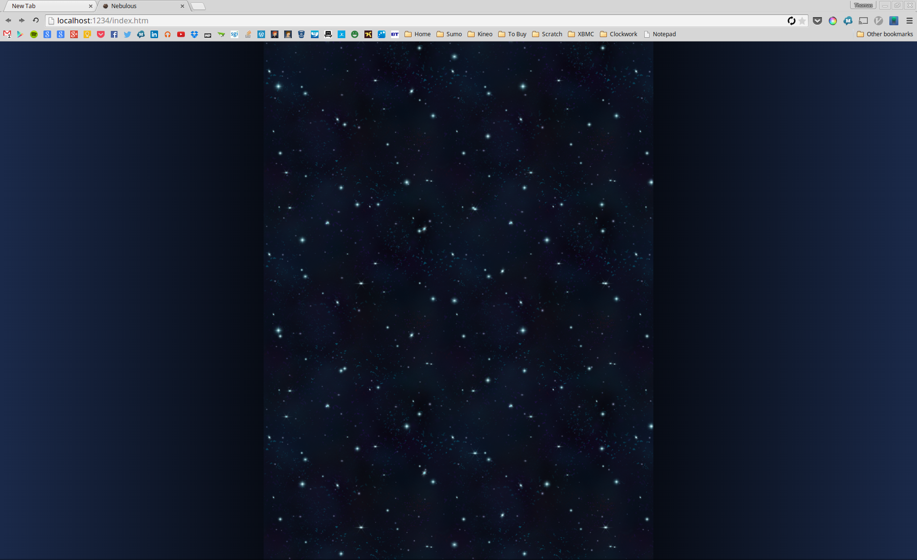
Exercise 2
[ Adding The Ship ]
y-axis
origin [0, 0]
x-axis

Slide 17
Exercise 2
[ Adding The Ship ]
RECAP
Every game object (ships, asteroids, trees, bullets etc) is represented by an “Entity”
A “Scene” can contain many “Entities”
Entities can be moved around the scene using the “MoveTo” command

Slide 18
Exercise 3
[ Moving The Ship ]
So far we’ve written some commands and operations which execute unconditionally
So we get the same result every time we play the game
Introducing the “if” keyword

Slide 19
Exercise 3
[ Moving The Ship ]
How to write an “if” statement
if(condition)
{
// Execute this block
OperationA();
OperationB();
}

Slide 20
Exercise 3
[ Moving The Ship ]
[EDITOR]

Slide 21
Exercise 3
[ Moving The Ship ]
Previously we moved the ship using the MoveTo operation
This moves the ship to specific x,y coordinates in the scene
This time we want to move the ship relative to it’s current position
For this we can use the Move operation

Slide 22
Exercise 3
[ Moving The Ship ]
[EDITOR]

Slide 23
Exercise 3
[ Moving The Ship ]
RECAP
To make games interesting we need to have conditional statements and blocks
Conditional statements are written using “if” and { }
We can move (nudge) entities relative to their current position using the Move command

Slide 24
Exercise 4
[ Firing Bullets ]
We want to make our ship fire bullets when the space-bar is pressed
How might we do this?
Each bullet will be a regular game “Entity” and needs to exist as part of the “Scene”

Slide 25
Exercise 4
[ Firing Bullets ]
[EDITOR]

Slide 26
Exercise 4
[ Firing Bullets ]
This time we’d like our bullet to move on it’s own without us having to manually nudge it every frame
To do this we can set the ship’s “Velocity” using the SetVelocity command
This time the [x,y] pair we specify, represent the velocity for each axis, rather than a position

Slide 27
Exercise 4
[ Firing Bullets ]
[EDITOR]

Slide 28
Exercise 4
[ Firing Bullets ]
RECAP
Everything we see on screen is a regular “Entity”
We can store the position of an “Entity” in a variable using the GetPosition() command
We can ask an “Entity” to update it’s position each frame using the SetVelocity([x,y]) command

Slide 29
Exercise 5
[ Creating Asteroids ]
By now you might be spotting a pattern…..
Each asteroid is a game “Entity”
Let’s create an asteroid in the code….

Slide 30
Exercise 5
[ Creating Asteroids ]
[EDITOR]

Slide 31
Exercise 5
[ Creating Asteroids ]
RECAP
We can use the Chance command to control how often a conditional block is triggered
We can introduce random behavior by using the Random command to generate random numbers

Slide 32
Exercise 6
[ Shooting Asteroids ]
Our bullets currently have no interaction with the asteroids (as you would expect)
We need to detect “collisions” between our bullets and asteroids, but……
The engine doesn’t know which entities are which
We need to “tag” our entities appropriately

Slide 33
Exercise 6
[ Shooting Asteroids ]
[EDITOR]

Slide 34
Exercise 6
[ Shooting Asteroids ]
Scene
asteroid
asteroid
bullet
asteroid
asteroid
bullet
bullet

Slide 35
Exercise 6
[ Shooting Asteroids ]
Now we need to use the scene’s HitTest command to give us a list of colliding items
HitTest will only test for collisions between the tags we specify
HitTest returns a list of colliding entities

Slide 36
Exercise 6
[ Shooting Asteroids ]
[EDITOR]

Slide 37
Exercise 6
[ Shooting Asteroids ]
RECAP
We can use “tags” to identify and group objects within our scene
We can use the HitTest command to give us lists of colliding “Entity” objects

Slide 38
Exercise 7
[ Asteroid Collisions ]
Almost the same code we wrote before but testing the “ship” and “asteroid” tags instead
First we need to tag our ship….

Slide 39
Exercise 7
[ Asteroid Collisions ]
[EDITOR]

Slide 40
Extension Tasks
[ Finishing Touches ]
Tweak your movement speed and velocity numbers to make the game feel fun
Try using the Random command to randomly size your asteroids
BONUS: Make the game restart after the “Game Over” message using: location.reload();

