Slide 1
Jason Stacy Portfolio Website

Slide 2
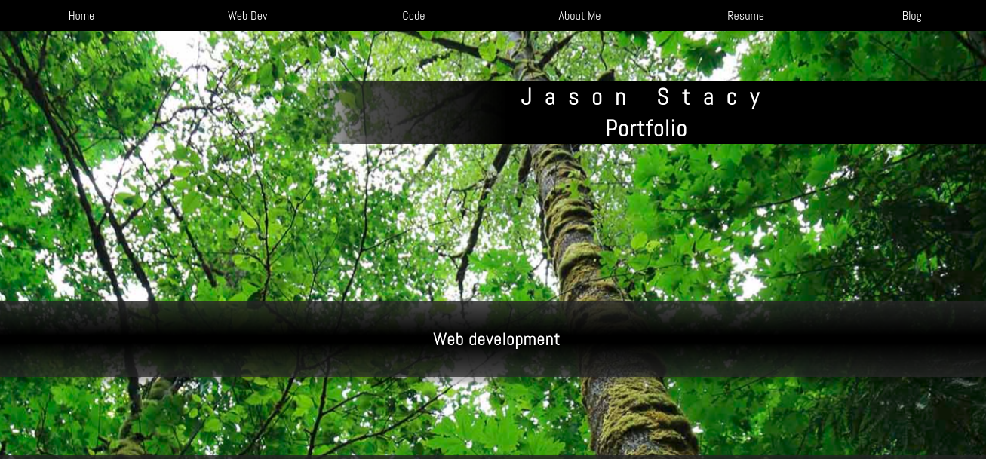
Home Screen
Parallax effect to scroll the background image slower than the foreground.

Slide 3
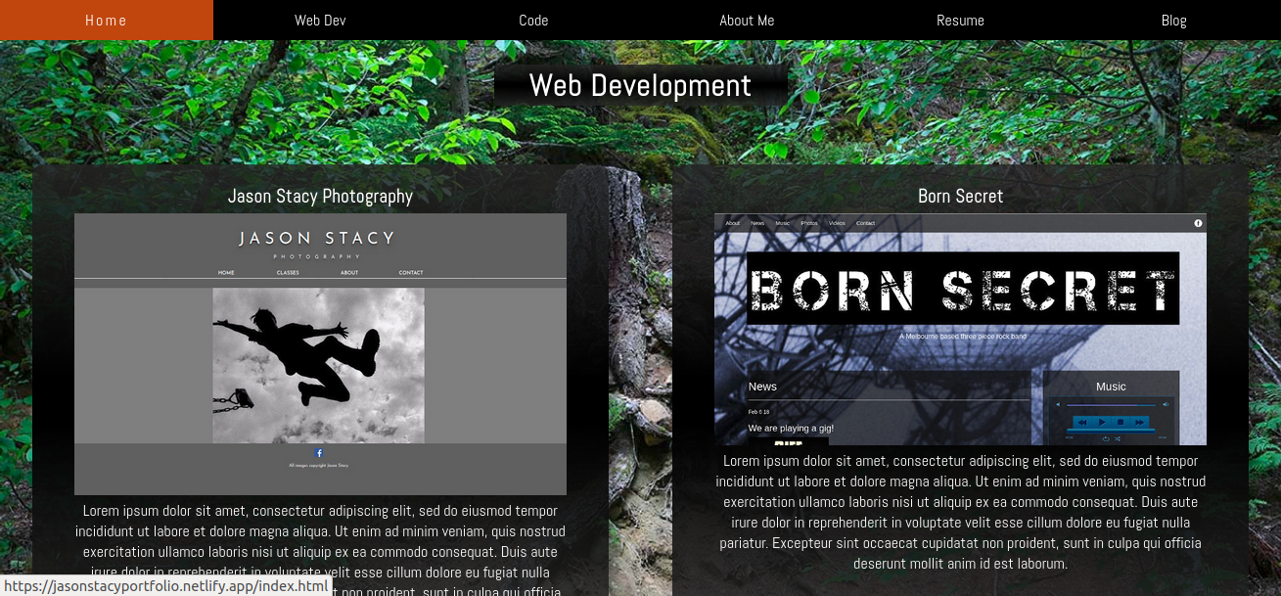
Web Development
All pages have the same navigation bar

Slide 4
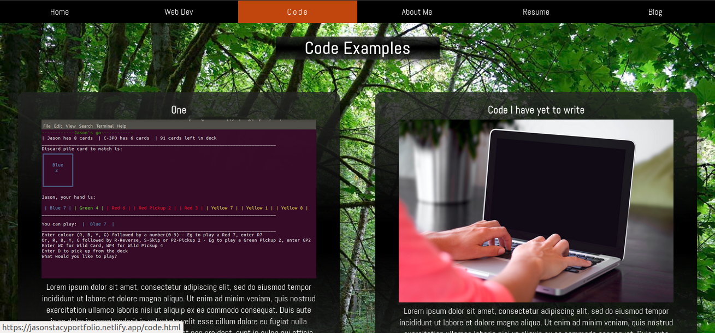
Code
Just the one real link to my terminal assignment. The rest are mock-ups.

Slide 5
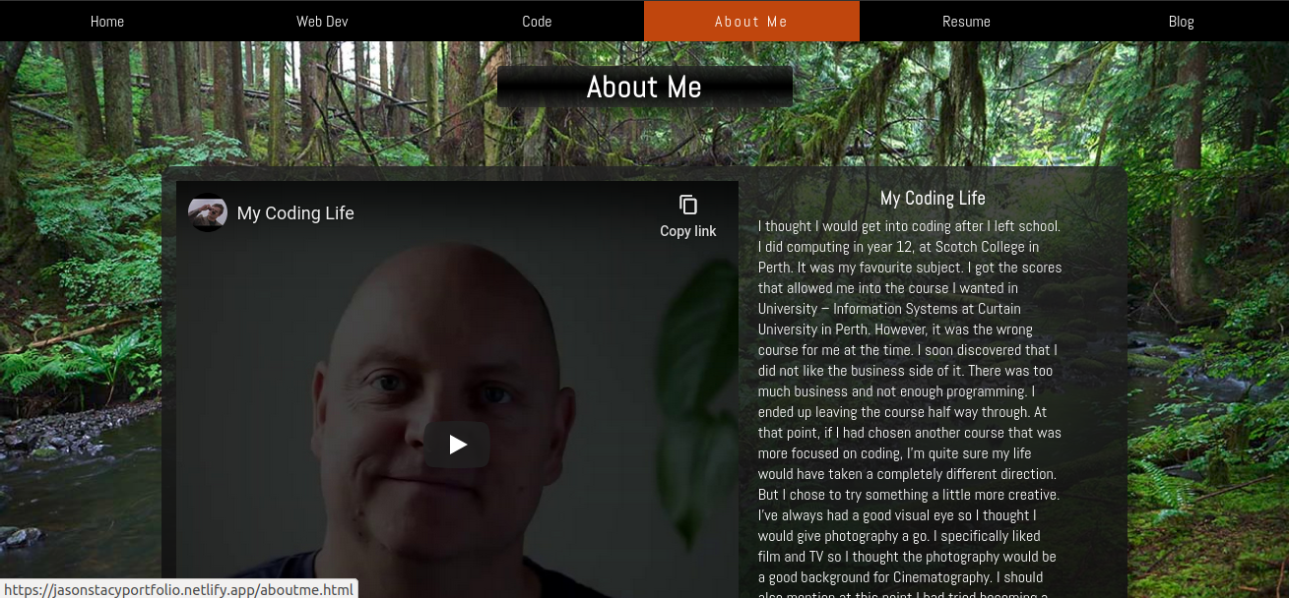
About Me
Originally, I had a photo but I decided to include a video instead.

Slide 6
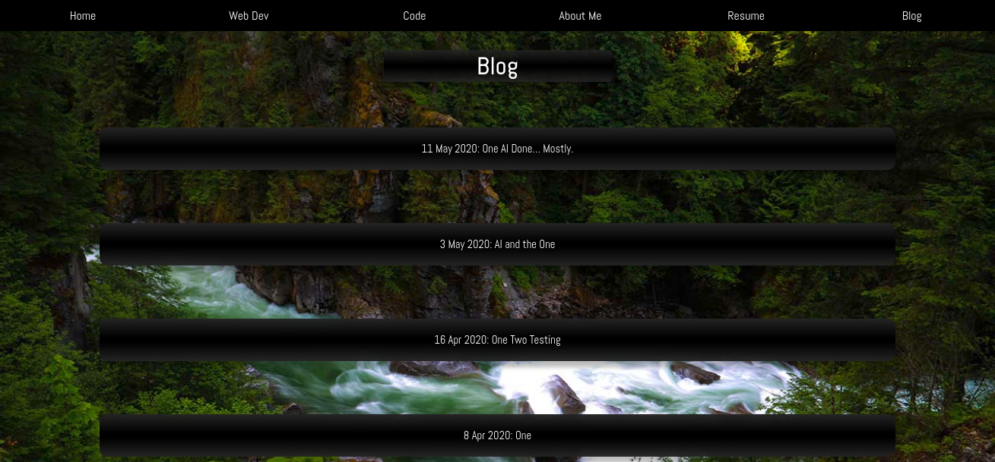
Blog
The blog posts have drop-down content as opposed to separate pages

Slide 7
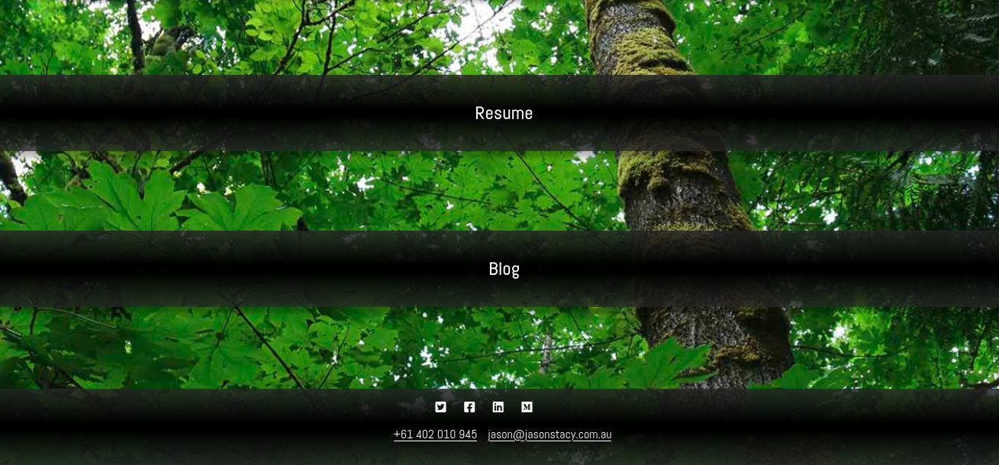
Footer
The footer is the same on all pages. I decided to include my contact details here too.

Slide 8
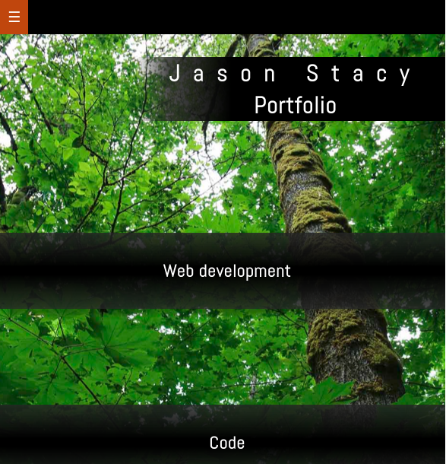
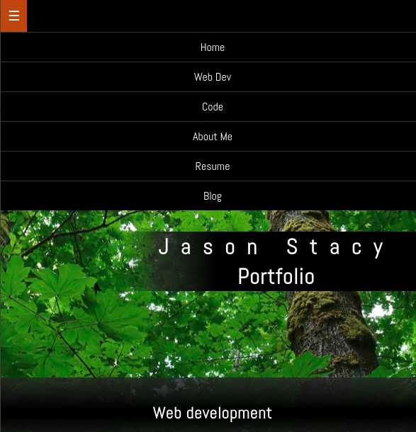
Navigation
Responsive hamburger navigation bar showing drop-down.

Slide 9
Design Process and Components
5 pages separating website and code examples.
Colourful, similar, relaxing forest scenes using my photographs to create a theme.
Parallax effect throughout.
Create first page as a template using flex-box, then use that to create other pages.
Simple, responsive, semi-transparent box structure with minimal colours to let the photos shine.

Slide 10
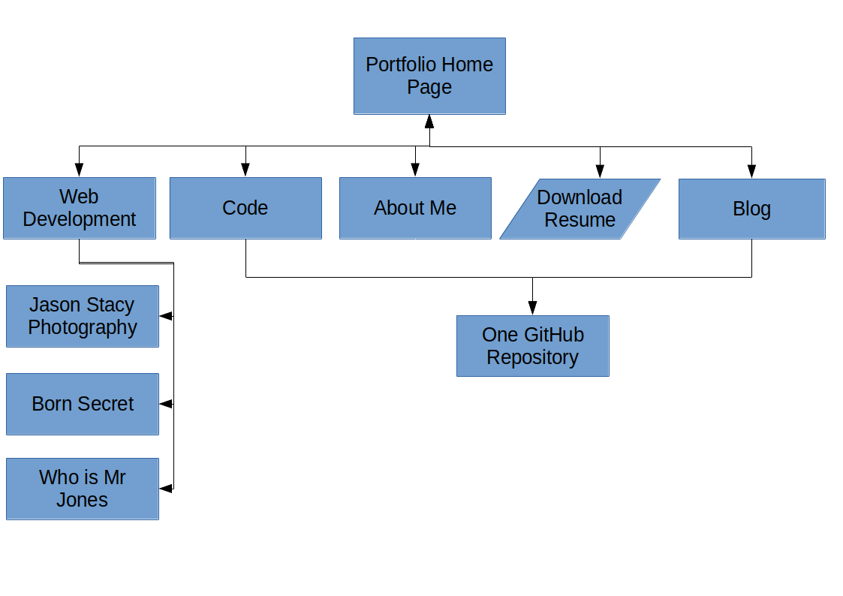
Site Map
The navigation bar on all pages links to every other page.

Slide 11
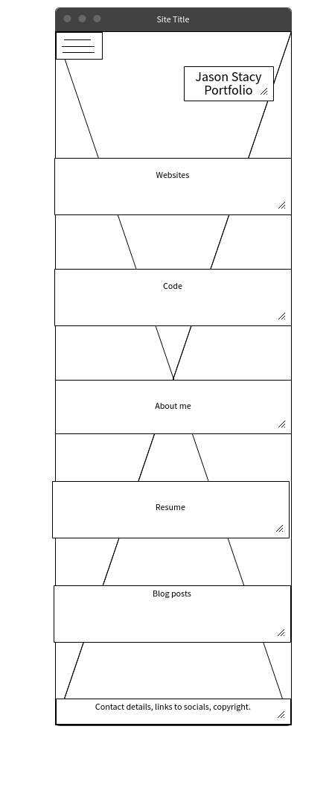
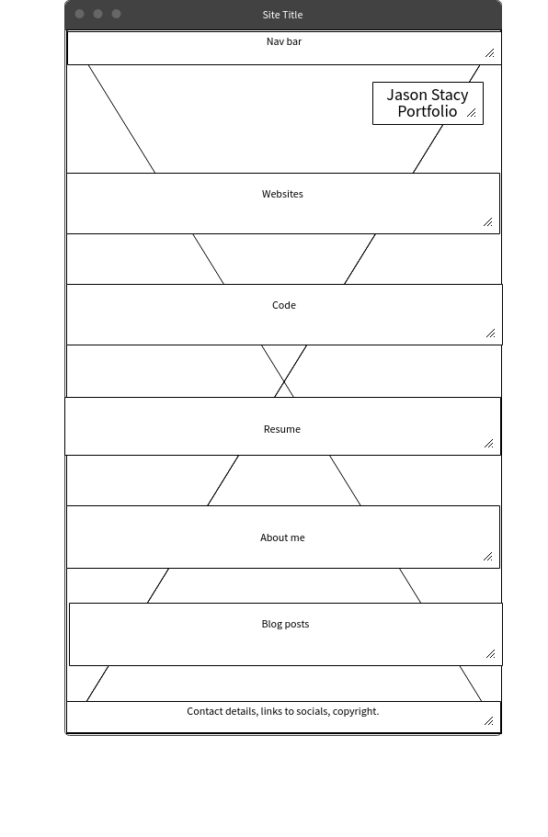
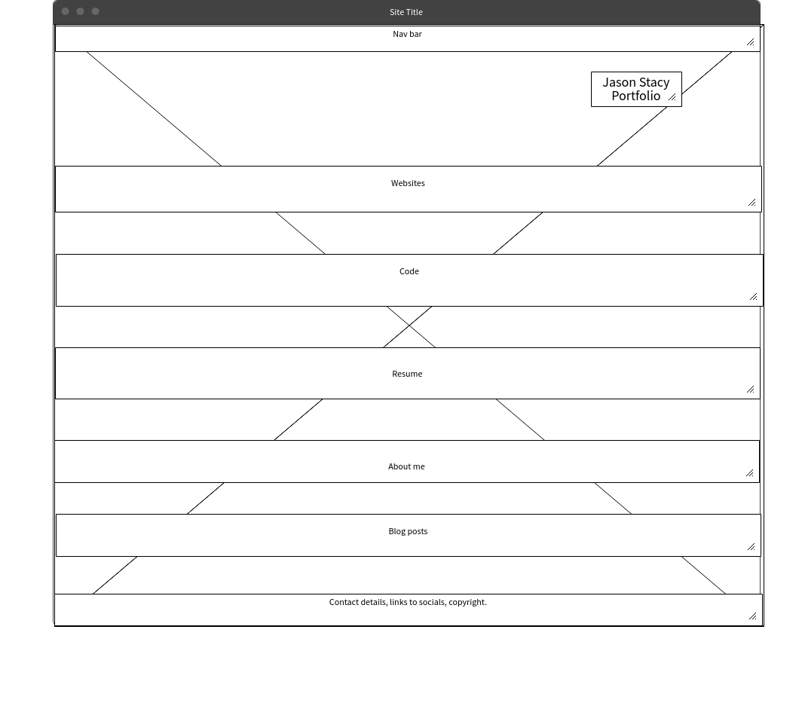
Wire-frame: Home

Slide 12
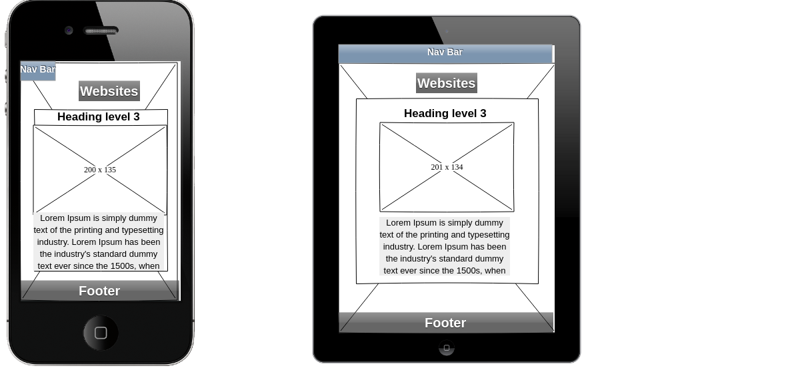
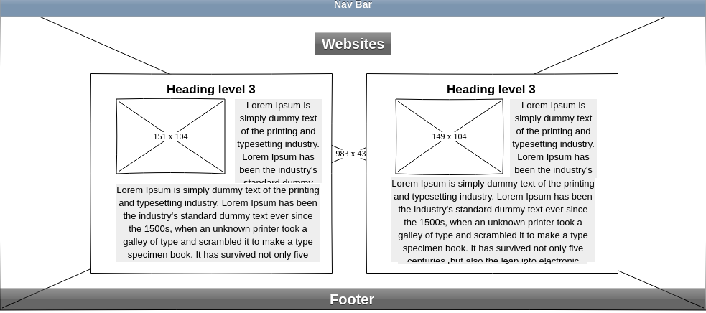
Wire-frame - Web Development

Slide 13
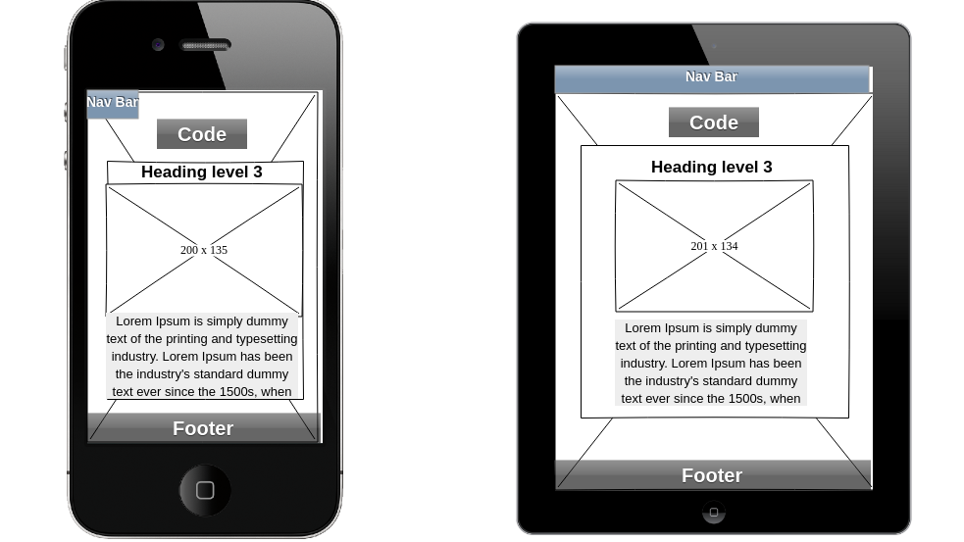
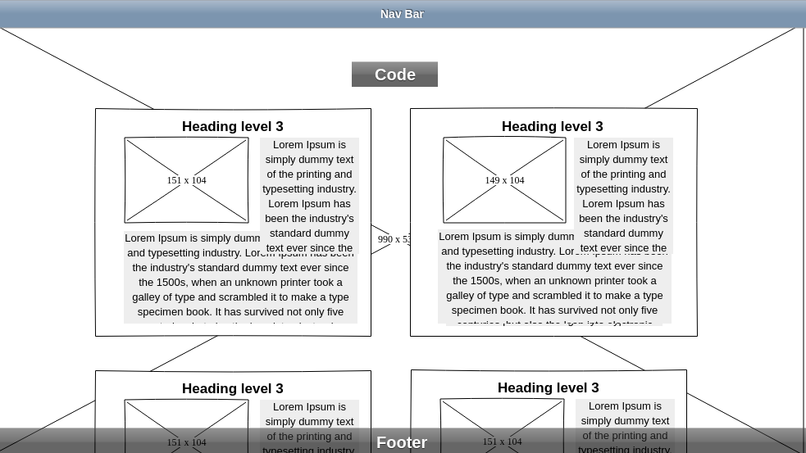
Wire-frame: Code

Slide 14
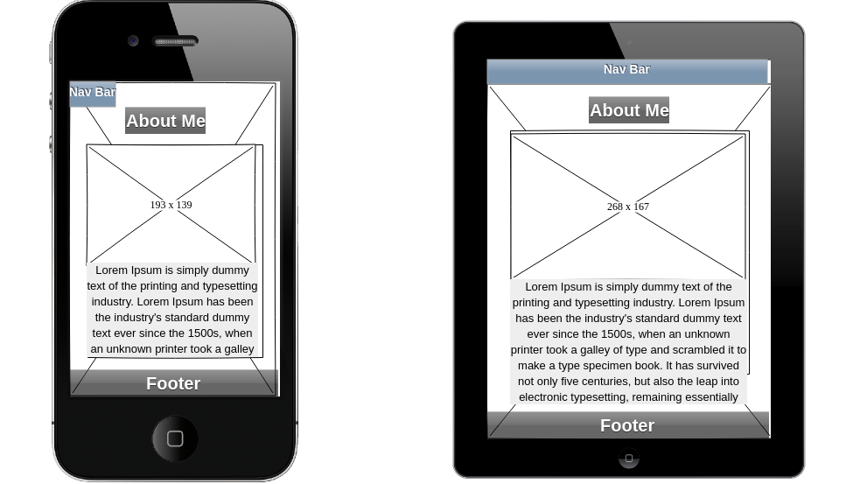
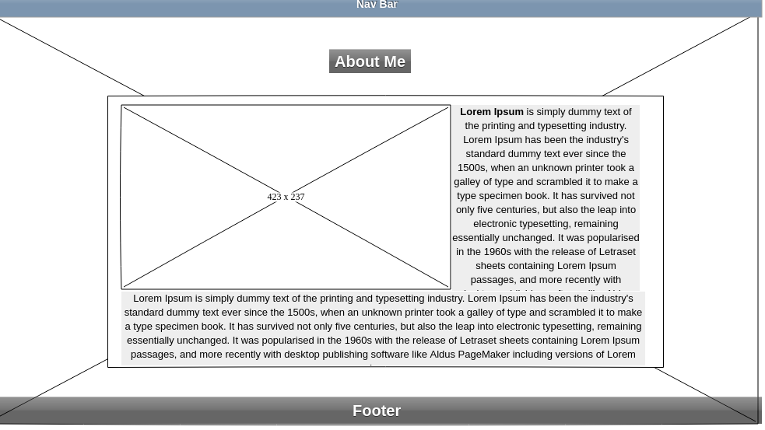
Wire-frame: About Me

Slide 15
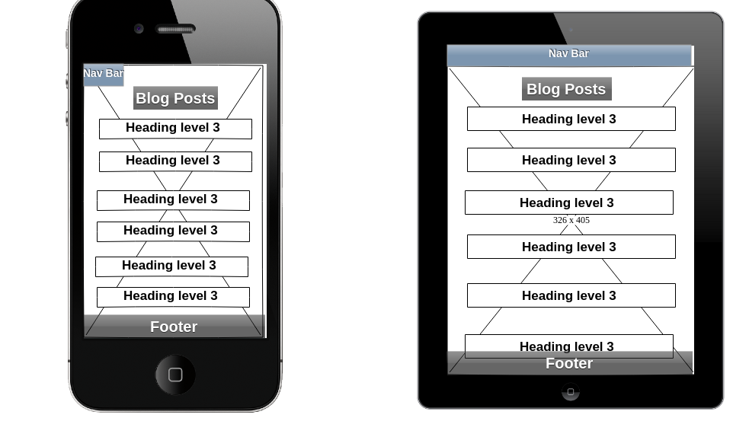
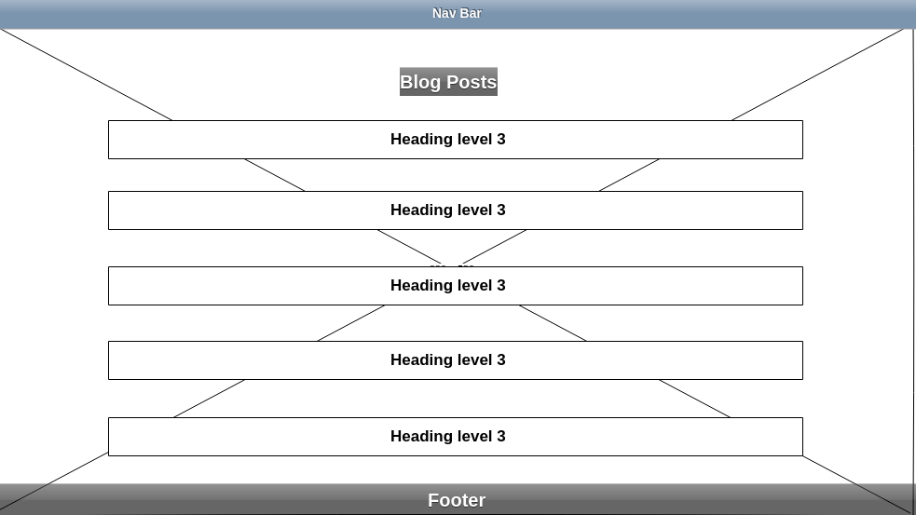
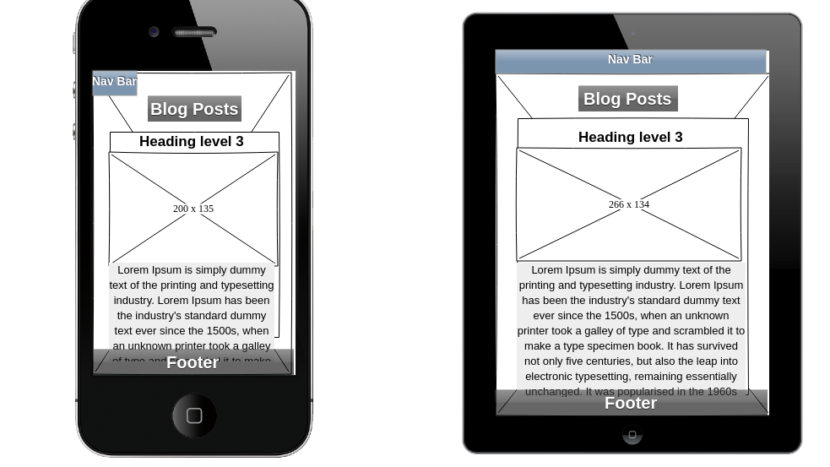
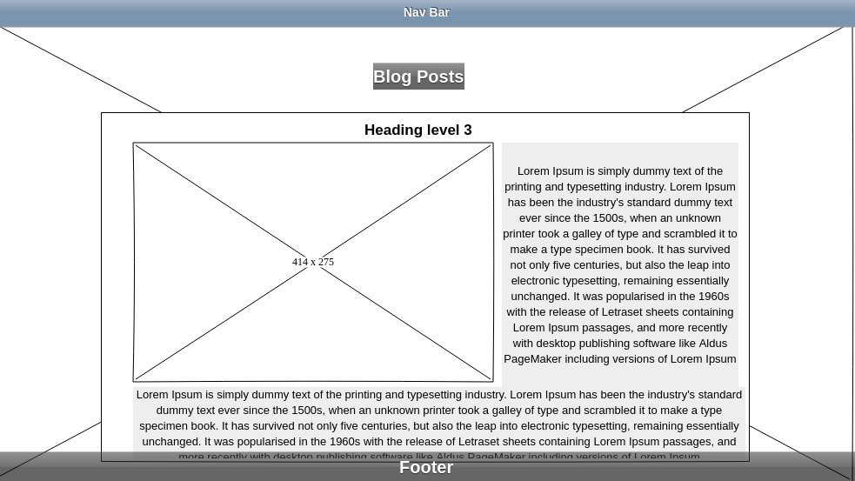
Wire-frame: Blog

Slide 16
Challenges
I researched parallax and decided I would try and do a pure CSS parallax effect.
This worked fine until I added more pages with longer content and then it broke.
I tried to fix it on a git branch but it was taking too much time so I compromised and left the home screen as it was and made the other pages static parallax.

Slide 17
Favourite Part
My favourite part is the blog page.
I was happy with the decision to include drop-down content as opposed to separate pages.
Since I already had my Medium posts, I was able to use them instead of placeholder content.
I ended up using a small amount of JavaScript to make the drop-down effect nicer.
The responsive rules work well with the images floating to the left allowing the text to wrap.

