Slide 1
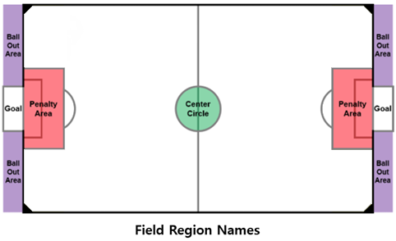
Own side
Opponent side
Field
Area
Field
Area

