Slide 1
VERSION CONTROL
By:- Manan Gupta

Slide 2
What is a version control system?
A system that keeps track of your changes
Required for collaborative development
Allows you to revert to any previous state
Git is a distributed version control system
In software development, distributed version control (also known as distributed revision control) is a form of version control in which the complete codebase, including its full history, is mirrored on every developer's computer.

Slide 3
Installing Git
Linux (Debian)
Command: sudo apt-get install git
Linux (Fedora)
Command: sudo yum install git
Mac
https://git-scm.com/download/mac
Windows
https://git-scm.com/download/win

Slide 4
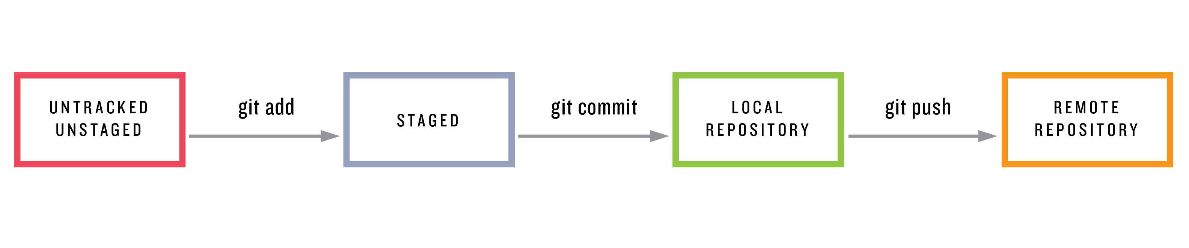
Git – Key Concept - Snapshots
The way that git keeps track of the code history
Essentially a record of what files look like at a given point in time
You decide when to take a snapshot
Can revert to any previous snapshot anytime

Slide 5
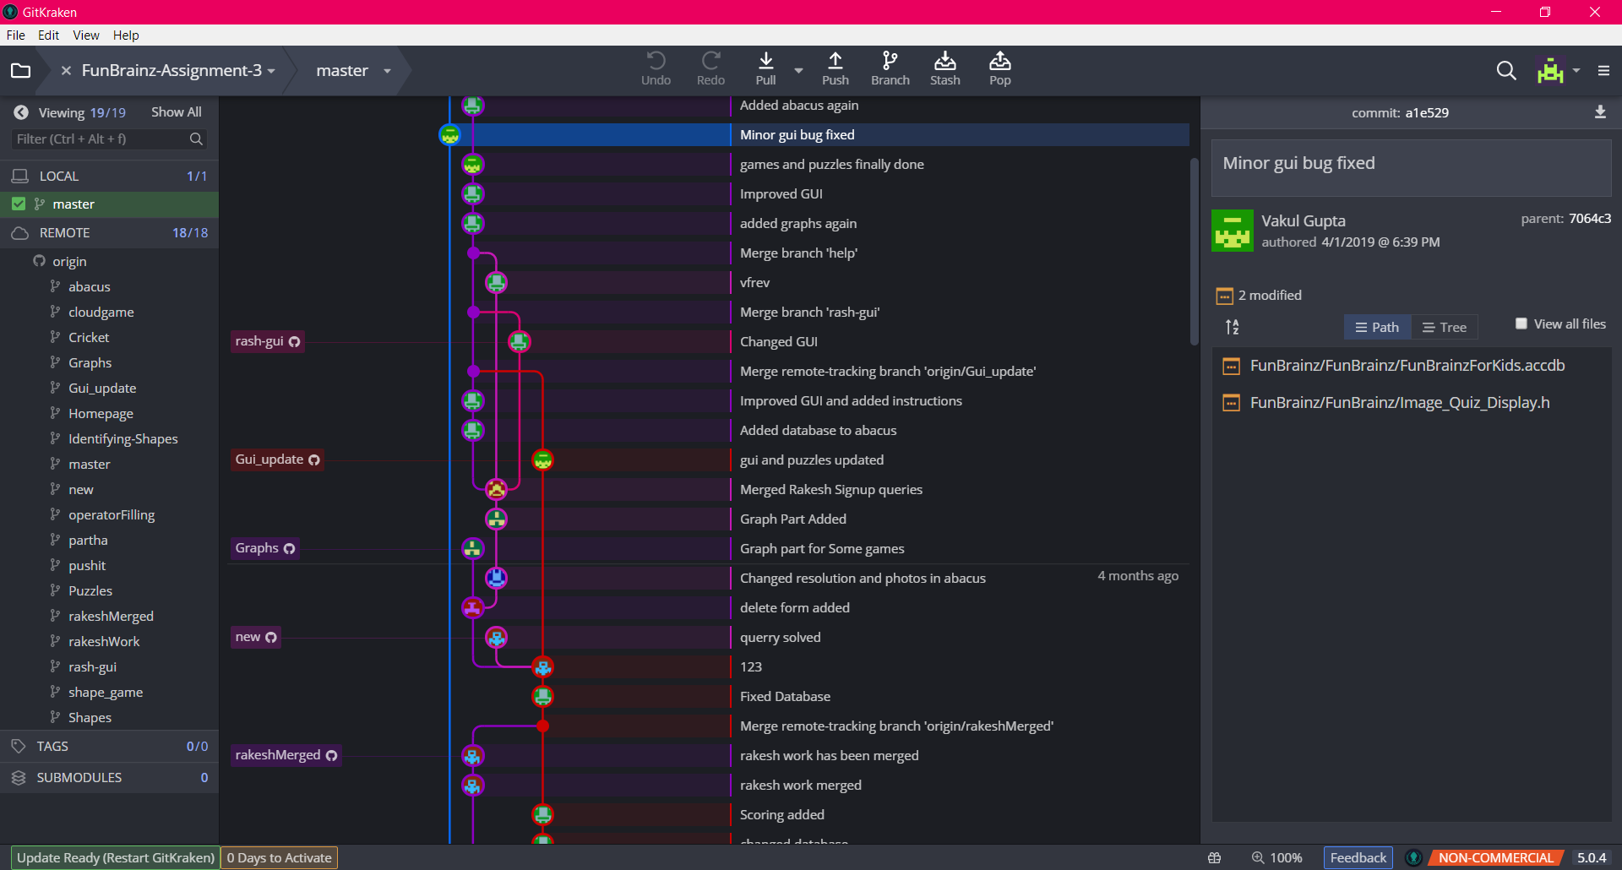
How useful git is?

Slide 6
Creating a Git Repository
To create a local git repository –
git init
This will create a .git directory in your folder
To clone a remote repository –
git clone
git clone url

Slide 7
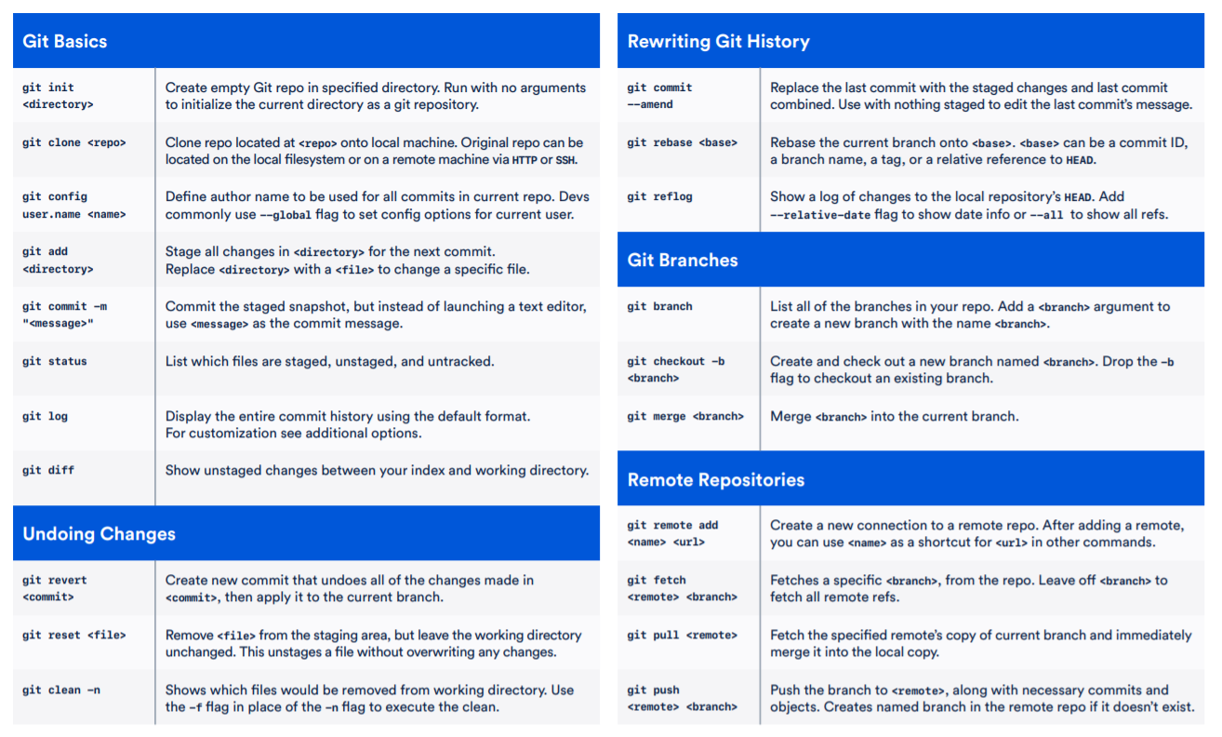

Slide 8
Git Add and Commit
The first time we ask a file to be tracked, and every time before we commit a file, we must add it to the staging area:
git add filename
Takes a snapshot of these files, adds them to the staging area.
To move staged changes into the repo, we commit:
git commit –m “your message“
To undo changes on a file before you have committed it:
git reset HEAD -- filename (unstages the file)
git checkout -- filename (undoes your changes)

Slide 9
Viewing current and previous commits
To view status of files in working directory and staging area:
git status
-s flag for short version
To see a log of all changes in your local repo:
git log
git log --oneline for shorter version

Slide 10
Branching and Merging
To create a new local branch:
git branch name
To list all local branches:
git branch
To switch to a given local branch:
git checkout branchname
To merge changes from a branch into the local master:
git checkout master
git merge branchname

Slide 11
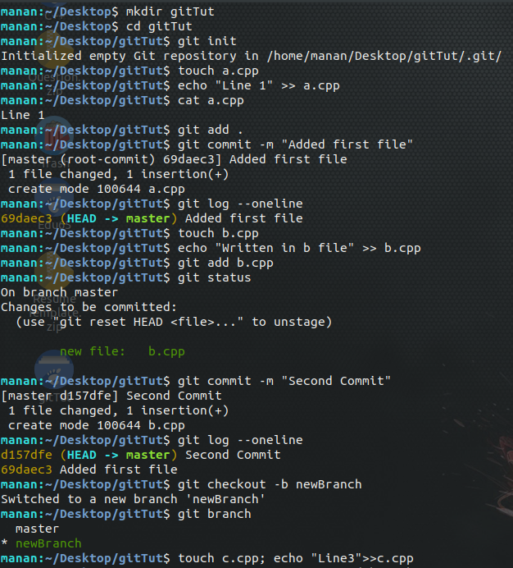

Slide 12
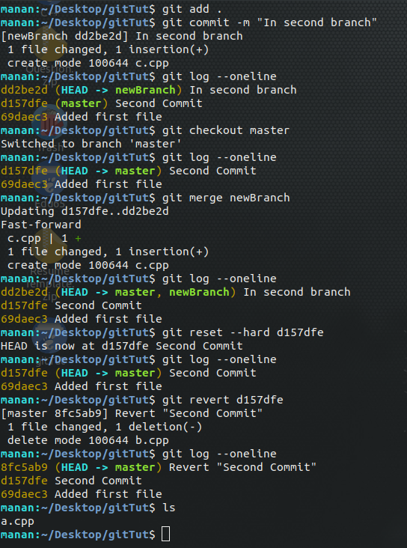

Slide 13
Interacting with remote repo
Add an alias for the repo
git remote add origin repo
Push your local changes to the remote repo.
git push origin master
Pull from remote repo to get most recent changes.
git pull origin master

Slide 14
Where to host git repositories?
Github
BitBucket
GitLab
SourceForge

Slide 15
GitKraken
It’ll make life much easier!
GitKraken is a Git GUI client for Windows, Mac and Linux. It helps developers become more productive and efficient with Git. It's free for non-commercial use.
Merging is extremely easy with this tool
Link for Tutorial Online
https://www.youtube.com/watch?v=ub9GfRziCtU

Slide 17
CVS (Concurrent Versions System)
CVS (Concurrent Versions System)
Centralized version control systems
Required for OS Lab!
Follows the Copy-Modify-Merge Model rather than The Lock-Modify-Unlock Model

Slide 18
Thankyou for attending!!!

