Slide 1
File formats in biology and generating plots
BioE 131/231
Fall 2018

Slide 2
Agenda for today
Overview of FASTA, FASTQ, and Stockholm formats
Reading and writing with BioPython
Overview of data types and types of plots
Using matplotlib
Load some sequences with BioPython, analyze them in iPython, and plot the results
Done!

Slide 3
Mo’ formats, mo’ problems
The more file formats we come across,
The more problems we see
— Notorious B.I.G.
There are tons of different file formats in bioinformatics, many of which contain the same or similar data. Converting between formats is a very common and necessary task. BioPython makes it pretty easy, fortunately!
File Format | What does it store? | Example
FASTA | Nucleic acid or protein sequences without any metadata (annotations, quality scores, etc). By far the most common! | >seq1 ATGTAGCACAGT
FASTQ | Same as FASTA, with per-base quality scores as reported by DNA sequencers (like Illumina). Quality scores are numerical values encoded as letters (like B or H in the example) | @seq1 ATGTAGCACAGT + BBBBBBBHBBBB
Stockholm | Multiple nucleic acid or protein sequences that have been aligned to one another. For example, copies of the Ras gene from different species. Allows storage of some metadata. | # STOCKHOLM 1.0 monkey ATGTAGCACAGT human AT-TAGGACA-T andrew AAAAAAAAAAAA

Slide 4
Reading and writing with BioPython
BioPython is a massive package that includes all sorts of data manipulation and analysis tools for biology. You’ll most commonly use it for reading and writing sequence files.
BioPython is already installed on the remote machine, but if you’re trying to use it on your laptop, you can install it with this terminal command:
pip3 install biopython
In Python, this will import the SeqIO package which we’ll use in the following examples:
from Bio import SeqIO
from Bio.SeqRecord import SeqRecord
from Bio.Seq import Seq
Notes:
IO – input to output

Slide 5
Reading and writing with BioPython
There are only a few pieces of the SeqIO module that you need to know about.
SeqIO.parse(filename, format) iterates over the contents of a file
SeqIO.write(sequences, handle, format) writes a bunch of sequences to a file
Seq is an object that contains a sequence—RNA, DNA, protein, etc.
SeqRecord is an object that contains a Seq along with any metadata
Here are some commonly used supported formats:
fasta, fastq, genbank, stockholm, nexus, phylip
Notes:
Parse – convert into a format of preference

Slide 6
Reading and writing with BioPython
Example #1: Converting between FASTQ and FASTA
my_recs = []
for seq_rec in SeqIO.parse(“input.fastq”, “fastq”):
my_recs.append(seq_rec)
SeqIO.write(my_recs, open(“output.fasta”, “w”), ”fasta”)

Slide 7
Reading and writing with BioPython
Example #2: Randomly generating a bunch of FASTA sequences
import random
my_recs = []
# generate 50 sequences
for seq_num in range(50):
# each is 50 nucleotides long
my_seq = “”
for _ in range(50):
my_seq += random.choice(“ATGC”)
my_recs.append(SeqRecord(seq=Seq(my_seq), id=“seq%d” % seq_num))
SeqIO.write(my_recs, open(“output.fasta”, “w”), ”fasta”)
Notes:
Write file in fasta form

Slide 8
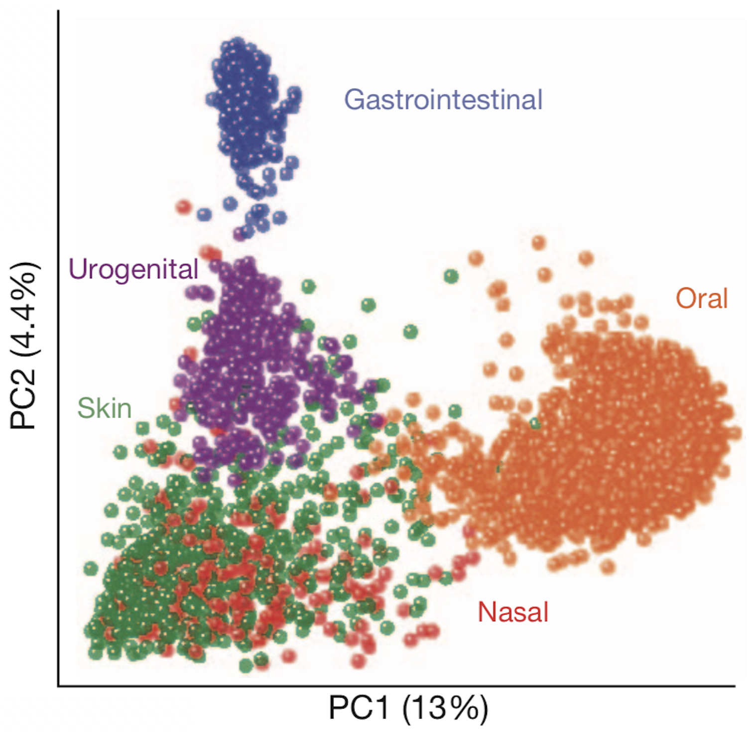
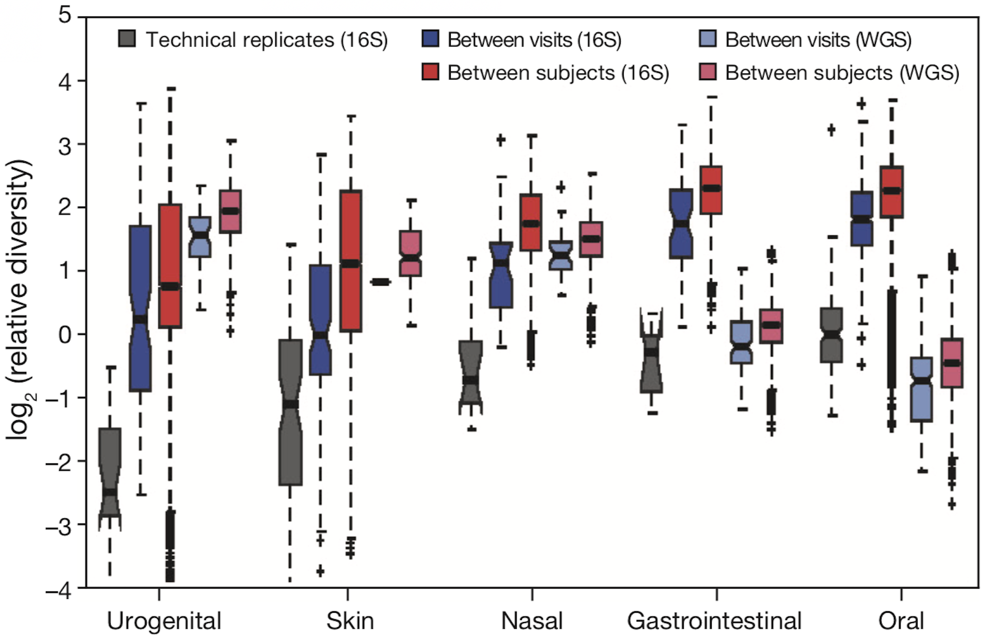
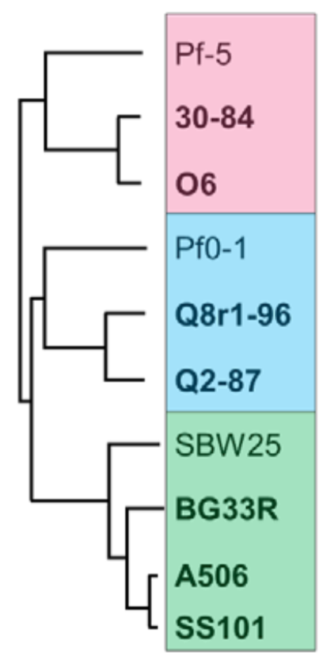
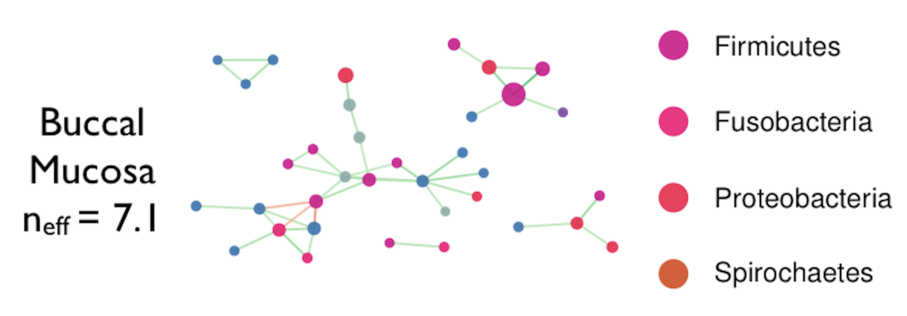
Types of data and corresponding plots
Chart Type | Type of Data
2D/3D Scatter | Data in sets of values, especially where a correlation (or a lack thereof) between the axes is expected.
Barplot or Boxplot | Categorical data where a single value (or distribution of values) is reported for each category.
Tree | Hierarchical relationships between nodes. Branch lengths related to distance.
Graph | Nodes and the edges connecting them, which can be weighted.

Slide 9
Generating plots in Python
Analyzing data is one piece of the puzzle, but visualizing the results in a way people can easily understand is equally important. With these modules, you can generate all the plots in the previous slide.
matplotlib
Scatter, barplot, and boxplot
Bio.Phylo (BioPython)
Trees
networkx (not covered today)
Graphs

Slide 10
In-line plots with matplotlib
The great thing about matplotlib and iPython is you can analyze your data, generate some plots, and discuss your results all in one place. We want our work to be reproducible, right? This helps.
A few notes for the next slides:
When importing matplotlib, convention is to rename it “plt” as in: import matplotlib.pyplot as plt
Similarly, numpy is usually np, and pandas (not covered today) is pd: import numpy as np import pandas as pd
To get iPython to plot stuff in-line, this magic command needs to go somewhere: %matplotlib inline

Slide 11
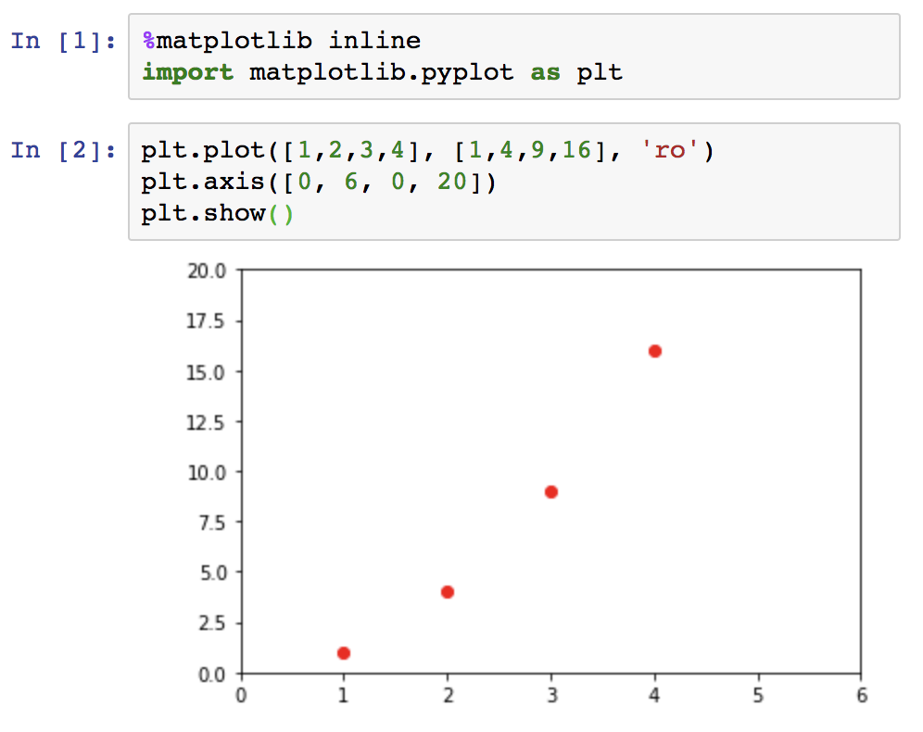
Anatomy of a scatter plot
Load matplotlib, tell it to plot inside our iPython notebook
plot(x_axis_pts, y_axis_pts, format_string) format_string is up to 3 characters consisting of (color)(point style)(line style)
When we’re done setting up the plot, this displays it to the screen
axis([x_min, x_max, y_min, y_max])
This set the limits of the axes. We can use this to show only a subset of the data by making the range small, or put the data in context by making the range large.
Notes:
Ro → red dots
Format_String → type of plotting

Slide 12
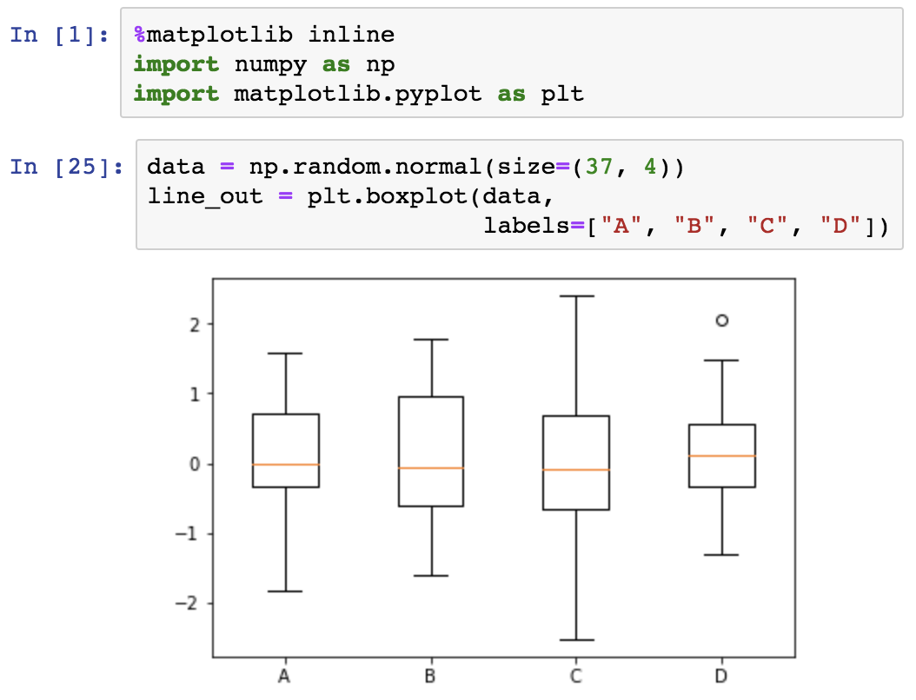
Anatomy of a box plot
First, we generate some random data drawn from a normal distribution and put it into a 37x4 matrix. boxplot() will generate one box-and-whiskers element for each column of 37 values.
Outliers are represented as individual points.
The uppermost and lowermost horizontal lines are the max and min values, respectively.
The box is bounded by the 25th through the 75th percentile of the data. This is also known as the interquartile range.
The horizontal line in the middle of the box is the median value.

Slide 13
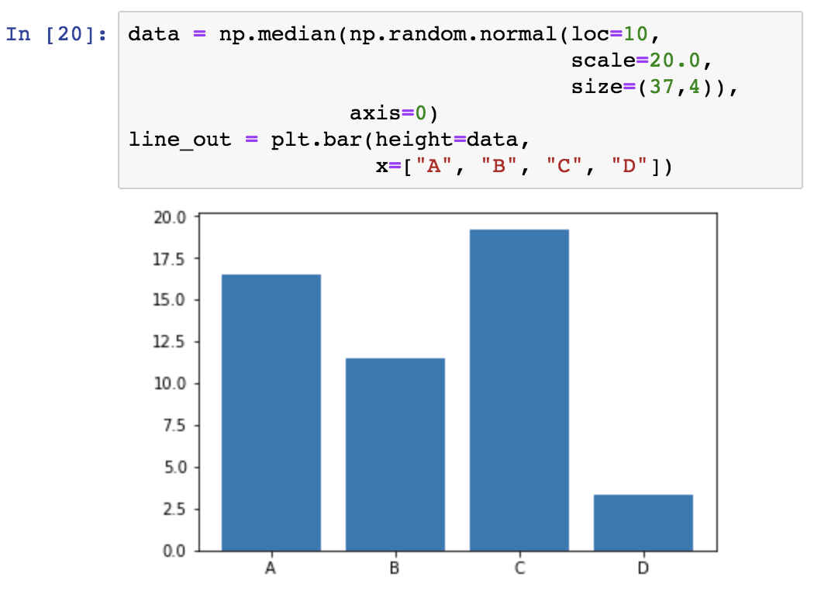
What about bar plots?
They contain a lot less information than a box plot. Here, we generate random data again and take the median of each set of 37 values.
Height is equal to the median of each data set.
Why would you use a bar plot over a box plot? Talk amongst yourselves and come up with some answers.

Slide 14
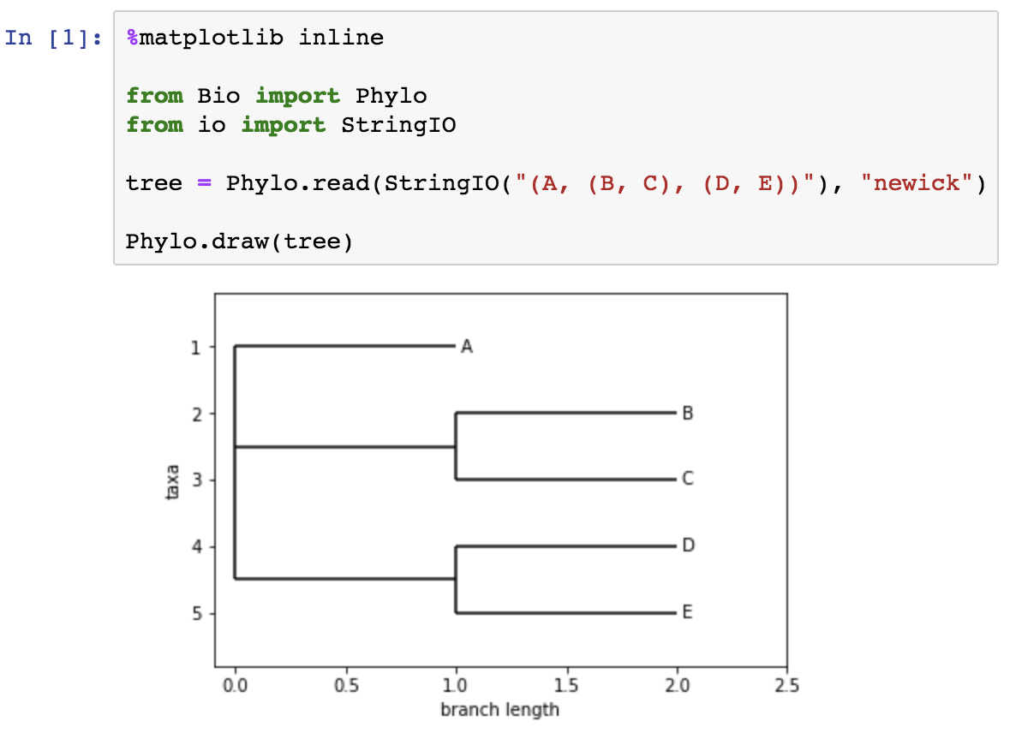
Quick trees in Newick format
Phylo.read(data, format) expects a filename or a file handle. To pass a string, we need to use StringIO, which will create a file handle out of a string!
Newick format is a quick way of specifying a tree toplogy. Have a look at the tree in the code above and compare it to the image below.
Forks are specified with commas, and subtrees are specified with parentheses. What would the tree specified by (A, (B, C), D) look like?

Slide 15
Ok, now get started…
Download the Lab 2 PDF from bCourses and go through it together with your lab partner
You’ll be importing some sequences, analyzing them, and plotting your results.
An iPython notebook with your analysis from today is due at the beginning of lab section next week.

