Slide 1
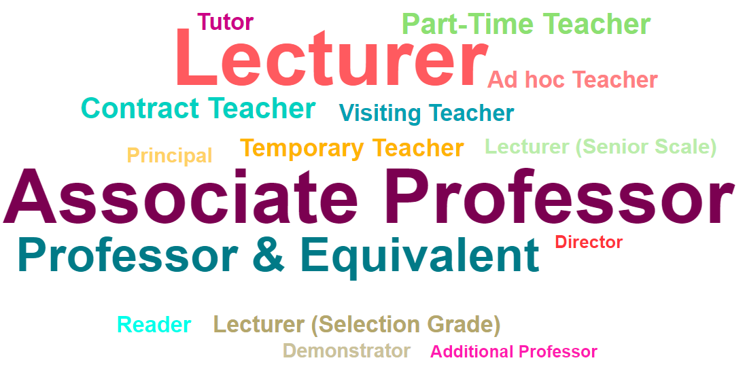
Patterns in Teaching Staff Recruitment in India (2015)
Data Mining Research Project

Slide 2
Team Work Division:
Piyush Kalantri: Data Selection and overall project planning
Inala Vivek Vamsi: Data visualization
Karri SriKanth: Data preprocessing and Report writing
Saksham Gupta: Data preprocessing and Data Visualization
Work was evenly distributed and each member took participation in the whole project though the work was distributed it was done as a team together.

Slide 3
Project Overview:
Data Explanation:
Objectives:
The Teaching Staff dataset contains information of technical staff recruits in the year 2015 across different universities and colleges in India. The dataset includes the college name, college id, department, designation of the recruits and the categories they belong to (namely General, OBC, ST, SC) along with their gender.
Columns: 26
Rows: 31978
Extract information about the recruitments in various colleges.
To obtain Beautiful patterns from the data based on departments and categories.
To make clusters of different types of categories in the teaching staff and designation.
To find the popularity of various branches based on the strength of the staff.
To evaluate the career prospectus for a faculty based on colleges.

Slide 4
Techniques Involved:
Data PreProcessing:
Data Cleaning:
Replacing Missing values with means for numerical attribute and with mode for categorical attributes.
Rows which had numerous missing values were removed.
Data Reduction:
Dimentionality reduction was done by removing various redundant attributes.
Data Transformation:
Feature creation was done by adding a new attribute.
Feature selection was done in overall.
Binarization was done to binary attributes.
Data Visualization:
Data was sorted in a specific order.
Various statistical measures were shown.
Matplotlib
Seaborn
Apache Superset

Slide 5
ShortComings:
Most of the data had numerical value in a wide range distributed unevenly so scaling of data could not be done as we needed exact no. of members in a department.
Nearly 43000 entries had NA in categorical data, replacing them with mode or median would have messed with the data so they had to replaced with unknown, such large no. of entries can’t be removed either.
Data had missing column for states of colleges,so possibilities for mining of various patterns were reduced.
For visualization we had very few attributes which could be plotted and produce meaningful result.
Many of the department names seemed invalid they could not be removed it was hard to figure them out.

Slide 6
NextSteps:
To perform Association rule mining to find some pattern in designation and department (whether a particular designation belongs to a particular department).
Also to find pattern in colleges and the category of the staff hired, thus depicting reservation in various colleges.
To see if clusters are formed on teaching staff vs department.
To find the branch most preferred by variously designated teaching staff,based on their career prospective.
To find colleges with well equipped facilities based on its preferences as seen by the 2015 data.

