Slide 1
Drupal
+
Ionic Framework
=
An App for a Megalomaniac

Slide 2
What We'll Talk About Today
Some background
Drupal as a RESTful API
What is Ionic Framework
Connecting the Dots
Q&A (please go easy on me)

Slide 3
Some Background
I decided to run as a candidate in the 2016 General Election.
I had everything in place ...

Slide 4

...My Poster Campaign

Slide 5
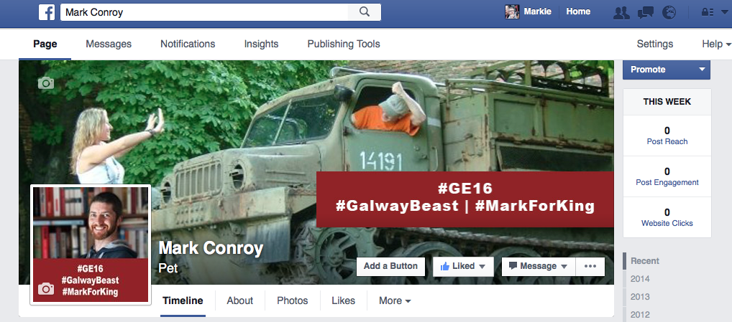
… My Facebook Page

Slide 6
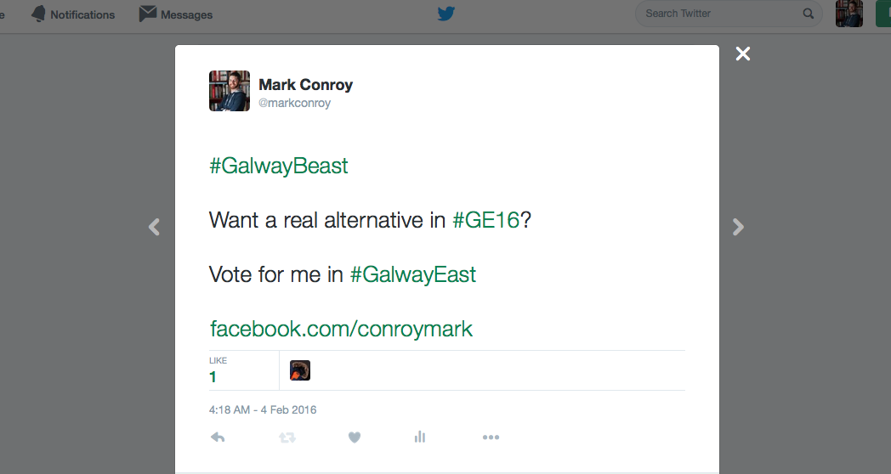
… A Twitter Hashtag: #GalwayBeast

Slide 7
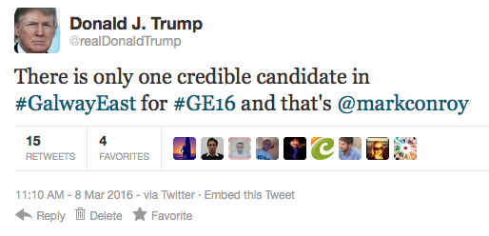
…an Endorsement from a fellow megalomaniac...

Slide 8
… except ...
I needed an app to get my message out to my tens of followers
Without one, I wouldn't get elected

Slide 9
What is Drupal?
Drupal is a content management framework
It can be used to create…
Blah
Blah
Blah
Let's skip the boring parts!

Slide 10
Drupal as a RESTful API
In Drupal 8 this is simple
Enable “Serialization” module
Enable “RESTful Web Services” module
Create the views you need

Slide 11
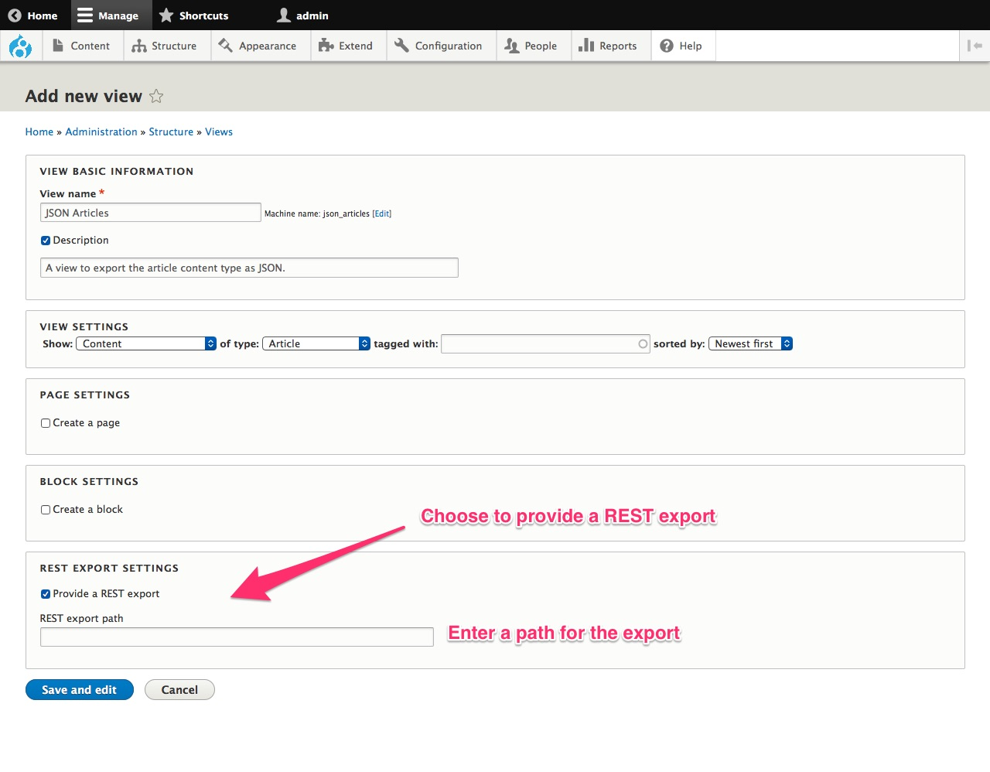
Create a View

Slide 12
You Now Have RESTful Data
You now have RESTful data
You can consume this for whatever purpose
  Create a headless Drupal site
  Allow it as a canonical source for other sites in your business
  Use this site as a content staging site
  Differentiate a great editor experience from a great front-end user experience
  Pull it into an app – our goal today!

Slide 13
What is Ionic Framework 1
A hybrid web app development kit
Based on Cordova and AngularJS
Packages HTML, CSS, and JS into
  Android apps
  iOS apps

Slide 14
What is Ionic Framework 2
Comes with LOADS of built-in features
  Lists
  Navigation/Tabs
and classes
  This helps apps to have a native look and feel
  Everything can be overridden to give custom look and feel
Comes with support for SCSS
Has live reload built-in

Slide 15
Create a Basic App
Run 'ionic start [appName] [appStyle]'
  appStyle can be
    blank
    tabs
    sidemenu

Slide 16
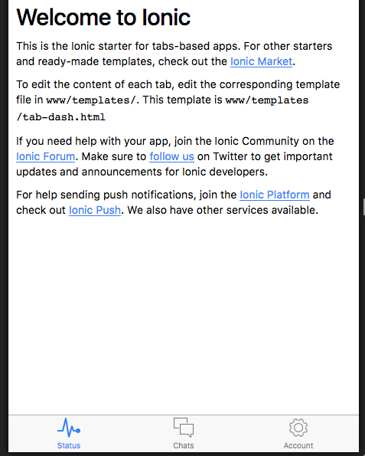
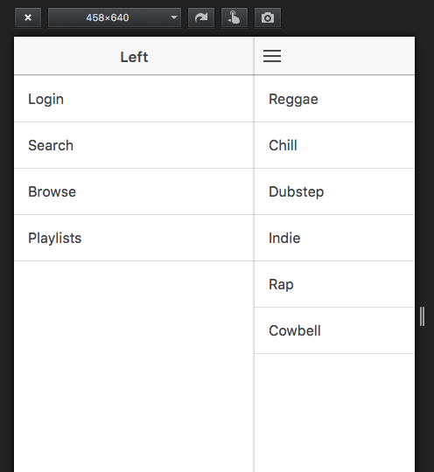
Tabs & SideMenu

Slide 17
Add New Menu Item
In www/js/app.js copy one of the states and edit to reflect your new info
Create a template file in /templates for your HTML
Add a menu entry in www/templates/menu.html
Create a controller for your state

Slide 18
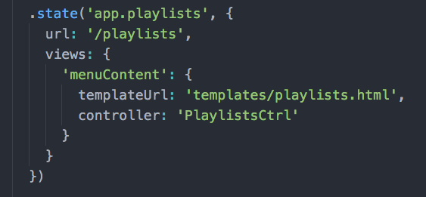
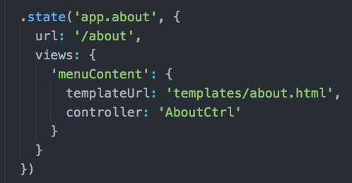
Edit States in app.js

Slide 19
Dynamic Content
The content created to now is static.
Let's connect it to our Drupal RESTful service from earlier
Means any content updated on the website will automatically update on the app

Slide 20
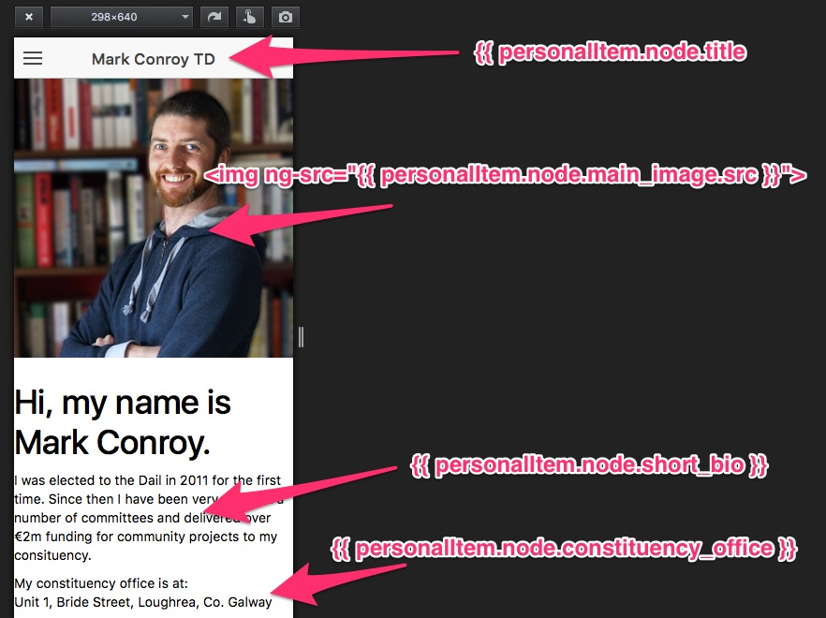
PersonalCtrl Anatomy

Slide 21
Edit Controller to use the $http service
In my case I have a controller called 'PersonalCtrl'
I use the '$http' service from AngularJS to 'GET' the JSON data
I then use 'expressions' in my html to situate that data in my template

Slide 22
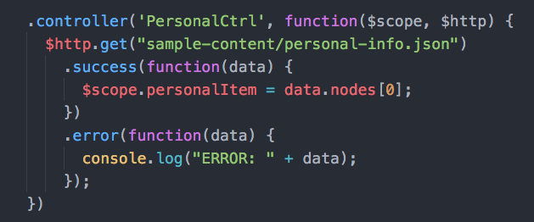
PersonalCtrl

Slide 23
Create a Listing Page
Same as for above.
Edit correct controller
Add in an 'ng-repeat' property to the HTML to show each item in the list
Add click function to open each item in its own view

Slide 24
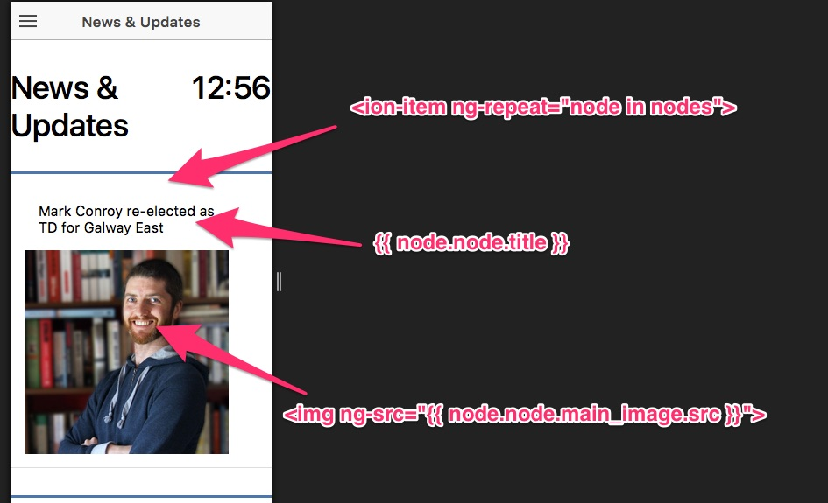
Listing Page Anatomy

Slide 25
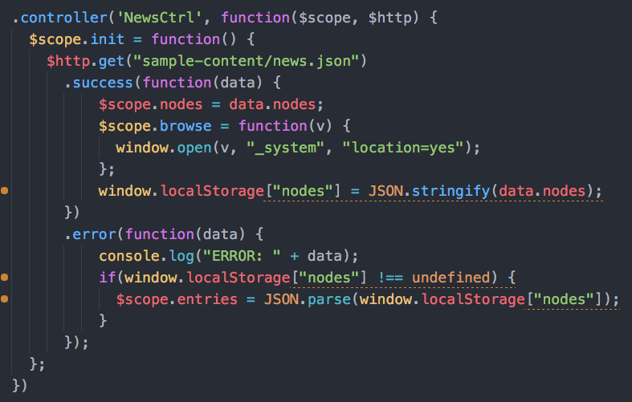
NewsCtrl

Slide 26
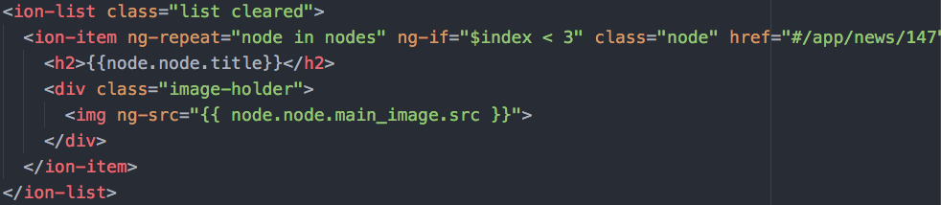
News List HTML

Slide 27
Need More Data in your App?
Repeat the above
Again
And again
And again

Slide 28
Build the Native App
To build, run:
  ionic build android
  ionic build ios
To test, run:
  ionic emulate android
  ionic emulate ios

Slide 29
THANKS FOR LISTENING!
Got any Questions?

