Slide 1
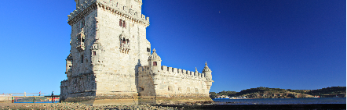

Session Title
Author Name

Slide 2

Diamond Sponsor

Slide 3

Platinum Sponsors

Slide 4

Gold Sponsors

Slide 5

Slide Title

Slide 6
Slide Title
Item level 1
Item level 2
Item level 1

Slide 7
Slide Title
This is a longer concept to be explained. Integer posuere erat a ante venenatis dapibus posuere velit aliquet. Donec id elit non mi porta gravida at eget metus.

Slide 8
“SECTION OR QUOTE”
–Authors Name

Slide 9

Slide Title
Item level 1
Item level 2
Item level 1

