Slide 1

Multilingual
Site Setup
and
Maintenance
Notes:
Introducing Lingotek THE TRANSLATION NETWORK

Slide 2
Name: Rob Bailey
Drupal ID: robertdbailey
Day Job: Developer @ Lingotek
Maintain: Lingotek Translation module

Slide 3
Overview
Establish requirements
Preparations and dependencies
Content translation and Entity translation
Interface translation
Configuration translation
Coping with content changes
Enlisting others to help translate
Translation workflows and automation
Machine vs. community vs. professional
Initializing.

Slide 4
Requirements to consider
Nature of the web site
How many languages?
How much of the site translated?
Who will be doing the translating?
How fast do you need translations?
What is the budget?
What modules are important?
Dev/Staging/Production synchronization
Translation in document lifecycle
What to do if a translation is missing?
...

Slide 5

Multilingual Adventure:
Packing List
Image by under Creative Commons license.

Slide 6
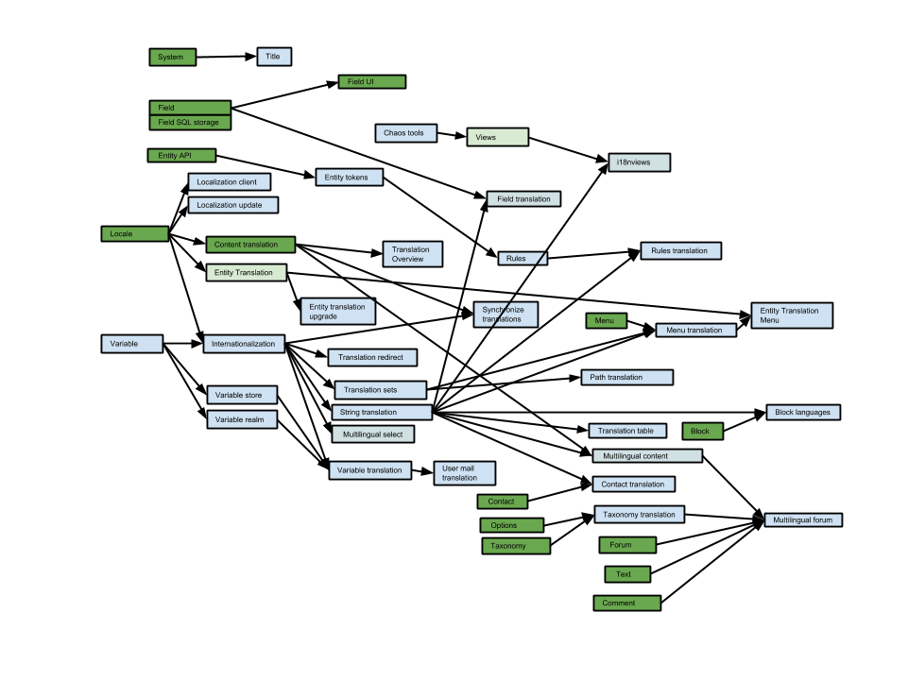
Drupal 7 Multilingual Landscape

Slide 7
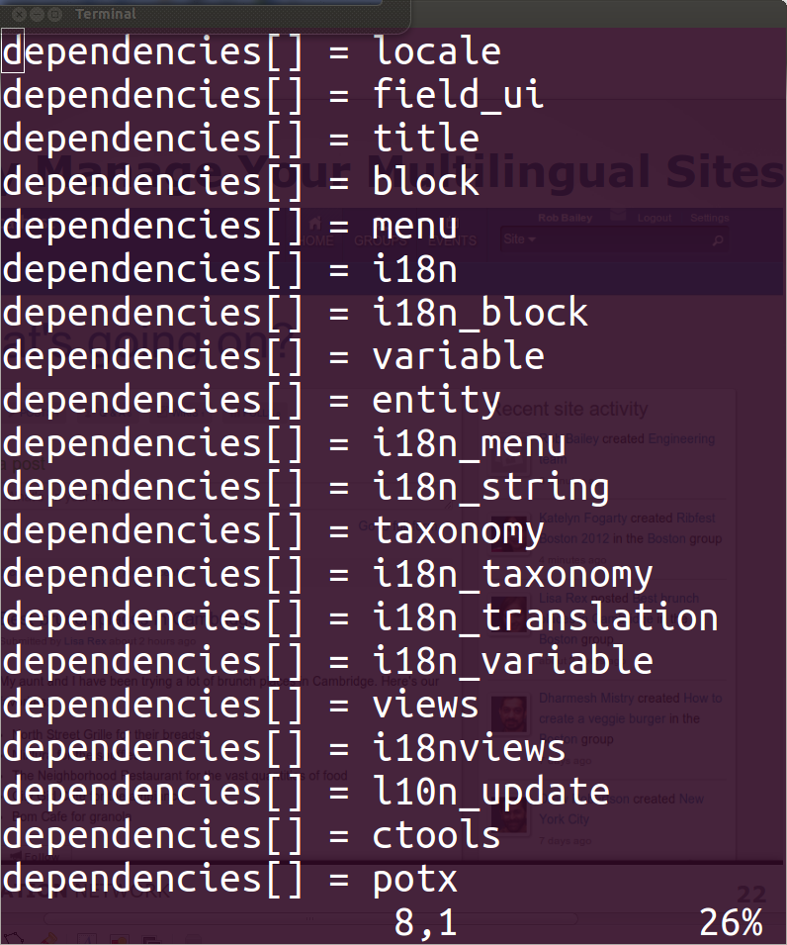
Standard Multilingual Dependencies
Notes:
Before starting to translate a site, it must be enabled for multilingual. You could think of it as a kind of gold rush, and Drupal provides all the pans and shovels

Slide 8
Multilingual Setup Checklist
Phase 1:
Set up the languages
Language detection and selection
Add a language switcher
Prepare content for translation
Translate content!

Slide 9
Content Translation
(node-based)
Entity Translation
(field-based)
Node 1 (English) | Node 2 (Spanish) | Node 3 (French)
Title (English) | Title (Spanish) | Title (French)
Image | Image Copy | Image Copy
Properties (English) | Properties (Spanish) | Properties (French)
 | Node 1 (All)
Title (English) | Title (Spanish) | Title (French)
 | Image (All)
 | Properties (All)
Notes:
The unstoppable force meets the immovable object: Content translation is the way people translated nodes in drupal 6, and even in drupal 7 it has a lot of momentum because some modules don't support field-based translations.

Slide 10
Content Translation
(node-based)
Tried and true method
from D6
Better for A-symmetric
multilingual sites
Must sync property
changes between nodes
Can clutter node
administration
Able to publish a node
in one language while
other languages are
still in process
Entity Translation
(field based)
Hot new method to
be used in D8
Able to select
specific fields
Works for more
than just nodes
Troubles with core
search feature
All or nothing
publishing*
Notes:
The unstoppable force meets the immovable object: Content translation is the way people translated nodes in drupal 6, and even in drupal 7 it has a lot of momentum because some modules don't support field-based translations.

Slide 11
Multilingual Setup Checklist
Phase 2:
Prepare blocks, menus, taxonomy
Prepare built-in interface

Slide 12

Coping with site changes
“defeat” by
Notes:
Remember preparing your module for translation by getting all strings wrapped in t() functions? Well this is where you translate them. You can also submit them back to the community, especially if you want translations available for your module.
For all modules contributed by the community, you can check if there are translations available using the l10n_update module. You use the same Translate Interface to translate these, and they are also stored as English in the locales_source table.
For Drupal 8: this all changes. Interface and Config translation are both stored on the filesystem, and the source does not have to be English!

Slide 13
Changes happen everywhere...
Core and module upgrades
Changes to site content
Changes to configuration
Theming changes
Changing business processes

Slide 14

Calling in the cavalry...
Cavalry Charge by
(enlisting help from others)
Notes:
Remember preparing your module for translation by getting all strings wrapped in t() functions? Well this is where you translate them. You can also submit them back to the community, especially if you want translations available for your module.
For all modules contributed by the community, you can check if there are translations available using the l10n_update module. You use the same Translate Interface to translate these, and they are also stored as English in the locales_source table.
For Drupal 8: this all changes. Interface and Config translation are both stored on the filesystem, and the source does not have to be English!

Slide 15
Drupal Translations

Slide 16
Lingotek Translation module
Automates multilingual site setup
Provides free access to enterprise
translation software and free machine translation
Backed by translation memories
(never translate the same phrase twice)
Handles change-management
Supports node-based and entity-based
Integrates with much more than Drupal
Use any translators, even your community!

Slide 17
Other Multilingual
Modules and Resources
Multilingual Book by Kristen Pol
TMGMT module
GTranslate module
Many more helpful tools!

Slide 18
Q&A

Slide 19
Name: Rob Bailey
Drupal ID: robertdbailey
Day Job: Developer @ Lingotek
Maintain: Lingotek Translation module

