Slide 1
“SHOW ME” COVID DATA!
EXAMINING THE RATES OF COVID-19 ACROSS POPULATIONS IN THE COUNTIES OF MISSOURI
Katherine Comfort-Mason, Melissa Memel, David Ruppel & Christopher Wecke

Slide 2
Covid-19 cases in

Slide 3
How do covid diagnoses & fatalities vary based upon the following factors?
Median income
Poverty level
Population density
Population over age 65
Health insurance

Slide 4
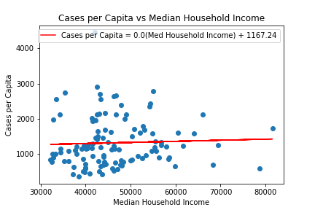
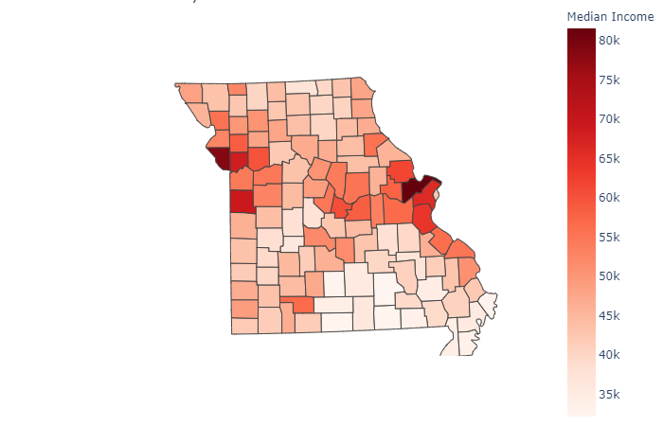
Cases per capita vs. Median household income

Slide 5
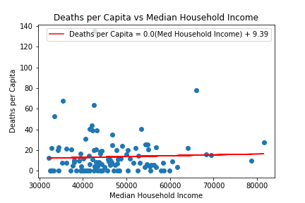
deaths per capita vs. Median household income

Slide 6
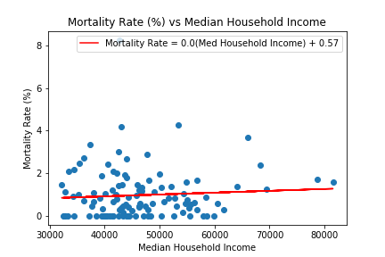
Mortality rate vs. Median household income

Slide 7
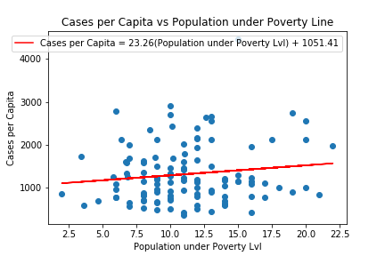
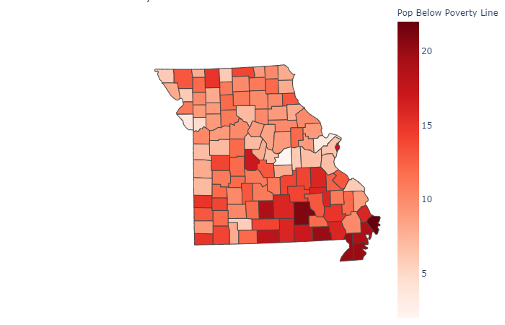
Cases per capita vs. pop. Below poverty line

Slide 8
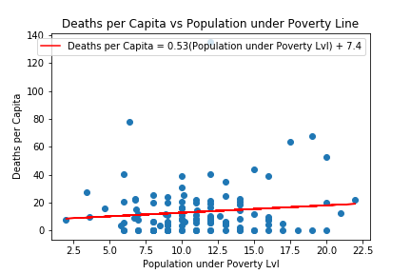
deaths per capita vs. pop. Below poverty line

Slide 9
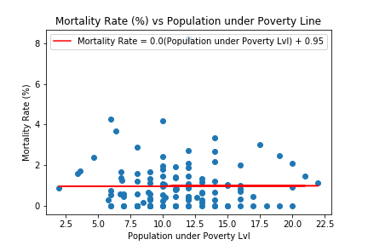
Mortality rate vs. pop. Below poverty line

Slide 10
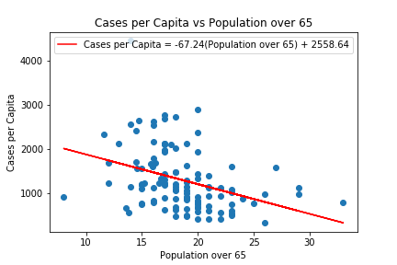
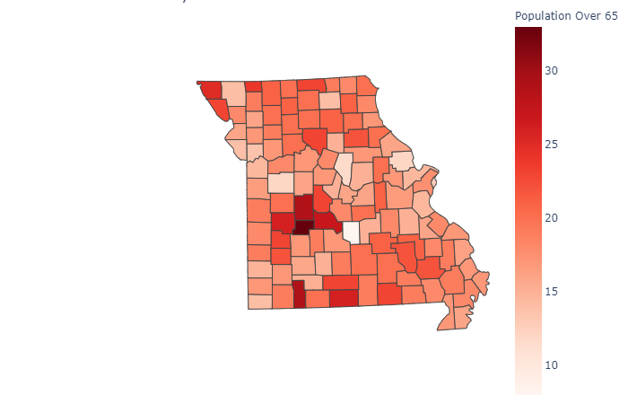
Cases per capita vs. Population age 65+
Notes:
No. 1 – Hickory County – 33% over 65

Slide 11
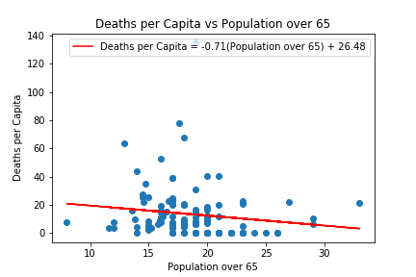
deaths per capita vs. Population age 65+

Slide 12
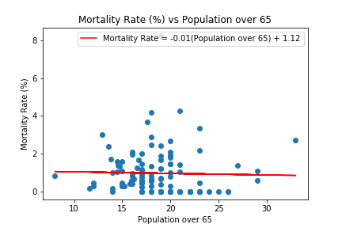
Mortality rate vs. Population age 65+

Slide 13
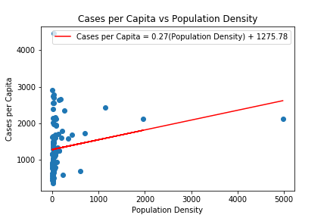
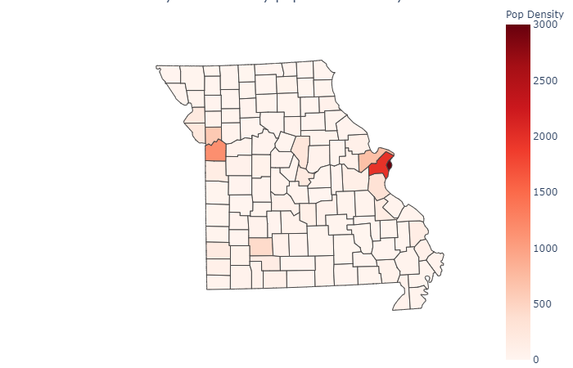
Cases per capita vs. population density

Slide 14
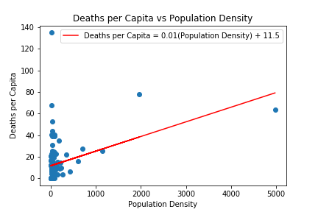
deaths per capita vs. population density

Slide 15
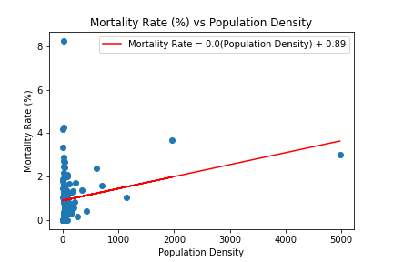
Mortality rate vs. population density
Notes:
Top areas – STL and KC metro areas.

Slide 16
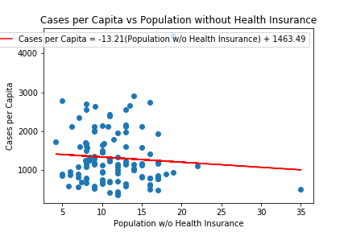
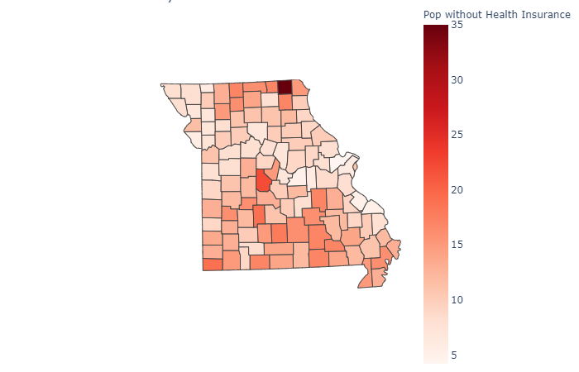
Cases per capita vs. uninsured population
Notes:
No. 1 – Scotland County (35%)
No. 2 – Morgan County (22%)

Slide 17
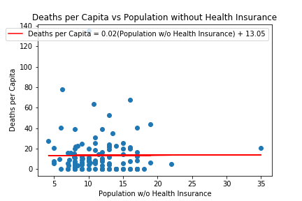

deaths per capita vs. uninsured population

Slide 18
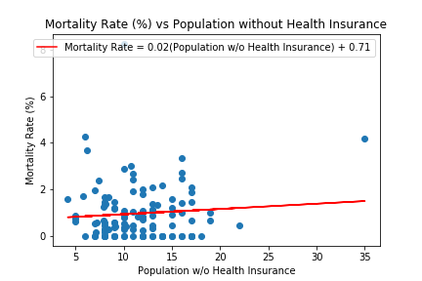
Mortality rate vs. uninsured population

