Slide 1
DOCKER
THE CONTAINER
-Nilesh Ghadge

Slide 2
AGENDA
Docker overview
Why docker
Docker Architecture
Docker Hub
Docker Installation
Hands on

Slide 3
DOCKER OVERVIEW
Docker is an open platform for developing, shipping, and running applications. Docker enables you to separate your applications from your infrastructure so you can deliver software quickly. With Docker, you can manage your infrastructure in the same ways you manage your applications. By taking advantage of Docker’s methodologies for shipping, testing, and deploying code quickly, you can significantly reduce the delay between writing code and running it in production.

Slide 4
THE DOCKER PLATFORM
Docker provides the ability to package and run an application in a loosely isolated environment called a container. The isolation and security allow you to run many containers simultaneously on a given host. Containers are lightweight because they don’t need the extra load of a hypervisor, but run directly within the host machine’s kernel. This means you can run more containers on a given hardware combination than if you were using virtual machines. You can even run Docker containers within host machines that are actually virtual machines!

Slide 5
DOCKER ENGINE
Docker Engine is a client-server application with these major components:
A server which is a type of long-running program called a daemon process (the dockerd command).
A REST API which specifies interfaces that programs can use to talk to the daemon and instruct it what to do.
A command line interface (CLI) client (the docker command).

Slide 6
WHY DOCKER ?
Isolation
Lightweight
Simplicity
Workflow
Community
Native to OS
Fast

Slide 7
DOCKER ARCHITECTURE
The CLI uses the Docker REST API to control or interact with the Docker daemon through scripting or direct CLI commands. Many other Docker applications use the underlying API and CLI.
The daemon creates and manages Docker objects, such as images, containers, networks, and volumes.
Server Host
Docker Daemon
Docker Hub
Docker Client
Rest API
Container 1
Images
Container 2

Slide 8
DOCKER ARCHITECTURE …
The Docker client (docker) is the primary way that many Docker users interact with Docker. When you use commands such as docker run, the client sends these commands to dockerd, which carries them out. The docker command uses the Docker API. The Docker client can communicate with more than one daemon.
The Docker daemon
Docker client
The Docker daemon (dockerd) listens for Docker API requests and manages Docker objects such as images, containers, networks, and volumes. A daemon can also communicate with other daemons to manage Docker services.
The Docker client (docker) is the primary way that many Docker users interact with Docker. When you use commands such as docker run, the client sends these commands to dockerd, which carries them out. The docker command uses the Docker API. The Docker client can communicate with more than one daemon.

Slide 9
DOCKER ARCHITECTURE …
Docker registries
Docker registry stores Docker images. Docker Hub and Docker Cloud are public registries that anyone can use, and Docker is configured to look for images on Docker Hub by default. You can even run your own private registry. If you use Docker Datacenter (DDC), it includes Docker Trusted Registry (DTR).
Docker Images
An image is a read-only template with instructions for creating a Docker container. You might create your own images or you might only use those created by others and published in a registry. To build your own image, you create a Dockerfile with a simple syntax for defining the steps needed to create the image and run it. Each instruction in a Dockerfile creates a layer in the image. When you change the Dockerfile and rebuild the image, only those layers which have changed are rebuilt. This is part of what makes images so lightweight, small, and fast, when compared to other virtualization technologies.

Slide 10
DOCKER ARCHITECTURE …
Docker Containers
A container is a runnable instance of an image. You can create, run, stop, move, or delete a container using the Docker API or CLI. You can connect a container to one or more networks, attach storage to it, or even create a new image based on its current state.
By default, a container is relatively well isolated from other containers and its host machine. You can control how isolated a container’s network, storage, or other underlying subsystems are from other containers or from the host machine.

Slide 11
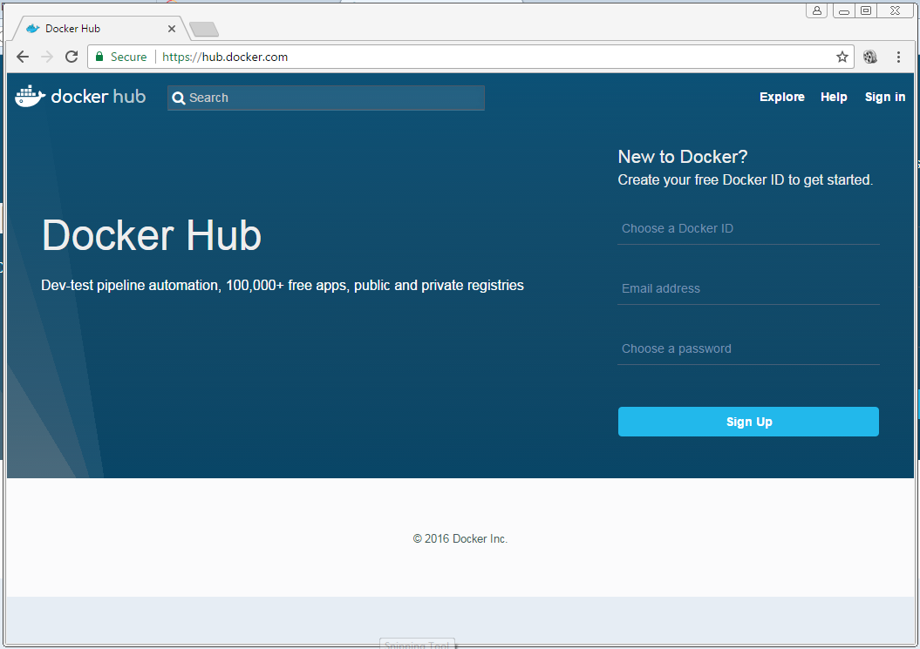
DOCKER HUB
Provide Docker Services
Library of public images
Storage for your images
Free for public images
Cost for private images
https://hub.docker.com

Slide 12
DOCKER INSTALLATION

