Slide 1
Introduction to Gradle
Dawid rusin, TOPdesk deutschland gmbh

Slide 2
Agenda
What is Gradle
Gradle Wrapper
Build files
Features
Tasks
Task types
Plugins
Dependency management
Practical exercises

Slide 3
What is Gradle
Build & automation tool
Written in Java
Used to build, test, publish, deploy etc.
Language support:
JVM languages
Native languages (Assembler, C, C++…)
Many other via plugins (e.g. Python, Node…)

Slide 4
What is Gradle
Open source (Apache v2, code on GitHub)
Active community
Minor release every 4-8 weeks
400+ pages user guide
Build Language Reference (https://docs.gradle.org/current/dsl/)
Docs + many sample builds in „gradle-all“ distribution

Slide 5
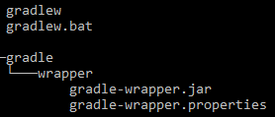
Gradle wrapper
Contains:
Shell-script + batch-script
Jar to download gradle + properties
Pros
No gradle installation needed
Set gradle version
Cons
Binary file in repository
Best practice: always include wrapper
Run „gradle wrapper“ in your project to create (gradle installation needed)

Slide 6
Build files
„build.gradle“ (+ optional „settings.gradle“)
„POMs“ for gradle
Written in Java Groovy
Some possibilities:
Write custom tasks
Apply plugins
Configure tasks
Declare dependencies
Backed by a org.gradle.api.Project object

Slide 7
Tasks
Basic unit of work
Implements the org.gradle.api.Task interface
General structure:
task taskName {
someLinesOfConfiguration
doFirst / doLast {
someLinesOfExecution
}
}
task helloGroovy { def userName = "Dawid" doLast { println "Hello, " + userName } } | task("helloJava", { String userName = "JDawid"; doLast({ System.out.println("Hello, " + userName); }); });
No side effects here!!!

Slide 8
Tasks API
doFirst / doLast
Add actions to the action queue
task queueTest { doFirst { println "Apple" } doLast { println "Pie" } doLast { println "Orange" } doFirst { println "Chocolate" } doFirst { println "Strawberry" } doLast { println "Banana" } doLast { println "Juice" } doFirst { println "Raspberry" } }
Raspberry Strawberry Chocolate Apple Pie Orange Banana Juice

Slide 9
Tasks API
dependsOn(“otherTask”) – only runs if otherTask was successfull
onlyIf({condition}) – task is only run if condition is satisfied
finalizedBy(“otherTask”) – run otherTask after this one, despite the result
mustRunAfter(“otherTasks”) – for ordering task execution
description
group

Slide 10
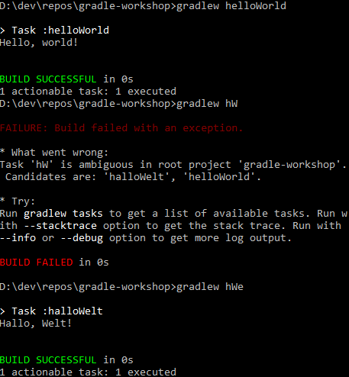
Running tasks
gradlew TASKNAME
gradlew helloWorld
CamelCase abbr.
gradlew hW
Abbr. have to be unambiguos
task helloWorld; task halloWelt
-> gradlew hWo / gradlew hWe
See all possible taks with
gradlew tasks --all

Slide 11
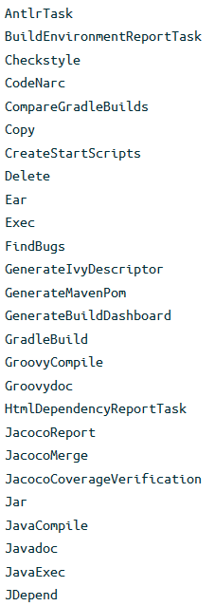
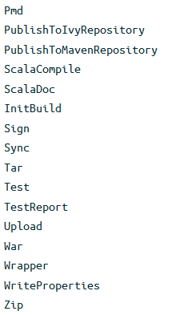
Task types
Tasks can have types
Built into gradle
From plugins
Custom types
Provide functionality, expect configuration
Tell what to do instead of how
Declaration
Default Task: task helloWorld { … }
E.g. Copy Task: task copyRessources(type: Copy) { … }

Slide 12
Task types
Usage, e.g. Copy Task
Custom tasks extend DefaultTask
task copyResources(type: Copy) { from "sourceDir“ to "targetDir“ }
class Greeting extends DefaultTask { String greeting = "Hi, unknown!"; @TaskAction void doGreet() { System.out.println(greeting); } } task customGreet(type: Greeting) { greeting = "Hello, Mr.“ }

Slide 13
Plugins
Just packaged build logic
Can do anything a buildscript can
Two types
Script plugins: plain gradle scripts
Binary plugins: classes that implement the Plugin interface
Typically compiled and reused via jars

Slide 14
Script plugins
myPlugin.gradle:
build.gradle
task taskFromPlugin() { doLast { println "added by a script plugin!“ } }
apply from: "myPlugin.gradle"

Slide 15
Standard plugins
java - compile, test, package, upload Java projects
checkstyle - static analysis for Java code
maven - uploading artifacts to Apache Maven repositories
scala - compile, test, package, upload Scala projects
idea and eclipse - generates metadata so IDEs understand the project
application - support packaging your Java code as a runnable application
Many more

Slide 16
Dependency management
Configurations provided with „java“ plugin
Compile
Runtime
testCompile
testRuntime
Using unmanaged dependencies
dependencies { compile fileTree(dir: "lib", include: "*.jar") }
Using managed dependencies
dependencies { compile "org.springframework:spring-core:4.0.5.RELEASE“ }

Slide 17
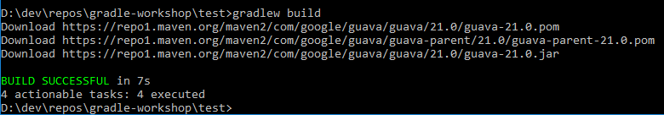
Dependency management
Simple java project
apply plugin: 'java' repositories { mavenCentral() } dependencies { compile 'com.google.guava:guava:21.0' testCompile 'junit:junit:4.12' }

Slide 18
Transitive dependency conflicts
Possible options on version conflicts
Use default strategy (highest version number)
Disable transitive dependency management
Excludes
Force a version
Fail on version conflict
Dependency resolution rules

Slide 19
Misc
gradle init --type java-application
Create skeleton projects
gradle build --continuous
Watch inputs and run tasks automatically when changes occur
com.moonwork.node Plugin
Run NodeJS/Yarn/Grunt/Gulp tasks without a global installation

Slide 20
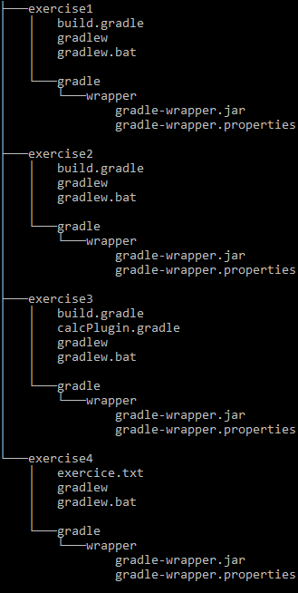
Exercises
The assignments are in the build.gradle or exercise.txt files
Do it alone or in a group of 2-3 people
~30-45 minutes

Slide 21
Questions?

