Slide 1

Markov Decision Processes
Slides by Svetlana Lazebnik, 11/2016 (UIUC)
Modified by Mark Hasegawa-Johnson, 3/2019 (UIUC)
Modified by Leonardo Bobadilla

Slide 2
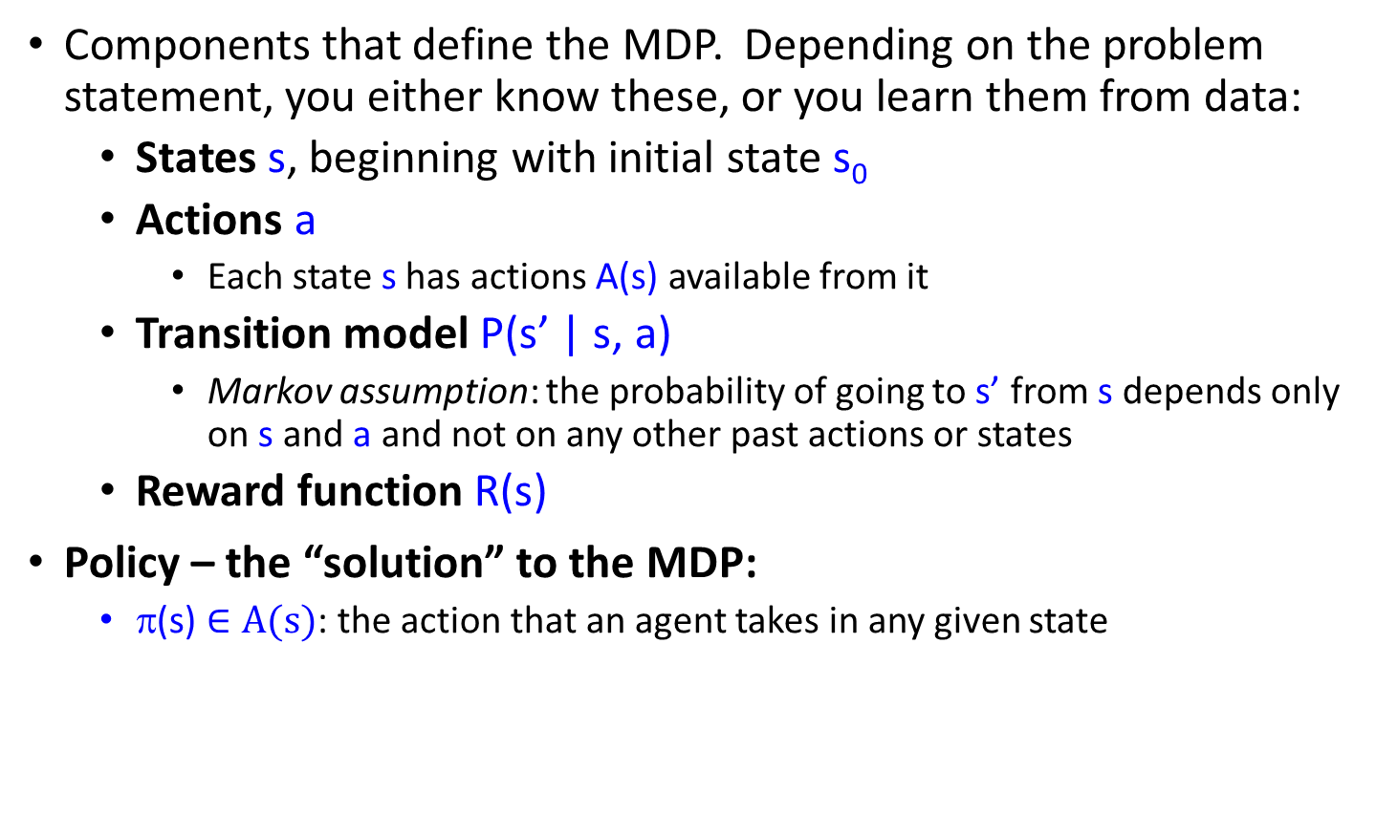
Markov Decision Processes
Components that define the MDP. Depending on the problem statement, you either know these, or you learn them from data:
States s, beginning with initial state s₀
Actions a
Each state s has actions A(s) available from it
Transition model P(s’ | s, a)
Markov assumption: the probability of going to s’ from s depends only on s and a and not on any other past actions or states
Reward function R(s)
Policy – the “solution” to the MDP:
π(s) $∈A(s)$: the action that an agent takes in any given state

Slide 3
Overview
First, we will look at how to “solve” MDPs, or find the optimal policy when the transition model and the reward function are known
Second, we will consider reinforcement learning, where we don’t know the rules of the environment or the consequences of our actions

Slide 4
Game show
A series of questions with increasing level of difficulty and increasing payoff
Decision: at each step, take your earnings and quit, or go for the next question
If you answer wrong, you lose everything
$100 question
$1,000 question
$10,000 question
$50,000 question
Correct:
$61,100
Q1
Correct
Q2
Correct
Q3
Correct
Q4
9/10
3/4
1/2
1/10
1/10
1/4
1/2
9/10
Incorrect:
$0
Incorrect:
$0
Incorrect:
$0
Incorrect:
$0
Quit:
$100
Quit:
$1,100
Quit:
$11,100

Slide 5
Game show
Consider $50,000 question
Probability of guessing correctly: 1/10
Quit or go for the question?
What is the expected payoff for continuing?
0.1 * 61,100 + 0.9 * 0 = 6,110
What is the optimal decision?
$100 question
$1,000 question
$10,000 question
$50,000 question
Correct:
$61,100
Q1
Correct
Q2
Correct
Q3
Correct
Q4
9/10
3/4
1/2
1/10
1/10
1/4
1/2
9/10
Incorrect:
$0
Incorrect:
$0
Incorrect:
$0
Incorrect:
$0
Quit:
$100
Quit:
$1,100
Quit:
$11,100

Slide 6
Game show
What should we do in Q3?
Payoff for quitting: $1,100
Payoff for continuing: 0.5 * $11,100 = $5,550
What about Q2?
$100 for quitting vs. $4,162 for continuing
What about Q1?
U = $3,746
U = $4,162
U = $5,550
U = $11,100
$100 question
$1,000 question
$10,000 question
$50,000 question
Correct:
$61,100
Q1
Correct
Q2
Correct
Q3
Correct
Q4
9/10
3/4
1/2
1/10
1/10
1/4
1/2
9/10
Incorrect:
$0
Incorrect:
$0
Incorrect:
$0
Incorrect:
$0
Quit:
$100
Quit:
$1,100
Quit:
$11,100

Slide 7
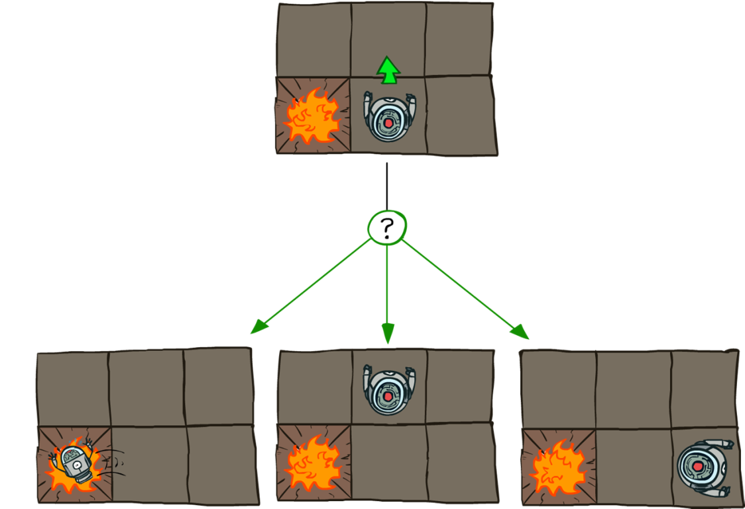
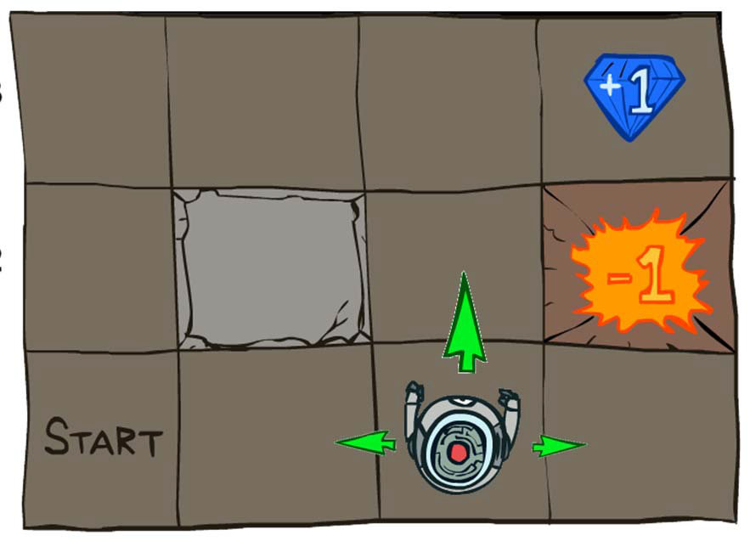
Grid world
Transition model:
0.1
0.8
0.1
R(s) = -0.04 for every non-terminal state
Source: P. Abbeel and D. Klein

Slide 8

Goal: Policy
Source: P. Abbeel and D. Klein

Slide 9
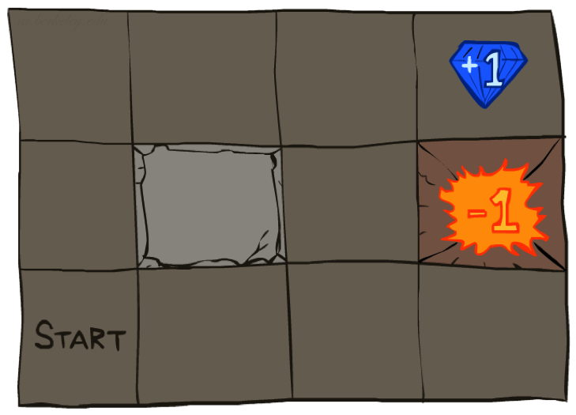




Example: Grid World
A maze-like problem
The agent lives in a grid
Walls block the agent’s path
Noisy movement: actions do not always go as planned
80% of the time, the action North takes the agent North (if there is no wall there)
10% of the time, North takes the agent West; 10% East
If there is a wall in the direction the agent would have been taken, the agent stays put
The agent receives rewards each time step
Small “living” reward each step (can be negative)
Big rewards come at the end (good or bad)
Goal: maximize sum of rewards
Notes:
[cut demo of moving around in grid world program]

Slide 10
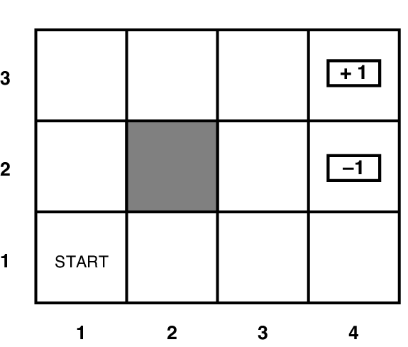
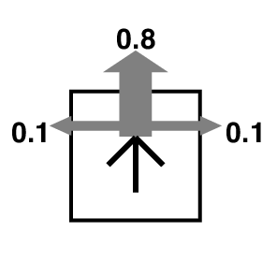
Grid world
Transition model:
R(s) = -0.04 for every non-terminal state

Slide 11
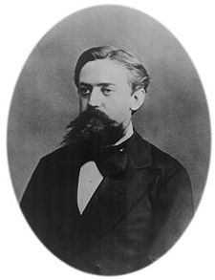

What is Markov about MDPs?
“Markov” generally means that given the present state, the future and the past are independent
For Markov decision processes, “Markov” means action outcomes depend only on the current state
This is just like search, where the successor function could only depend on the current state (not the history)
Andrey Markov (1856-1922)
Notes:
Like search: successor function only depended on current state
Can make this happen by stuffing more into the state;
Very similar to search problems: when solving a maze with food pellets, we stored which food pellets were eaten

Slide 12
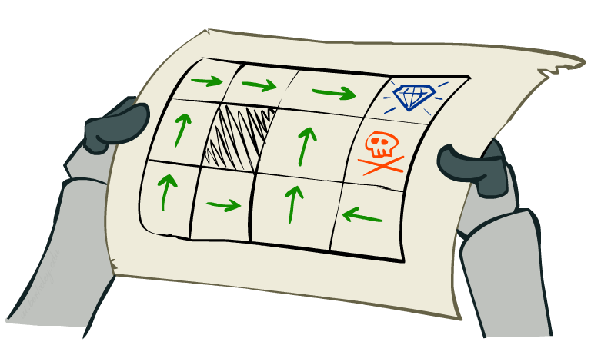
Policies
In deterministic single-agent search problems, we wanted an optimal plan, or sequence of actions, from start to a goal
For MDPs, we want an optimal policy π*: S → A
A policy π gives an action for each state
An optimal policy is one that maximizes expected utility if followed
Expectimax didn’t compute entire policies
It computed the action for a single state only
Optimal policy when R(s, a, s’) = -0.03 for all non-terminals s
Notes:
Dan has a DEMO for this.

Slide 13
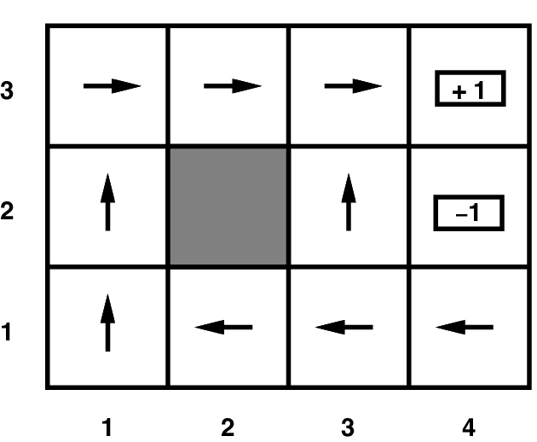
Grid world
Optimal policy when R(s) = -0.04 for every non-terminal state

Slide 14
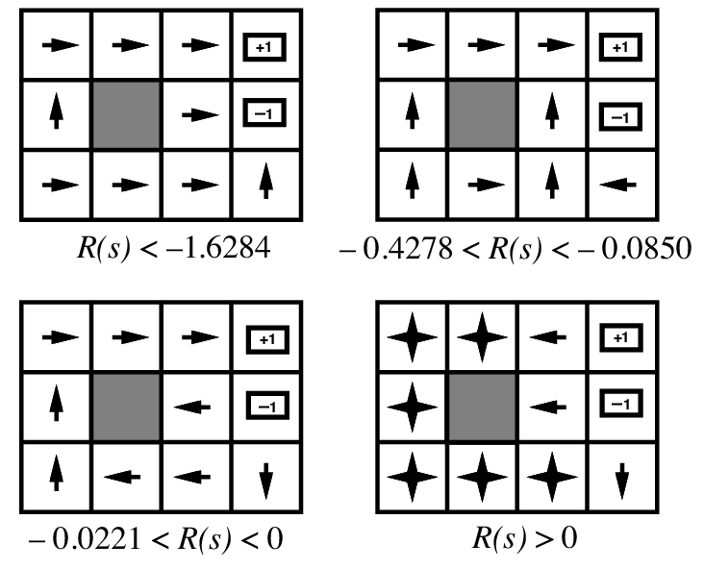
Grid world
Optimal policies for other values of R(s):

Slide 15
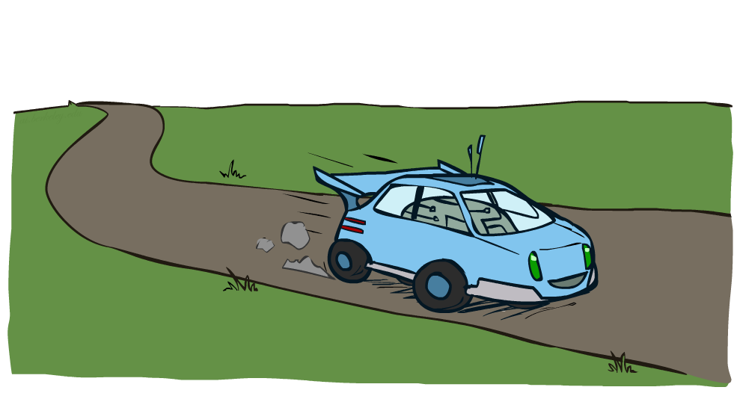
Another Example: Racing

Slide 16
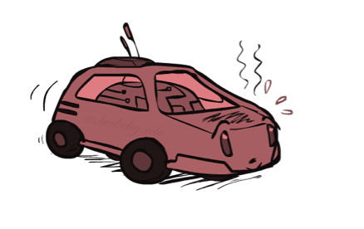
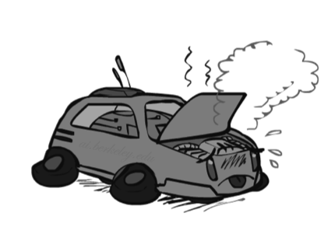

Example: Racing
A robot car wants to travel far, quickly
Three states: Cool, Warm, Overheated
Two actions: Slow, Fast
Going faster gets double reward
0.5
+1
1.0
Fast
Slow
-10
+1
0.5
Warm
Slow
Fast
0.5
+2
Cool
0.5
Overheated
+1
1.0
+2

Slide 17




Racing Search Tree

Slide 18
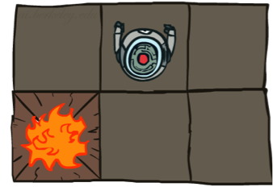
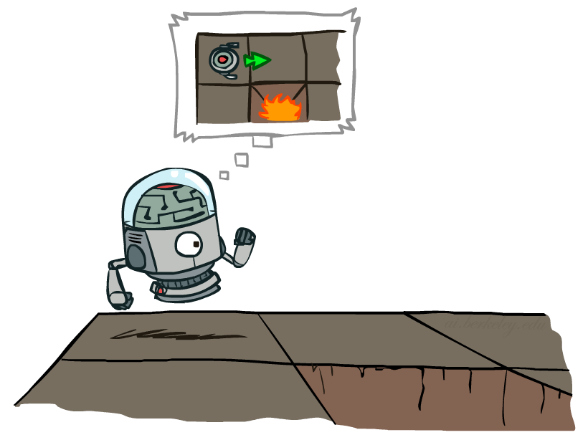

MDP Search Trees
Each MDP state projects an expectimax-like search tree
s
s is a state
a
(s, a) is a q-state
s, a
(s,a,s’) called a transition
T(s,a,s’) = P(s’|s,a)
R(s,a,s’)
s,a,s’
s’
Notes:
In MDP chance node represents uncertainty about what might happen based on (s,a) [as opposed to being a random adversary]
Q-state (s,a) is when you were in a state and took an action

Slide 19
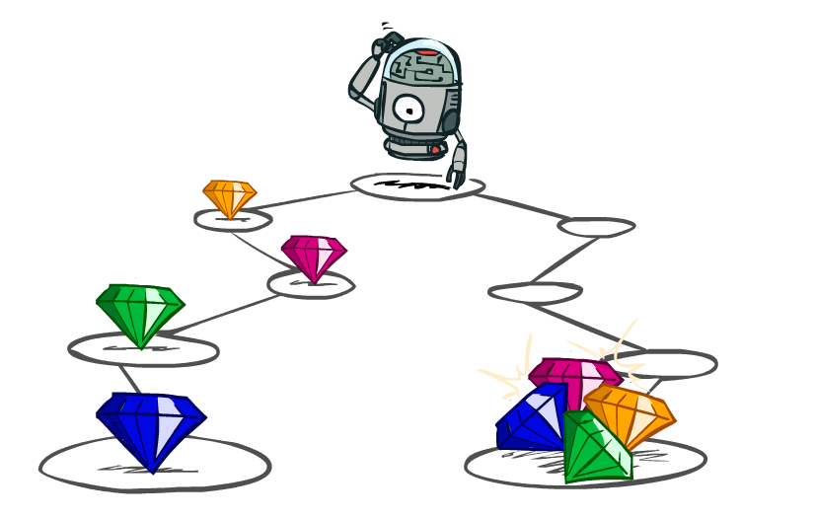
Utilities of Sequences

Slide 20
Utilities of Sequences
What preferences should an agent have over reward sequences?
More or less?
Now or later?
[1, 2, 2]
or
[2, 3, 4]
[0, 0, 1]
or
[1, 0, 0]

Slide 21
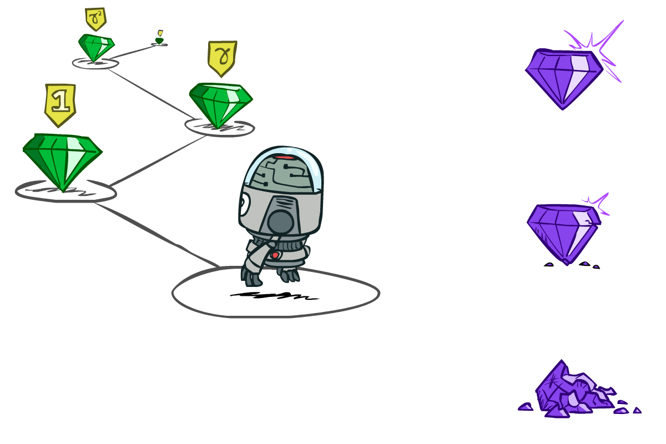

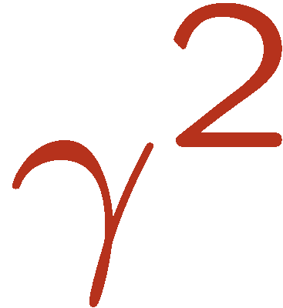

Discounting
It’s reasonable to maximize the sum of rewards
It’s also reasonable to prefer rewards now to rewards later
One solution: values of rewards decay exponentially
Worth Now
Worth Next Step
Worth In Two Steps

Slide 22

Discounting
How to discount?
Each time we descend a level, we multiply in the discount once
Why discount?
Sooner rewards probably do have higher utility than later rewards
Also helps our algorithms converge
Example: discount of 0.5
U([1,2,3]) = 1*1 + 0.5*2 + 0.25*3
U([1,2,3]) < U([3,2,1])
Notes:
Rewards in the future (deeper in the tree) matter less
Interesting: running expectimax, if having to truncate the search, then not losing much; e.g., less then \gamma^d / (1-\gamma)

Slide 23
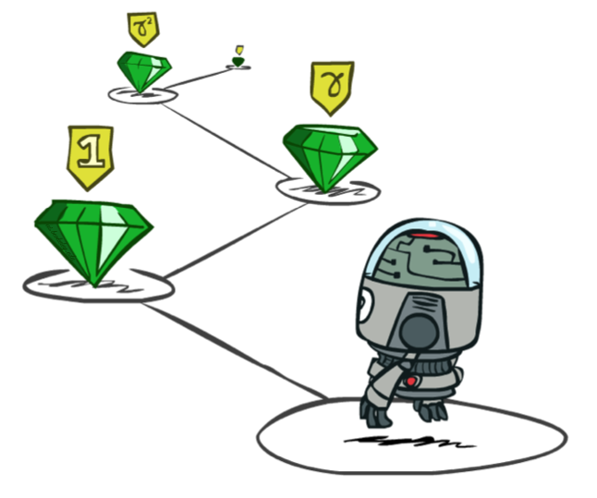
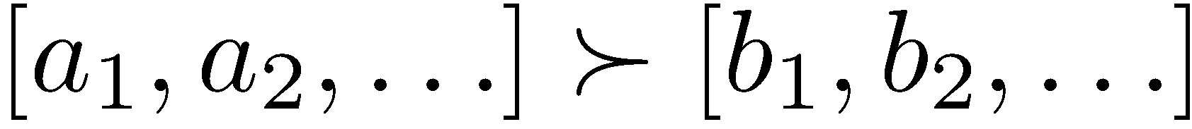
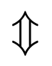
Stationary Preferences
Theorem: if we assume stationary preferences:
Then: there are only two ways to define utilities
Additive utility:
Discounted utility:

Slide 24


Quiz: Discounting
Given:
Actions: East, West, and Exit (only available in exit states a, e)
Transitions: deterministic
Quiz 1: For γ = 1, what is the optimal policy?
Quiz 2: For γ = 0.1, what is the optimal policy?

Slide 25

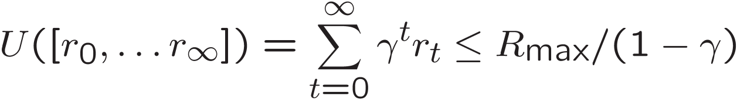
Infinite Utilities?!
Problem: What if the game lasts forever? Do we get infinite rewards?
Solutions:
Finite horizon: (similar to depth-limited search)
Terminate episodes after a fixed T steps (e.g. life)
Gives nonstationary policies (π depends on time left)
Discounting: use 0 < γ < 1
Smaller γ means smaller “horizon” – shorter term focus
Absorbing state: guarantee that for every policy, a terminal state will eventually be reached (like “overheated” for racing)

Slide 26
Recap: Defining MDPs
Markov decision processes:
Set of states S
Start state s₀
Set of actions A
Transitions P(s’|s,a) (or T(s,a,s’))
Rewards R(s,a,s’) (or R(s)) (and discount γ)
MDP quantities so far:
Policy = Choice of action for each state
Utility = sum of (discounted) rewards
s
a
s, a
s,a,s’
s’

Slide 27
Solving MDPs
MDP components:
States s
Actions a
Transition model P(s’ | s, a)
Reward function R(s)
The solution:
Policy π(s): mapping from states to actions
How to find the optimal policy?

Slide 28
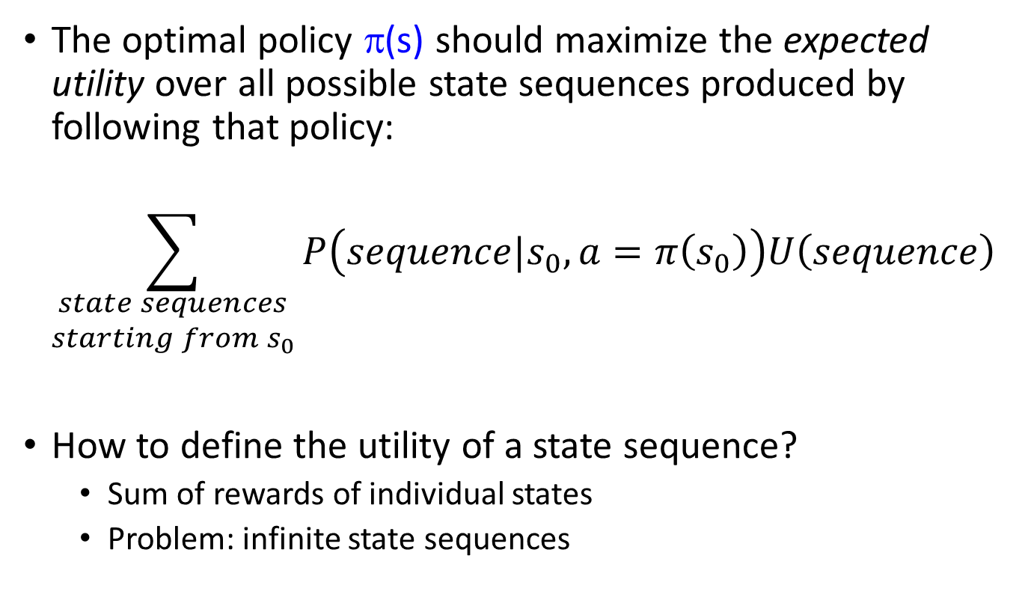
Maximizing expected utility
The optimal policy π(s) should maximize the expected utility over all possible state sequences produced by following that policy:
$$\sum_{\begin{aligned}state sequences \\ starting from s_{0}\end{aligned}}{P\left(sequence|s_{0},a=π\left(s_{0}\right)\right)U\left(sequence\right)}$$
How to define the utility of a state sequence?
Sum of rewards of individual states
Problem: infinite state sequences

Slide 29
Utilities of state sequences
Normally, we would define the utility of a state sequence as the sum of the rewards of the individual states
Problem: infinite state sequences
Solution: discount the individual state rewards by a factor γ between 0 and 1:
Sooner rewards count more than later rewards
Makes sure the total utility stays bounded
Helps algorithms converge

Slide 30
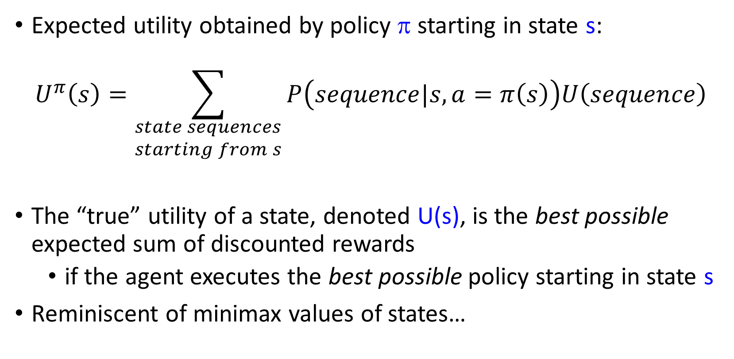
Utilities of states
Expected utility obtained by policy π starting in state s:
$$U^{π}\left(s\right)=\sum_{\begin{aligned}state sequences \\ starting from s\end{aligned}}{P\left(sequence|s,a=π\left(s\right)\right)U\left(sequence\right)}$$
The “true” utility of a state, denoted U(s), is the best possible expected sum of discounted rewards
if the agent executes the best possible policy starting in state s
Reminiscent of minimax values of states…

Slide 31
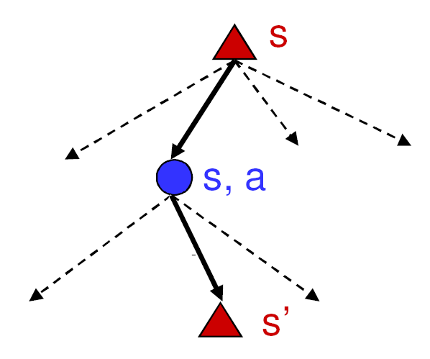
Finding the utilities of states
Max node
If state s’ has utility U(s’), then what is the expected utility of taking action a in state s?
How do we choose the optimal action?
Chance node
P(s’ | s, a)
U(s’)
What is the recursive expression for U(s) in terms of the utilities of its successor states?

Slide 32
The Bellman equation
Recursive relationship between the utilities of successive states:
Receive reward R(s)
Choose optimal action a
End up here with P(s’ | s, a)
Get utility U(s’)
(discounted by γ)

Slide 33
The Bellman equation
Recursive relationship between the utilities of successive states:
For N states, we get N equations in N unknowns
Solving them solves the MDP
Nonlinear equations -> no closed-form solution, need to use an iterative solution method (is there a globally optimum solution?)
We could try to solve them through expectiminimax search, but that would run into trouble with infinite sequences
Instead, we solve them algebraically
Two methods: value iteration and policy iteration

Slide 34
Method 1: Value iteration
Start out with every U(s) = 0
Iterate until convergence
During the ith iteration, update the utility of each state according to this rule:
In the limit of infinitely many iterations, guaranteed to find the correct utility values
Error decreases exponentially, so in practice, don’t need an infinite number of iterations…

Slide 35
Value iteration
What effect does the update have?

Slide 36
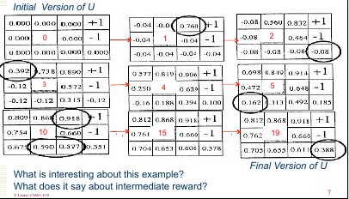
Value iteration
From http://mas.cs.umass.edu/classes/cs683/lectures-2010/Lec13_MDP2-F2010.pdf

Slide 37
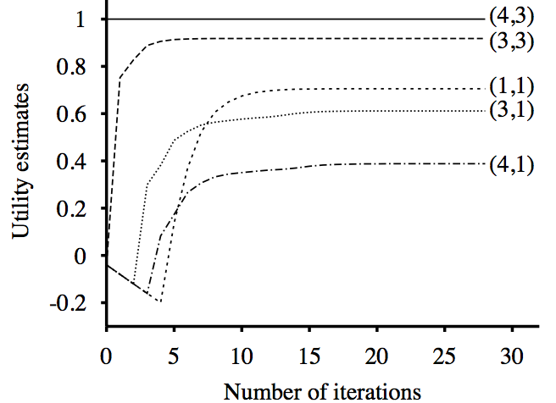
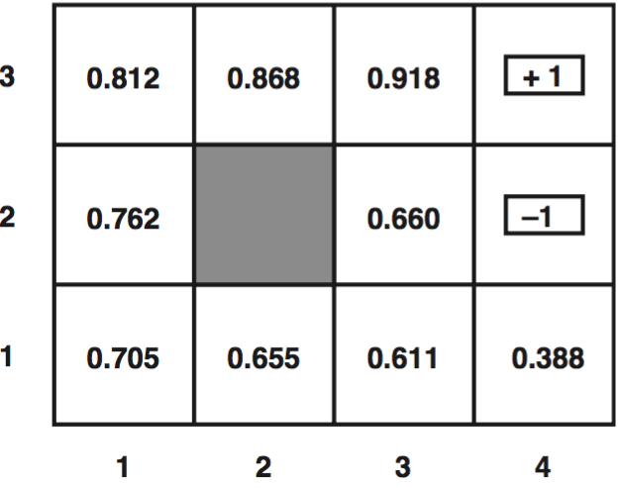
Value iteration
Input (non-terminal R=-0.04)
Utilities with discount factor 1
Final policy

Slide 38
Method 2: Policy iteration
Start with some initial policy π₀ and alternate between the following steps:
Policy evaluation: calculate U^{πi}(s) for every state s
Policy improvement: calculate a new policy π_{i+1} based on the updated utilities
Notice it’s kind of like hill-climbing in the N-queens problem.
Policy evaluation: Find ways in which the current policy is suboptimal
Policy improvement: Fix those problems
Unlike Value Iteration, this is guaranteed to converge in a finite number of steps, as long as the state space and action set are both finite.

Slide 39

Method 2, Step 1: Policy evaluation
Given a fixed policy π, calculate U^{π}(s) for every state s
π(s) is fixed, therefore $P(s^{′}|s,π\left(s\right))$ is an $s’×s$ matrix, therefore we can solve a linear equation to get U^{π}(s)!
Why is this “Policy Evaluation” formula so much easier to solve than the original Bellman equation?

Slide 40
Method 2, Step 2: Policy improvement
Given U^{π}(s) for every state s, find an improved π(s)

Slide 41
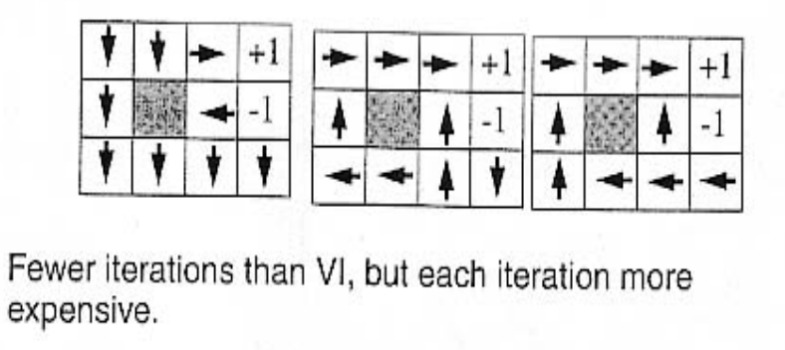
Policy iteration
From http://mas.cs.umass.edu/classes/cs683/lectures-2010/Lec13_MDP2-F2010.pdf

Slide 42
Summary
MDP defined by states, actions, transition model, reward function
The “solution” to an MDP is the policy: what do you do when you’re in any given state
The Bellman equation tells the utility of any given state, and incidentally, also tells you the optimum policy. The Bellman equation is N nonlinear equations in N unknowns (the policy), therefore it can’t be solved in closed form.
Value iteration:
At the beginning of the (i+1)’st iteration, each state’s value is based on looking ahead i steps in time
… so finding the best action = optimize based on (i+1)-step lookahead
Policy iteration:
Find the utilities that result from the current policy,
Improve the current policy

