Slide 1
Deep Learning ch 21 Russell and Norvig

Slide 2
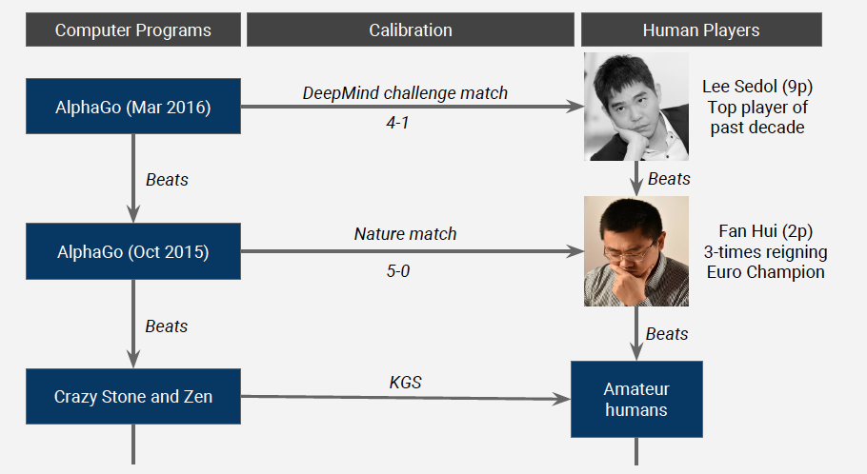
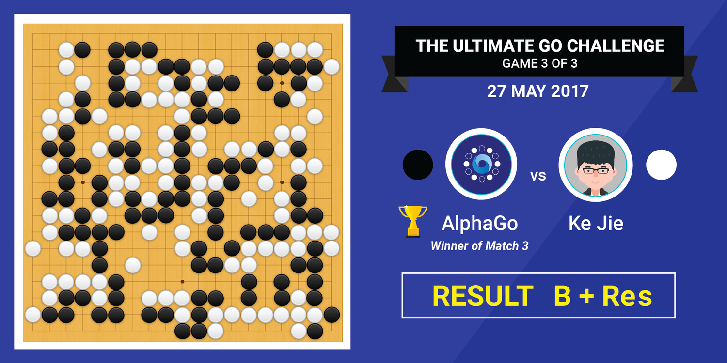
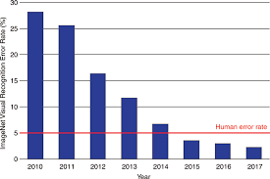
Deep Neural Networks Applications
Image Classification

Slide 3
Deep Learning
Hypothesis take the for of algebraic circuits with tunable connections strengths.
“Deep” means this circuits can be organized into many layers
Most widely used approach for:
Visual object recognition
Machine translation
Speech recognition
Speech synthesis
Image synthesis
Also used in Reinforcement Learning

Slide 4
Very loose inspiration: Human neurons

Slide 5
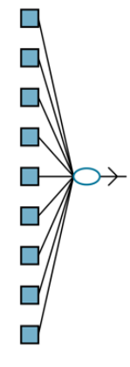
Advantages over Linear Methods
Reasons of success of deep learning is an active area of research.
Has advantages over some of the methods covered in Chapter 19 particularly for high-dimensional data such as images.
Linear and logistic regression can handle a large number of input variables, the computation path from each input to the output is very short: multiplication by a single weight, then adding into the aggregate output.
Moreover, the different input variables contribute independently to the output, without interacting with each other
Limits the expressivity, only linear functions, real-world concepts are more complex.
Notes:
other (Figure 21.1(a) ). This significantly limits the expressive power of such models. They can represent only linear functions and boundaries in the input space, whereas most real-world concepts are far more complex.

Slide 6
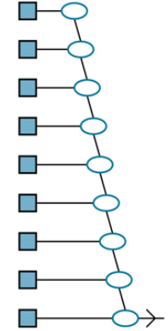
Advantages over Decision Trees
Decision trees allow for long computation paths that can depend on many input variables—but only for a relatively small fraction of the possible input vectors.
If a decision tree has long computation paths for a significant fraction of the possible inputs, it must be exponentially large in the number of input variables.
Notes:
other (Figure 21.1(a) ). This significantly limits the expressive power of such models. They can represent only linear functions and boundaries in the input space, whereas most real-world concepts are far more complex.

Slide 7
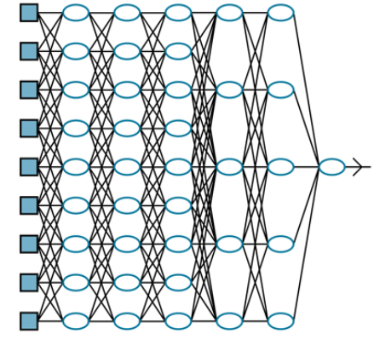
Deep Neural Networks
The basic idea of deep learning is to train circuits such that the computation paths are long, allowing all the input variables to interact in complex ways
These circuit models turn out to be sufficiently expressive to capture the complexity of real-world data for many important kinds of learning problems.
Notes:
other (Figure 21.1(a) ). This significantly limits the expressive power of such models. They can represent only linear functions and boundaries in the input space, whereas most real-world concepts are far more complex.

Slide 8
21.1 Simple Feedforward Networks
A feedforward network, has connections only in one direction (directed acyclic graph with designated input and output nodes).
Each node computes a function of its inputs and passes the result to its successors in the network.
Information flows through the network from the input nodes to the output nodes, and there are no loops.

Slide 9
Simple model of a neuron (McCulloch & Pitts, 1943)
Inputs a_{i} come from the output of node i to this node j (or from “outside”)
Each input link has a weight w_{i,j}
There is an additional fixed input a₀ with bias weight w_{0,j}
The total input is in_{j} = Σ_{i} w_{i,j} a_{i}
The output is a_{j} = g(in_{j}) = g(Σ_{i} w_{i,j} a_{i}) = g(w.a)
Notes:
fix notation: x, a, h, etc, explain bias

Slide 10
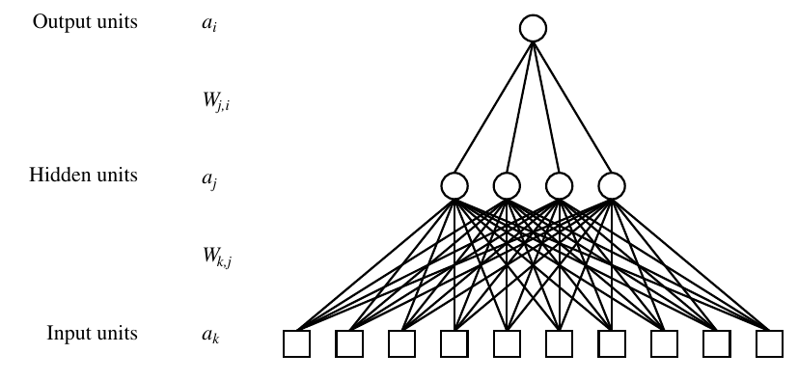
Neural Networks Properties
Theorem (Universal Function Approximators). A two-layer neural network with a sufficient number of neurons can approximate any continuous function to any desired accuracy.
Practical considerations
Can be seen as learning the features
Large number of neurons
Danger for overfitting

Slide 11
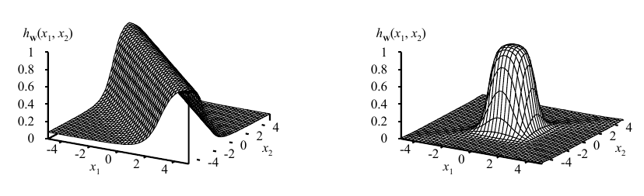
Expressiveness of Neural Networks
All continuous functions w/ 2 layers, all functions w/ 3 layers
Combine two opposite-facing threshold functions to make a ridge
Combine two perpendicular ridges to make a bump
Add bumps of various sizes and locations to fit any surface
Proof requires exponentially many hidden

Slide 12
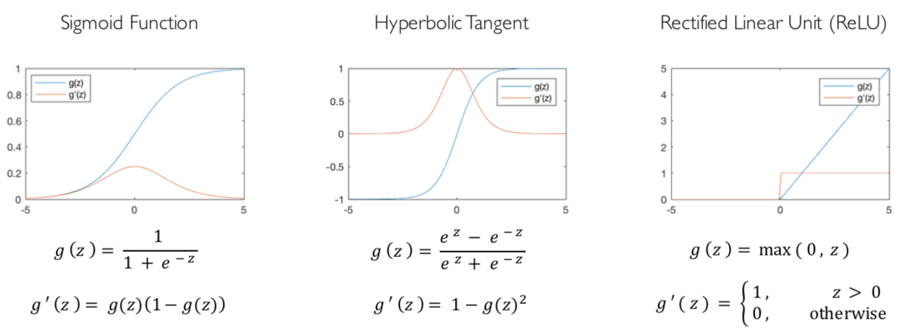
Common Activation Functions
[source: MIT 6.S191 introtodeeplearning.com]

Slide 13
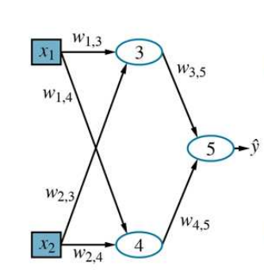
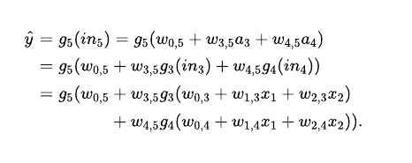
Combining Units
Represents a function parameterized by weights w, that maps a two-element input vector x to a scalar output value ŷ . The internal

Slide 14
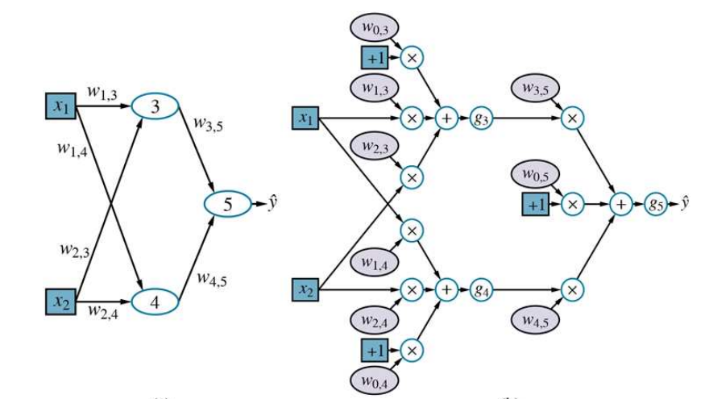
Computation Tree

Slide 15
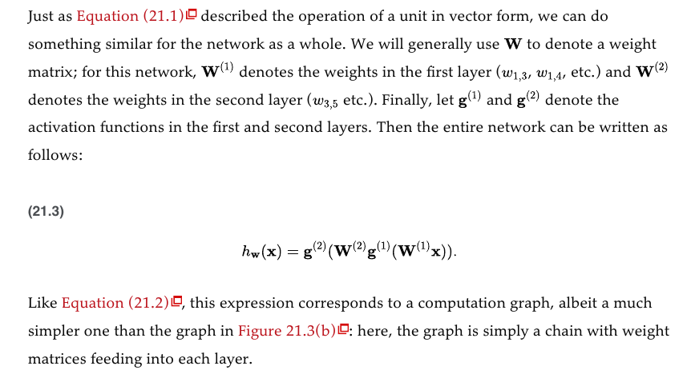
Extending the notation

