Slide 1
Deep Learning Part II ch 21 Russell and Norvig
Including Slides by
Mark Hasegawa-Johnson, 4/2019
Svetlana Lazebnik, 10/2016
From UIUC CS 440

Slide 2
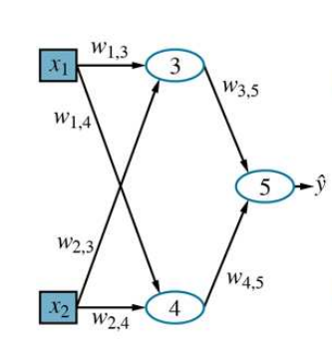
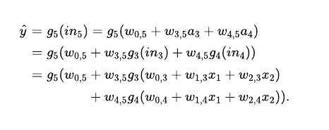
Combining Units
Represents a function parameterized by weights w, that maps a two-element input vector x to a scalar output value ŷ . The internal

Slide 3
Gradients and Learning (21.2)
In Section 19.6 gradient descent: calculate the gradient of the loss function with respect to the weights and adjust the weights along the gradient direction to reduce the loss.
Same approach to learning the weights in computation graphs
For the weights leading into units in the output layer, the gradient calculation is essentially identical to the process in Section 19.6.
For weights leading into units in the hidden layers (not directly connected to the outputs) process is only slightly more complicated.

Slide 4
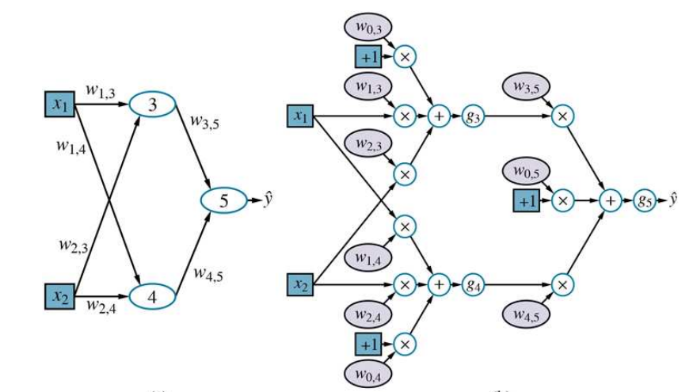
Neural Network Example

Slide 5

Gradients and Learning
For now, we will use the squared loss function, L₂, and we will calculate the gradient for the network in the with respect to a single training example (x,y).
The network outputs a prediction ŷ = h_{w} (x) and the true value is y, so we have
We need the chain rule:

Slide 6
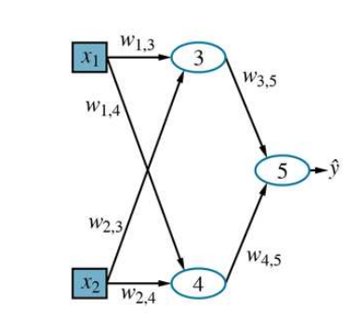
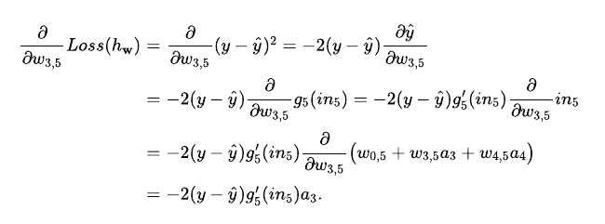
Weight connected output unit

Slide 7
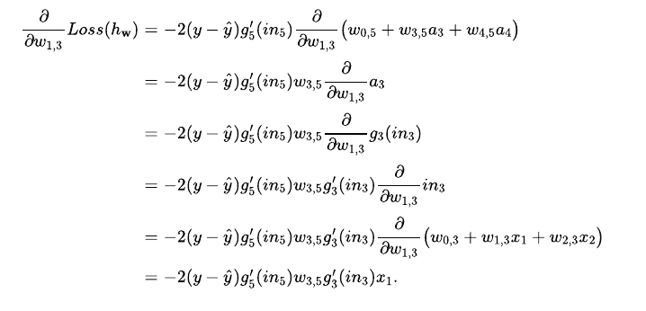
Weight not connected to output unit

Slide 8
21.2 Computation Graphs for Deep Learning
Key ideas so far:
Represent hypotheses as computation graphs with tunable weights
Compute the gradient of the loss function with respect to those weights in order to fit the training data.
How to put together computation graphs?
First the input layer, which is where the training or test example x is encoded as values of the input nodes.
Then the output layer, where outputs ŷ are compared with the true values y to derive a learning signal fortuning the weights.
Finally, we look at the hidden layers of the network.
Combine two opposite-facing threshold functions to make a ridge
Combine two perpendicular ridges to make a bump
Add bumps of various sizes and locations to fit any surface
Proof requires exponentially many hidden

Slide 9
Input encoding
If the attributes are Boolean, we have n input nodes; usually false is mapped to an input of 0 and true is mapped to 1, although sometimes −1 and +1
Numeric attributes, whether integer or real-valued, are typically used as is, although they may be scaled to fit within a fixed range; if the magnitudes for different examples vary enormously, the values can be mapped onto a log scale.
Categorical attributes with more than two values—like the Type attribute in the restaurant problem, which has values French, Italian, Thai, or burger)—are usually encoded using the so-called one-hot encoding. An attribute with d possible values is represented by d separate input bits. For any given value, the corresponding input bit is set to 1 and all the others are set to 0.
We will cover images in detail in 21.3
Notes:
other (Figure 21.1(a) ). This significantly limits the expressive power of such models. They can represent only linear functions and boundaries in the input space, whereas most real-world concepts are far more complex.

Slide 10
Output layers and loss functions
Data y encoding output nodes of the graph is much the same as the input encoding problem. For example, if the network is trying to predict the Weather variable from Chapter 12, which has values {sun, rain, cloud, snow}, we would use a one-hot encoding with four bits.
What about the prediction ŷ? Ideally, it would exactly match the desired value y , and the loss would be zero, and we’d be done. In practice, this seldom happen. Take a look to the discussion on 22.2.1
Notes:
other (Figure 21.1(a) ). This significantly limits the expressive power of such models. They can represent only linear functions and boundaries in the input space, whereas most real-world concepts are far more complex.

Slide 11
Hidden Layers
In training a neural network is shown many input values x and many corresponding output values y. While processing an input vector x, the neural network performs several intermediate computations before producing the output y.
Think of the values computed at each layer of the network as a different representation for the input x.
Each layer transforms the representation produced by the preceding layer to produce a new representation.
The composition of all these transformations succeeds in transforming the input into the desired output
One hypothesis for why deep learning works well is that the complex end-to-end transformation that maps from input to output—say, from an input image to the output category “giraffe”—is decomposed by the many layers into the composition of many relatively simple transformations, each of which is fairly easy to learn by a local updating process.
Notes:
other (Figure 21.1(a) ). This significantly limits the expressive power of such models. They can represent only linear functions and boundaries in the input space, whereas most real-world concepts are far more complex.

Slide 12
Hidden Layers
In the process of forming all these internal transformations, deep networks often discover meaningful intermediate representations of the data.
For example, a network learning to recognize complex objects in images may form internal layers that detect useful subunits: edges, corners, ellipses, eyes, faces—cats.
Or it may not—deep networks may form internal layers whose meaning is opaque to humans, even though the output is still correct. This is a big disadvantage of Deep Neural Networks
Notes:
other (Figure 21.1(a) ). This significantly limits the expressive power of such models. They can represent only linear functions and boundaries in the input space, whereas most real-world concepts are far more complex.

Slide 13
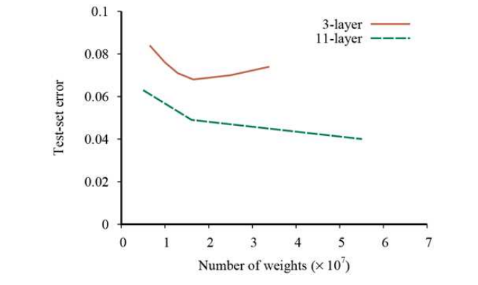
Hidden Layers
The hidden layers typically less diverse than the output layers.
First 25 years of research with multilayer networks (roughly 1985–2010), internal nodes used sigmoid and tanh
From 2010 onwards, the ReLU and softplus become more popular.
Experimentation with deep networks suggested that better learning was obtained with deep and relatively narrow networks rather than shallow, wide networks, given a fixed total number of weights.
Notes:
other (Figure 21.1(a) ). This significantly limits the expressive power of such models. They can represent only linear functions and boundaries in the input space, whereas most real-world concepts are far more complex.

