Slide 1
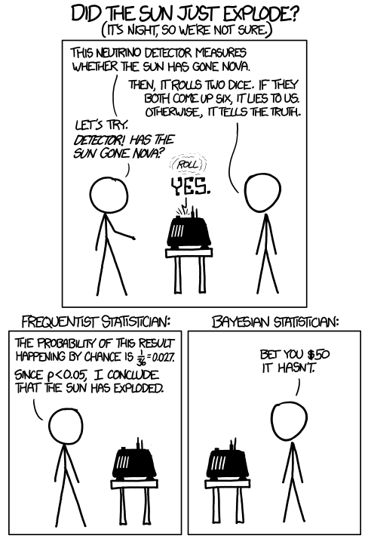
Bayesian Inference and Bayesian Learning
Slides by Svetlana Lazebnik, 10/2016
Modified by Mark Hasegawa-Johnson, 3/2019
Modified by Leonardo Bobadilla

Slide 2
Bayesian Inference and Bayesian Learning
Bayes Rule
Bayesian Inference
Misdiagnosis
The Bayesian “Decision”
The “Naïve Bayesian” Assumption
Bag of Words (BoW)
Bayesian Learning
Maximum Likelihood estimation of parameters
Maximum A Posteriori estimation of parameters
Laplace Smoothing

Slide 3
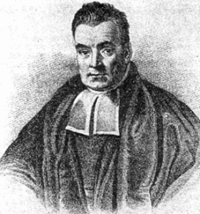
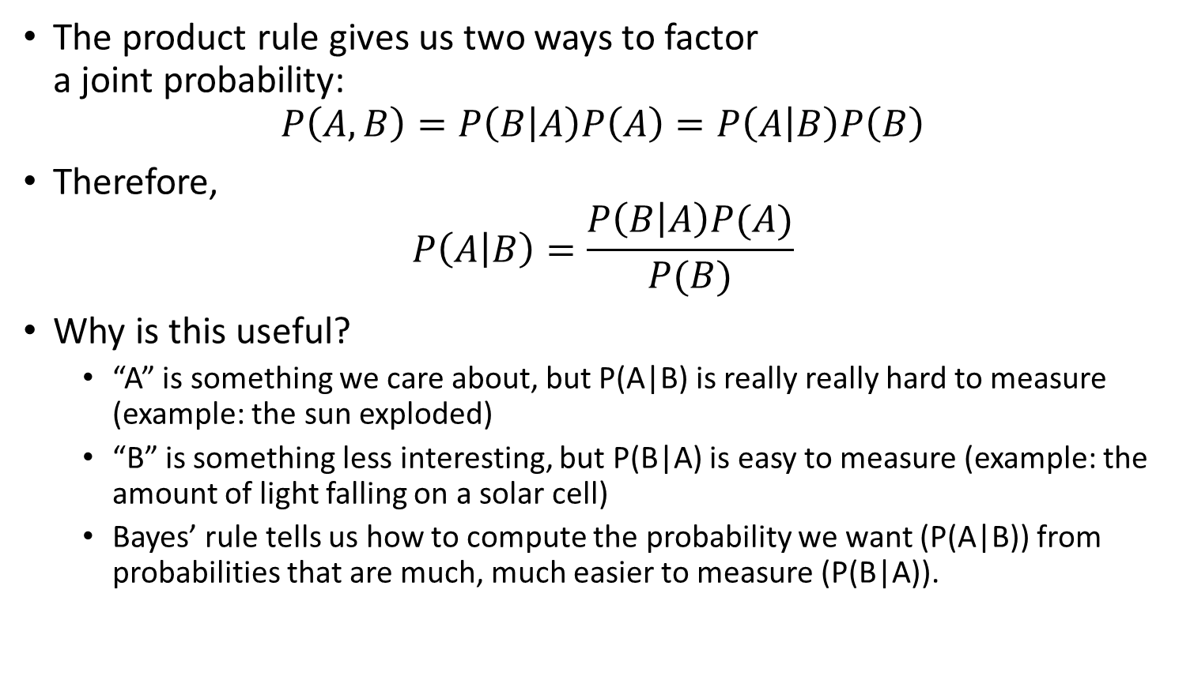
Bayes’ Rule
Rev. Thomas Bayes (1702-1761)
The product rule gives us two ways to factor a joint probability:
$$P\left(A,B\right)=P\left(B | A\right)P\left(A\right)=P\left(A | B\right)P\left(B\right)$$
Therefore,
$$P\left(A | B\right)=\frac{P\left(B | A\right)P(A)}{P(B)}$$
Why is this useful?
“A” is something we care about, but P(A|B) is really really hard to measure (example: the sun exploded)
“B” is something less interesting, but P(B|A) is easy to measure (example: the amount of light falling on a solar cell)
Bayes’ rule tells us how to compute the probability we want (P(A|B)) from probabilities that are much, much easier to measure (P(B|A)).
Notes:
A: some unobservable aspect of the world that we are trying to predict (query variable)
B: observable evidence

Slide 4
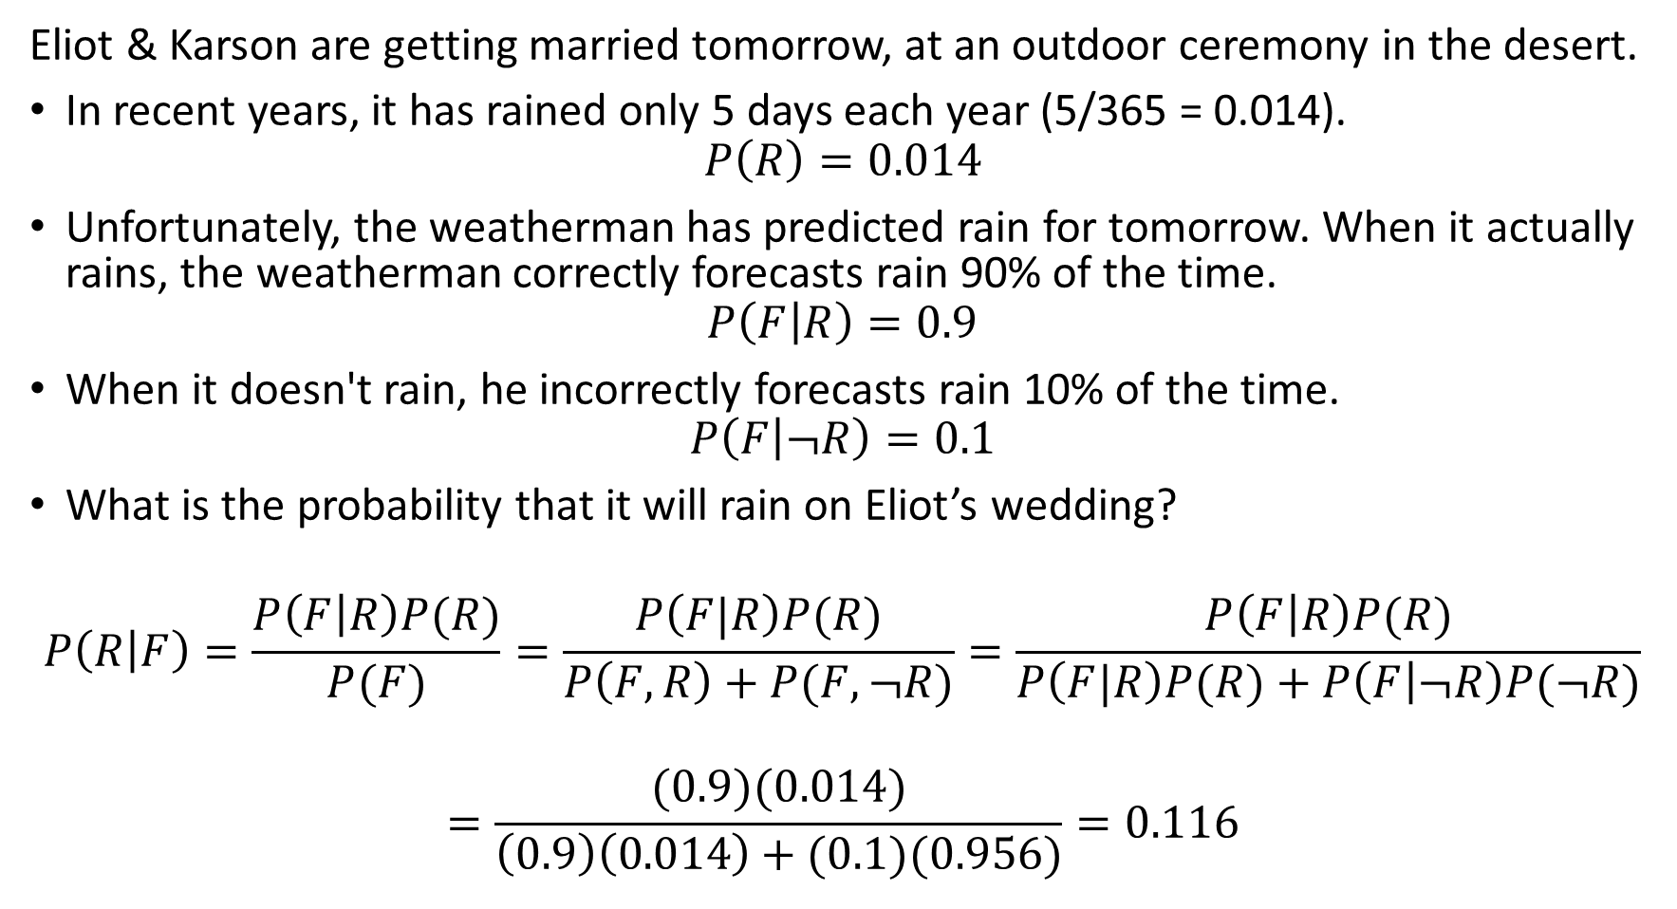
Bayes Rule example
Eliot & Karson are getting married tomorrow, at an outdoor ceremony in the desert.
In recent years, it has rained only 5 days each year (5/365 = 0.014).
$$P\left(R\right)=0.014$$
Unfortunately, the weatherman has predicted rain for tomorrow. When it actually rains, the weatherman correctly forecasts rain 90% of the time.
$$P\left(F | R\right)=0.9$$
When it doesn't rain, he incorrectly forecasts rain 10% of the time.
$$P\left(F | ¬R\right)=0.1$$
What is the probability that it will rain on Eliot’s wedding?
$$P\left(R | F\right)=\frac{P\left(F | R\right)P(R)}{P(F)}=\frac{P\left(F|R\right)P(R)}{P\left(F,R\right)+P(F,¬R)}=\frac{P\left(F | R\right)P(R)}{P\left(F|R\right)P(R)+P\left(F | ¬R\right)P(¬R)}$$
$$=\frac{(0.9)(0.014)}{\left(0.9\right)\left(0.014\right)+(0.1)(0.956)}=0.116$$

Slide 5
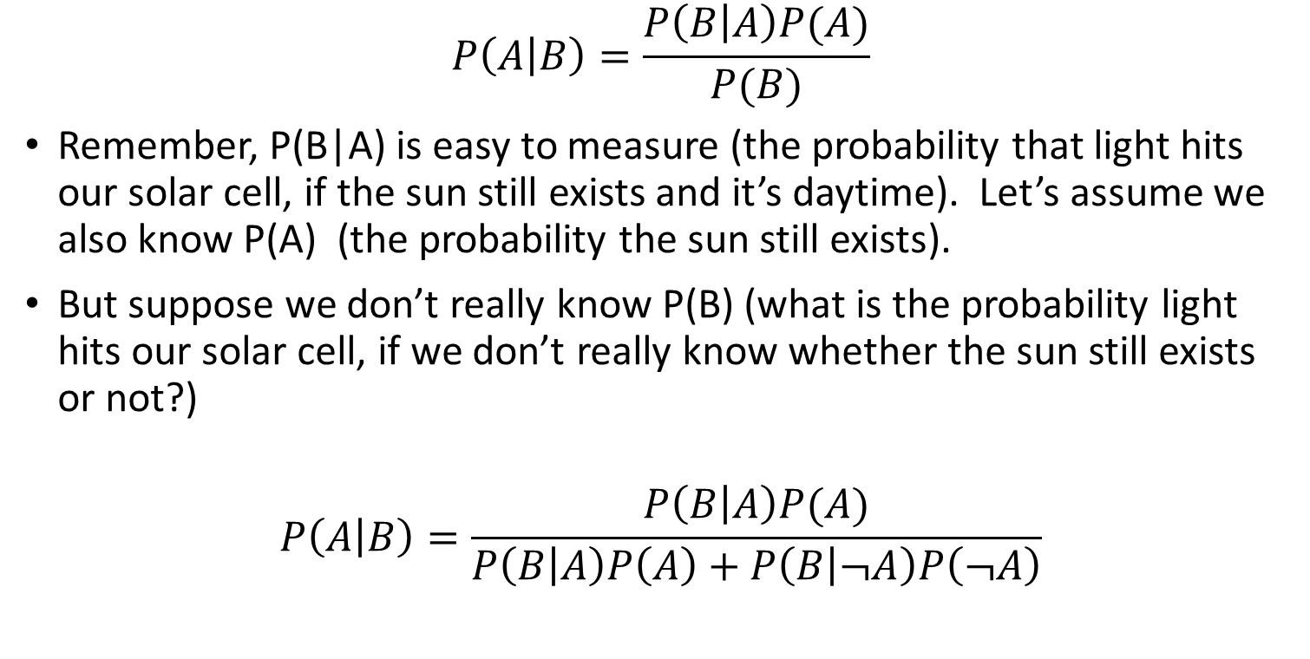
The More Useful Version of Bayes’ Rule
Rev. Thomas Bayes (1702-1761)
This version is what you
memorize.
$$P\left(A | B\right)=\frac{P\left(B | A\right)P(A)}{P(B)}$$
Remember, P(B|A) is easy to measure (the probability that light hits our solar cell, if the sun still exists and it’s daytime). Let’s assume we also know P(A) (the probability the sun still exists).
But suppose we don’t really know P(B) (what is the probability light hits our solar cell, if we don’t really know whether the sun still exists or not?)
$$P\left(A | B\right)=\frac{P\left(B | A\right)P(A)}{P\left(B | A\right)P\left(A\right)+P\left(B | ¬A\right)P\left(¬A\right)}$$
This version is what you
actually use.
Notes:
A: some unobservable aspect of the world that we are trying to predict (query variable)
B: observable evidence

Slide 6
Bayesian Inference and Bayesian Learning
Bayes Rule
Bayesian Inference
Misdiagnosis
The Bayesian “Decision”
The “Naïve Bayesian” Assumption
Bag of Words (BoW)
Bayesian Learning
Maximum Likelihood estimation of parameters
Maximum A Posteriori estimation of parameters
Laplace Smoothing

Slide 7
The Misdiagnosis Problem
1% of women at age forty who participate in routine screening have breast cancer. 80% of women with breast cancer will get positive mammographies. 9.6% of women without breast cancer will also get positive mammographies. A woman in this age group had a positive mammography in a routine screening. What is the probability that she actually has breast cancer?

Slide 9

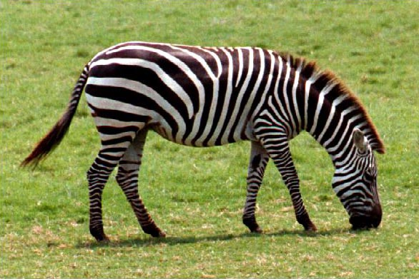
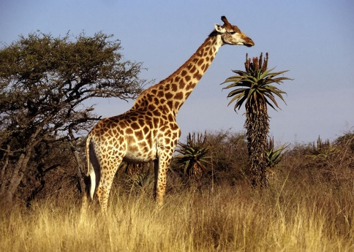
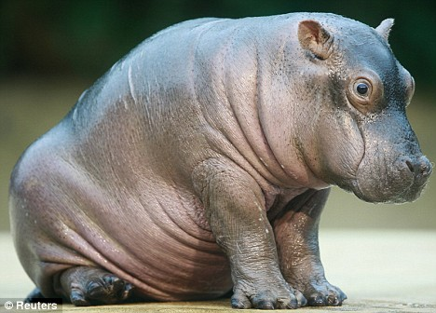
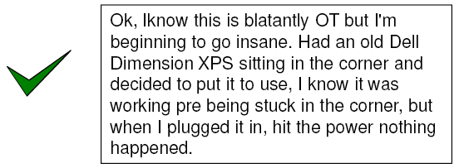
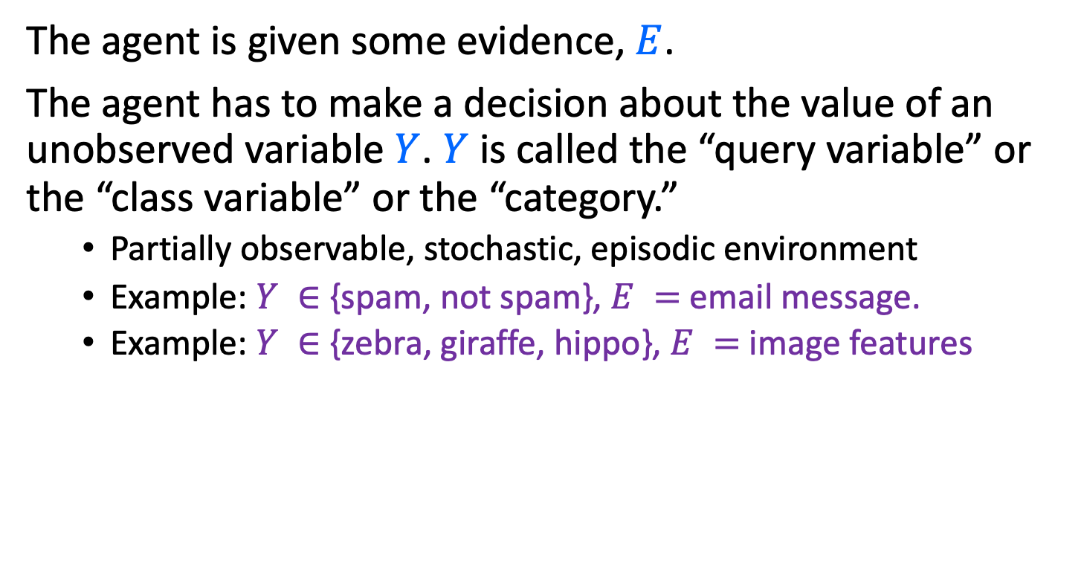
The Bayesian Decision
The agent is given some evidence, $E$.
The agent has to make a decision about the value of an unobserved variable $Y$. $Y$ is called the “query variable” or the “class variable” or the “category.”
Partially observable, stochastic, episodic environment
Example: $Y ∈$ {spam, not spam}, $E =$ email message.
Example: $Y ∈$ {zebra, giraffe, hippo}, $E =$ image features
Notes:
Expected loss of a decision: P(decision is correct) * 0 + P(decision is wrong) * 1

Slide 10
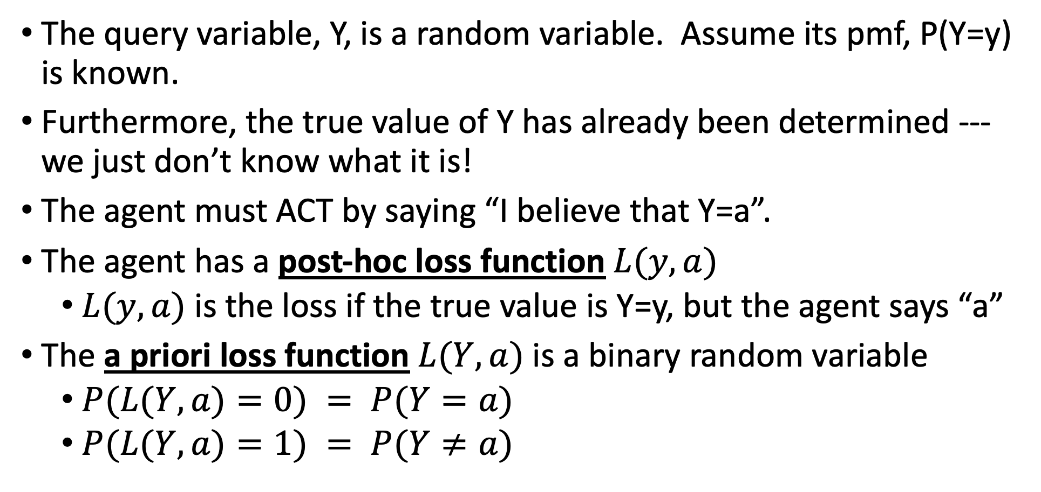
The Bayesian Decision: Loss Function
The query variable, Y, is a random variable. Assume its pmf, P(Y=y) is known.
Furthermore, the true value of Y has already been determined --- we just don’t know what it is!
The agent must ACT by saying “I believe that Y=a”.
The agent has a post-hoc loss function $L(y,a)$
$L(y,a)$ is the loss if the true value is Y=y, but the agent says “a”
The a priori loss function $L(Y,a)$ is a binary random variable
$P(L(Y,a)=0) = P(Y=a)$
$P(L(Y,a)=1) = P(Y≠a)$
Notes:
Expected loss of a decision: P(decision is correct) * 0 + P(decision is wrong) * 1

Slide 11
Loss Function Example
Suppose Y=outcome of a coin toss.
The agent will choose the action “a” (which is either a=heads, or a=tails)
The loss function L(y,a) is
Suppose we know that the coin is biased, so that P(Y=heads)=0.6. Therefore the agent chooses a=heads. The loss function L(Y,a) is now a random variable:
L(y,a) | y=heads | y=tails
a=heads | 0 | 1
a=tails | 1 | 0
 | c=0 | c=1
P(L(Y,a)=c) | 0.6 | 0.4
Notes:
Expected loss of a decision: P(decision is correct) * 0 + P(decision is wrong) * 1

Slide 12
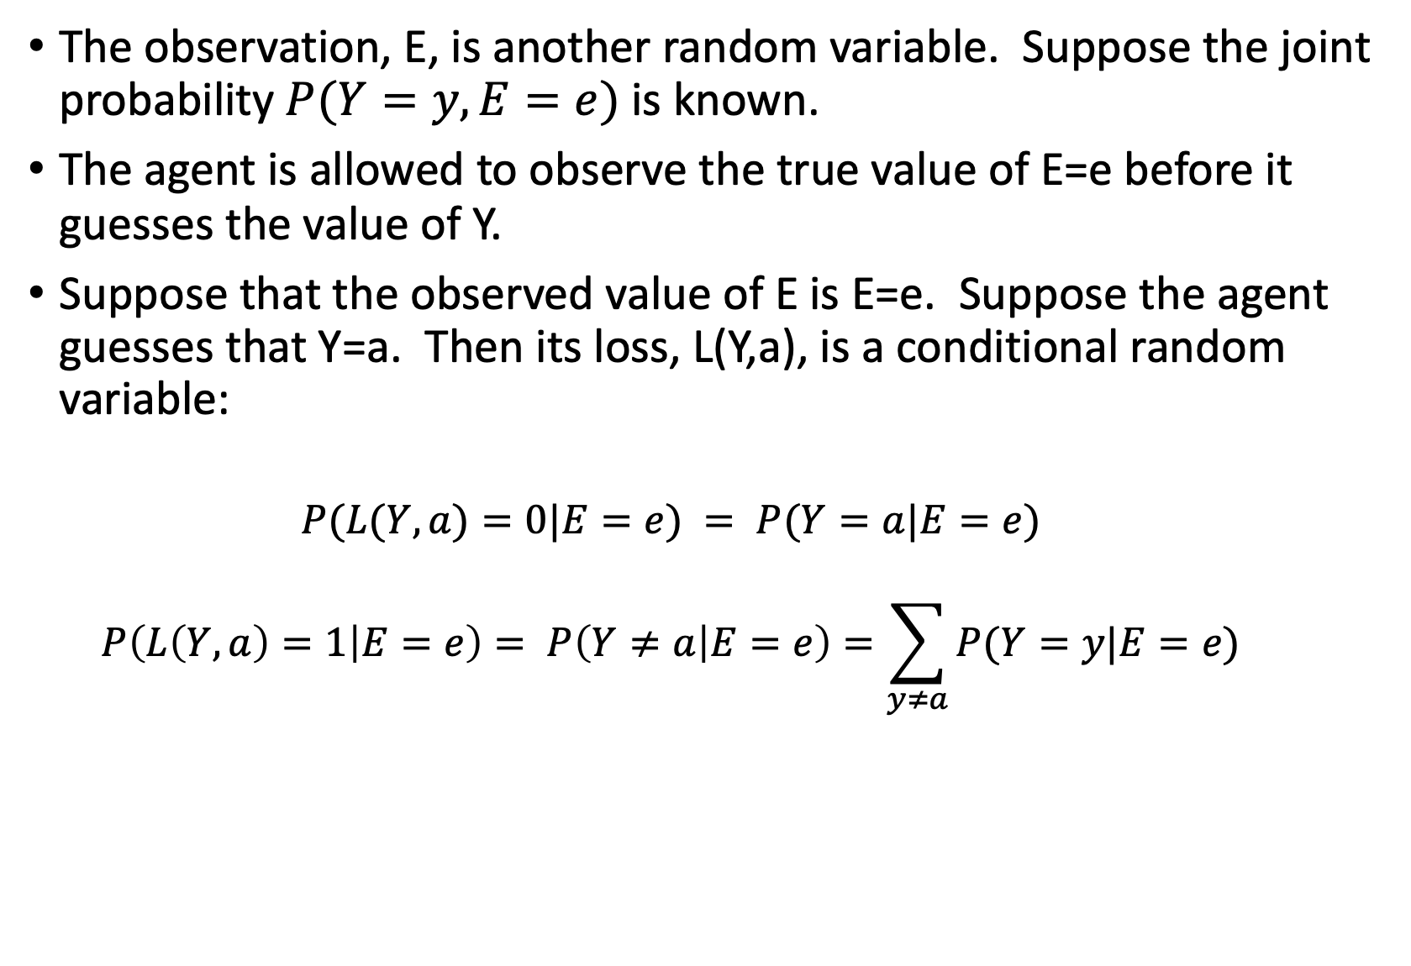
The Bayesian Decision
The observation, E, is another random variable. Suppose the joint probability $P(Y=y,E=e)$ is known.
The agent is allowed to observe the true value of E=e before it guesses the value of Y.
Suppose that the observed value of E is E=e. Suppose the agent guesses that Y=a. Then its loss, L(Y,a), is a conditional random variable:
$$P(L(Y,a)=0|E=e) = P(Y=a|E=e)$$
$$P\left(L\left(Y,a\right)=1 | E=e\right)= P\left(Y≠a | E=e\right)=\sum_{y≠a}{P(Y=y|E=e)}$$
Notes:
Expected loss of a decision: P(decision is correct) * 0 + P(decision is wrong) * 1

Slide 13
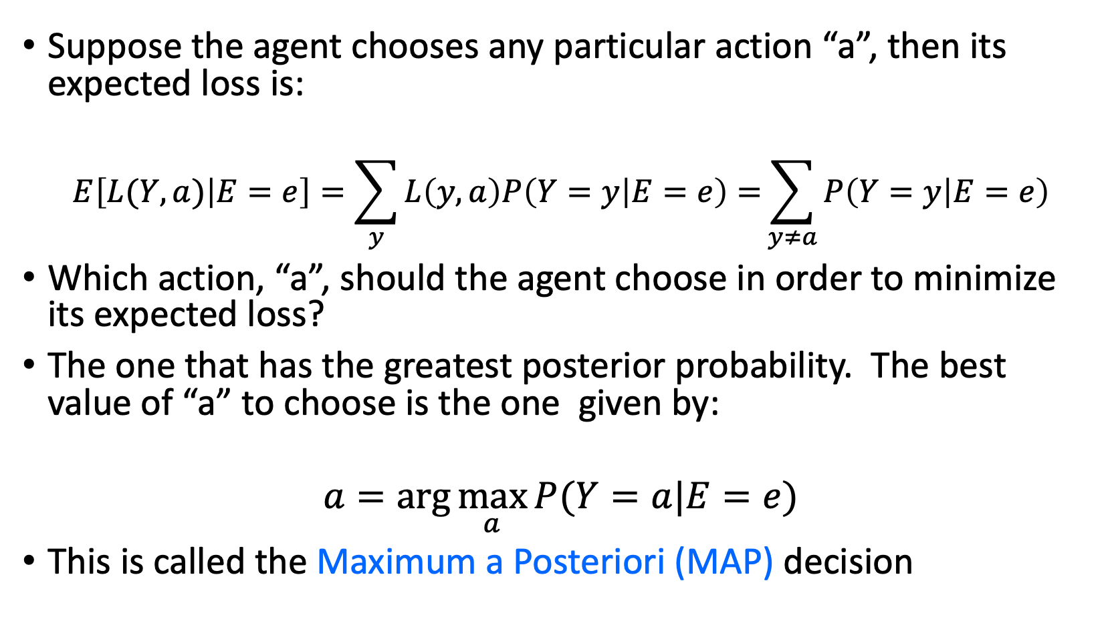
The Bayesian Decision
Suppose the agent chooses any particular action “a”, then its expected loss is:
$$E\left[L(Y,a) | E=e\right]=\sum_{y}{L\left(y,a\right)P\left(Y=y | E=e\right)=}\sum_{y≠a}{P\left(Y=y | E=e\right)}$$
Which action, “a”, should the agent choose in order to minimize its expected loss?
The one that has the greatest posterior probability. The best value of “a” to choose is the one given by:
$$a=arg\max_{a}{P(Y=a|E=e)}$$
This is called the Maximum a Posteriori (MAP) decision
Notes:
Expected loss of a decision: P(decision is correct) * 0 + P(decision is wrong) * 1

Slide 14
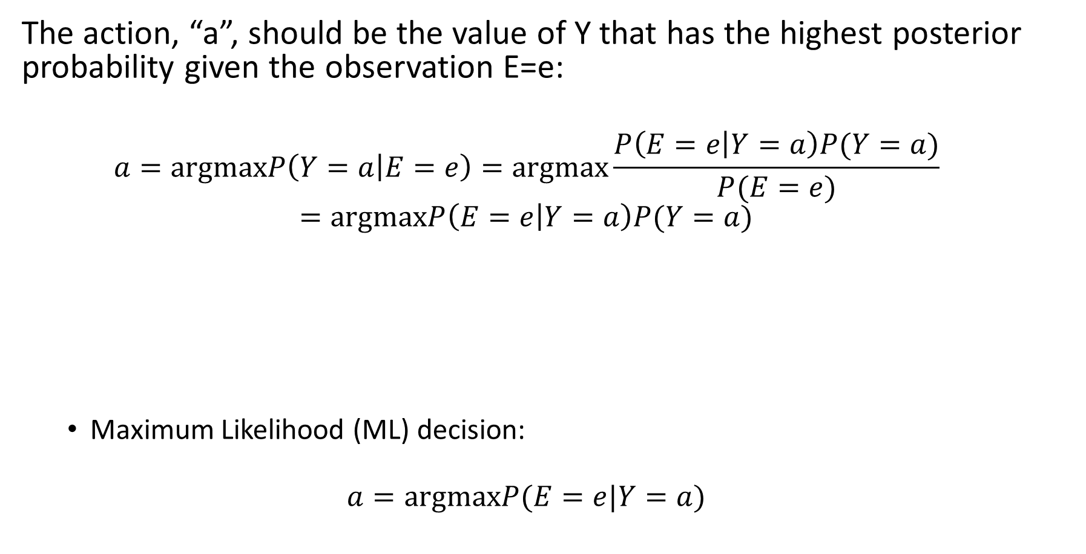
MAP decision
The action, “a”, should be the value of Y that has the highest posterior probability given the observation E=e:
$$a=argmaxP\left(Y=a | E=e\right)=argmax\frac{P\left(E=e | Y=a\right)P(Y=a)}{P(E=e)}$$
$$=argmaxP\left(E=e | Y=a\right)P(Y=a)$$
Maximum Likelihood (ML) decision:
$$a=argmaxP(E=e|Y=a)$$
$$P\left(Y=a | E=e\right)∝P\left(E=e | Y=a\right)P(Y=a)$$
posterior
likelihood
prior
Notes:
Expected loss of a decision: P(decision is correct) * 0 + P(decision is wrong) * 1

Slide 15
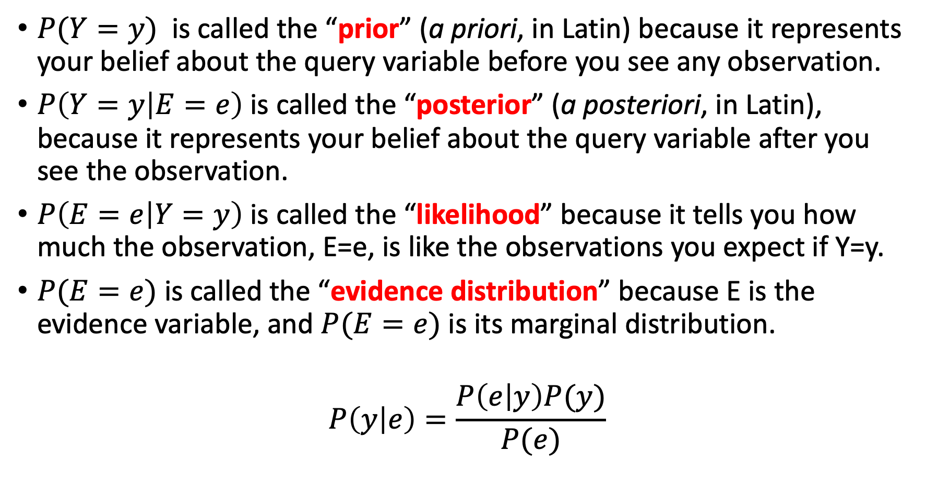
The Bayesian Terms
$P(Y=y)$ is called the “prior” (a priori, in Latin) because it represents your belief about the query variable before you see any observation.
$P\left(Y=y | E=e\right)$ is called the “posterior” (a posteriori, in Latin), because it represents your belief about the query variable after you see the observation.
$P\left(E=e | Y=y\right)$ is called the “likelihood” because it tells you how much the observation, E=e, is like the observations you expect if Y=y.
$P(E=e)$ is called the “evidence distribution” because E is the evidence variable, and $P(E=e)$ is its marginal distribution.
$$P\left(y | e\right)=\frac{P\left(e | y\right)P(y)}{P(e)}$$

Slide 16
Bayesian Inference and Bayesian Learning
Bayes Rule
Bayesian Inference
Misdiagnosis
The Bayesian “Decision”
The “Naïve Bayesian” Assumption
Bag of Words (BoW)
Bayesian Learning
Maximum Likelihood estimation of parameters
Maximum A Posteriori estimation of parameters
Laplace Smoothing

Slide 17
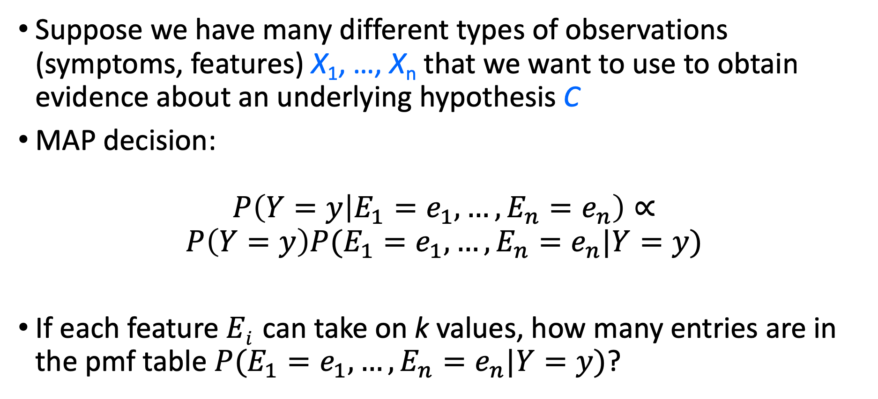
Naïve Bayes model
Suppose we have many different types of observations (symptoms, features) X₁, …, X_{n} that we want to use to obtain evidence about an underlying hypothesis C
MAP decision:
$$P\left(Y=y | E_{1}=e_{1},…,E_{n}=e_{n}\right)∝$$
$$P\left(Y=y\right)P(E_{1}=e_{1},…,E_{n}=e_{n}|Y=y)$$
If each feature $Ei$ can take on k values, how many entries are in the pmf table $P(E_{1}=e_{1},…,E_{n}=e_{n}|Y=y)$?

Slide 18
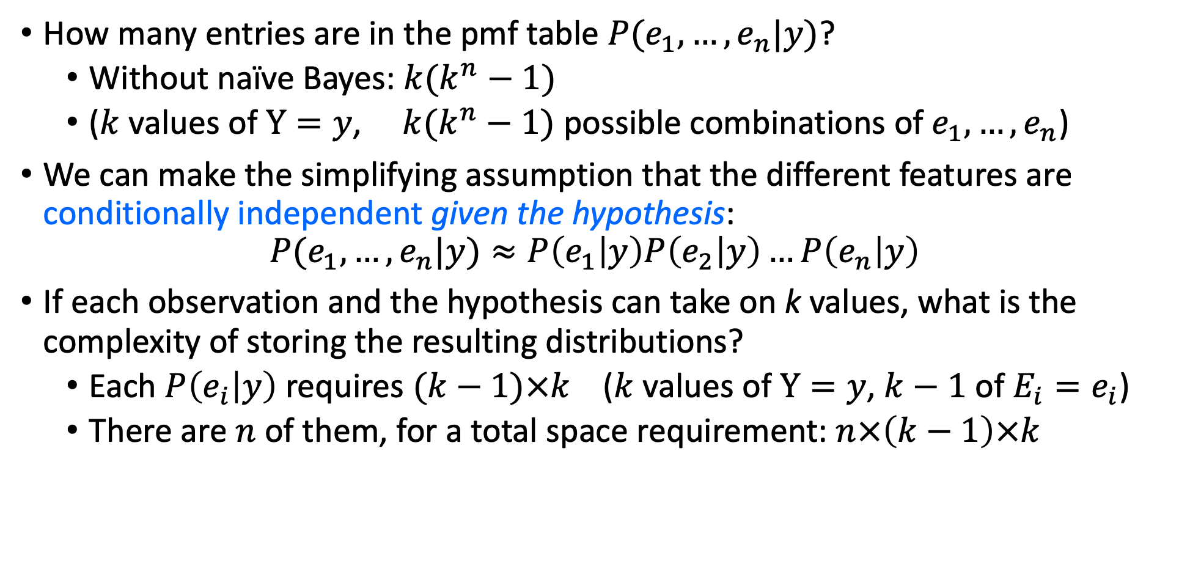
Naïve Bayes model
How many entries are in the pmf table $P(e_{1},…, e_{n}|y)$?
Without naïve Bayes: ${k(k}^{n}−1)$
($k$ values of $Y=y$, ${k(k}^{n}−1)$ possible combinations of $e_{1},…, e_{n}$)
We can make the simplifying assumption that the different features are conditionally independent given the hypothesis:
$$P(e_{1},…, e_{n}|y)≈P\left(e_{1} | y\right)P\left(e_{2} | y\right)…P\left(e_{n} | y\right)$$
If each observation and the hypothesis can take on k values, what is the complexity of storing the resulting distributions?
Each $P\left(e_{i} | y\right)$ requires $(k−1)×k$ ($k$ values of $Y=y$, $k−1$ of $E_{i}=e_{i}$)
There are $n$ of them, for a total space requirement: $n×\left(k−1\right)×k$

Slide 19
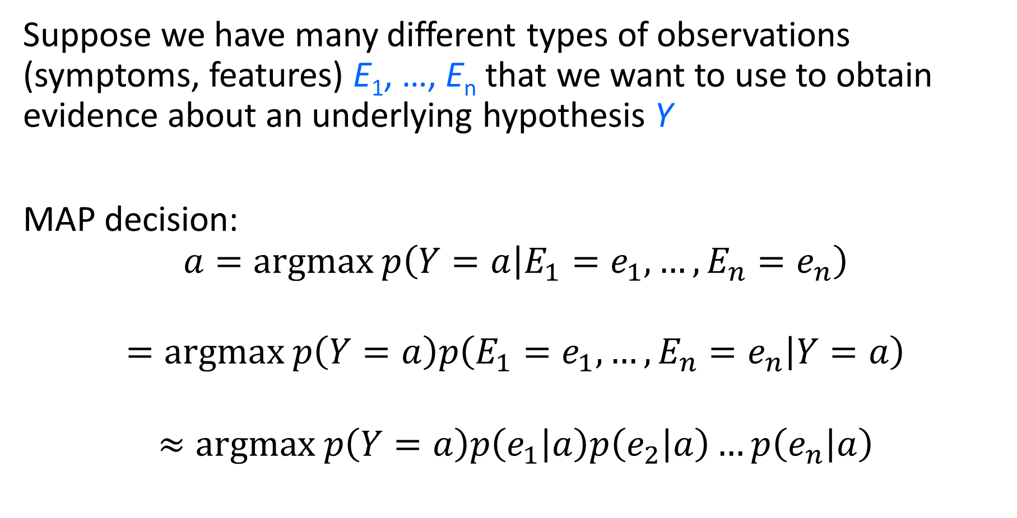
Naïve Bayes model
Suppose we have many different types of observations (symptoms, features) E₁, …, E_{n} that we want to use to obtain evidence about an underlying hypothesis Y
MAP decision: $$a=argmax p\left(Y=a | E_{1}=e_{1},…,E_{n}=e_{n}\right)$$
$$=argmax p\left(Y=a\right)p\left(E_{1}=e_{1},…,E_{n}=e_{n} | Y=a\right)$$
$$≈argmax p\left(Y=a\right)p\left(e_{1} | a\right)p\left(e_{2} | a\right)…p\left(e_{n} | a\right)$$

Slide 20
Case study: Text document classification
MAP decision: assign a document to the class with the highest posterior P(class | document)
Example: spam classification
Classify a message as spam if P(spam | message) > P(¬spam | message)

Slide 21
Case study: Text document classification
MAP decision: assign a document to the class with the highest posterior P(class | document)
We have P(class | document) ∝ P(document | class)P(class)
To enable classification, we need to be able to estimate the likelihoods P(document | class) for all classes and priors P(class)

Slide 22
Naïve Bayes Representation
Goal: estimate likelihoods P(document | class) and priors P(class)
Likelihood: bag of words representation
The document is a sequence of words (w₁, …, w_{n})
The order of the words in the document is not important
Each word is conditionally independent of the others given document class

Slide 23
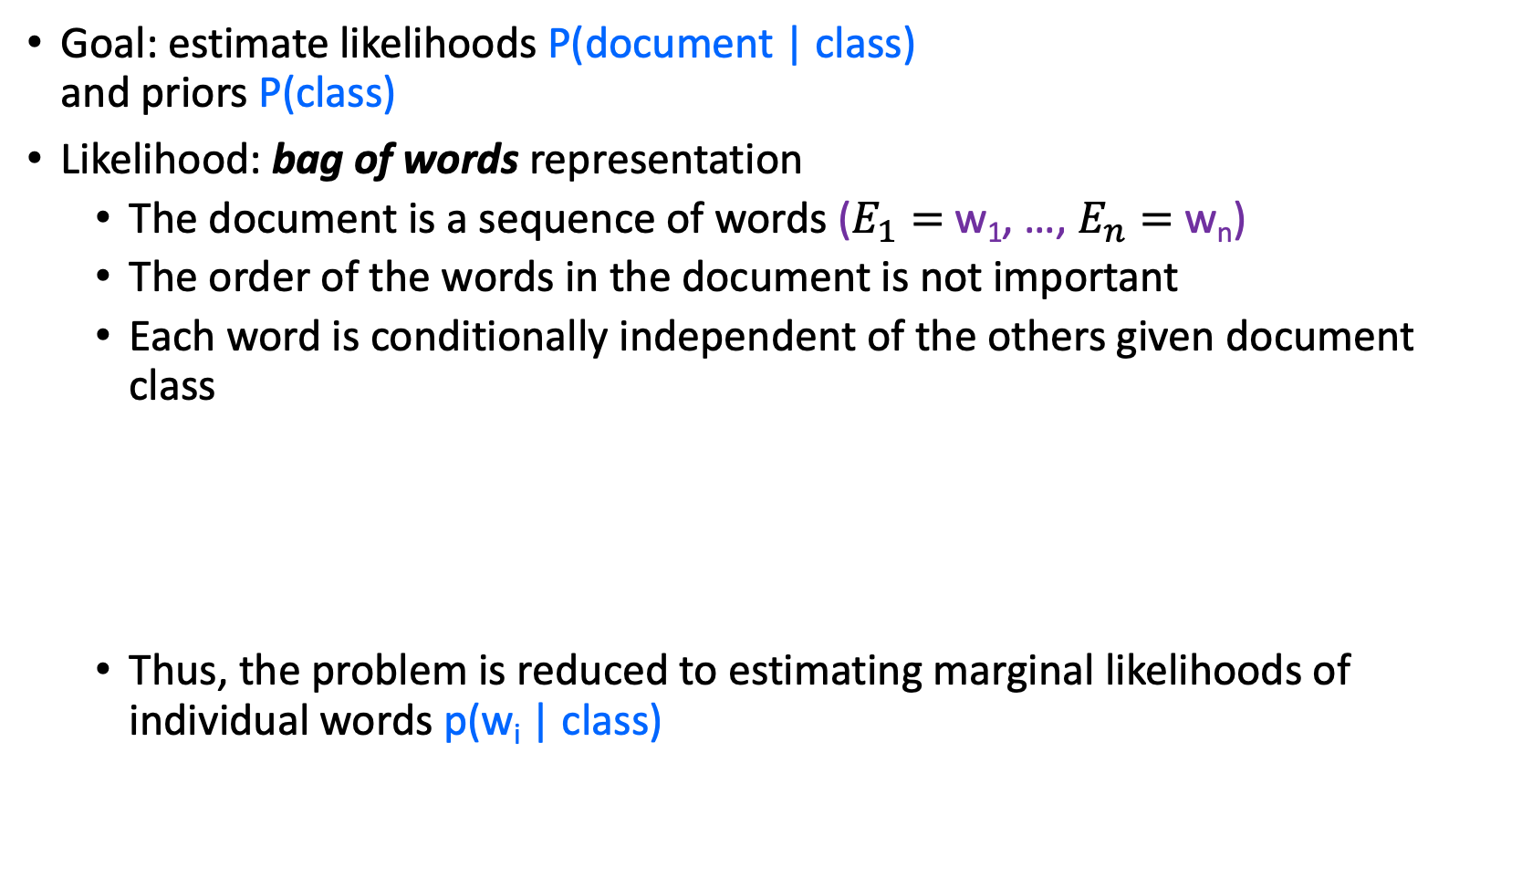
Naïve Bayes Representation
Goal: estimate likelihoods P(document | class) and priors P(class)
Likelihood: bag of words representation
The document is a sequence of words ($E_{1}=$w₁, …, $E_{n}=$w_{n})
The order of the words in the document is not important
Each word is conditionally independent of the others given document class
Thus, the problem is reduced to estimating marginal likelihoods of individual words p(w_{i} | class)

Slide 24
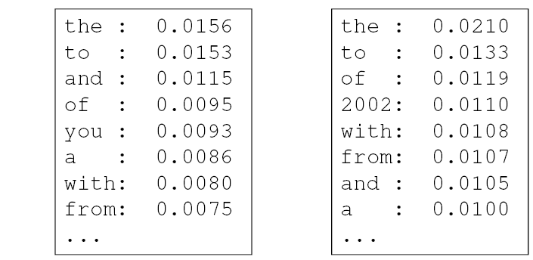
Parameter estimation
Model parameters: feature likelihoods p(word | class) and priors p(class)
How do we obtain the values of these parameters?
prior
P(word | spam)
P(word | ¬spam)
spam: 0.33
¬spam: 0.67

Slide 25

Bag of words illustration
US Presidential Speeches Tag Cloud http://chir.ag/projects/preztags/

Slide 26
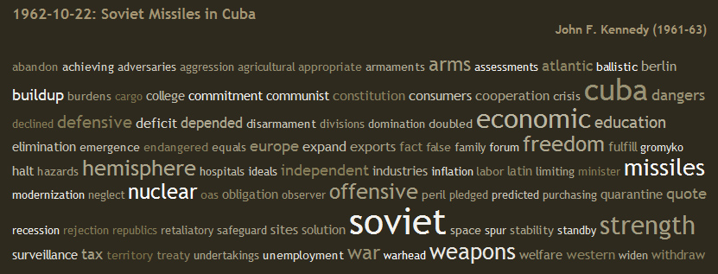
Bag of words illustration
US Presidential Speeches Tag Cloud http://chir.ag/projects/preztags/

Slide 27

Bag of words illustration
US Presidential Speeches Tag Cloud http://chir.ag/projects/preztags/

Slide 28
Bayesian Inference and Bayesian Learning
Bayes Rule
Bayesian Inference
Misdiagnosis
The Bayesian “Decision”
The “Naïve Bayesian” Assumption
Bag of Words (BoW)
Bayesian Learning
Maximum Likelihood estimation of parameters
Laplace Smoothing

Slide 29
Bayesian Learning
Model parameters: feature likelihoods P(word | class) and priors P(class)
How do we obtain the values of these parameters?
Need training set of labeled samples from both classes
This is the maximum likelihood (ML) estimate, or estimate that maximizes the likelihood of the training data:
# of occurrences of this word in docs from this class
P(word | class) =
total # of words in docs from this class
d: index of training document, i: index of a word

Slide 30
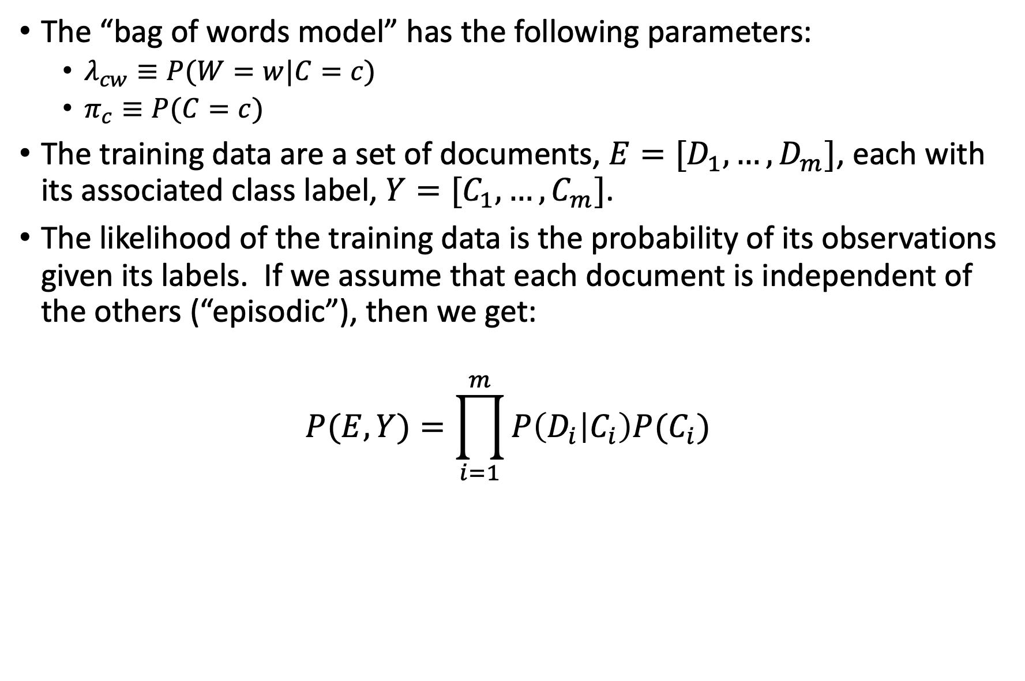
Bayesian Learning
The “bag of words model” has the following parameters:
$λ_{cw}≡P(W=w|C=c)$
$π_{c}≡P(C=c)$
The training data are a set of documents, ${E=[D}_{1},…,D_{m}]$, each with its associated class label, ${Y=[C}_{1},…,C_{m}]$.
The likelihood of the training data is the probability of its observations given its labels. If we assume that each document is independent of the others (“episodic”), then we get:
$$P(E,Y)=\prod_{i=1}^{m}{P\left(D_{i} | C_{i}\right)P(C_{i})}$$

Slide 31
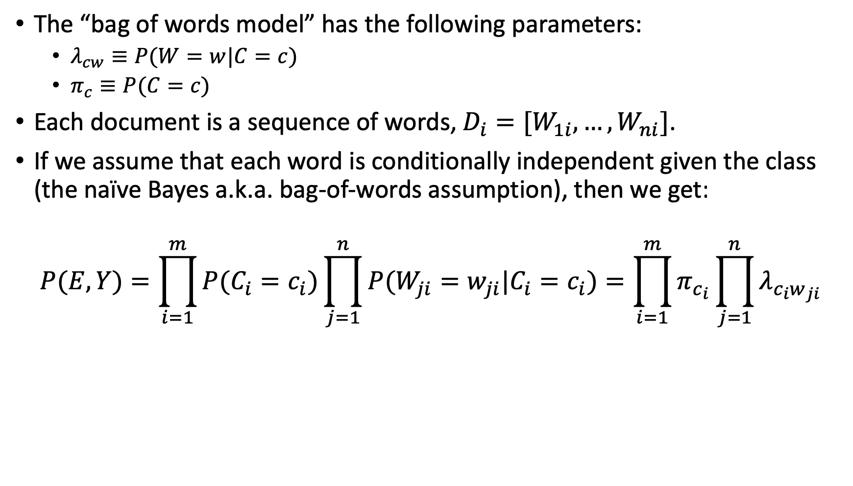
Bayesian Learning
The “bag of words model” has the following parameters:
$λ_{cw}≡P(W=w|C=c)$
$π_{c}≡P(C=c)$
Each document is a sequence of words, $D_{i}=[W_{1i},…,W_{ni}]$.
If we assume that each word is conditionally independent given the class (the naïve Bayes a.k.a. bag-of-words assumption), then we get:
$$P(E,Y)=\prod_{i=1}^{m}{P(C_{i}=c_{i})\prod_{j=1}^{n}{P(W_{ji}=w_{ji}|C_{i}=c_{i})}}=\prod_{i=1}^{m}{π_{c_{i}}\prod_{j=1}^{n}{λ_{c_{i}w_{ji}}}}$$

Slide 32
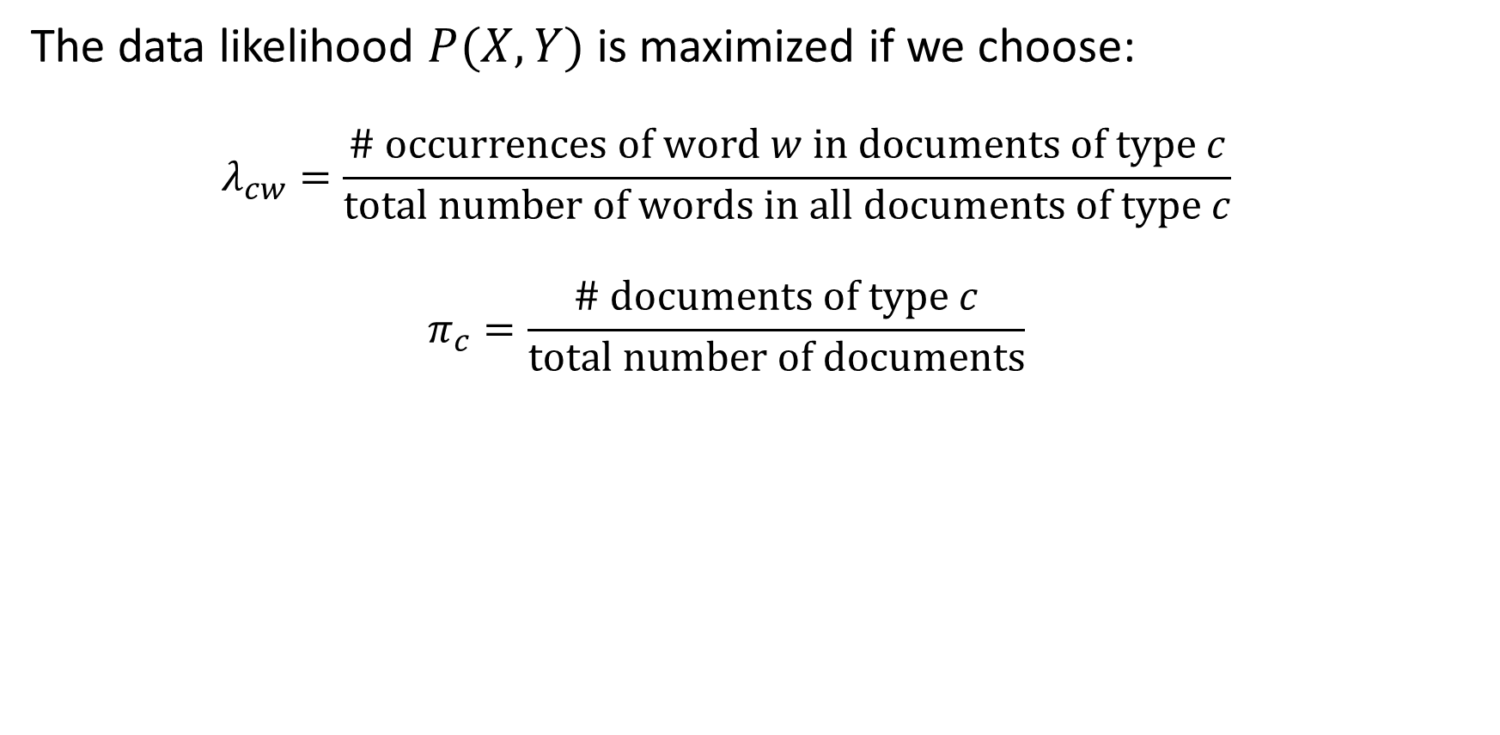
Bayesian Learning
The data likelihood $P(X,Y)$ is maximized if we choose:
$$λ_{cw}=\frac{\# occurrences of word w in documents of type c}{total number of words in all documents of type c}$$
$$π_{c}=\frac{\# documents of type c}{total number of documents}$$

Slide 33
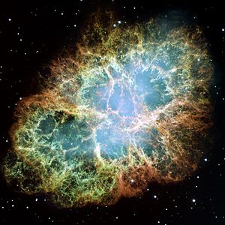

What is the probability that the sun will fail to rise tomorrow?
# times we have observed the sun to rise = 100,000,000
# times we have observed the sun not to rise = 0
Estimated probability the sun will not rise = $\frac{0}{0+100,000,000}=0$
Oops….

Slide 34
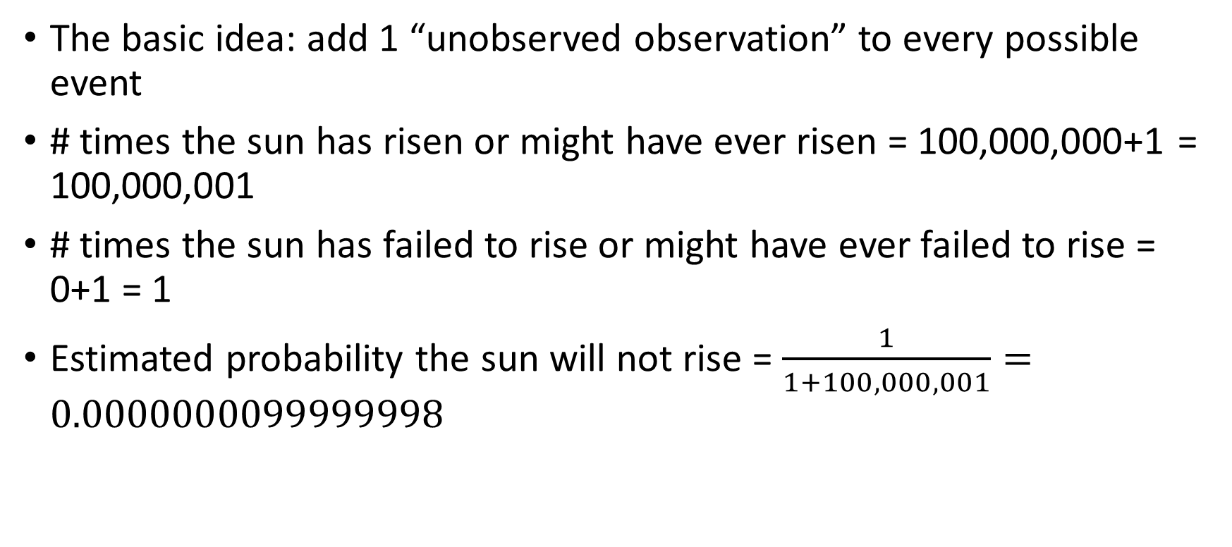
Laplace Smoothing
The basic idea: add 1 “unobserved observation” to every possible event
# times the sun has risen or might have ever risen = 100,000,000+1 = 100,000,001
# times the sun has failed to rise or might have ever failed to rise = 0+1 = 1
Estimated probability the sun will not rise = $\frac{1}{1+100,000,001}=0.0000000099999998$

Slide 35
Parameter estimation
ML (Maximum Likelihood) parameter estimate:
Laplacian Smoothing estimate
How can you estimate the probability of a word you never saw in the training set? (Hint: what happens if you give it probability 0, then it actually occurs in a test document?)
Laplacian smoothing: pretend you have seen every vocabulary word one more time than you actually did
# of occurrences of this word in docs from this class
P(word | class) =
total # of words in docs from this class
# of occurrences of this word in docs from this class + 1
P(word | class) =
total # of words in docs from this class + V
(V: total number of unique words)

Slide 36
Summary: Naïve Bayes for Document Classification
Naïve Bayes model: assign the document to the class with the highest posterior
Model parameters:
Likelihood
of class 1
Likelihood
of class K
prior
P(w₁ | class₁)
P(w₂ | class₁)
…
P(w_{n} | class₁)
P(w₁ | class_{K})
P(w₂ | class_{K})
…
P(w_{n} | class_{K})
P(class₁)
…
P(class_{K})
…

Slide 37
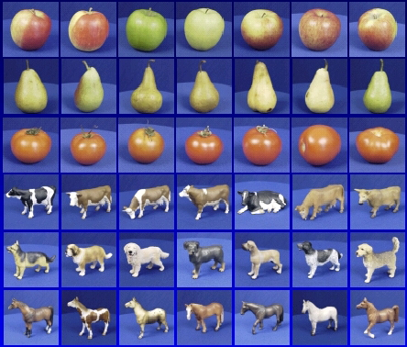

Bayesian Learning and Bayesian Inference irl:
Learning
Training Labels
Training Samples
Features
Training
Learned model
Learned model
Inference
Features
Prediction
Test Sample

Slide 38
Review: Bayesian decision making
Suppose the agent has to make decisions about the value of an unobserved query variable Y based on the values of an observed evidence variable E
Inference problem: given some observation E = e, what is P(Y | E=e)?
Learning problem: estimate the parameters of the probabilistic model P(y | e) given a training sample {(e₁,y₁), …, (e_{n},y_{n})}

