Slide 1
Artificial Intelligence
Intro & History of AI
Notes:
1

Slide 2
Today’s Class
What is Artificial Intelligence?
History of AI
What can AI do?
Applications
Roadmap ahead

Slide 3
What is Artificial Intelligence?

Slide 4
What is Artificial Intelligence? 1
Artificial (adj., Wiktionary): Man-made, i.e., constructed by means of skill or specialized art.
Intelligence (noun, Wiktionary): Capacity of mind to understand meaning, acquire knowledge, and apply it to practice.
Artificial Intelligence (implied by above): capacity of a man-made system to understand, acquire, and apply knowledge.

Slide 5
What is Artificial Intelligence? 2
The science of making machines that:
Thinking like a human
Acting like a human
Thinking rationally
Acting rationally

Slide 6
What is Artificial Intelligence? 3
Thinking Humanly “The exciting new effort to make computers think…machines with minds, in the full and literal sense.” (Haugeland, 1985) “[The automation of] activities that we associate with human thinking, activities such as decision-making, problem solving, learning…”(Bellman, 1978) | Thinking Rationally “The study of mental facilities through the use of computational models.” (Charniak and McDermott, 1985) “The study of the computations that make it possible to perceive, reason, and act.” (Winston, 1992)
Acting Humanly “The art of creating machines that perform functions that require intelligence when performed by people.” (Kurzweil, 1990) “The study of how to make computers do things at which, at the moment, people are better.” (Rich and Knight, 1991) | Acting Rationally “Computational Intelligence is the study of the design of intelligent agents.” (Poole et al., 1998) “AI…is concerned with intelligent behavior in artifacts.” (Nilsson, 1998)

Slide 7
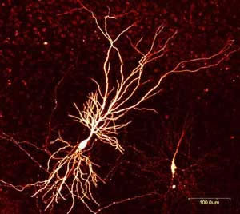
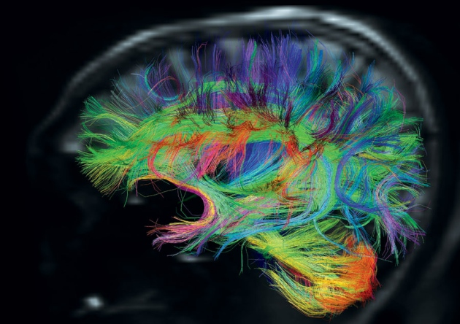
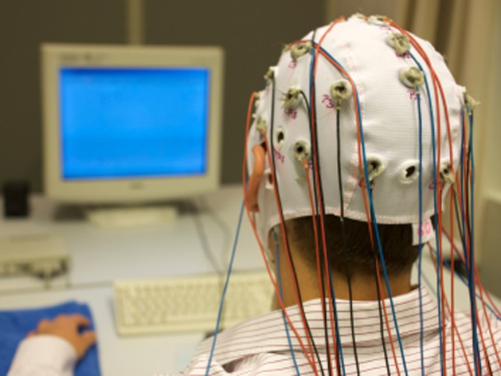
AI Definition 1. Thinking like a Human
Neuron, showing branching of the dendrites; EEG cap; Cortical connectivity map, computed using diffusion tensor MRI
Notes:
7

Slide 8
AI Definition 1. Thinking like a Human 1
The best supercomputers perform far more computations/second than the human brain. If that’s true, why have we not yet duplicated a human brain? We must determine how humans think, get inside the actual workings of human minds.
Options
introspection—trying to catch our own thoughts
psychological experiments—observing a person in action; and through
3) brain imaging—observing the brain in action.
Once we have a sufficiently precise theory of the mind, it becomes possible to express the theory as a computer program.

Slide 9
AI Definition 1. Thinking like a Human 2
If the program’s input–output behavior matches corresponding human behavior, that is evidence that some of the program’s mechanisms could also be operating in humans.
For example, Allen Newell and Herbert Simon, who developed GPS, the “General Problem Solver”
Cognitive science brings together computer models from AI and experimental techniques from psychology to construct precise and testable theories of the human mind.
The two fields continue to fertilize each other, most notably in computer vision, which incorporates neurophysiological evidence into computational models.

Slide 10
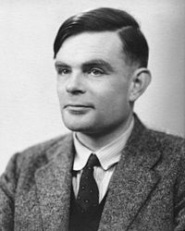
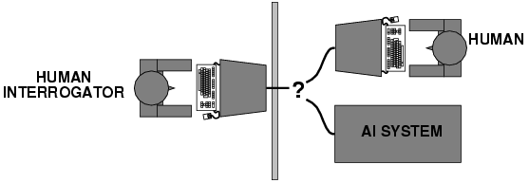
AI Definition 2. Acting like a Human
Schematic of the Turing test; Alan Turing
Notes:
10

Slide 11
AI Definition 2. Acting like a Human 1
What capabilities would a computer need to have to pass the Turing Test?
Notes:
11

Slide 12
AI Definition 2. Acting like a Human 2
What capabilities would a computer need to have to pass the Turing Test?
Natural language processing
Knowledge representation
Automated reasoning
Machine learning
Turing predicted that by the year 2000, machines would be able to fool 30% of human judges for five minutes
Notes:
12

Slide 13
What’s wrong with the Turing test?
Variability in protocols, judges
Success depends on deception!
Chatbots can do well using “cheap tricks”
First example: ELIZA (1966)
Notes:
13

Slide 14
AI definition 3: Thinking rationally
Idealized or “right” way of thinking
Logic: patterns of argument that always yield correct conclusions when supplied with correct premises
“Socrates is a man; all men are mortal; therefore Socrates is mortal.”
Logicist approach to AI: describe problem in formal logical notation and apply general deduction procedures to solve it
Notes:
14

Slide 15
Successes of Logicist Approach: Expert Systems
Expert system = (knowledge base) + (logical rules)
Knowledge base = database of examples
Logical rules = easy to deduce from examples, and easy to verify by asking human judges
Combination of the two: able to analyze never-before-seen examples of complicated problems, and generate an answer that is often (but not always) correct
Expert systems = commercial success in the 1970s
Radiology, geology, materials science expert systems advised their human users
Dating services (match users based on hobbies, etc.)
Notes:
15

Slide 16
Failures of Logicist Approach: Fragility, and the “AI Winter”
Expert systems/fuzzy logic work if the number of rules you have to program is small and finite.
The law of the out-of-vocabulary word: No matter how many words are in your dictionary, there are words you missed.
Implication: no matter how carefully you design the rules for your expert system, there will be real-world situations that it doesn’t know how to handle.
This is a well-known problem with expert systems, called “fragility”
Corporations and governments reacted to fragility by reducing funding of AI, from about 1966-2009. This was called the “AI Winter.”
Notes:
16

Slide 17
AI definition 4: Acting rationally
A rational agent acts to optimally achieve its goals
Goals are application-dependent and are expressed in terms of the utility of outcomes
Being rational means maximizing your (expected) utility
This definition of rationality only concerns the decisions/actions that are made, not the cognitive process behind them
An unexpected step: rational agent theory was originally developed in the field of economics
Norvik and Russell: “ Economists think that what they study is the behavior of rational actors seeking to maximize their own happiness.”
Notes:
17

Slide 18
Rational Decisions
We’ll use the term rational in a very specific, technical way:
Rational: maximally achieving pre-defined goals
Rationality only concerns what decisions are made (not the thought process behind them)
Goals are expressed in terms of the utility of outcomes
Being rational means maximizing the expected utility (a measure of how good is the resulting situation)

Slide 19
Expected Utility Maximization
Pros:
Generality: goes beyond explicit reasoning, and even human cognition altogether
Practicality: can be adapted to many real-world problems. Avoids philosophy and psychology.
Solvability: Amenable to good scientific and engineering methodology
Cons:
Practical cons: can a machine act rationally in order to achieve a desirable outcome? Why or why not?
Theoretical cons: should a machine act rationally in order to achieve a desirable outcome? Why or why not?

Slide 20
What about the brain?
Brains (human minds) are very good at making rational decisions, but not perfect
Brains aren’t as modular as software, so hard to reverse engineer!
“Brains are to intelligence as wings are to flight”
Lessons learned from the brain: memory (data) and simulation (computation) are key to decision making

Slide 21
What is Artificial Intelligence? 4
Recap: The science of making machines that:
Thinking like a human
Acting like a human
Thinking rationally
Acting rationally

Slide 22
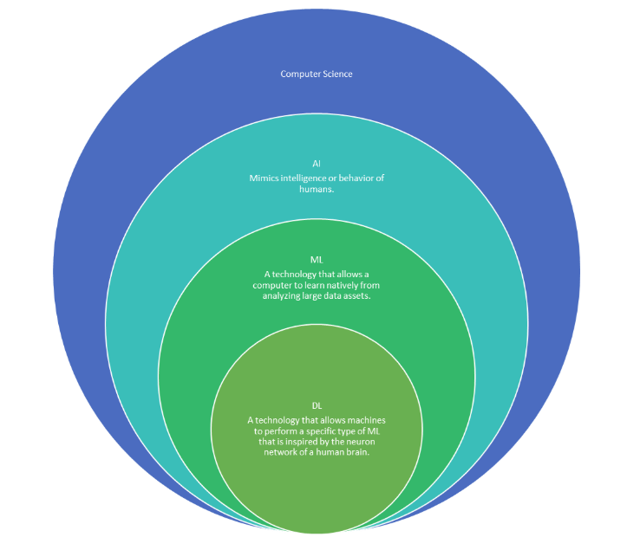
AI vs. Machine Learning

Slide 23
A Short History of AI
1940 — 1950: Early days
1943: McCulloch & Pitts: Boolean circuit model of brain
1950: Turing's “Computing Machinery and Intelligence”
1950 — 70: Excitement: Look, Ma, no hands!
1950s: Early AI programs: chess, checkers program, theorem proving
1956: Dartmouth meeting: “Artificial Intelligence” adopted
1965: Robinson's complete algorithm for logical reasoning
1970 — 90: Knowledge-based approaches
1969—79: Early development of knowledge-based systems
1980—88: Expert systems industry booms
1988—93: Expert systems industry busts: “AI Winter”
1990 — 2012: Statistical approaches + subfield expertise
Resurgence of probability, focus on uncertainty
General increase in technical depth
Agents and learning systems… “AI Spring”?
2012— now: Excitement: Look, Ma, no hands again?
Big data, big compute, neural networks
Some re-unification of sub-fields
AI used in many industries

Slide 24
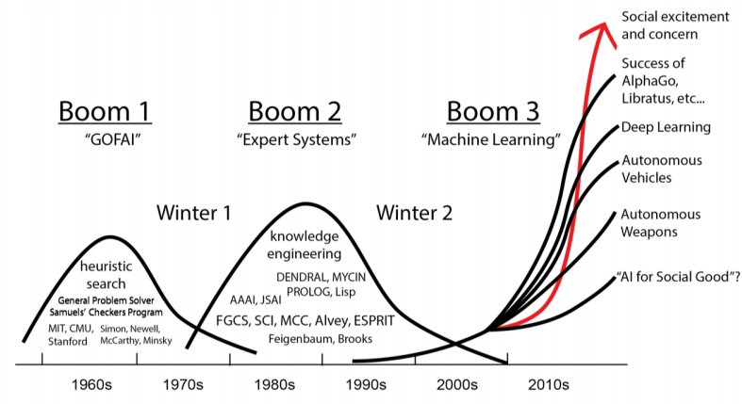
AI Boom and Bust Cycles

Slide 25
What can AI do?
Quiz: Which of the following can be done at present?
Play a decent game of table tennis?
Play a decent game of Jeopardy?
Drive safely along a curving mountain road?
Drive safely along Telegraph Avenue?
Buy a week's worth of groceries on the web?
Discover and prove a new mathematical theorem?
Converse successfully with another person for an hour?
Perform a surgical operation
Translate spoken Chinese into spoken English in real time
Fold the laundry and put away the dishes?
Write an intentionally funny story?

Slide 26
What can AI do? 1
Quiz: Which of the following can be done at present?
 Play a decent game of table tennis?
 Play a decent game of Jeopardy?
 Drive safely along a curving mountain road?
? Drive safely along Telegraph Avenue?
 Buy a week's worth of groceries on the web?
? Discover and prove a new mathematical theorem?
 Converse successfully with another person for an hour?
? Perform a surgical operation
 Translate spoken Chinese into spoken English in real time
? Fold the laundry and put away the dishes?
 Write an intentionally funny story?

Slide 27
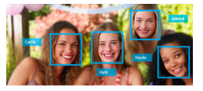
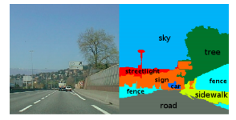
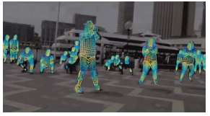
Vision (Perception)
Pixel ➔Info/Decision
Face detection and recognition
Semantic Scene Segmentation
[Source: TechCrunch]
3-D Understanding
[Caesar et al, ECCV 2017]
[DensePose]

Slide 28
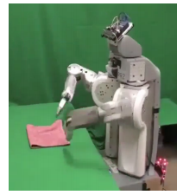
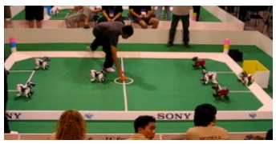
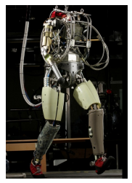
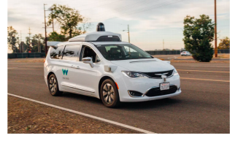
Robotics
Robotics
Part mech. eng.
Part AI
Reality much harder than simulations!
Technologies
Vehicles
Rescue
Soccer!
Lots of automation…
In this class:
We ignore mechanical aspects
Methods for planning
Methods for control

Slide 29



Natural Language Processing
Speech technologies (e.g. Siri)
Automatic speech recognition (ASR)
Text-to-speech synthesis (TTS)
Dialog systems
Language processing technologies
Question answering
Machine translation
Web search
Text classification, spam filtering, etc…

Slide 30
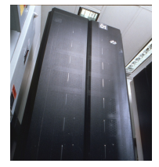
Game Playing
Classic Moment: May, '97: Deep Blue vs. Kasparov
First match won against world champion
“Intelligent creative” play
200 million board positions per second
Humans understood 99.9 of Deep Blue's moves
Can do about the same now with commodity parts
1996: Kasparov beats Deep Blue: “I could feel --- I could smell --- a new kind of intelligence across the table.”
1997: Deep Blue beats Kasparaov: “Deep Blue hasn’t proven anything.”
Open question:
How does human cognition deal with the search space explosion of chess?
Or: how can humans compete with computers at all??
2016: AlphaGo beats Lee Sedol – huge advance: sparse rollouts and self-play
Right now: OpenAI Five vs Team paiN (human pros) -- some caveats!
“[The AI play] was just something like completely different.” Austin Walsh
Text from Bart Selman, image
from IBM’s Deep Blue pages

Slide 31
AI is starting to be everywhere!
Applied AI automates all kinds of things
Search engines
Route planning, e.g. maps, traffic
Logistics, e.g. packages, inventory
Medical diagnosis
Automated help desks
Spam / fraud detection
Smarter devices, e.g. cameras
Product recommendations
… Lots more

Slide 32
What accounts for recent successes in AI?
Faster computers
The IBM 704 vacuum tube machine that played chess in 1958 could do about 50,000 calculations per second
Deep Blue could do 50 billion calculations per second – a million times faster!
Dominance of statistical approaches, machine learning
Big data
Crowdsourcing
Notes:
32

Slide 33
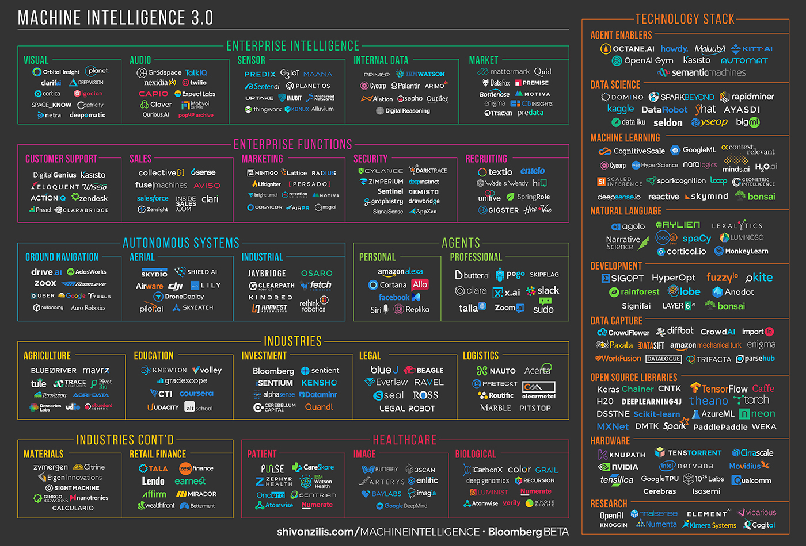
Machine Intelligence 3.0

Slide 34
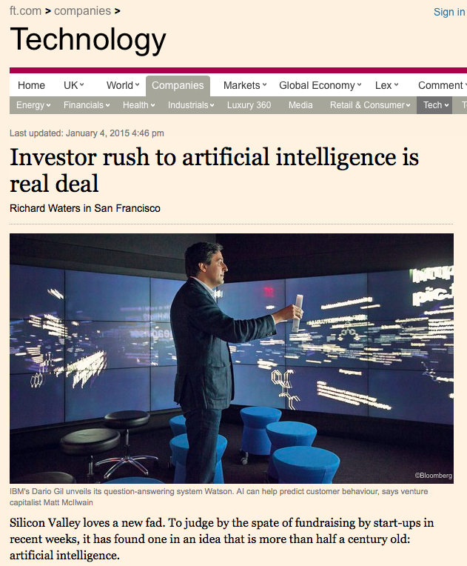
Investor rush to AI is real deal

Slide 35
Historical themes
Boom and bust cycles
Periods of (unjustified) optimism followed by periods of disillusionment and reduced funding
Silver bulletism (Levesque, 2013):
“The tendency to believe in a silver bullet for AI, coupled with the belief that previous beliefs about silver bullets were hopelessly naïve”
Image problems
“AI effect”/Moravec’s paradox: As soon as a machine gets good at performing some task, the task is no longer considered to require much intelligence
AI as a threat to safety?
AI as a threat to jobs?
Notes:
35

Slide 36
AI Effect/Moravec’s paradox
Moravec’s paradox
“It is comparatively easy to make computers exhibit adult level performance on intelligence tests or playing checkers, and difficult or impossible to give them the skills of a one-year-old when it comes to perception and mobility” [Hans Moravec, 1988]
Why is this?
Early AI researchers concentrated on the tasks that they themselves found the most challenging, abilities of animals and two-year-olds were overlooked
We are least conscious of what our brain does best
Sensorimotor skills took millions of years to evolve, whereas abstract thinking is a relatively recent development
Notes:
36

Slide 37
Relationship to other fields
Theoretical computer science:
– Emphasis on proving theorems
Computer science systems and programming languages
– Emphasis on engineering systems
Operations research/optimization
Probability and statistics
Machine learning and “data science”
Philosophy
Mathematics
Economics
Neuroscience
Psychology, computer engineering, control theory and
cybernetics, linguistics, ...
Notes:
37

Slide 38
Designing Rational Agents
An agent is an entity that perceives and acts.
A rational agent selects actions that maximize its (expected) utility.
Characteristics of the percepts, environment, and action space dictate techniques for selecting rational actions
This course is about:
General AI techniques for a variety of problem types
Learning to recognize when and how a new problem can be solved with an existing technique
Sensors
Percepts
Agent
?
Environment
Actuators
Actions

Slide 39
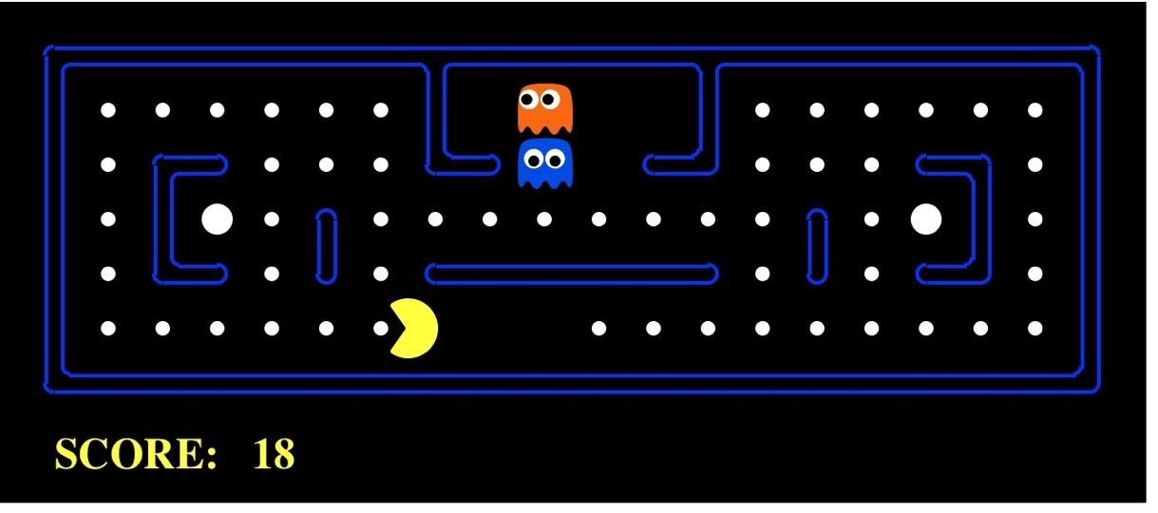
Pac-Man as an Agent
Agent
Environment
Sensors
Percepts
?
Actuators
Actions
Pac-Man is a registered trademark of Namco-Bandai Games, used here for educational purposes
Notes:
L1D2 =
python demos.py
Select Lecture 1 → select demo 2
39

Slide 40
Course Topics
Part I: Introduction
Intro, intelligent agents
Part II: Solving Problems
Search / planning
Constraint satisfaction
Adversarial and uncertain search
Logical Agents
Part III: Reasoning under Uncertainty
Markov Decision Processes.
Reinforcement Learning
Part IV: Machine Learning
Decision Trees, Linear Models
Deep Neural Networks

Slide 41
Acknowledgements
Slides based on:
Pieter Abbeel and Dan Klein (UC Berkeley)
Mark Hasegawa-Johnson and Julia Hockenmaier (UIUC)
Tauhidul Alam (LSUS)

Slide 42
Thank you!

