Slide 1
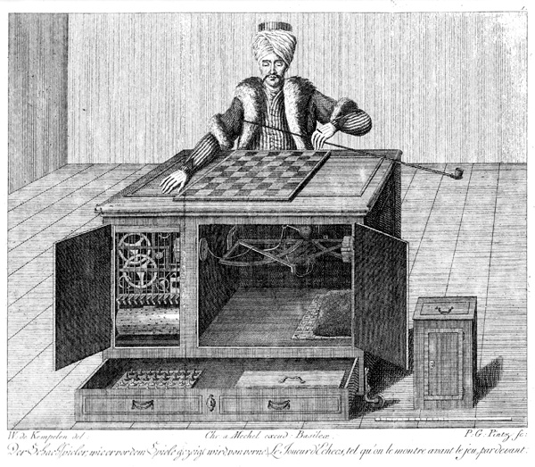
Ch 5: Adversarial Search
Slides modified from Svetlana Lazebnik and Mark Hasegawa-Johnson, UIUC

Slide 2
Why study games?
Games are a traditional hallmark of intelligence
Games are easy to formalize
Games can be a good model of real-world competitive or cooperative activities
Military confrontations, negotiation, auctions, etc.

Slide 3
Game AI: Origins
Minimax algorithm: Ernst Zermelo, 1912
Chess playing with evaluation function, quiescence search, selective search: Claude Shannon, 1949 (paper)
Alpha-beta search: John McCarthy, 1956
Checkers program that learns its own evaluation function by playing against itself: Arthur Samuel, 1956

Slide 4
Types of game environments
 | Deterministic | Stochastic
Perfect information (fully observable)
Imperfect information (partially observable)
Chess, checkers, go
Backgammon, monopoly
Battleship
Scrabble, poker, bridge

Slide 5
Zero-sum Games

Slide 6
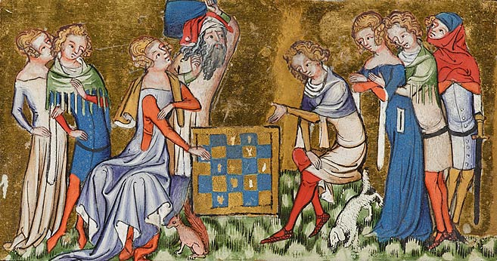
Alternating two-player zero-sum games
Players take turns
Each game outcome or terminal state has a utility for each player (e.g., 1 for win, 0 for loss)
The sum of both players’ utilities is a constant

Slide 7
Games vs. single-agent search
We don’t know how the opponent will act
The solution is not a fixed sequence of actions from start state to goal state, but a strategy or policy (a mapping from state to best move in that state)

Slide 8
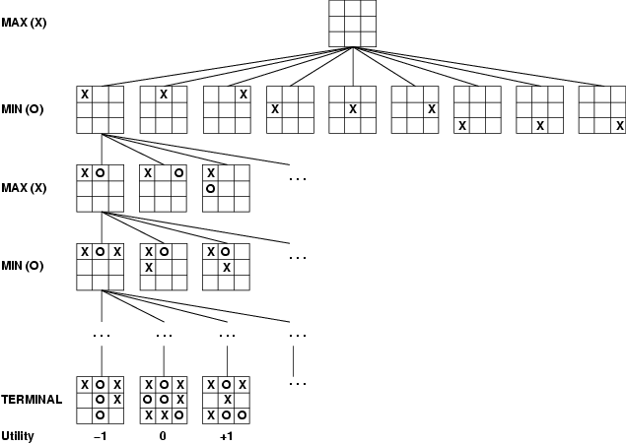
Game tree
A game of tic-tac-toe between two players, “max” and “min”

Slide 9
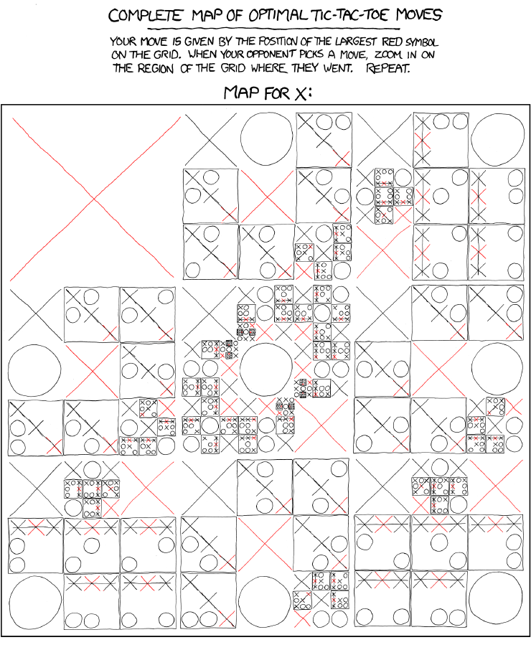
http://xkcd.com/832/

Slide 10
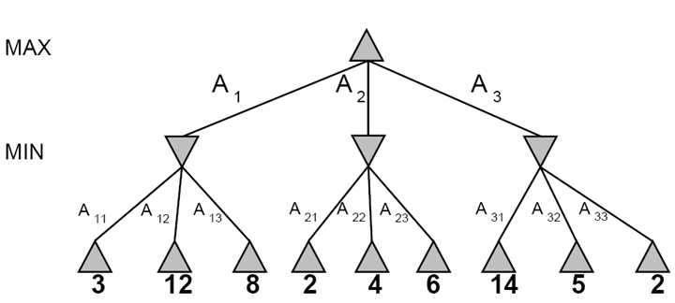
A more abstract game tree
Terminal utilities (for MAX)
A two-ply game

Slide 11
Minimax Search

Slide 12
The rules of every game
Every possible outcome has a value (or “utility”) for me.
Zero-sum game: if the value to me is +V, then the value to my opponent is –V.
Phrased another way:
My rational action, on each move, is to choose a move that will maximize the value of the outcome
My opponent’s rational action is to choose a move that will minimize the value of the outcome
Call me “Max”
Call my opponent “Min”

Slide 13
Game tree search
3
3
2
2
Minimax value of a node: the utility (for MAX) of being in the corresponding state, assuming perfect play on both sides
Minimax strategy: Choose the move that gives the best worst-case payoff

Slide 14
Computing the minimax value of a node
3
3
2
2
Minimax(node) =
Utility(node) if node is terminal
max_{action} Minimax(Succ(node, action)) if player = MAX
min_{action} Minimax(Succ(node, action)) if player = MIN

Slide 15
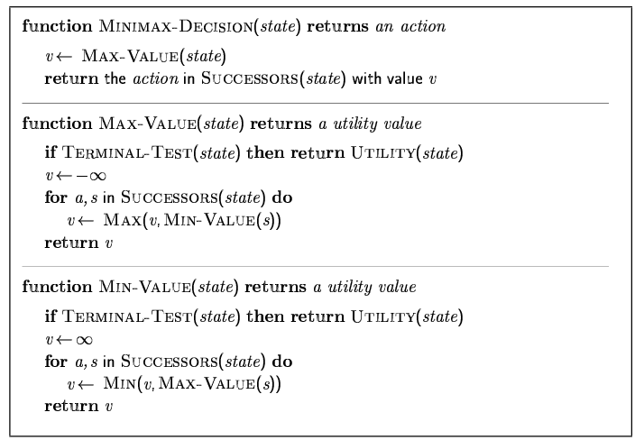
Minimax algorithm

Slide 16
Properties of minimax
Complete? Yes (if tree is finite)
Optimal? Yes (against an optimal opponent)
Time complexity? O(b^{m})
Space complexity? O(bm) (depth-first exploration) For chess, b ≈ 35, m ≈100 for "reasonable" games → exact solution completely infeasible

Slide 17
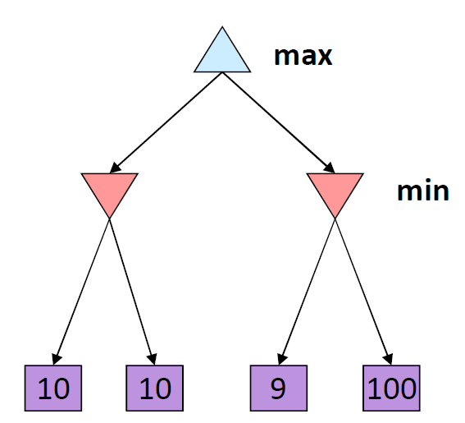
Optimality of minimax
The minimax strategy is optimal against an optimal opponent
What if your opponent is suboptimal?
Your utility will ALWAYS BE HIGHER than if you were playing an optimal opponent!
A different strategy may work better for a sub-optimal opponent, but it will necessarily be worse against an optimal opponent
10
Example from D. Klein and P. Abbeel

Slide 18
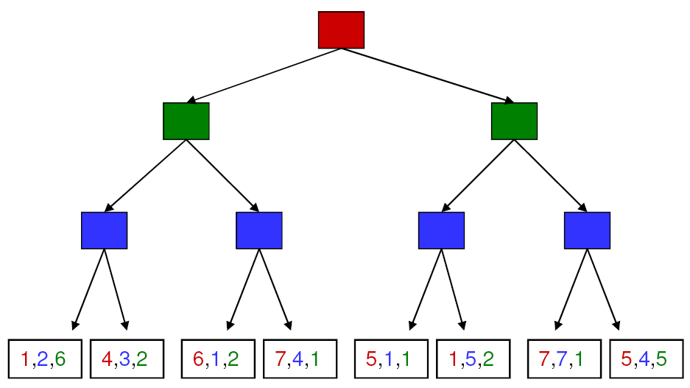
More general games
4,3,2
4,3,2
1,5,2
4,3,2
7,4,1
1,5,2
7,7,1
More than two players, non-zero-sum
Utilities are now tuples
Each player maximizes their own utility at their node
Utilities get propagated (backed up) from children to parents

Slide 19
Alpha-Beta Pruning

Slide 20
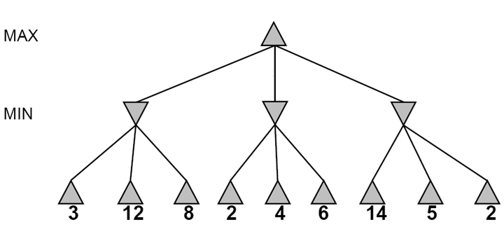
Alpha-beta pruning
It is possible to compute the exact minimax decision without expanding every node in the game tree

Slide 21
Alpha-beta pruning
It is possible to compute the exact minimax decision without expanding every node in the game tree
≥3
3

Slide 22
Alpha-beta pruning
It is possible to compute the exact minimax decision without expanding every node in the game tree
≥3
3
≤2

Slide 23
Alpha-beta pruning
It is possible to compute the exact minimax decision without expanding every node in the game tree
≥3
3
≤2
≤14

Slide 24
Alpha-beta pruning
It is possible to compute the exact minimax decision without expanding every node in the game tree
≥3
3
≤2
≤5

Slide 25
Alpha-beta pruning
It is possible to compute the exact minimax decision without expanding every node in the game tree
3
3
≤2
2
Notes:
Could we have done better with the right branch?

Slide 26
Alpha-Beta Pruning
Summary:
MIN needs to calculate which move MAX will make.
MAX would never choose a suboptimal move.
So if MIN discovers that, at a particular node in the tree, she can make a move that’s REALLY REALLY GOOD for her…
She can assume that MAX will never let her reach that node.
… and she can prune it away from the search, and never consider it again.

Slide 27
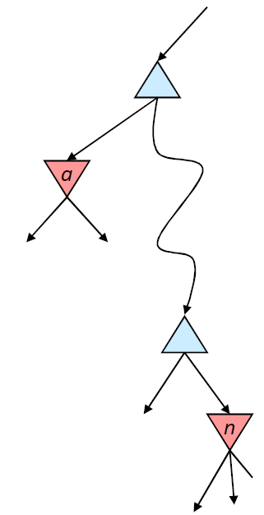

Alpha-beta pruning
α is the value of the best choice for the MAX player found so far at any choice point above node n
More precisely: α is the highest number that MAX knows how to force MIN to accept
We want to compute the MIN-value at n
As we loop over n’s children, the MIN-value decreases
If it drops below α, MAX will never choose n, so we can ignore n’s remaining children

Slide 28
Alpha-beta pruning
β is the value of the best choice for the MIN player found so far at any choice point above node n
More precisely: β is the lowest number that MIN know how to force MAX to accept
We want to compute the MAX-value at m
As we loop over m’s children, the MAX-value increases
If it rises above β, MIN will never choose m, so we can ignore m’s remaining children
β
m

Slide 29
Alpha-beta pruning
Pruning does not affect final result
Amount of pruning depends on move ordering
Should start with the “best” moves (highest-value for MAX or lowest-value for MIN)
For chess, can try captures first, then threats, then forward moves, then backward moves
Can also try to remember “killer moves” from other branches of the tree
With perfect ordering, the time to find the best move is reduced to O(b^{m/2}) from O(b^{m})
Depth of search is effectively doubled

Slide 30
Limited-Horizon Computation

Slide 31
Games vs. single-agent search
We don’t know how the opponent will act
The solution is not a fixed sequence of actions from start state to goal state, but a strategy or policy (a mapping from state to best move in that state)

Slide 32
Games vs. single-agent search
We don’t know how the opponent will act
The solution is not a fixed sequence of actions from start state to goal state, but a strategy or policy (a mapping from state to best move in that state)
Efficiency is critical to playing well
The time to make a move is limited
The branching factor, search depth, and number of terminal configurations are huge
In chess, branching factor ≈ 35 and depth ≈ 100, giving a search tree of 10¹⁵⁴ nodes
Number of atoms in the observable universe ≈ 10⁸⁰
This rules out searching all the way to the end of the game

Slide 33
Evaluation function
Cut off search at a certain depth and compute the value of an evaluation function for a state instead of its minimax value
The evaluation function may be thought of as the probability of winning from a given state or the expected value of that state
A common evaluation function is a weighted sum of features:
Eval(s) = w₁ f₁(s) + w₂ f₂(s) + … + w_{n} f_{n}(s)
For chess, w_{k} may be the material value of a piece (pawn = 1, knight = 3, rook = 5, queen = 9) and f_{k}(s) may be the advantage in terms of that piece
Evaluation functions may be learned from game databases or by having the program play many games against itself

Slide 34
Cutting off search
Horizon effect: you may incorrectly estimate the value of a state by overlooking an event that is just beyond the depth limit
For example, a damaging move by the opponent that can be delayed but not avoided
Possible remedies
Quiescence search: do not cut off search at positions that are unstable – for example, are you about to lose an important piece?
Singular extension: a strong move that should be tried when the normal depth limit is reached

Slide 35
Chess playing systems
Baseline system: 200 million node evalutions per move (3 min), minimax with a decent evaluation function and quiescence search
5-ply ≈ human novice
Add alpha-beta pruning
10-ply ≈ typical PC, experienced player
Deep Blue: 30 billion evaluations per move, singular extensions, evaluation function with 8000 features, large databases of opening and endgame moves
14-ply ≈ Garry Kasparov
More recent state of the art (Hydra, ca. 2006): 36 billion evaluations per second, advanced pruning techniques
18-ply ≈ better than any human alive?

Slide 36
Summary
A zero-sum game can be expressed as a minimax tree
Alpha-beta pruning finds the correct solution. In the best case, it has half the exponent of minimax (can search twice as deeply with a given computational complexity).
Limited-horizon search is always necessary (you can’t search to the end of the game), and always suboptimal.
Estimate your utility, at the end of your horizon, using some type of learned utility function
Quiescence search: don’t cut off the search in an unstable position (need some way to measure “stability”)
Singular extension: have one or two “super-moves” that you can test at the end of your horizon

Slide 37
Acknowledgements
Slides based on:
Pieter Abbeel and Dan Klein (UC Berkeley)
Mark Hasegawa-Johnson and Julia Hockenmaier (UIUC)
Tauhidul Alam (LSUS)
http://aima.eecs.berkeley.edu/slides-ppt/

