Slide 1
Logical Agents
Chapter 7

Slide 2
Outline
Knowledge-based agents
Wumpus world
Logic in general - models and entailment
Propositional (Boolean) logic
Equivalence, validity, satisfiability
Inference rules and theorem proving
  forward chaining
  backward chaining
  resolution

Slide 3

Knowledge bases
Knowledge base = set of sentences in a formal language
Declarative approach to building an agent (or other system):
  Tell it what it needs to know
Then it can Ask itself what to do - answers should follow from the KB
Agents can be viewed at the knowledge level
  i.e., what they know, regardless of how implemented
  i.e., data structures in KB and algorithms that manipulate them
  Or at the implementation level

Slide 4

A simple knowledge-based agent
The agent must be able to:
Represent states, actions, etc.
Incorporate new percepts
Update internal representations of the world
Deduce hidden properties of the world
Deduce appropriate actions

Slide 5

Wumpus World PEAS description
Performance measure
  gold +1000, death -1000
  -1 per step, -10 for using the arrow
Environment
Sensors: Stench, Breeze, Glitter, Bump, Scream
Actuators: Left turn, Right turn, Forward, Grab, Release, Shoot
Squares adjacent to wumpus are smelly
Squares adjacent to pit are breezy
Glitter iff gold is in the same square
Shooting kills wumpus if you are facing it
Shooting uses up the only arrow
Grabbing picks up gold if in same square
Releasing drops the gold in same square

Slide 6
Wumpus world characterization
Fully Observable No – only local perception
Deterministic Yes – outcomes exactly specified
Episodic No – sequential at the level of actions
Static Yes – Wumpus and Pits do not move
Discrete Yes
Single-agent? Yes – Wumpus is essentially a natural feature

Slide 7

Exploring a wumpus world
Sensors: Stench, Breeze, Glitter, Bump, Scream

Slide 8

Exploring a wumpus world

Slide 9

Exploring a wumpus world

Slide 10

Exploring a wumpus world

Slide 11

Exploring a wumpus world

Slide 12

Exploring a wumpus world

Slide 13

Exploring a wumpus world

Slide 14

Exploring a wumpus world

Slide 15
Logic in general
Logics are formal languages for representing information such that conclusions can be drawn
Syntax defines the sentences in the language
Semantics define the "meaning" of sentences;
  i.e., define truth of a sentence in a world
E.g., the language of arithmetic
  x+2 ≥ y is a sentence; x2+y > {} is not a sentence
  x+2 ≥ y is false in a world where x = 0, y = 6
  x+2 ≥ y is true iff the number x+2 is no less than the number y
  x+2 ≥ y is true in a world where x = 7, y = 1

Slide 16
Entailment
Entailment means that one thing follows from another:
KB ╞ α
Knowledge base KB entails sentence α if and only if α is true in all worlds where KB is true
  E.g., the KB containing “the Giants won” and “the Reds won” entails “Either the Giants won or the Reds won”
  E.g., x+y = 4 entails 4 = x+y
  Entailment is a relationship between sentences (i.e., syntax) that is based on semantics

Slide 17

Models
Logicians typically think in terms of models, which are formally structured worlds with respect to which truth can be evaluated
We say m is a model of a sentence α if α is true in m
M(α) is the set of all models of α
Then KB ╞ α iff M(KB) ⊆ M(α)
  E.g. KB = Giants won and Reds
  won
  α = Giants won

Slide 18

Entailment in the wumpus world
Situation after detecting nothing in [1,1], moving right, breeze in [2,1]
Consider possible models for KB assuming only pits
3 Boolean choices ⇒ 8 possible models

Slide 19

Wumpus models

Slide 20

Wumpus models
KB = wumpus-world rules + observations

Slide 21

Wumpus models
KB = wumpus-world rules + observations
α₁ = "[1,2] is safe", KB ╞ α₁, proved by model checking
Rembember KB ╞ α iff M(KB)  M(α)

Slide 22
Wumpus models
KB = wumpus-world rules + observations

Slide 23

Wumpus models
KB = wumpus-world rules + observations
α₂ = "[2,2] is safe", KB ╞ α₂
Rembember KB ╞ α iff M(KB)  M(α)

Slide 24
Inference
KB ├_{i} α = sentence α can be derived from KB by procedure i
Soundness: i is sound if whenever KB ├i α, it is also true that KB╞ α
Completeness: i is complete if whenever KB╞ α, it is also true that KB ├i α

Slide 25
Propositional logic: Syntax
Propositional logic is the simplest logic – illustrates basic ideas
  If S is a sentence, ¬S is a sentence (negation)
  If S₁ and S₂ are sentences, S₁ ∧ S₂ is a sentence (conjunction)
  If S₁ and S₂ are sentences, S₁ ∨ S₂ is a sentence (disjunction)
  If S₁ and S₂ are sentences, S₁ ⇒ S₂ is a sentence (implication)
  If S₁ and S₂ are sentences, S₁ ⇔ S₂ is a sentence (biconditional)
The proposition symbols P1, P2 etc are sentences

Slide 26
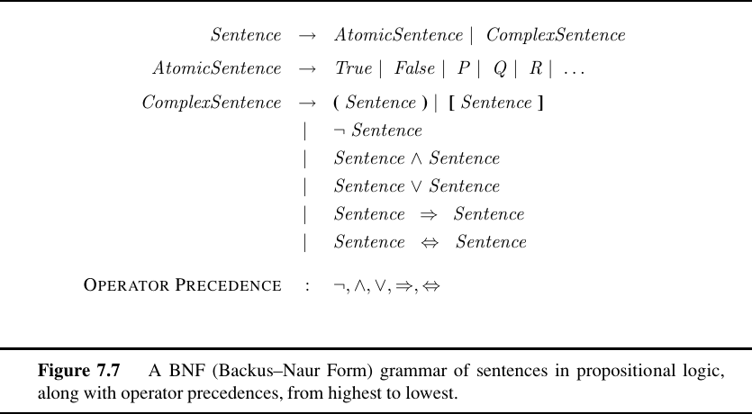
Grammar of Propositional Logic

Slide 27
Propositional logic: Semantics
Each model specifies true/false for each proposition symbol
  E.g. P_{1,2} P_{2,2} P_{3,1}
  false true false
With these symbols, 8 possible models, can be enumerated automatically.
Rules for evaluating truth with respect to a model m:
¬S is true iff S is false
S₁ ∧ S₂ is true iff S₁ is true and S₂ is true
S₁ ∨ S₂ is true iff S₁is true or S₂ is true
S₁ ⇒ S₂ is true iff S₁ is false or S₂ is true
i.e., is false iff S₁ is true and S₂ is false
S₁ ⇔ S₂ is true iff S₁⇒S₂ is true andS₂⇒S₁ is true
Simple recursive process evaluates an arbitrary sentence, e.g.,
¬P_{1,2} ∧ (P_{2,2} ∨ P_{3,1}) = true ∧ (true ∨ false) = true ∧ true = true

Slide 28

Truth tables for connectives

Slide 29
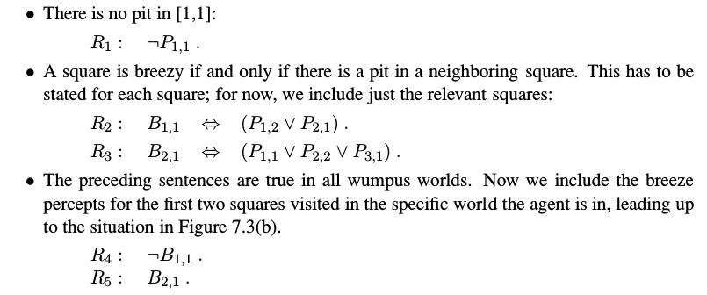
A simple Knowledge Base

Slide 30
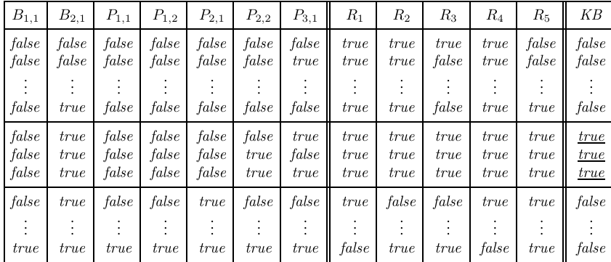
Truth tables for inference

Slide 31

Inference by enumeration
Depth-first enumeration of all models is sound and complete
For n symbols, time complexity is O(2^{n}), space complexity is O(n)

Slide 32

Logical equivalence
Two sentences are logically equivalent} iff true in same models: α ≡ ß iff α╞ β and β╞ α

Slide 33
Validity and satisfiability
A sentence is valid if it is true in all models,
  e.g., True, A ∨¬A, A ⇒ A, (A ∧ (A ⇒ B)) ⇒ B
Validity is connected to inference via the Deduction Theorem:
  KB ╞ α if and only if (KB ⇒ α) is valid
A sentence is satisfiable if it is true in some model
  e.g., A∨ B, C
A sentence is unsatisfiable if it is true in no models
  e.g., A∧¬A
Satisfiability is connected to inference via the following:
  KB ╞ α if and only if (KB ∧¬α) is unsatisfiable

Slide 34
A KB Example

Slide 35
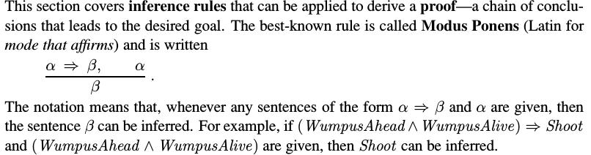
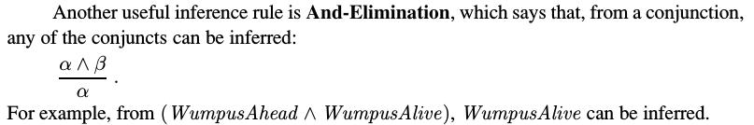
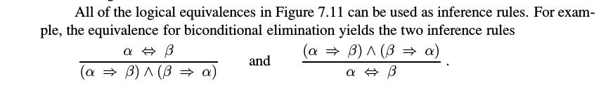
Inference and proofs

Slide 36
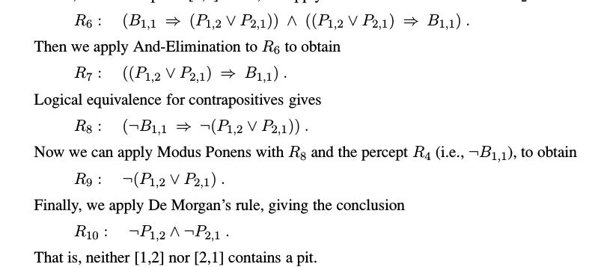
Inference and proofs

Slide 37
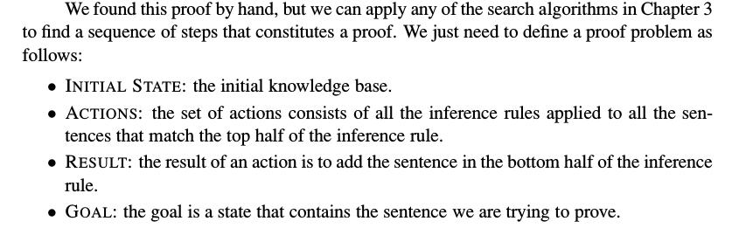
Inference and proofs

Slide 38
Proof methods
Proof methods divide into (roughly) two kinds:
  Application of inference rules
    Legitimate (sound) generation of new sentences from old
    Proof = a sequence of inference rule applications
    Can use inference rules as operators in a standard search algorithm
    Typically require transformation of sentences into a normal form
  Model checking
    truth table enumeration (always exponential in n)
    e.g., min-conflicts-like hill-climbing algorithms
    improved backtracking, e.g., Davis--Putnam-Logemann-Loveland (DPLL)
    heuristic search in model space (sound but incomplete)

Slide 39
Summary
Logical agents apply inference to a knowledge base to derive new information and make decisions
  syntax: formal structure of sentences
  semantics: truth of sentences wrt models
  entailment: necessary truth of one sentence given another
  inference: deriving sentences from other sentences
  soundness: derivations produce only entailed sentences
  completeness: derivations can produce all entailed sentences
Wumpus world requires the ability to represent partial and negated information, reason by cases, etc.
Basic concepts of logic:

Slide 40
Acknowledgements
Slides based on:
  Pieter Abbeel and Dan Klein (UC Berkeley)
  Mark Hasegawa-Johnson and Julia Hockenmaier (UIUC)
  Tauhidul Alam (LSUS)
  http://aima.eecs.berkeley.edu/slides-ppt/

