Slide 1
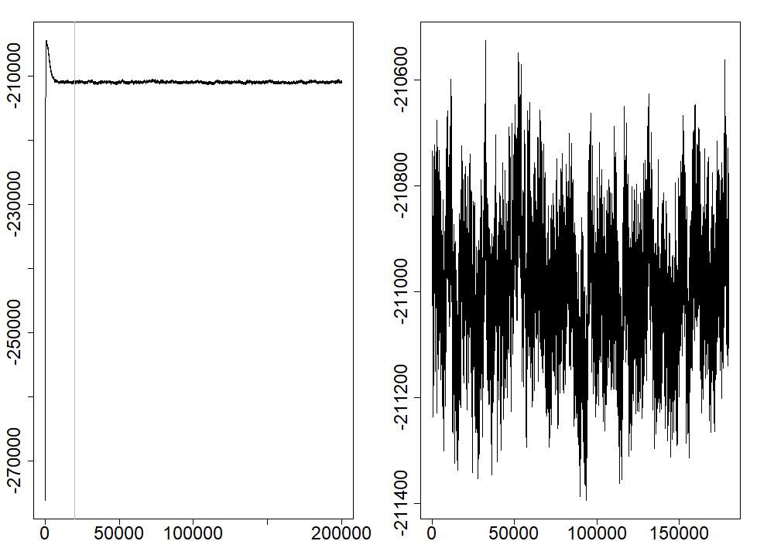
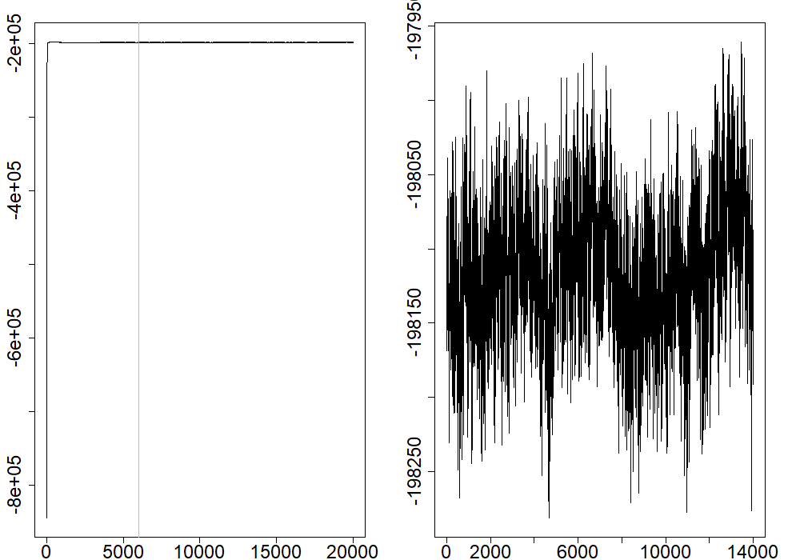
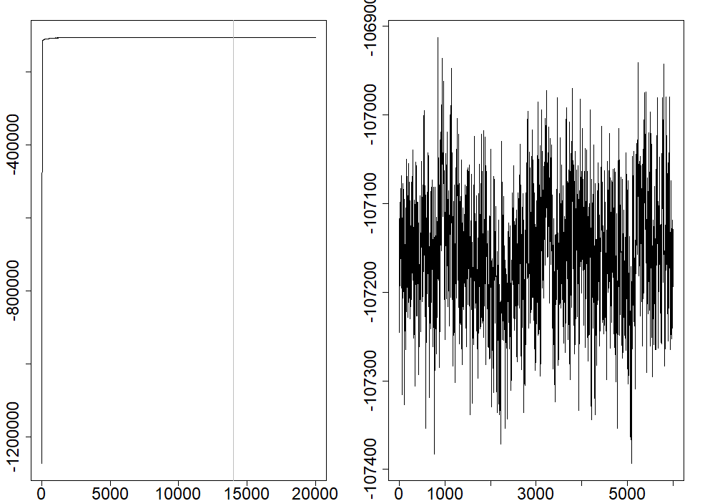
Before
After
Empirical data
Log-likelihood
Sim. data (3 clusters)
Sim. data (5 clusters)
Iterations

