Slide 1

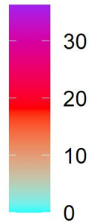


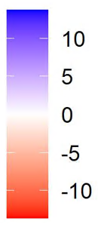
A. 2014
B. 2018
C. Difference (2018-2014)

