Slide 1

Accomodation for Caregivers in Bari
An urban inquiry to provide a more comfortable stay to relatives and caregivers accompanying hospitalized patients

Slide 2
Rationale
Every year thousands of patients move to Bari (Apulia, Italy) for medical treatment from nearby regions.
Hospital neighborhoods are not always capable of providing a comfortable stay to patients' relatives and/or caregivers during hospitalization becaouse of the lack of hotels and food places.
The Mayor of Bari requested an urban inquiry trying to unveil which hospital neighborhood requires new food places and/or accommodations.

Slide 3
Aim
To determine which hospital area needs new licenses for food places and accomodations.

Slide 4
Methods
Hospital database from Apulia Region (IT)
FOURSQUARE API to retrieve services in neighborhoods
Kmeans clusterization (attributes: services in hospital neighborhoods, coordinates)
Statistical analysis in Python environment

Slide 5
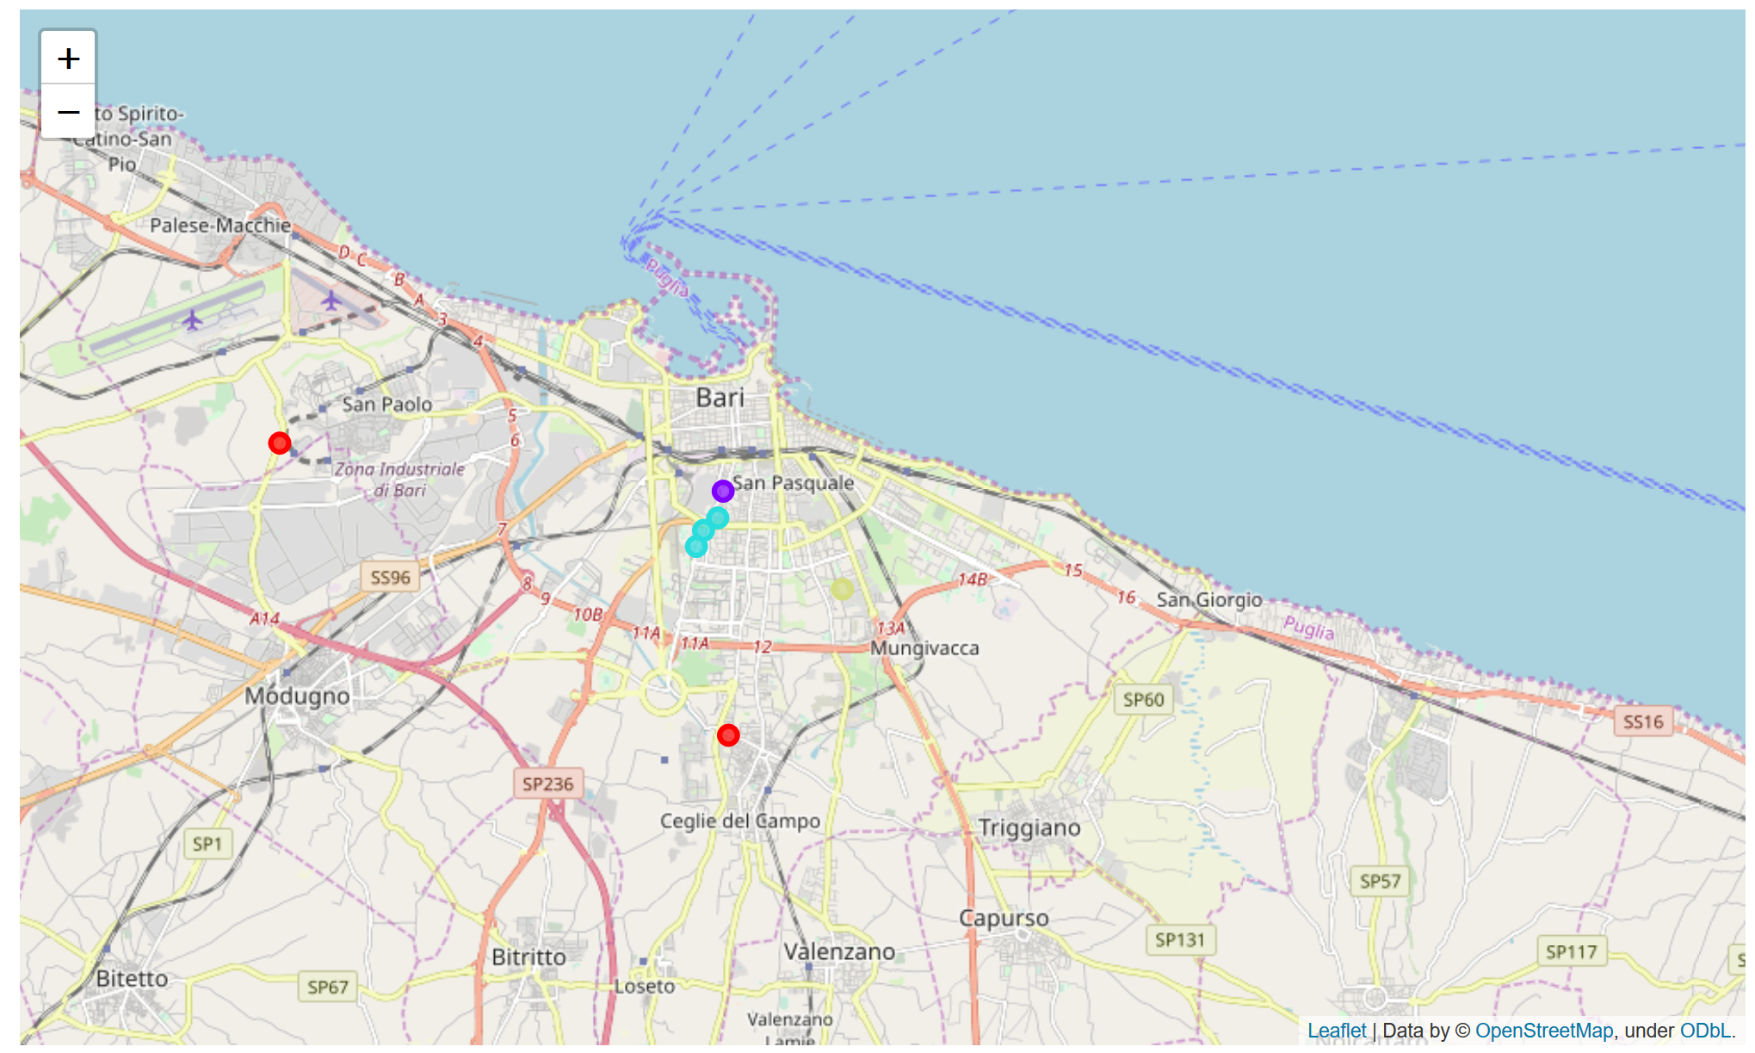
Results - Clusterization
Labels | Hospital Name | Accomodations | Food Places
Cluster 1 | AOSP Policlinico Consorziale | 0 | 1
Cluster 2 | Villa Anthea Santa Maria Hospital IRCCS San Giovanni Paolo II | 5 | 3
Cluster 3 | CBH Mater Dei Hospital | 3 | 10
Cluster 4 | San Paolo Hospital Di Venere Hospital | 0 | 2

Slide 6
Conclusions
Hospital neighborhood in Cluster 0 urgently need new accomodations.
Hospital neighborhood in Cluster 1-2 may offer a nice stay because of several accomodations and food places
Hospital neighborhoods in Cluster 3 needs more accomodations.

