Slide 1

Community as a client: applying the nursing process
NUR 415 – 2025/26

Slide 2
Objectives
Describe the characteristics of a healthy community.
Describe the meaning of community as client.
Articulate three specific considerations of each of the three dimensions of the community as client.
Explain methods the community health nurse might use to interact with the community.
Discuss methods of community health assessment.
Compare and contrast five types of community assessment.
Delineate five sources of community data.
Describe the role of the community health nurse as a catalyst for community development.

Slide 3
Community as a client
The concept of community as client refers to a group or population of people as the focus of nursing service (Anderson & McFarlane, 2015)
It is a new experience to think of an entire community as your focus of care, but similar principles apply

Slide 4
WHAT IS A HEALTHY COMMUNITY
A community’s health can be viewed within the context of health being more than just the absence of disease and including things that promote the maintenance of a high quality of life and productivity

Slide 5
Dimensions of Community as a Client
Status/ people
Structure
Process

Slide 6
Status/people
The most common measure of health of the community.
It comprises of morbidity and mortality data identifying the physical, emotional and social determinants of health.
  The physical and social indices include- vital statistics, leading causes of death and illness, suicide rates, rates of drug and alcohol addiction.
  Social determinants are- crime rates, functional ability level, or high-school drop out rates, average income levels, single, female-leaded households.

Slide 7
Structure
Refers to its services and resources, which can include:
E.g.1 adequacy and appropriateness of health services, and utilization of it, number and type of health and social services, and quality measures.
E.g.2 Also availability of health care providers- nurses, doctors, dentists etc.
E.g.3. Demographic data such as socio-economic and racial distribution, age, gender and educational level.

Slide 8
The Processes
refers to its ability of the community to function effectively.
This can see through the collaboration between community with other subsystems such as education and health (e.g. With municipality, educational institutions, environment, media etc).

Slide 9
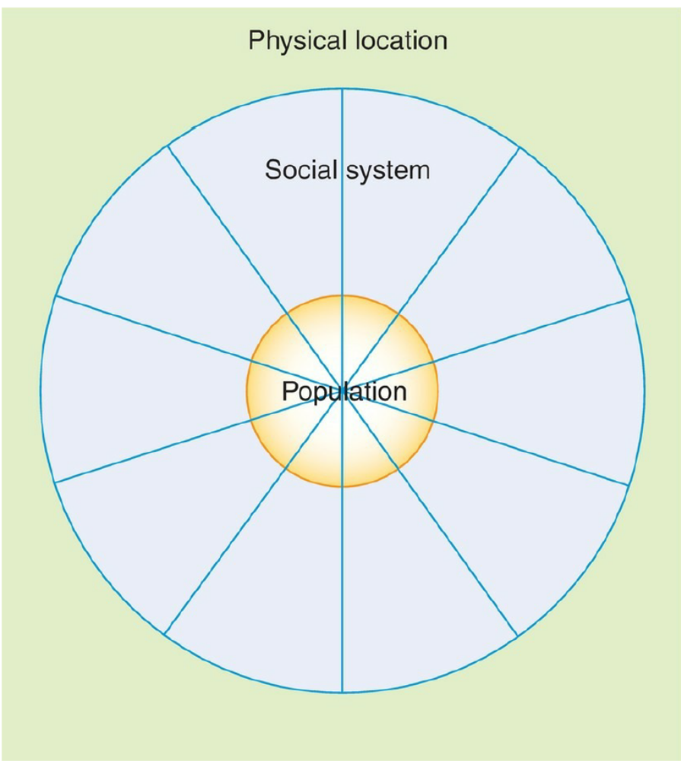
Three features of Community
Another perspective identifies community as having three features which are analyzed while assessing the health of the community as follow:
Location
Population.
Social system.

Slide 10
Three features of Community
1- Location

Slide 11

Location features
Health of the community is affected by location.
It can be offering resources or threats.
A healthy community is one that makes wise use of resources and is prepared to meet the threats and dangers.
E.g. Zinj area has lots of services, restaurants, gym or sports centers, walkable/ garden areas.

Slide 12
The Six Location Variables
Community boundaries
Location of health services
Geographic features
Climate
Flora and fauna
Human-made environment.

Slide 13
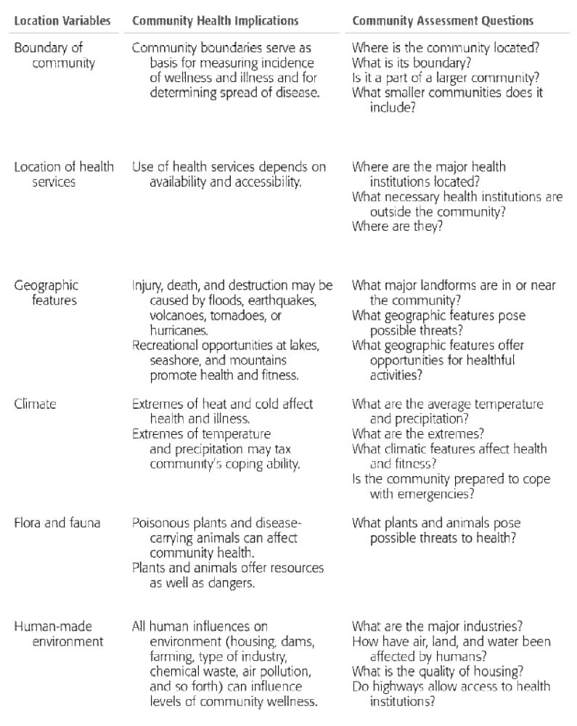

Slide 15
Match the Variable
Respiratory health problems are high in Ma’meer area due to the industrial location
Smoking cessation clinic is only available in East Riffa health centre.
An outbreak of respiratory problems and influenza occurs during December-January months
Al-Jasra, Budaiya regions has a lot of plants and vegetations
Waste water treatment plant in Tubli area gives rise to bad odor to neighborhoods
Notes:
Geographic features
Location of health service
Climate
Flora and fauna
Human made environment

Slide 16
Three features of Community
2- Population

Slide 17
Population Characteristics
The population consists not of a specialized aggregate but of all the diverse people who live within the boundaries of the community.
The health of any community is greatly influenced by the attributes of its population
The various variables in the population are:
  Size
  Density
  Composition or demography
  Rate of growth or decline
  Cultural characteristics
  Social class structure
  Mobility

Slide 18

Population Size
The population size can affect the health of the community.
E.g. Large number of geriatric population may need resources for the care.
Large crowd of population also create environmental sanitation problems.
Heterogeneity is another factor which affect the health.
E.g. A community with large number of males/ children etc, we may need to plan services accordingly.

Slide 19

Population Density
The population density can affect the health of the community.
E.g. overcrowded or congested housing.
Creates also environmental hazards – like smoke pollution (due to vehicles smoke), more number of motor vehicle accidents, lung problems etc.
On the opposite, What is the disadvantage of low-density community?

Slide 20

Composition/ Demographics
The composition of the population density can be a concern or an interest.
E.g. Communities with a high proportion of high-income families/ low-income families.
E.g. Communities with a large number of children.
Communities with a large number of smokers.

Slide 21

Rate of Growth or Decline
The populations change over time due to economic growth or due to better living conditions.
E.g. A shift of population occur in some areas as some of them move towards other residential areas.

Slide 22

Cultural Characteristics
A community can have one or many cultures.
E.g. Manama area can have different cultures due to expatriate populations.

Slide 23

Social class and Educational level
Social class refers to the ranking of groups within society by income, education, occupation, prestige, or a combination of these factors.
Class rankings are usually based on occupation, education and wealth (income or assets).
These comprises the social and physical determinants of health.
E.g. upper, middle, lower etc.

Slide 24

Mobility
Population turnover may affect the health of the population.
Continuity of services can be affected.
Nomadic populations sometimes present with special health needs.
E.g. Traveling community causes defaulter children, and not completing vaccinations.
E.g. Visiting certain countries causes contracting diseases like yellow fever.

Slide 25
Three features of Community
3- Social System
Every community has a social system.
The various parts of a community’s social system that interact and influence the health of the community are called social system variables

Slide 26
Social System
For example, a high rate of Sickle cell marriage in a city may signal inadequate functioning of several systems (e.g., family, educational, religious, health), so a closer look is in order.
What community values influence marital decisions and behavior among adolescents? What pre-marital education programs are available to this population? Does the health system provide information and counseling?

Slide 27
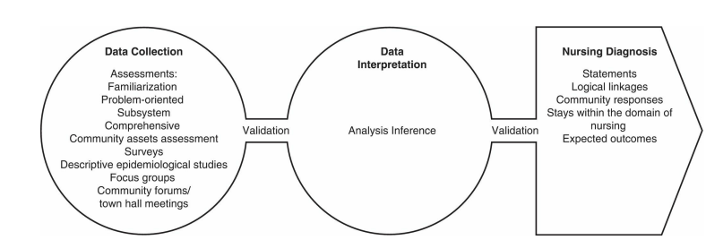
Nursing Process
Applied to the Community as A Client

Slide 28
Community needs assessment
Community health assessment is the process of determining the real or perceived needs of a defined community
  Windshield survey (familiarization assessment)
  Problem-oriented assessment
  Community subsystem assessment
  Comprehensive assessment (key informants)
  Community assets assessment

Slide 29
Familiarization assessment
Familiarization assessment involves studying data already available on a community and then gathering a certain amount of firsthand data in order to gain a working knowledge of the community

Slide 30
problem-oriented assessment
problem-oriented assessment, begins with a single problem and assesses the community in terms of that problem
e.g. first step would be to discover the incidence of childhood deafness, both in the community and in the state. Second, she might begin interviewing officials in the schools and health institutions to find out what had been done in the past to assist deaf children. She could do an Internet search to locate available resources on the subject of deafness. Are there interpreters available for people who use sign language? How do hospitals and courts approach deafness? Are there any clubs or other organizations for deaf people? Are there school programs for the deaf, and if so, where are they located?

Slide 31
community subsystem assessment
In community subsystem assessment, the community health nurse focuses on a single dimension of community life.
For example, the nurse might decide to survey churches and religious organizations to discover their roles in the community.

Slide 32
Comprehensive Community assessment
Comprehensive assessment seeks to discover all relevant community health information.
Key informants are interviewed in every major system— education, health, religious, economic, and others.

Slide 33
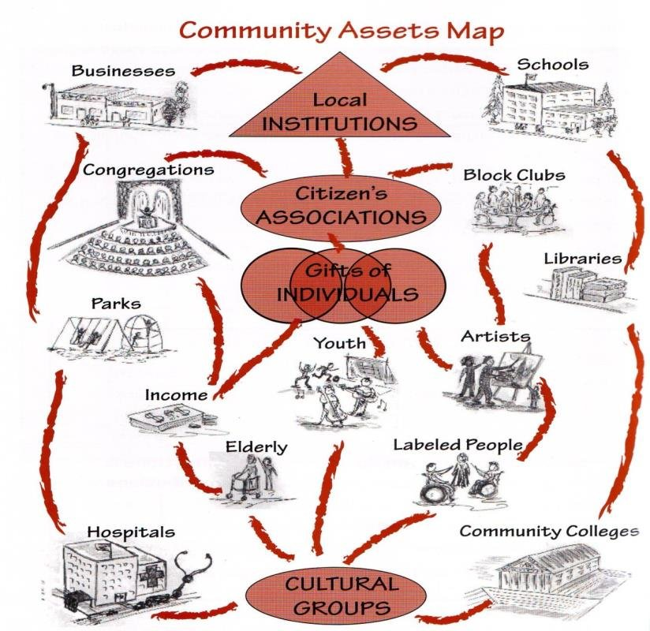
Community Assets Assessment
This method of assessment focuses on the strengths and capacities of a community rather than its problems.
The capacities and skills of community members are identified, with a focus on creating or rebuilding relationships among local residents, associations, and institutions to multiply power and effectiveness.
This approach requires that the assessor look for the positive or see the glass as half full.

Slide 34
What type of assessment is being used here?
Scenario: A health department is investigating a sudden increase in asthma cases in a specific area. They survey residents to identify potential triggers such as air quality issues or exposure to allergens.
Scenario: Community health workers conduct in-depth interviews with local leaders, healthcare providers, and residents to gather information about health concerns, resources, and barriers to care in the community.
Notes:
Problem-Oriented Assessment
Comprehensive Assessment

Slide 35
What type of assessment is being used here?
Scenario: A group of nursing students drives through a neighborhood to observe the condition of parks, schools, and grocery stores, noting the overall cleanliness and safety of the environment.
Scenario: A local organization is analyzing the health education services available in the community, focusing on schools, clinics, and community centers to assess their effectiveness in promoting healthy lifestyles.
Notes:
Windshield Survey
Community Subsystem Assessment

Slide 36
What type of assessment is being used here?
Scenario: A community group maps out local resources such as parks, fitness centers, food banks, and support groups to understand existing strengths that can be leveraged for health promotion initiatives.
Scenario: A health advocacy group organizes a workshop to inventory community resources like vaccination clinics, health fairs, and exercise classes, aiming to enhance access to preventive healthcare services for low-income families.
Notes:
Community Assets Assessment

Slide 37

Community Assessment Methods
Surveys
Descriptive epidemiologic studies
Community forums/town hall meetings
Focus groups

Slide 38
Community Nursing Diagnosis
presents a community focus
Include statements narrow enough to guide interventions
Use a community response instead of a risk, goal, or need statement
Include factors within the domain of community health nursing intervention

Slide 39
Wellness nursing diagnosis
Wellness nursing diagnosis for an assisted living community of elders.
The senior residents of an assisted living center (community focus) have the potential for achieving optimal functioning related to (host factors) their expressed interest in exercise, diet, and meaningful activities and to (environmental factors) their access to exercise opportunities, nutritional information, and social outlets.

Slide 40
Deficit community nursing diagnosis
Deficit community nursing diagnosis for a rural farmworker community.
The inhabitants of (name of the town) in (name of the state) are at risk for illness and injury related to (host factors) exposure to pesticides, lack of motivation to add or use safety devices on farm machinery, lack of safety knowledge, choice to take unnecessary risks (environmental factors), lack of family income to purchase newer equipment, and long hours of work that lead to stress and exhaustion.

Slide 41

PLANNING to Meet Community Health Needs
Planning is the logical decision-making process used to design an orderly detailed serious of actions for accomplishing specific goals and objectives
List needs in order to priority
Establish goals and objectives
Write an action plan

Slide 42

Implementation
Implementation is putting the plan into action. The nurse, other professionals, or clients carry out the activities of the plan
Implementation starts with Preparation
“Who, what, when, where and how”
“Who will be involved in carrying out the plan”
“What are each person ‘ responsibilities”
“Do all understand why and how to do their parts

Slide 43

Implementation
The process of implementation requires a series of nursing actions or activities
Applies system or change theory
Facilitate an environment conductive to carrying out the plan
Prepare clients to receive services
Carry out the plan, modify and then carried out by professionals and clients
Monitor and document process

Slide 44

Evaluation
Measuring or judging effectiveness of goal or outcome attainment
Formative: focus on process during actual interventions
Summative: focus on the outcomes of interventions; effect; impact

Slide 45
Thank you

