Slide 1


Family as A Client: Applying the Nursing Process
NUR415, October 2025

Slide 2
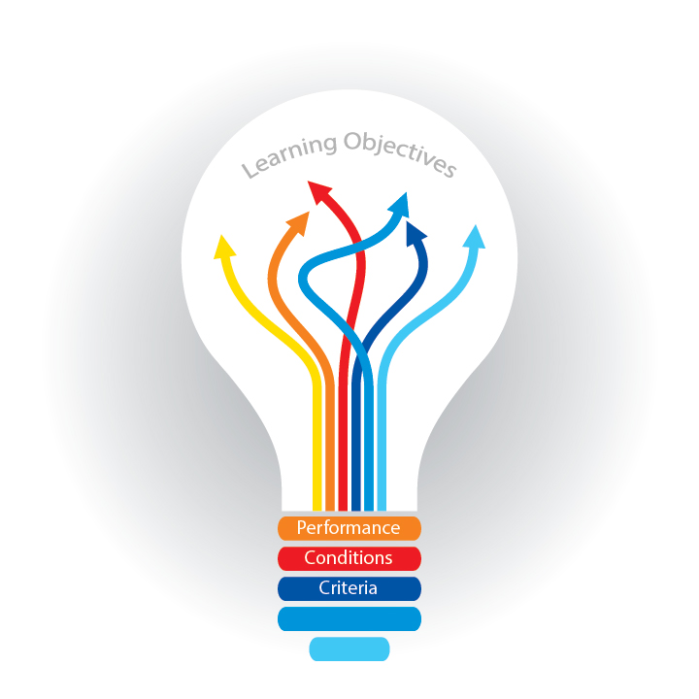
Learning Objectives
At the end of this session, students will be able to:
Define family health nursing.
Analyze definitions of family.
Discuss characteristics all families have in common.
Identify types od family.
Discuss skills used during home visits.
Describe components of the family home visits.
List specific safety measures the community/public health nurse should take when traveling to a home or making a home visit.
Describe the data collection categories for family health assessment.
List the five basic principles the community/public health nurse should follow when assessing family health.
Describe the three types of evaluations that are necessary after family health interventions.

Slide 3

Introduction
The family plays a critical role in the health of its members.
Health habits such as preventative care, diet, exercise, and physical activity are developed in the context of family.
Health beliefs, genetic influences, and care of the ill family member all take place within the family environment.
The community health nurse is in a unique position to influence and promote family health.

Slide 4

Definitions
Family
“The basic unit of society”
“two or more individuals who depend on one another for emotional, physical, and economical support.
“Family is who they say they are”

Slide 5

Definitions
Family Health:
“Dynamic changing state of wellbeing, which includes the biological, psychological, spiritual, sociological, and culture factors of individual members and the whole family system”

Slide 6

Definitions
Family Health Nursing:
"The practical science of preventative and remedial support to the family in order to help the family system unit independently and maintain & improve its family functions.”

Slide 7

Universal Characteristics of Families
1. Every family is a small social system.
Families are interdependent.
Families maintain boundaries.
Families exchange energy with their environments.
Families adapt.
Families are goal oriented (providing love, security, and a sense of belonging).
2. Every family moves through stages in its life cycle.
3. Every family has its own cultural values and rules.
4. Family members share certain values that affect their behavior.

Slide 8
Universal Characteristics of Families
5. Certain roles are defined for family members.
6. A family's culture influences its distribution and use of power.
7. Every family has structure.
8. Every family has certain basic functions:
Providing affection
Providing security
Instilling identity
Promoting affiliation
Providing socialization
Establishing controls

Slide 9
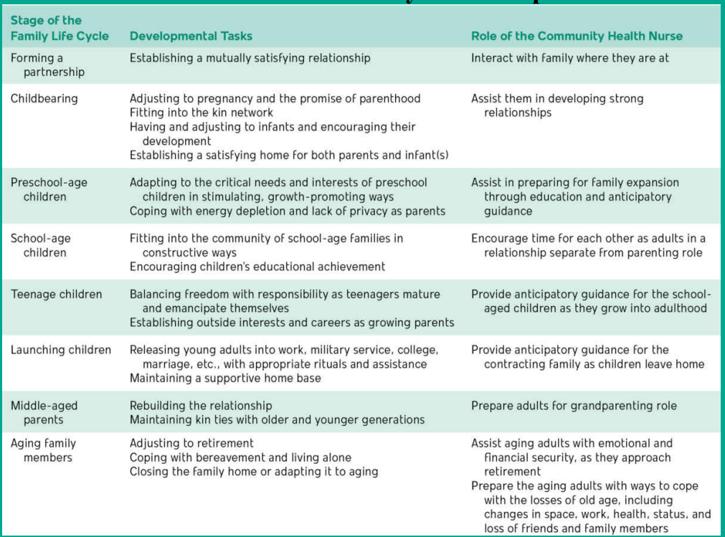
Family Stage of Development

Slide 10

Types of Families
Traditional Families
Contemporary Families

Slide 11
Types of Families “Traditional Families” reflect structures that were historically considered the “norm” in many societies and reinforced by religion, education, and cultural institutions.
Nuclear Family: Husband, wife, and children living together. Roles may vary: both adults working, one adult working and one managing the home, or partners alternating responsibilities.
Nuclear Dyad Family: Two adults living together without children (either by choice or after children leave home).
Kin Network Families: Multiple nuclear families (e.g., grandparents, aunts, uncles, cousins) living together or close by, sharing resources, childcare, and responsibilities.
Example: Extended households in close-knit ethnic communities or children postponing leaving home due to economic or educational reasons.

Slide 12
Types of Families “Contemporary Families” reflect social, cultural, and economic shifts that challenge the traditional “ideal.” These forms are increasingly accepted and visible in media, communities, and healthcare.
Families Experiencing Divorce, Remarriage, and Blending
Blended (or Step-) Families: Created when parents remarry and bring children from previous relationships. Requires adjusting roles, communication, and traditions.
Requires significant adjustment, redefinition of roles, and can involve complex dynamics with noncustodial parents.
Single-Parent Families
Structure: One adult (by choice, divorce, death, or separation) raising children.
Key Feature: Most often headed by women. Faces unique challenges related to being the sole financial, emotional, and caregiving support.

Slide 13
Types of Families “Contemporary Families”
LGBTQ Families: Families headed by one or more lesbian, gay, bisexual, transgender, or queer individuals. They may have biological children (from previous or current relationships), adopted children, or foster children.
Families Headed by an Adolescent Parent(s):
Structure: A family where one or both parents are teenagers..
Cohabitating Couple Family:
Structure: An unmarried couple, heterosexual or LGBTQ, living together with or without children.
Key Feature: Chosen for various reasons, including delayed marriage, career focus, or as an alternative to marriage in later life. Not always a precursor to marriage.
Families with Older Adults:
This can refer to elderly couples living independently, multi-generational households, or situations where adult children become caregivers for their aging parents.
Foster Families:
Trained individuals or couples who provide temporary, safe, and loving homes for children removed from their biological families due to maltreatment.

Slide 14
Q??
Types of Families
A household consists of J, his wife M, and their two biological children, D and S. They all live together in one family home. J works as an engineer, while M is a teacher.
After her divorce, A lives alone with her young son, K. She is solely responsible for the family's income, caregiving, and household decisions.
M and her daughter E moved in with C and his son J after they got married. Now, all four of them live together, navigating new relationships and merging their family traditions.

Slide 15
Q??
Types of Families
M and L have been together for five years and share an apartment. They have a dog and are both focused on their careers. They are not married but consider each other life partners.
Seventeen-year-old C lives with her mother and her newborn baby, L. She is balancing her responsibilities as a new mother while trying to finish high school with the support of her family.
D and S have been certified by the state to provide a temporary, safe, and loving home. They are currently caring for 8-year-old Leo, who was placed with them while his biological parents receive counseling and support to overcome challenges.

Slide 16

Working with Family: Home Visit
The family is the client and unit of service.
The Home as a Unique Setting:
  The nurse is a guest in the family's most intimate space.
  Entry is based on mutual trust: the family trusts the nurse to help, and the nurse trusts the family's welcome.
Nurse's Preparation: Requires skills in observation, communication, understanding visit components, and ensuring personal safety.

Slide 17
Working with Family: Home Visit
Foundational Principles for the CH Nurse
Non-Judgmental Practice:
  Work with all families (e.g., same-sex couples) without letting personal values conflict with professional responsibility.
  Provide unbiased care to promote collective family health.
Ultimate Goal: Assist the family in becoming independent of services.
Move from focusing on family "problems" and "needs" to identifying family strengths (The Asset-Based Approach)
Consider Existing Support: Ask "Who did this before me?" to avoid replacing natural support systems.
Practice Empathy: Reflect on how you would cope if you were in the family's situation.

Slide 18
Working with Families
“Home visits”
Skills Used During Home Visits
A) Essential Skills for the Home Visit
A trusting relationship is key to a productive visit.
Required Skill Set:
  Expert interviewing & communication.
  Relational skills (intuition, openness, compassion).
  Acute observational skills.
Overall Goal: Use these skills to promote nurturing relationships and stronger family health.

Slide 19
Working with Families
“Home visits”
Skills Used During Home Visits
B) Acute Observational Skills
What to Observe: Everything! Both the family and their environment.
Key Areas of Focus:
  Neighborhood: Safety, general conditions.
  Home Environment: Physical appearance, resources, barriers.
  Family: Demeanor of all family members (present and absent), number of members. Nurse can inquire about absent members.
Purpose: This information helps you understand the family, identify patterns, and provide context for their situation.

Slide 20
Working with Families
“Home visits”
Skills Used During Home Visits
C) Observing the Family: Nonverbal Cues
Data Collection Starts Immediately: From the moment you knock on the door.
What to Look For:
  Body language, facial expressions, eye contact, gestures.
Action Steps:
  Acknowledge and greet everyone.
  Use observations to open conversation (e.g., "You seem anxious today...").

Slide 21
Working with Families
“Home visits”
Skills Used During Home Visits
D) The Nurse's Own Nonverbal Communication
Nurse Are Also Being Observed: The family reads her/his body language closely.
Behaviors to Avoid:
  Fidgeting (e.g., keys): Signals nervousness or not wanting to be there.
  Appearing rushed: Shows a lack of interest.
  Minimal eye contact: Perceived as rude or unprofessional.
  Refusing to sit or showing shock: Implies fear or judgment.

Slide 22
Components of the Family Home Visit
1- Pre visit preparation
2- Making the visit
3- Concluding and documenting the visit

Slide 23
Components of the Family Home Visit
1- Pre-visit preparation
Triggered by a Referral: A request for service, which can be:
  Formal: From physicians, hospitals, social services.
  Informal: From family, friends, or shelters.
Common Referral Examples:
  Follow-up for low-birth-weight babies or teen mothers.
  Home assessment for a child returning to parents.
  Checking on an elderly relative with health concerns.

Slide 24
Components of the Family Home Visit
When calling for the first time, you, the PHN, will:
Introduce yourself
Explain the reason for the call
Give the reason why the family was referred
Indicate what the visit consists of
Determine when a visit would be convenient for the family and you
Get explicit directions to where the family is staying (the referral may have a different address, or the family did not mention that they are staying elsewhere)
Repeat the date and time of the scheduled visit
1- Pre-visit preparation

Slide 25
Components of the Family Home Visit
1- Pre-visit preparation
Nurse's Toolkit:
  Contact info, educational materials, charting tools.
  Resource directory, nursing bag/supplies.
  Specialized supplies for specific visit types.
Managing Defensiveness: Be prepared to explain the purpose clearly:
  It's a routine service to support the transition home.
  It's an opportunity for them to ask questions.
  It's a free service provided by the agency (no direct cost).

Slide 26
Components of the Family Home Visit
  Be Adaptable & Flexible: The visit's agenda may need to change based on new circumstances (e.g., a new baby arrives).
  Wellness-Oriented: Remember, clients often have higher levels of wellness than in acute care.
  Collaborate Actively: Develop a sustained plan of care with the family.
Concluding the Visit Effectively:
  Review important points.
  Emphasize and validate family strengths.
  Plan together for the next visit.
2- Making the visit

Slide 27
Components of the Family Home Visit
The Balancing Act: Visit Length
Too Short (< 20 mins):
  Insufficient for a thorough assessment.
  Ideal for: Dropping supplies, relaying quick info, a brief check-in.
Too Long (> 60 mins):
  Avoid. Can be disruptive and unproductive.
  Risks: Disrupts family routines, family may feel no value was gained, can lead to missed future visits.
  Better Approach: Split lengthy assessments over two visits.
  Key: Pick up on nonverbal cues to gauge the right time to end.
2- Making the visit

Slide 28
Components of the Family Home Visit
Immediate Post-Visit Actions:
  Say goodbye and pack up efficiently.
  Prepare for your next visit while still in the community to demonstrate respect and professionalism.
Documentation (Charting):
  Gold Standard: Complete documentation immediately after the visit, before the next one.
  Tools: Use agency-provided devices (laptop, tablet) for electronic health records.
Documentation Forms: Vary by agency but are designed for efficiency (e.g., checklists, coded care plans, narrative forms for specific assessments like postpartum visits).
3- Concluding & Documenting the Visit

Slide 29
Focus of the Family Home Visit
1- Family Education & Anticipatory Guidance
2- Health Promotion & Illness Prevention

Slide 30
Focus of the Family Home Visit
1- Family Education & Anticipatory Guidance
Tailored to Community Needs: Health departments design services based on local population data.
Example 1: High-Risk Maternal/Child Health
  Target: Communities with high rates of teen pregnancy or high-risk infants.
  Interventions: Home/clinic visits for prenatal, postpartum, and newborn care education.
  Guidance: Promotes well-baby visits, immunizations, and safety awareness.
Example 2: Aging Populations & Chronic Illness
  Target: Older adults or migrant workers.
  Interventions: Teaching chronic disease management, enhanced nutrition, and fall/injury prevention.

Slide 31
Focus of the Family Home Visit
2- Health Promotion & Illness Prevention
Empowering Families: Teaching healthy living practices, even with chronic illness limitations.
Core Activities Include:
  Screening (e.g., hypertension, cholesterol).
  Physical assessments.
  Nutrition and safety education.
  Promotion of Immunization.
The Critical Role of Immunization:
  Protects individual and community health ("herd immunity").
  The nurse's role: Provide information, teach the importance of schedules, and conduct follow-up.

Slide 32
Personal Safety on the Home Visit
Personal Safety: A Professional Priority
Safety is essential and must be balanced with maintaining respect, trust, and professionalism.

Slide 33
Personal Safety on the Home Visit
Safety While Traveling
Informing the Agency:
  Always leave a detailed itinerary with family contact info and your mobile number.
By Car:
  Full gas tank, GPS/map, addresses, and a cell phone.
By Public Transportation:
  Bus fare/schedule, knowledge of stops (to and from), and a cell phone.
General Rule: Always call the family ahead of time with your estimated arrival time.

Slide 34
Personal Safety on the Home Visit
Safety Upon Arriving at the Home
Verification is Critical: Do not enter until you are sure it's the right house and the correct family is home.
The Golden Rule: Do not enter if someone other than your identified client invites you in.

Slide 35
Personal Safety on the Home Visit
Dealing with Challenging Situations: Family Conflict
If an argument or physical fight breaks out:
  Immediately terminate the visit.
  Calmly state that the distraction prevents the visit's purpose.
  Inform them you will reschedule.
  Calmly and quickly remove yourself from the home.
NEVER: Intervene, try to stop a fight, or act as a referee. You could become the next victim.
After Leaving: Use your observational skills to document the event for future assessment.

Slide 36
Personal Safety on the Home Visit
Dealing with Challenging Situations: Intoxication & Strangers
Family Members Under the Influence:
  Assess the situation. If the person is calm and in another room, you may continue.
  Terminate the visit if the person is disruptive, abusive, or the situation feels volatile.
  Reschedule for a time when the person is not under the influence. Never put yourself in the middle of a deteriorating situation.
Presence of Strangers:
  This may be the family's norm but can be distracting or make you uncomfortable.
  Rely on observation and inquiry. Ask who they are and their relationship to the family.
  Decide on inclusion: Determine if they should be included in the visit or if their presence indicates other family health needs.

Slide 37
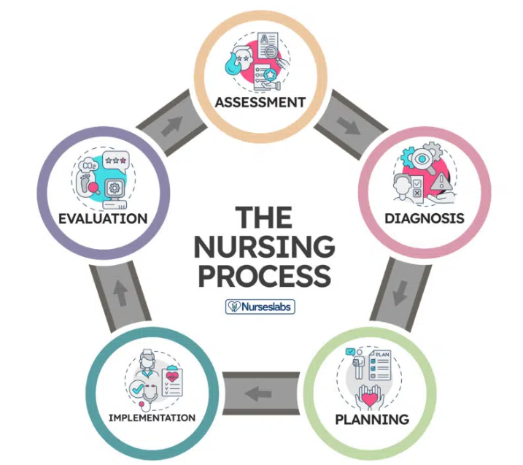
Using of Nursing Process
Family as A Client

Slide 38
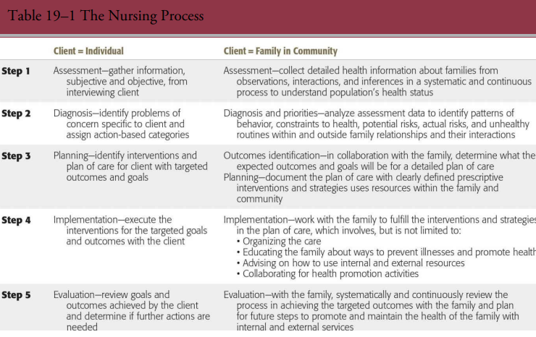
Nursing Process

Slide 39
Nursing Process
Family Health Assessment
Data Collection Categories
  Family demographics, Physical environment, Psychological and spiritual environment, Family structure and roles, Family values and beliefs, Family communication patterns, Family health behavior, Family decision-making patterns, Family problem-solving patterns, Family coping patterns.

Slide 40
Nursing Process
Family Health Assessment
Assessment Methods
1- Informal approach
where the nurse relies on her or his acute observational skills for the assessment.
2- Formal approach
include specific questions and assessment tools such as questionnaires, tests, and/or charts/diagrams

Slide 41
Nursing Process
Family Health Assessment
Assessment Methods:
2- formal approach: Examples
The Eco-Map
The Genogram

Slide 42
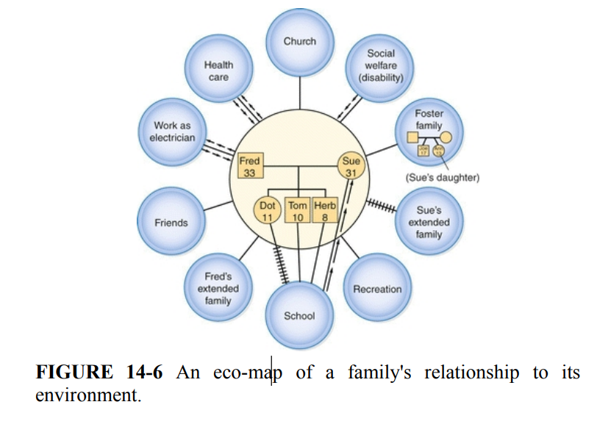
Nursing Process
Family Health Assessment
2- Formal approach: Examples (Eco-map)
A visual map of the family's connections with external systems in their environment.
Key Components:
  Central Circle: The family or a specific family member.
  Peripheral Circles: Other people, organizations, and systems (e.g., work, school, healthcare).
  Connecting Lines: Depict the strength and nature of the relationships (e.g., strong, weak, stressful).
Benefit: Depicts dynamic family-environment interactions and sources of support or stress.

Slide 43
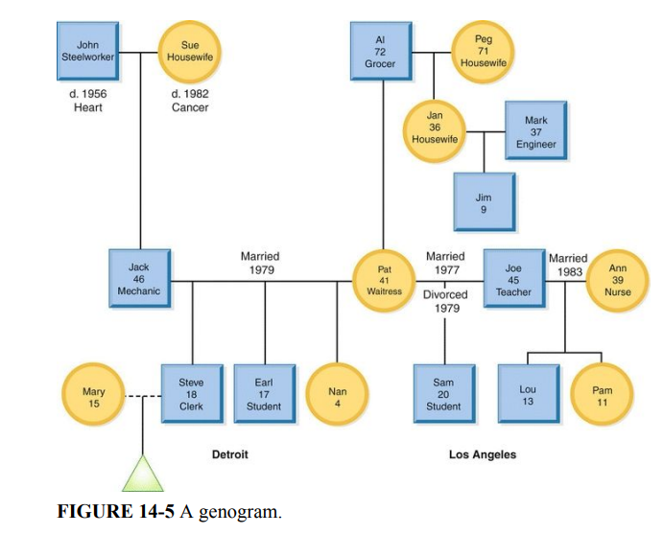
Nursing Process
Family Health Assessment
2- Formal approach: Examples (Genogram)
A visual diagram of the family's genealogy and relationships across generations.
Key Uses & Benefits:
  Reveals complex family patterns (e.g., hereditary diseases, relationship dynamics).
  Helps formulate hypotheses about family health over time.
  Encourages family expression and storytelling.
  Links health outcomes to preventive strategies based on identified risks.

Slide 44
Nursing Process
Family Health Assessment
Focus on the family as a total unit.
Ask goal-directed questions.
Collect data over time.
Combine quantitative and qualitative data.
Exercise professional judgment.
Guidelines for Family Health Assessment

Slide 45
Nursing Process
Family diagnosis process
During the family diagnosis process, the CH nurse recognizes patterns, behaviors, and/or seen/unseen routines from the collected information during the assessment.
This step involves identifying issues, risks concerns, and problems that can negatively alter the health of the family.

Slide 46
Nursing Process
Family diagnosis process
Identify the family health problems.
Determine what family members are directly and indirectly related to the problem.
Determine what factors from the external environment are related to the problem.
Describe the problem as it impacts the identified family members and external environment.
Indicate the risks that are associated with the problem(s).
Prioritize the problems along with their risks with an emphasis on the problems that are overlapping and/or have overlapping risks.
2. Indicate the factors from the family (family unit and family members) and the external environment that are associated with the health problems.
3. Determine the measurements (quantitative and qualitative data) that confirm or verify the health problems.

Slide 47
Family NANDA 2024
Ineffective family health self-management
Risk for impaired attachment
Disturbed family identity syndrome
Risk for disturbed family identity syndrome
Dysfunctional family processes
Interrupted family processes
Readiness for enhanced family processes
Compromised family coping
Disabled family coping
Readiness for enhanced family coping

Slide 48
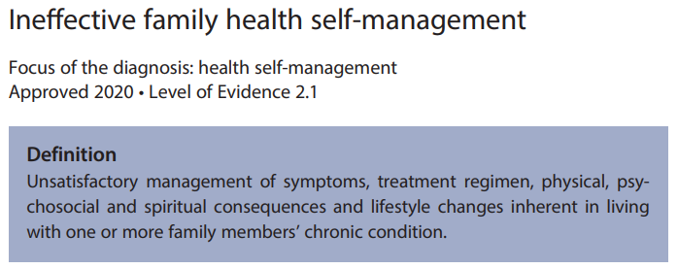
NANDA Ex.

Slide 49
Nursing Process
Family Care Planning
Planning occurs when:
Family assessment is made
Data is analyzed in a systematic way.
Priorities are determined.

Slide 50
Nursing Process
Family Care Planning
The five areas of needs identified through nurse-family interactions are:
Growth and development
Coping with losses and illness
Adapting to the demands of modifying the environment
Strengthening inadequate resources and support
Dealing with disturbances in internal dynamics.

Slide 51
Nursing Process
Family Care Planning
Goals should be set mutually by nurse and the family member.
Each family is unique, and thus their care plan also.
Set realistic goals, according to time and resources and within limitations determined by the nurse employer/ organization.
Plan care according to family’s values and health care beliefs.
Coordinates with the health care team.

Slide 52
Nursing Process
Implementation
Making Referrals
Purpose: To connect the family with services beyond the agency's own resources.
Nurse's Responsibility:
  Have in-depth knowledge of community resources (official, voluntary, religious).
  Know eligibility requirements and service availability.
Contacting Resources
The Nurse as a Connector: Knowing key personnel in agencies can help "cut through red tape" for families.
Building Rapport: Establishing relationships with agency staff helps:
  Secure services for families more effectively.
  Expand the nurse's own database of available services for future referrals.
Empowering Families: The nurse can also give families pointers on how to procure services themselves.

Slide 53
Nursing Process
Family Health Evaluation
Structure-Process Evaluation: How the visit was organized and conducted.
Outcome Evaluation: Whether the goals were achieved.
Self-Evaluation: The nurse's assessment of their own performance.

Slide 54
Nursing Process
Family Health Evaluation
Structure-Process Evaluation
Focus: The organization and flow of the visit itself.
What to Analyze:
  Resources & Environment: Timing, number of people present, materials used.
  Nurse's Actions: Use of observational skills, adherence to standards.
Goal: Identify what to change or modify to make the next visit more effective and avoid distractions.

Slide 55
Nursing Process
Family Health Evaluation
Outcome Evaluation
Focus: Determining if the planned goals (outcomes) were met.
How it's Measured:
  Agency-Driven Criteria: Success based on specific expectations for a client type or visit.

Slide 56
Nursing Process
Family Health Evaluation
Self-Evaluation & Peer Review
Self-Evaluation:
  The nurse reflects on their own preparedness, data collection, and effectiveness.
  Goal: Identify personal strengths and areas for improvement to enhance future practice.
Peer Evaluation:
  Another nurse observes a visit and provides feedback.

Slide 57

Case Study Analysis
Family Profile:
Family Name: R. Family
Location: Small, rural community outside of the city. Nearest healthcare facility is 45 minutes away.

Slide 58
Case Study Analysis
Household Members:
Mother (A, 35 years old): Diagnosed with Type 2 diabetes and hypertension, non-compliant with medication due to financial difficulties.
Father (H, 40 years old): Works long hours in construction, has a history of smoking and persistent coughs but hasn’t visited a doctor in years due to lack of time and money.
Child 1 (S, 12 years old): Frequently misses school due to recurrent respiratory infections, sleeps in a shared, poorly ventilated bedroom with three younger siblings.
Child 2 (O, 9 years old): Struggles with obesity, likely due to a poor diet, which consists of mostly processed foods due to the family's financial constraints.
Child 3 (F, 6 years old): Appears healthy but is starting to show signs of behavioral issues, such as aggression at school, potentially linked to stressful family dynamics.

Slide 59
Case Study Analysis
Environment:
The R live in a small, crowded two-bedroom house in a low-income rural area. The home has minimal insulation and poor ventilation, which exacerbates S’s respiratory issues. The area has limited access to healthcare, fresh produce, and health education resources.
Referral Reason:
The R family has been referred for a family health visit by a school nurse at S’s school, concerned about the overall health of the family and their limited access to healthcare. The school nurse reports that the children often appear undernourished, fatigued, and unkempt. The school nurse is also worried about the mother’s chronic conditions and her ability to care for the family, given her non-compliance with prescribed treatments.

Slide 60
Case Study Analysis
Pre-Visit Preparation:
How will you introduce yourself, explain the reason for the visit, and gather necessary information (e.g., health records, community resources) while addressing potential communication barriers and building rapport with the family?
Making the Visit:
How will you assess the health of each family member, prioritize health issues, and provide interventions considering the family's financial constraints and living conditions, while addressing behavioral and mental health concerns?
Concluding and Documenting the Visit:
What key information will you document, how will you ensure follow-up with the family given their barriers to healthcare access, and what action plan will you develop to support their ongoing care?

Slide 61
Case Study Analysis
Pre-Visit Preparation:
How will you introduce yourself, explain the reason for the visit, and gather necessary information (e.g., health records, community resources) while addressing potential communication barriers and building rapport with the family?
Making the Visit:
How will you assess the health of each family member, prioritize health issues, and provide interventions considering the family's financial constraints and living conditions, while addressing behavioral and mental health concerns?
Concluding and Documenting the Visit:
What key information will you document, how will you ensure follow-up with the family given their barriers to healthcare access, and what action plan will you develop to support their ongoing care?
Application of Nursing Process:
How can the nursing process be applied to the Rahman family's case during the family health visit?

Slide 62
References
Rector, C. L. (2018). Community Health Nursing: Promotion & Protecting the Public’s Health. 9th ed. Philadelphia: Wolters Kluwer Lippincott Williams and Wilkins.
Robinson, M., Coehlo, D. P., & Smith, P. S. (2022). Family health care nursing : theory, practice, and research (7th edition). F.A. Davis Company.

Slide 63


