Slide 1
Epidemiology in Community Health Care
Course Code (title)
2026-2027

Slide 2
Objectives
Explore epidemiology.
Explain the host, agent, and environment model.
Describe theories of causality in health and illness.
List the major sources of epidemiologic information.
Distinguish between incidence and prevalence in health and illness states.
Use epidemiologic methods to describe an aggregate’s health.

Slide 3

Epidemiology
The word epi means among, and demos means people and logos study.
Epidemiology involves consideration of health problem in light of factors involved in its development.
The primary concern of epidemiology is the health of groups of people.

Slide 4

Epidemiology
Epidemiology is concerned with the distribution and determinants of health-related states or events of health and illness in specified human populations and the application of this study to the control of health problems. (USDHHS, 2012).
Its is data driven and relies on an unbiased and systematic approach to collecting and analyzing and interpreting data.

Slide 5

Terminologies Frequently used in

Slide 6
Endemic
Refers to the constant presence of a disease or infectious agent within a given geographic area or population group, without importation from outside.; may also refer to the “usual” or expected frequency of the disease within such area or population group. E.g. common cold.
An endemic can turn to an epidemic, e.g. typhoid fever.

Slide 7
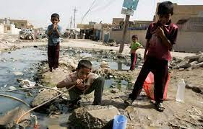

Epidemics
An epidemic refers to a disease occurrence that clearly exceeds the normal or expected frequency in a community or region.
“In past centuries, epidemics of cholera, bubonic plague, and smallpox swept through community after community, killing thousands of people, changing the community structure, and altering the lifestyle of masses of people”.

Slide 8

Pandemic
When an epidemic, such as the bubonic plague (also called pneumonic plague or the Black Death) or HIV/AIDS, is worldwide in distribution, it is known as a pandemic.

Slide 9

Surveillance
Continuous scrutiny of the factors that determine the occurrence and distribution of disease and other conditions of ill health.
The main purpose is to detect changes in trend or distribution in order to initiate investigative or control measures.
e.g. Surveillance for occurrence of Hepatitis B

Slide 10
Concepts of Epidemiology
Host, Agent, and Environment Model
Causality

Slide 11
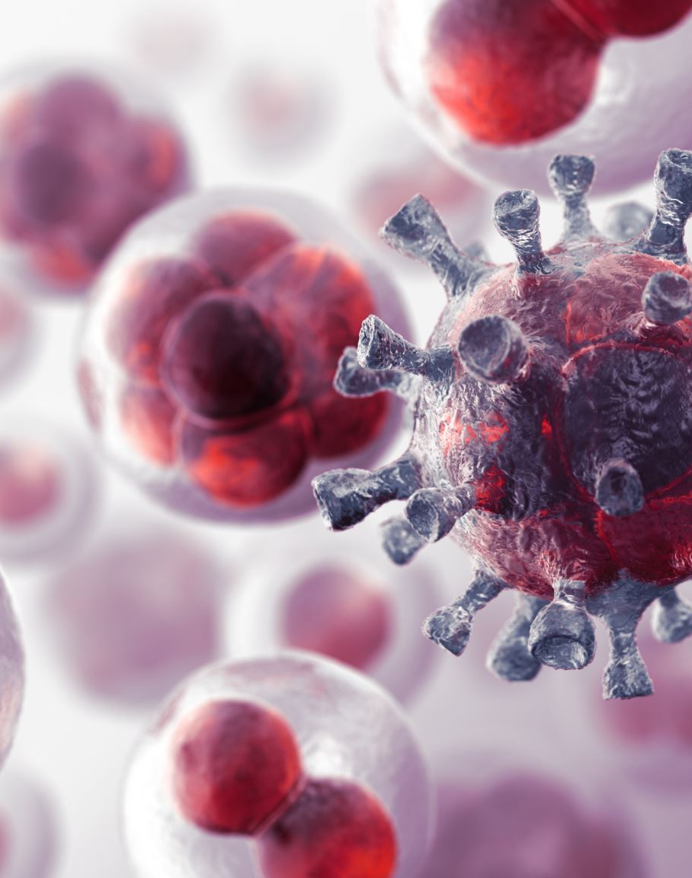
Host, Agent, and Environment Model
Through their early study of infectious diseases, epidemiologists began to consider disease states generally in terms of the epidemiologic triad, or the host, agent, and environment model.
Interactions among these three elements explained infectious and other disease patterns.

Slide 12
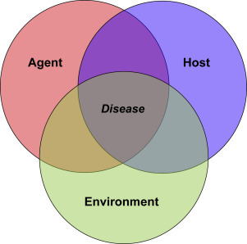
Host, Agent, and Environment Model
Host
  Susceptible human or animal who harbors and nourishes a disease-causing agent
Agent
  A factor that causes or contributes to a health problem or condition
Environment
  All the external factors surrounding the host that might influence vulnerability or resistance

Slide 13
Host
Many physical, psychological, and lifestyle factors influence the host’s susceptibility and response to an agent.
    Physical factors include age, sex, race, and genetic influences on the host’s vulnerability or resistance.
    Psychological factors, such as outlook and response to stress, can strongly influence host susceptibility.
    Lifestyle factors also play a major role. Diet, exercise, sleep patterns, and healthy or unhealthy habits all contribute to either increased or decreased vulnerability to the disease-causing agent (Fletcher & Fletcher, 2012).

Slide 14
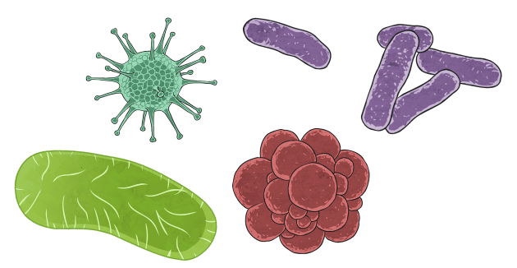
Agent
Causative agents can be:
Factors that are present (e.g., bacteria that cause tuberculosis, rocks on a mountain road that contribute to an automobile crash).
Factors that are lacking (e.g., a low serum iron level that causes anemia or the lack of seat belt use that contributes to the extent of injury during an automobile crash).
Agents vary considerably and include five types: biologic, chemical, nutrient, physical, and psychological.

Slide 15

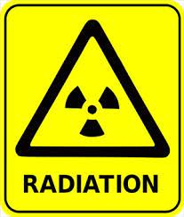
Agent
Biologic agents include bacteria, viruses, fungi, protozoa, worms, and insects. Some biologic agents are infectious, such as Influenza virus or HIV.
Chemical agents may be in the form of liquids, solids, gases, dusts, or fumes. Examples are poisonous sprays used on garden pests and industrial chemical wastes.
Nutrient agents include essential dietary components that can produce illness conditions if they are deficient or are taken in excess. For example, a deficiency of niacin can cause pellagra, and too much vitamin A can be toxic.
Physical agents include anything mechanical (e.g., chainsaw, automobile), material (e.g., rock slide), atmospheric (e.g., ultraviolet radiation), geologic (e.g., earthquake), or genetically transmitted that causes injury to humans.
Psychological agents are events that produce stress leading to health problems (e.g., war, terrorism).

Slide 16
Agent
Agents may also be classified as infectious or noninfectious.
Infectious agents cause communicable diseases, such as AIDS or tuberculosis—that is, the disease can be spread from one person to another.
Factors that influence the effect of the agent on the host
Extent of exposure to the agent,
the agent’s pathogenicity (capacity to cause disease in the host)
Infectivity (capacity to enter the host and multiply)
its virulence (severity of disease)
Toxigenicity (capacity to produce a toxin or poison)
Resistance (ability of the agent to survive environmental conditions)
Antigenicity (ability to induce an antibody response in the host)
Its structure and chemical composition

Slide 17
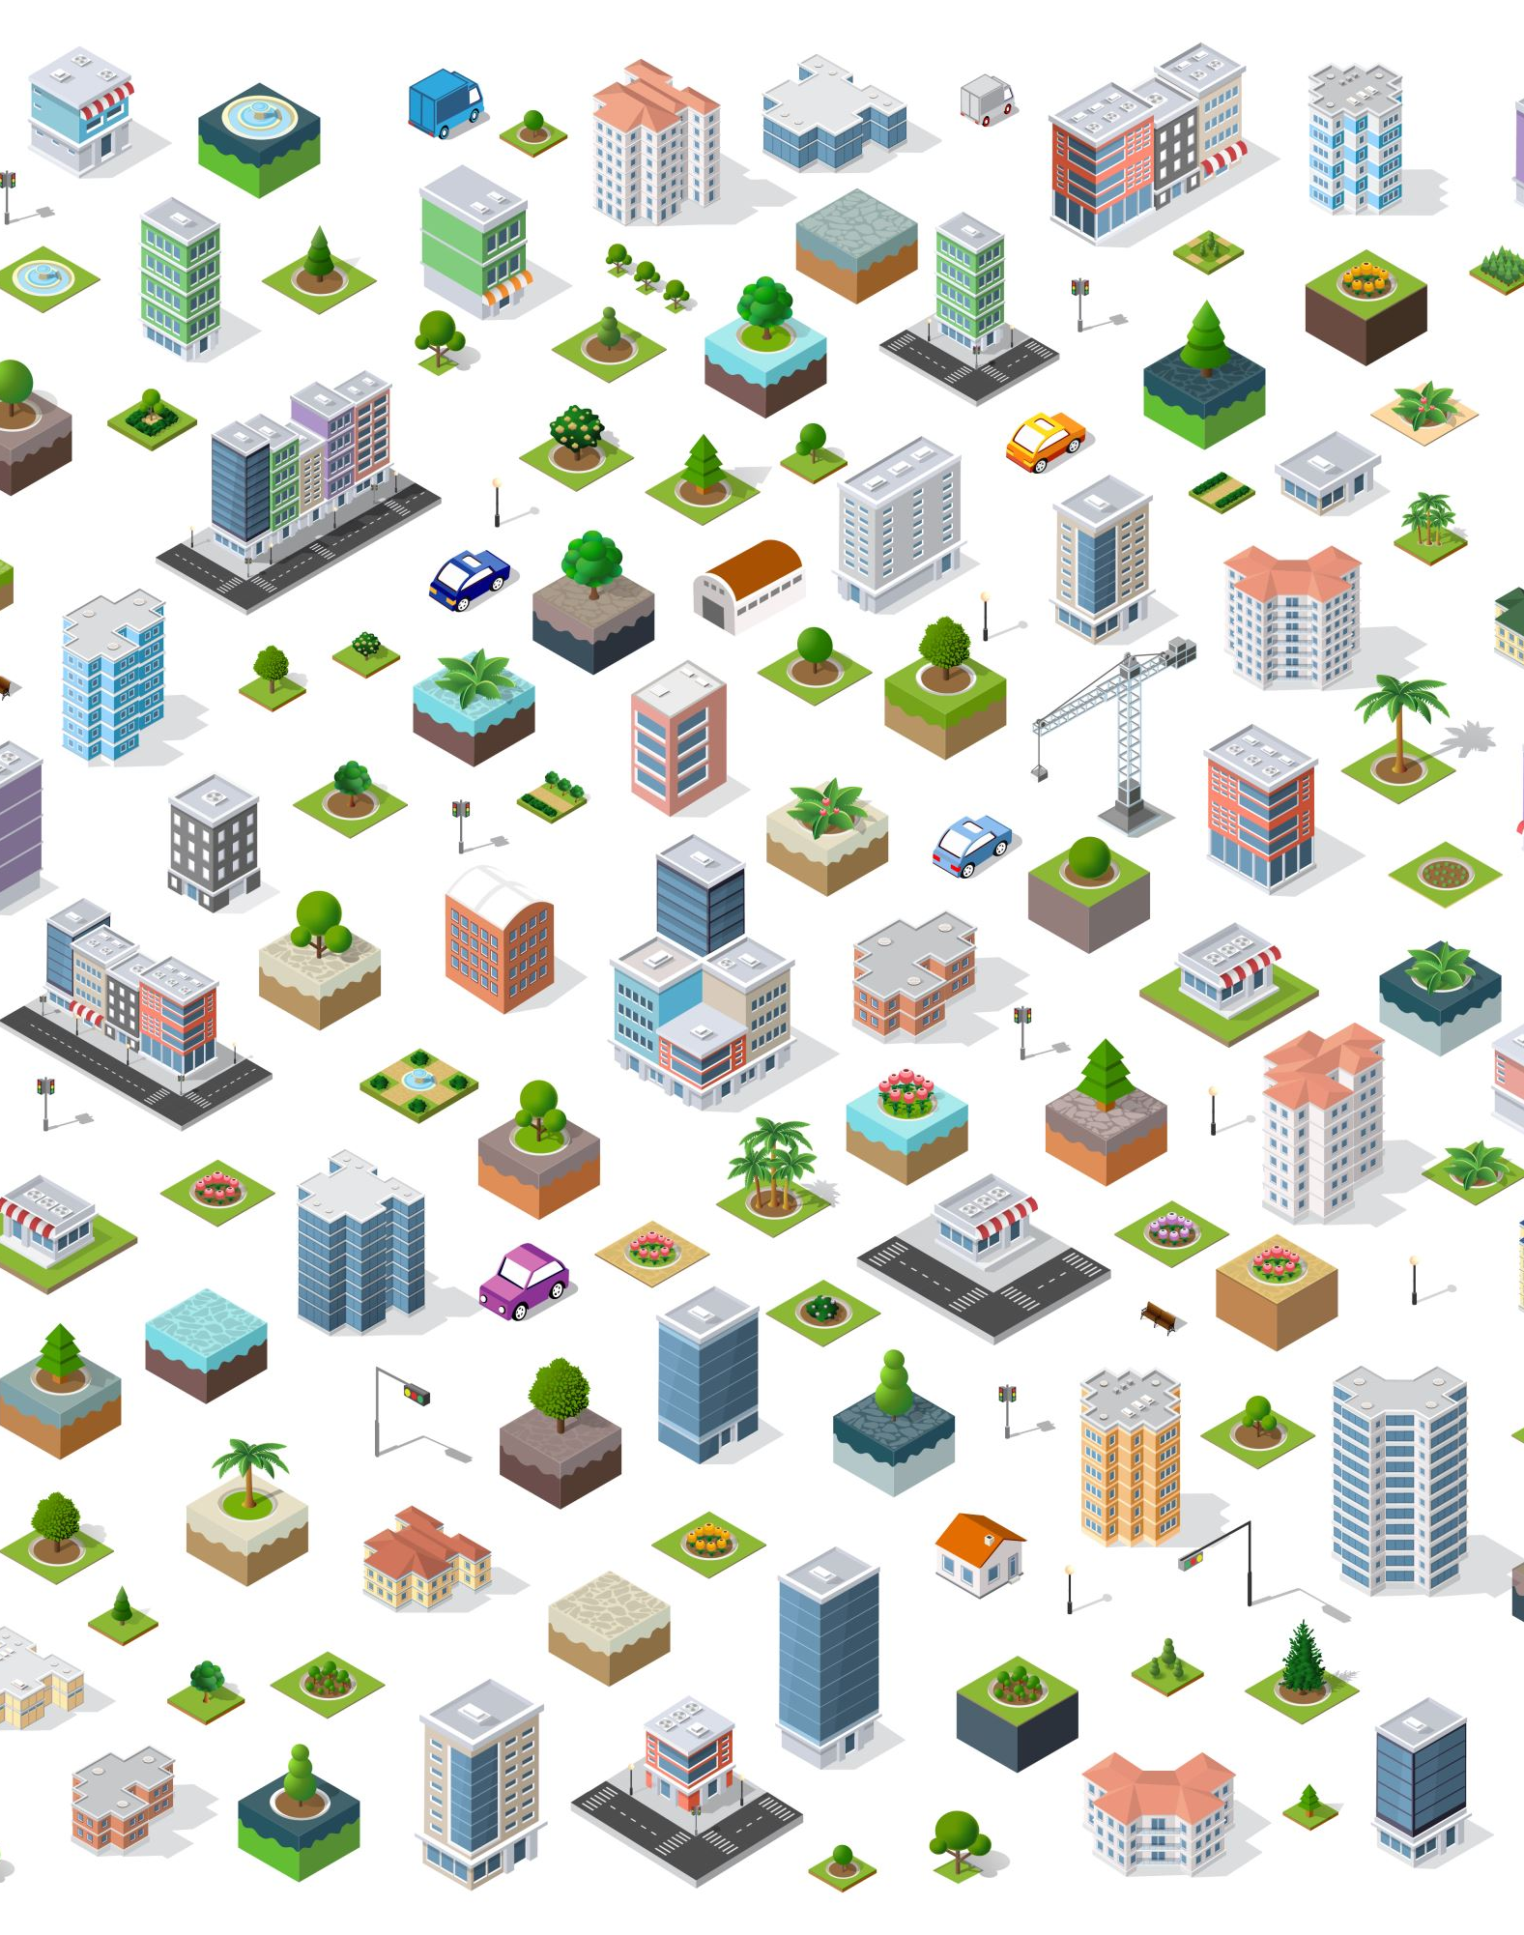
Environment
The physical environment includes factors such as geography, climate and weather, safety of buildings, water and food supply, and presence of animals, plants, insects, and microorganisms that have the capacity to serve as reservoirs (storage sites for disease-causing agents) or vectors (carriers) for transmitting disease.
The psychosocial environment refers to social, cultural, economic, and psychological influences and conditions that affect health, such as access to health care, cultural health practices, poverty, and work stressors, which can all contribute to disease or health (Fletcher & Fletcher, 2012).

Slide 18
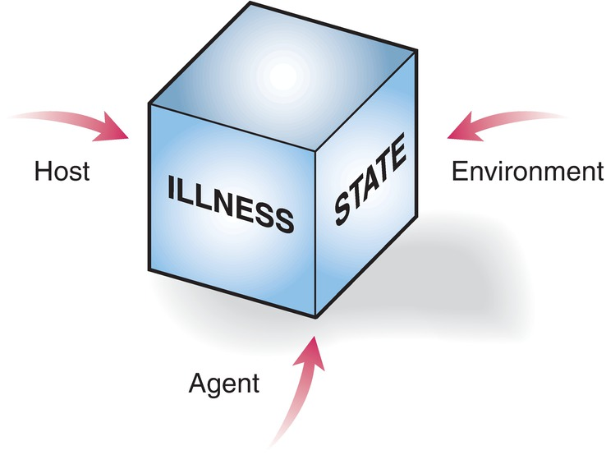
Epidemiologic triad.
Epidemiologists study the causal agent, the susceptible host, and environmental factors that contribute to an illness, an injury, or a wellness state. Intervention may focus on any of these three to prevent the spread of illness or to improve health in a population.

Slide 19

Causality
The relationship between a cause and its effect
to discover causal relationships, in order to understand why conditions, develop, and to offer effective prevention and protection (Fletcher & Fletcher, 2012).

Slide 20

Causality
  Chain of causation
  Causation in noninfectious disease
  Multiple causation
  Web of causation

Slide 21
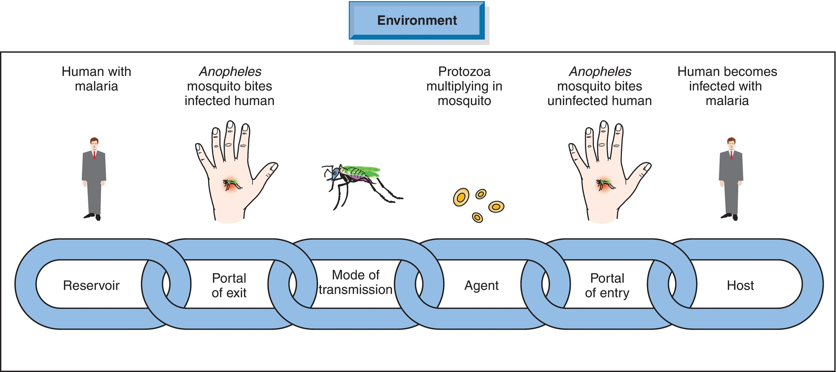
Chain of Causation

Slide 22

Causation in noninfectious Disease
Nine Criteria was developed to evaluate the relationship between environmental exposure and potential health outcomes
Strength of association
Consistency of association
Specificity
Temporality
Biological gradient
Biological plausibility
Coherence of explanation
Analogy
Experiment evidence

Slide 23
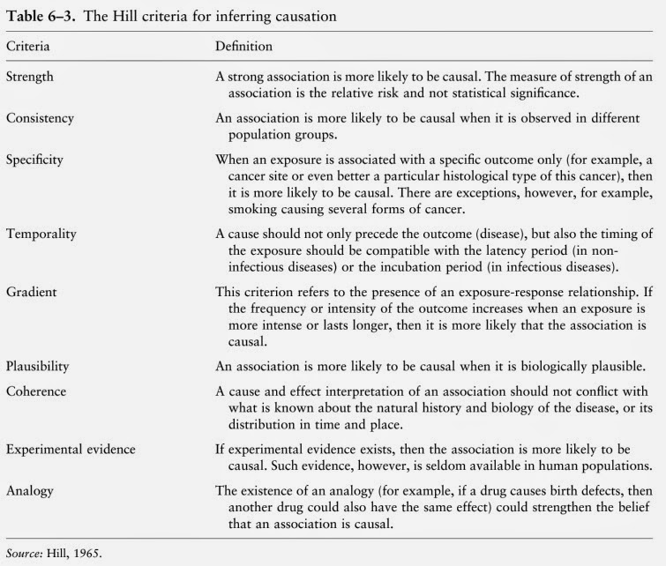

Slide 24

Multiple Causation
causation was never completely straightforward.
e.g., Even with long-recognized contagious diseases like cholera, the organism was only part of the equation. Factors such as availability of clean water, the number of trained nurses and doctors, the overall nutrition of the population, and even political upheaval could influence the spread of disease and the number who ultimately died”

Slide 25
Web of Causation
The implication that intervention (or breaking of the web at any point nearest to the disease) could profoundly impact the development of that disease.
Another common term used for this approach is causal matrix.

Slide 26
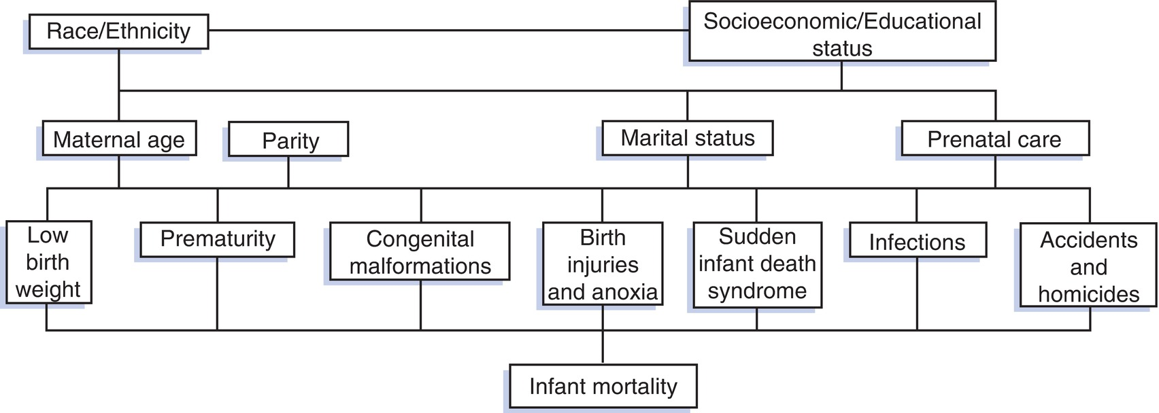
Causal Matrix for Infant Mortality

Slide 27
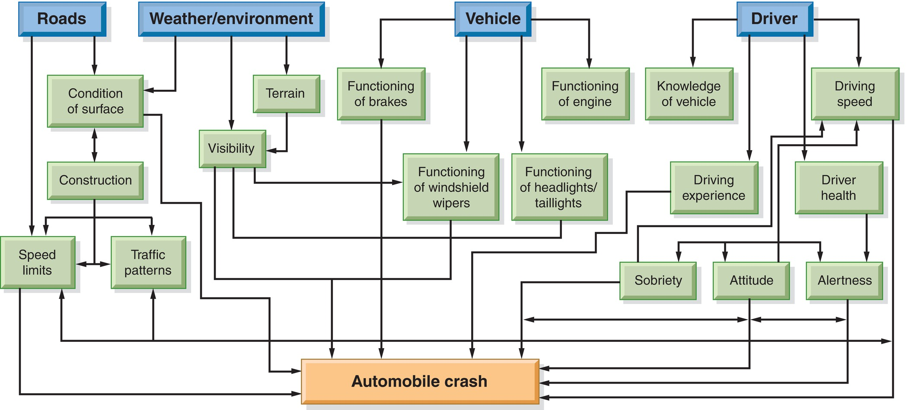
Web of Causation for Automobile Crash

Slide 28
Sources of Epidemiologic Information

Slide 29
Existing Data
Vital statistics (births, deaths,, divorces, and marriages
Census data (Population statistics)
Reportable diseases
Disease registries
Environmental monitoring (Pesticides, industrial wastes, radioactive or nuclear materials, chemical additives in foods etc..)
National Center for Health Statistics Health surveys

Slide 30
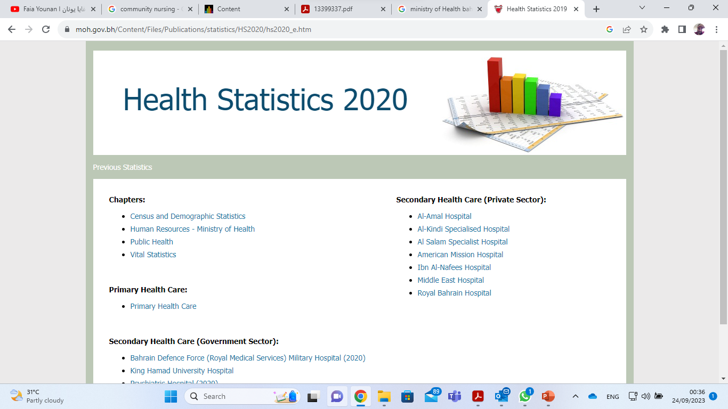
https://www.moh.gov.bh/Content/Files/Publications/statistics/HS2020/hs2020_e.htm

Slide 31

Other Sources
Informal observational studies
Informal observational study often raises questions and suggests hypotheses that form the basis for designing larger-scale epidemiologic investigations
Scientific studies
The Cochrane Database of Systematic Reviews (CDSR) is the most popular resource for systematic reviews in health care and includes a section on public health

Slide 32
Methods in Epidemiology
Descriptive epidemiology:
Includes investigations that seek to observe and describe patterns of health-related conditions that occurs naturally in a population
Example
“CHN might seek to learn how many children have been immunized against measles in a school district”

Slide 33

Descriptive Methods
Counts
simplest measure of description
If a nurse discovers 50 cases of measles in an elementary school, that is a simple count.

Slide 34
Descriptive Methods
Incidence
Incidence refers to all new cases of a disease or health condition appearing during a given time.
e.g. Three weeks after the start of a measles epidemic in a school, 20 New cases were identified. The incidence rate for that period is (20”New Cases” /450” Population at risk”)

Slide 35
Descriptive Methods
Prevalence
Prevalence refers to all of the people with a particular health condition existing in a given population at a given point in time.
For instance, if the school has 500 students, the prevalence of measles on that day would be 10% (50 measles/500 population).

Slide 36
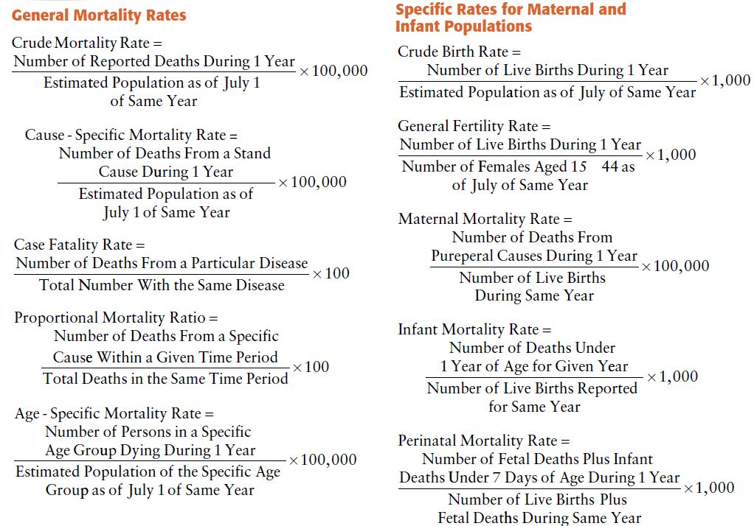

Slide 37
Methods in Epidemiology
Analytic epidemiology
  Case–control studies: compares people who have a health or illness condition (number of cases with the condition) with those who lack this condition (controls)
  Cohort studies: A cohort study begins by selecting a group of people who display certain defined characteristics before the onset of the condition being investigated (Gordis, 2014). They would be observed over time to evaluate which variables were associated with the development or nondevelopment of the disease.

Slide 38
Methods in Epidemiology
Experimental epidemiology:
Experimental epidemiology follows and builds on information gathered from descriptive and analytic approaches.
In an experimental study, the investigator actually controls or changes the factors suspected of causing the health condition under study and then observes what happens to the health state (Merrill, 2013).
In human populations, experimental studies should focus on disease prevention or health promotion rather than testing the causes of disease, which is done primarily on animals

Slide 39

Practice:
While collecting data in Jidhaf’s Health Centre, it was found:
The total no. of breast cancer deaths reported among females is 5 during 2013. The total mid-year population of females is 146,400.
The total number of new diabetic cases reported in adults last year was 487 and the old cases were 7890.
The total number of births were 11678 and the deaths were 899.
The estimated mid-year population is 267, 970. The total adult population is 1, 89, 780.

Slide 40

Calculate:
Rate of breast cancer deaths in females
Prevalence rate of diabetes
Birth rate
Death rate

Slide 41
Thank you

