Slide 1

Immunity & Communicable Diseases
NUR415 – Family and Community Health Nursing Care
Sep. 2025

Slide 2
Objectives
Define immunity and compare passive immunity, active immunity, cross-immunity, and herd immunity.
Explore recent regulations and statics of communicable diseases in Bahrain
Explain the significance of immunization as a communicable disease control measure.
Discuss the role of community nurse toward immunizations
Discuss different Measure of Safe Administration of Vaccines

Slide 3
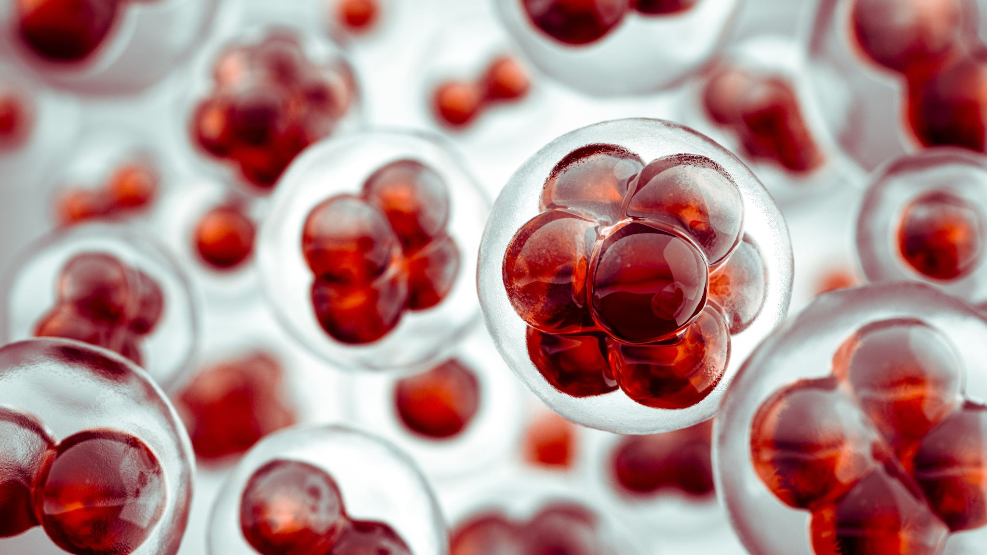
Immunity
Immunity refers to a host’s ability to resist a particular infectious disease–causing agent.
This occurs when the body forms antibodies and lymphocytes that react with the foreign antigenic molecules and render them harmless

Slide 4
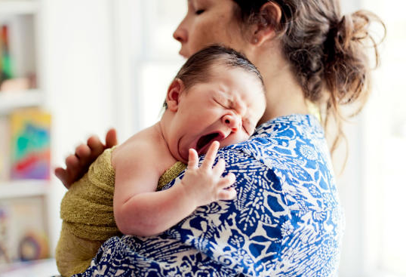
Types of Immunity - Passive Immunity
Passive immunity refers to short-term resistance that is acquired either naturally or artificially.
e.g. Newborns, through maternal antibody transfer, have natural passive immunity that lasts up to 1 year for certain diseases
e.g. immune globulin (hepatitis A) used to boost a susceptible person’s immunity, and administration must be repeated periodically

Slide 5

Types of Immunity - Active Immunity
Active immunity is long-term and sometimes offers lifelong resistance that is acquired either naturally or artificially.
e.g. a person who contracts a disease develops long-lasting antibodies that provide immunity against future exposures.
e.g. Artificially acquired active immunity is attained through vaccine inoculation. Like polio, diphtheria, smallpox vaccine

Slide 6
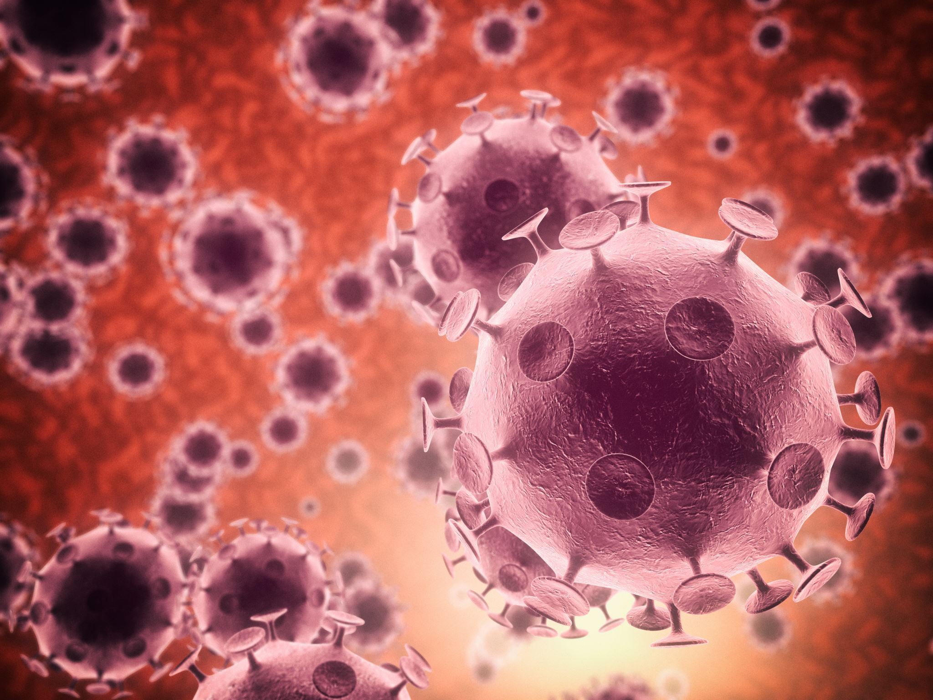
Types of Immunity - Cross-Immunity
Cross-immunity refers to a situation in which a person’s immunity to one agent provides immunity to a related agent as well.
e.g. Sometimes, infection with one disease, such as cowpox, gives immunity to a related disease, such as smallpox.

Slide 7

Types of Immunity - Herd Immunity
Herd immunity describes the immunity level that is present in a population group.
a population with high herd immunity is one in which the immune people in the group outnumber the susceptible people
Mandatory preschool immunizations and required travel vaccinations are applications of the herd immunity concept
The immunity level needed for herd protection varies by disease, generally ranging from about 80% to over 90% depending on how contagious the disease is.

Slide 8
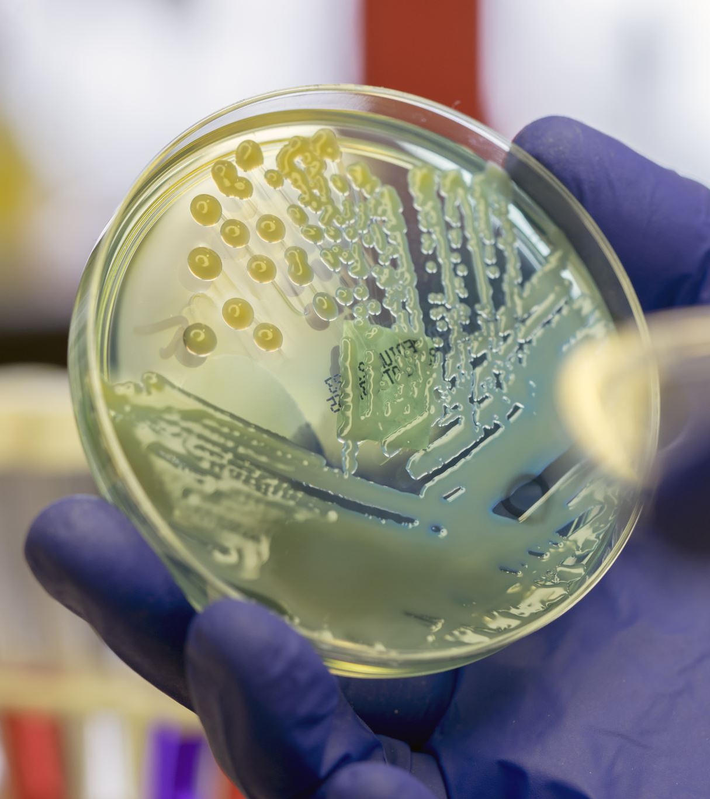
Communicable Diseases
A communicable disease is caused by an infectious agent, such as a virus or bacteria, and can be transmitted from one source to another.
Knowledge of communicable diseases is fundamental to the practice of community/public health nursing because these diseases typically spread through communities of people

Slide 9
Modes of Transmission
Communicable diseases spread through direct or indirect transmission.
Direct transmission: person-to-person or animal-to-human contact.
Indirect transmission: spread through a reservoir such as a vector, contaminated food or water, or airborne particles.
Vectors (e.g., insects) may transmit disease mechanically, carried on the body, or biologically, after the organism multiplies within the vector.

Slide 10
Foodborne & Waterborne Illness
Food- or water-related illness results from either infection (a pathogen multiplies in the GI tract) or intoxication (a bacterial toxin is ingested).
Contamination can occur at the source, through unsanitary handling, or from improper storage temperatures.
The time between exposure and symptom onset is called the incubation period.
Core prevention: handwashing, thorough cooking, safe storage and reheating, and avoiding cross-contamination between raw and cooked food.

Slide 11
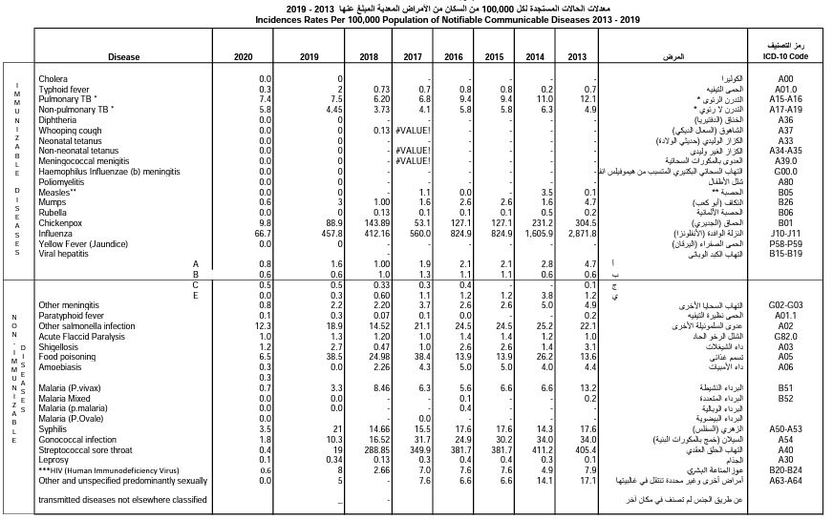

Slide 12

Prevention of communicable diseases
In the context of communicable disease control, two approaches are useful in achieving primary prevention:
immunizations
education using mass media with targeted health messages to aggregates.

Slide 13
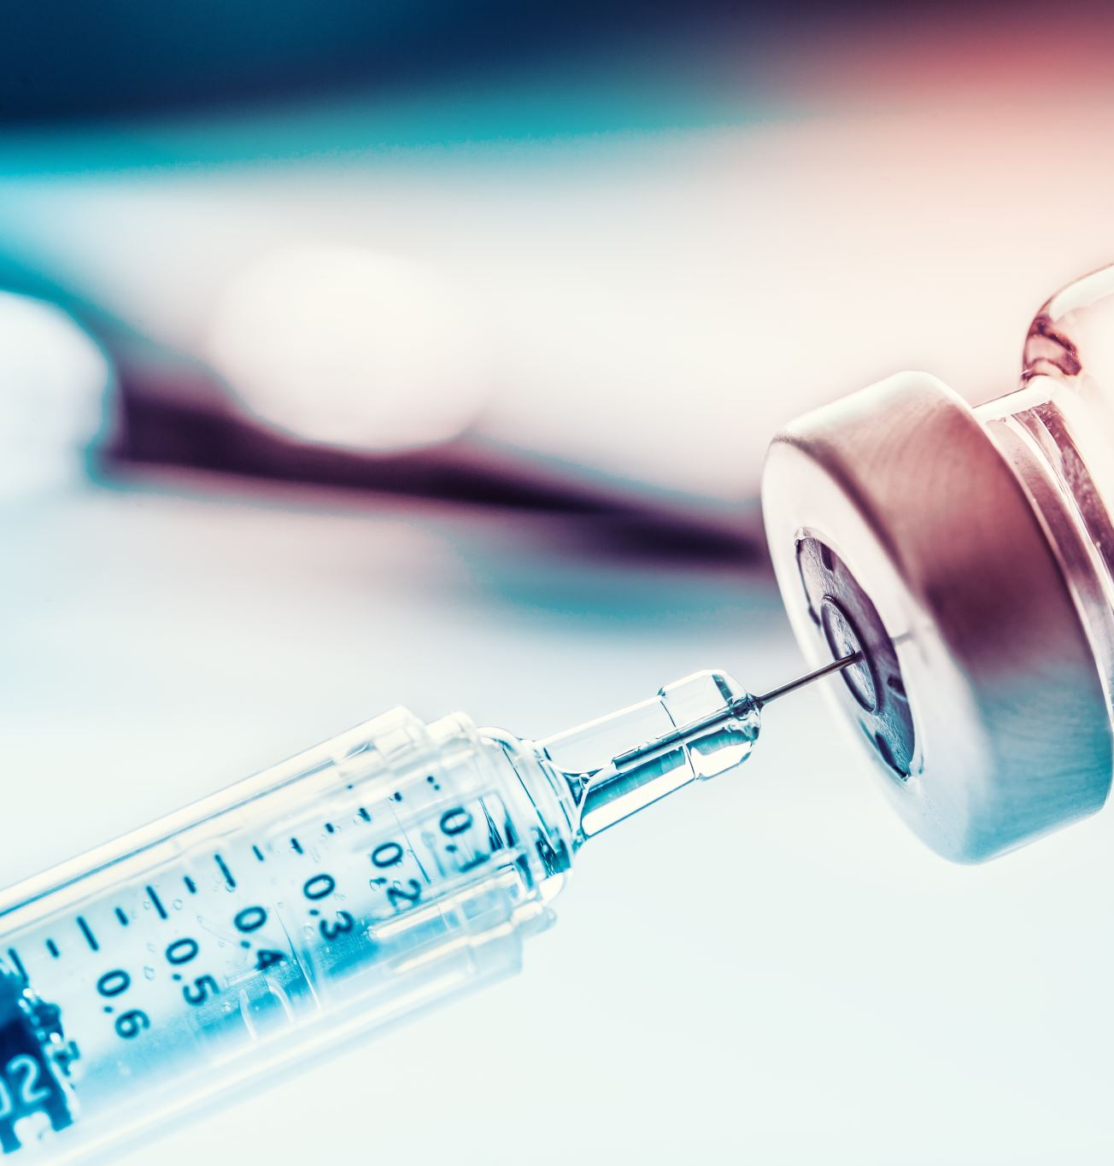
Immunization & Vaccination
The extended life expectancy that has been enjoyed during the 20th century was largely due to the expansion of immunization programs that are provided to families
Immunization: A process by which a person becomes protected against a disease through vaccination. This term is often used interchangeably with vaccination or inoculation
Vaccination: The act of introducing a vaccine into the body to produce protection from a specific disease

Slide 14
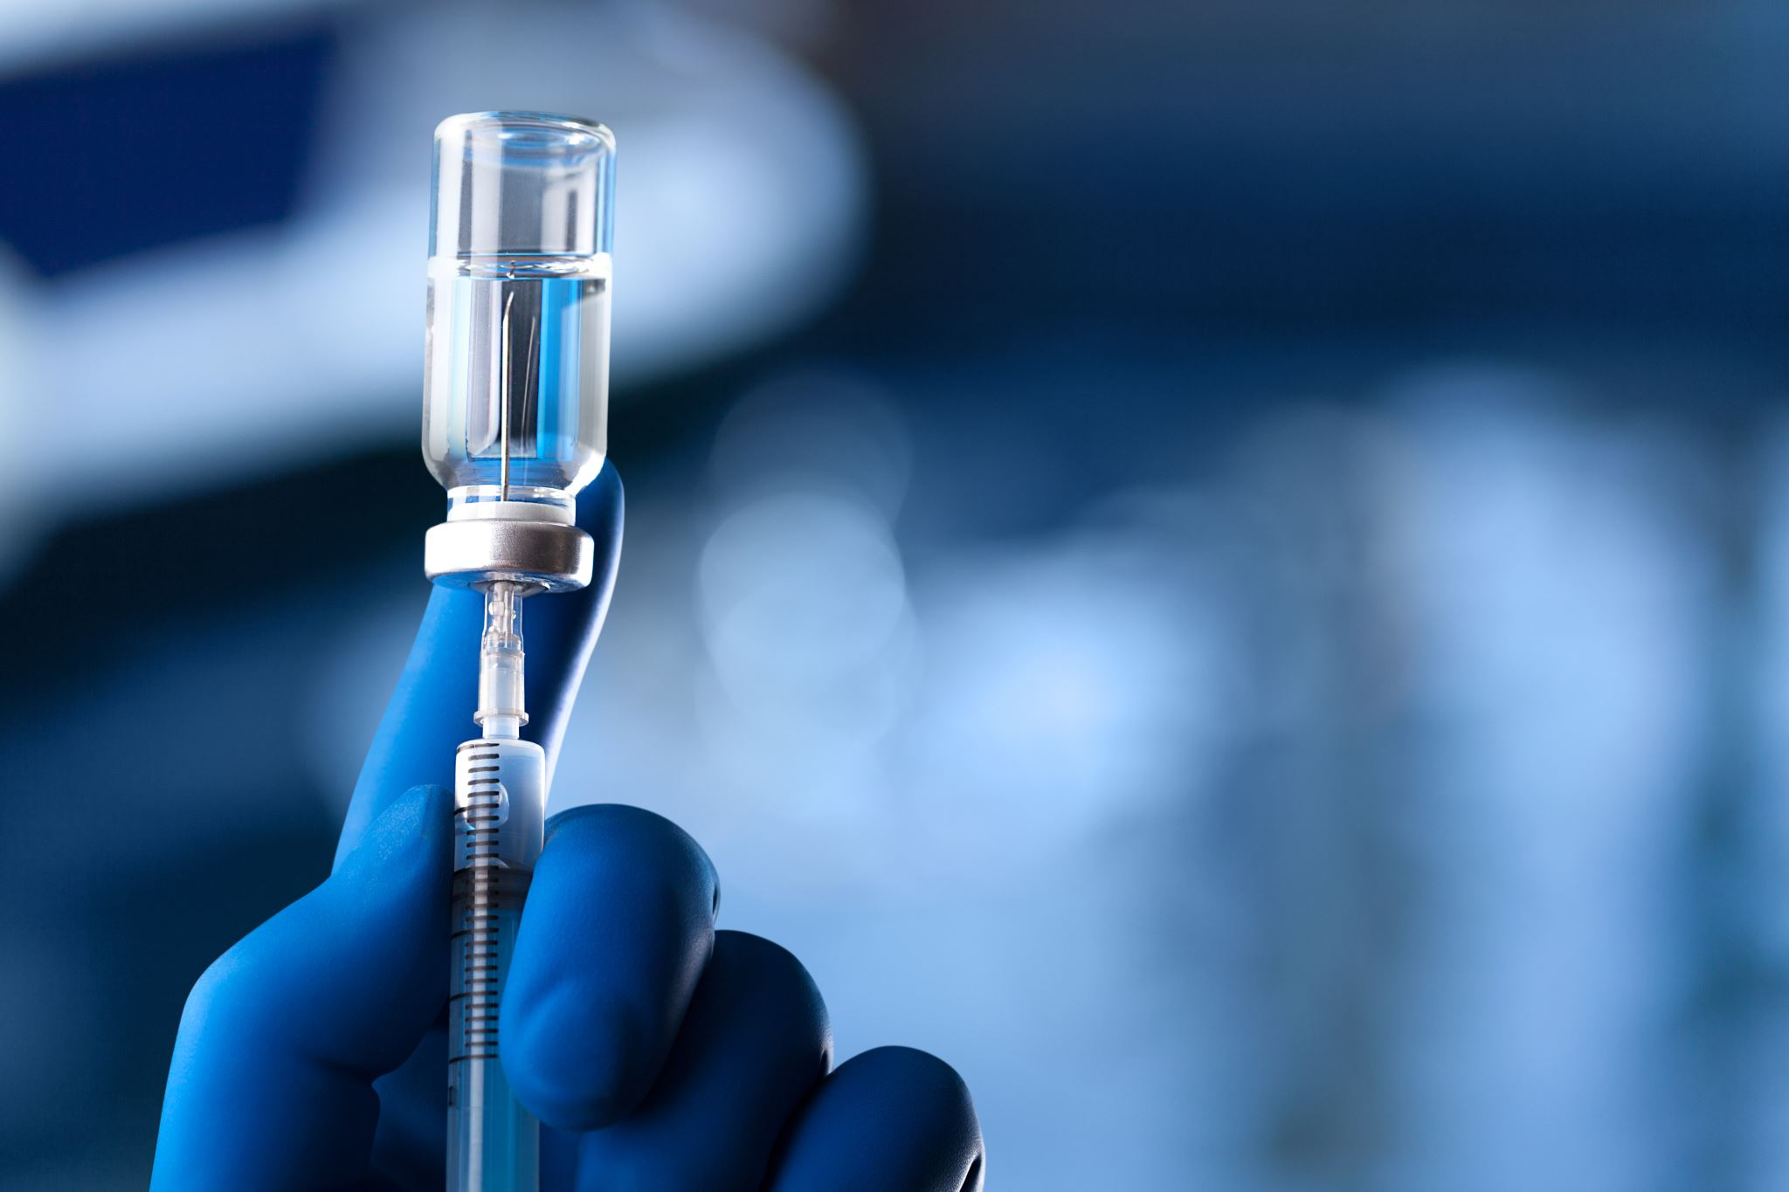
Types of Vaccines
Vaccines are prepared from either a live organism or an inactivated form of the organism.
Live attenuated vaccines use a weakened organism that can still replicate, producing a strong immune response from a small dose.
Inactivated vaccines use an organism inactivated by heat or chemicals; it cannot replicate in the recipient.
Vaccine type influences the recommended dosing schedule and storage requirements.

Slide 15
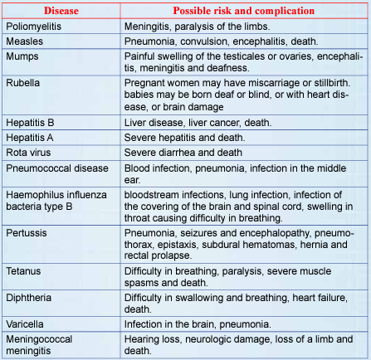
Vaccine Preventable Diseases (VPD)

Slide 16
Role of Community Health Nurse
Work
work to ensure that all those who need vaccines are receiving them.
Assess
assess community to identify the barriers to receiving the immunizations.(e.g. Transportation , Beliefs etc.. )
Be Aware
be aware of factors that may contribute to low vaccination levels among children and adults
Engage
engage with families who are hesitant about vaccines in open conversation

Slide 17
C/PHN Role in Disease Investigation & Reporting
Reportable diseases must be reported to the local or state health department; select diseases are then voluntarily shared with the CDC as notifiable diseases.
Reporting is generally an obligation of physicians, nurses, dentists, veterinarians, pharmacists, and administrators of hospitals, schools, and nursing homes.
Investigation steps: identify others who may be infected, determine the source and mode of transmission, identify at-risk contacts for screening, prevent further transmission, and monitor the response.
Interviews should be conducted with a neutral, nonjudgmental approach and assurance of confidentiality.

Slide 18
Disease Surveillance & Control
Surveillance is the ongoing, systematic collection, analysis, and interpretation of health data (WHO).
Surveillance enables early identification of public health emergencies and evaluation of intervention effectiveness.
Contact tracing identifies additional people who may have been exposed.
Disease control measures may include testing, counseling, education, environmental modification, vaccination, treatment, or prophylaxis.

Slide 19

Factors Influencing Vaccine Timing
Age-specific risk of the disease itself.
Age-specific risk of complications from the disease.
Ability of a person at a given age to mount an adequate and lasting immune response.
Potential interference from passively transferred maternal antibodies.

Slide 20
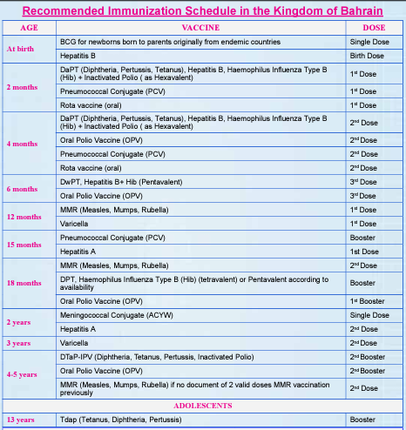
Immunizations Schedule

Slide 21
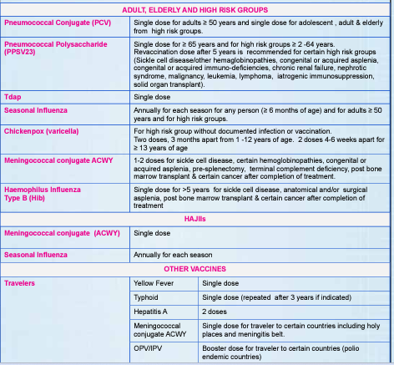
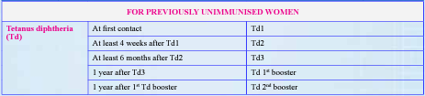
Immunizations Schedule

Slide 22
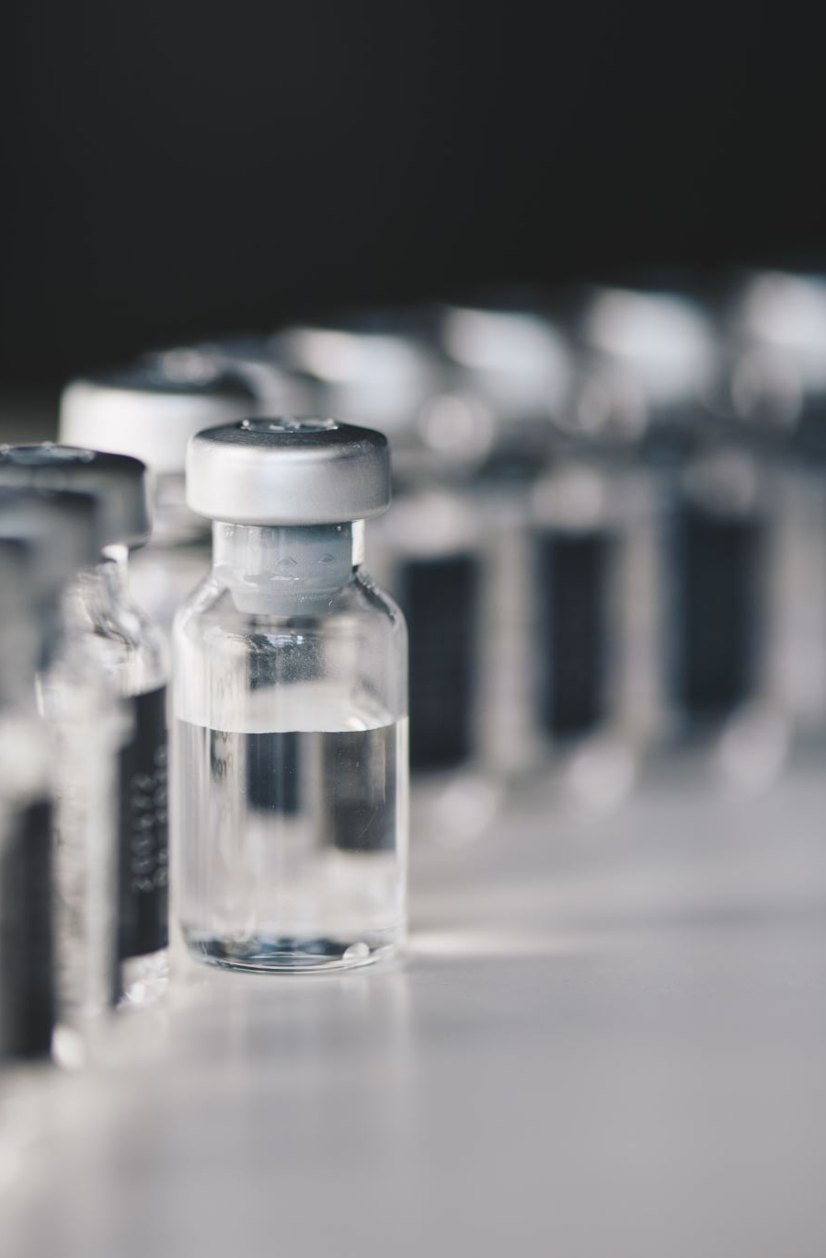
Vaccine Hesitancy: Addressing Parents’ Concerns
“Are the vaccines safe?” – explain the required safety trials and how to manage possible side effects.
“Why so many vaccines at once?” – reassure that vaccine antigen exposure is far less than everyday environmental exposure.
“Why give vaccines so young?” – explain that early protection reduces the window of vulnerability to serious disease.
Nurses should provide accurate, evidence-based information, since online misinformation can strongly influence parents’ vaccination decisions.

Slide 23
Safe Administration of Vaccines

Slide 24

Administering Vaccines
Prepare each injectable vaccine using a separate syringe.
Assess for Proper Needle gauge and length according to age group , weight, gender and selected site
Use combination vaccines (e.g., DTaP-IPV-HepB or DTaP-IPV/Hib) to reduce the number of injections, when appropriate
Do NOT mix more than one vaccine in the same syringe in an effort to create a “combination vaccine.”
Administer vaccines that are known to be painful when injected (e.g., MMR, HPV) last
Administer vaccines that may be more likely to cause a local reaction (e.g., tetanus-toxoid-containing and PCV13) in different limbs, if possible

Slide 25
Possible Vaccine Side Effects
severe allergy to any of the vaccine components
Pain and redness may occur at the site of injection
low grade fever , Skin Rash
headache, muscle pain
mild, temporary diarrhea or vomiting after (rotavirus vaccine)
Infants might become drowsy or lose their appetite temporary (Pneumococal)
Mild chickenpox- like disease with rash within 4 weeks (chicken Pox)

Slide 26
General Vaccine Contradictions - MOH
The vaccine is contraindicated in case of severe allergic reaction to vaccine component following a prior dose.
Fitness certificate from treating physician is recommended for immunocompromised and cancer patients.
Moderate to severe illness at the time of vaccination.
BCG vaccination should not be given to persons who are immunosuppressed

Slide 27
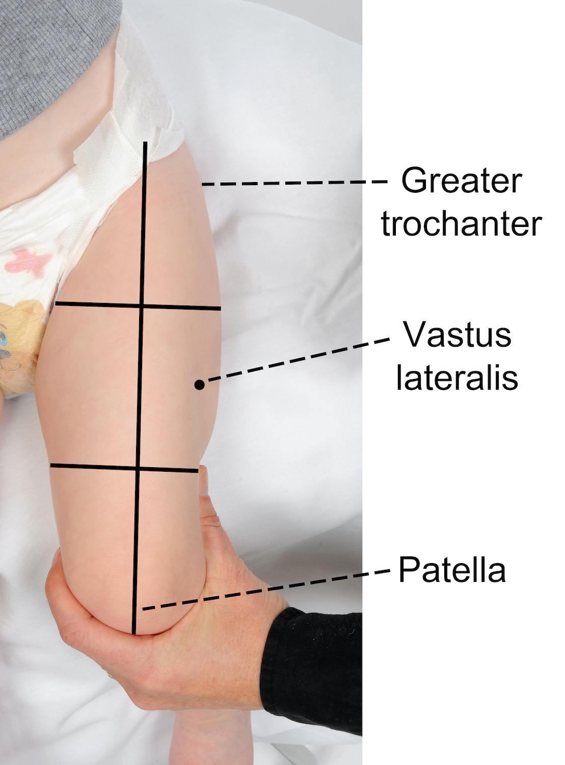
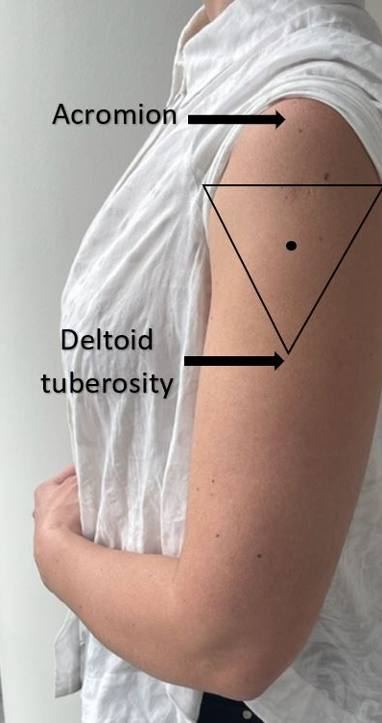
Vaccine Routes and sites
Each vaccine has a recommended administration route and site. This information is included in the manufacturer’s package.
Deviation from the recommended route may reduce vaccine efficacy or increase local adverse reactions.

Slide 28
Managing Acute Vaccine Reactions
measures should be taken to prevent injuries if a patient becomes weak or dizzy or loses consciousness
Have the patient seated.
Be aware of symptoms that precede fainting (e.g., weakness, dizziness, pallor).
Provide supportive care and take appropriate measures to prevent injuries if such symptoms occur.
Observe recipients after vaccination to decrease the risk for injury should they faint. For most vaccines a 15-minute observation period is recommended.

Slide 29

Thank you

