Slide 1
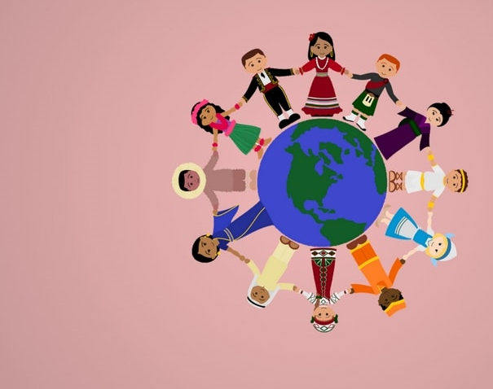
Transcultural Nursing
2025-2026

Slide 2

Objectives
By the end of the session, the student will be able to:
Define the concept of culture
Discuss the meaning of cultural diversity, ethnocentrism, ethnorelativism and their effects on community health nursing practice.
Identify the five characteristics shared by all culture.
Discuss the major views in the world culture.
Discuss the health-related values, beliefs and practices of selected culturally diverse population (Activity).
Identify the guidelines for nurses working with all immigrant groups.
Apply principles of transcultural nursing in community health nursing principles.

Slide 3

The Meaning of Culture
Culture: refers to the beliefs, values, and behaviours that are shared by members of a society and provide a template or “road map” for living
design for living; it provides a set of norms and values that offer stability and security for members of a society.
It forms the basis for the definitions of male and female roles.

Slide 4
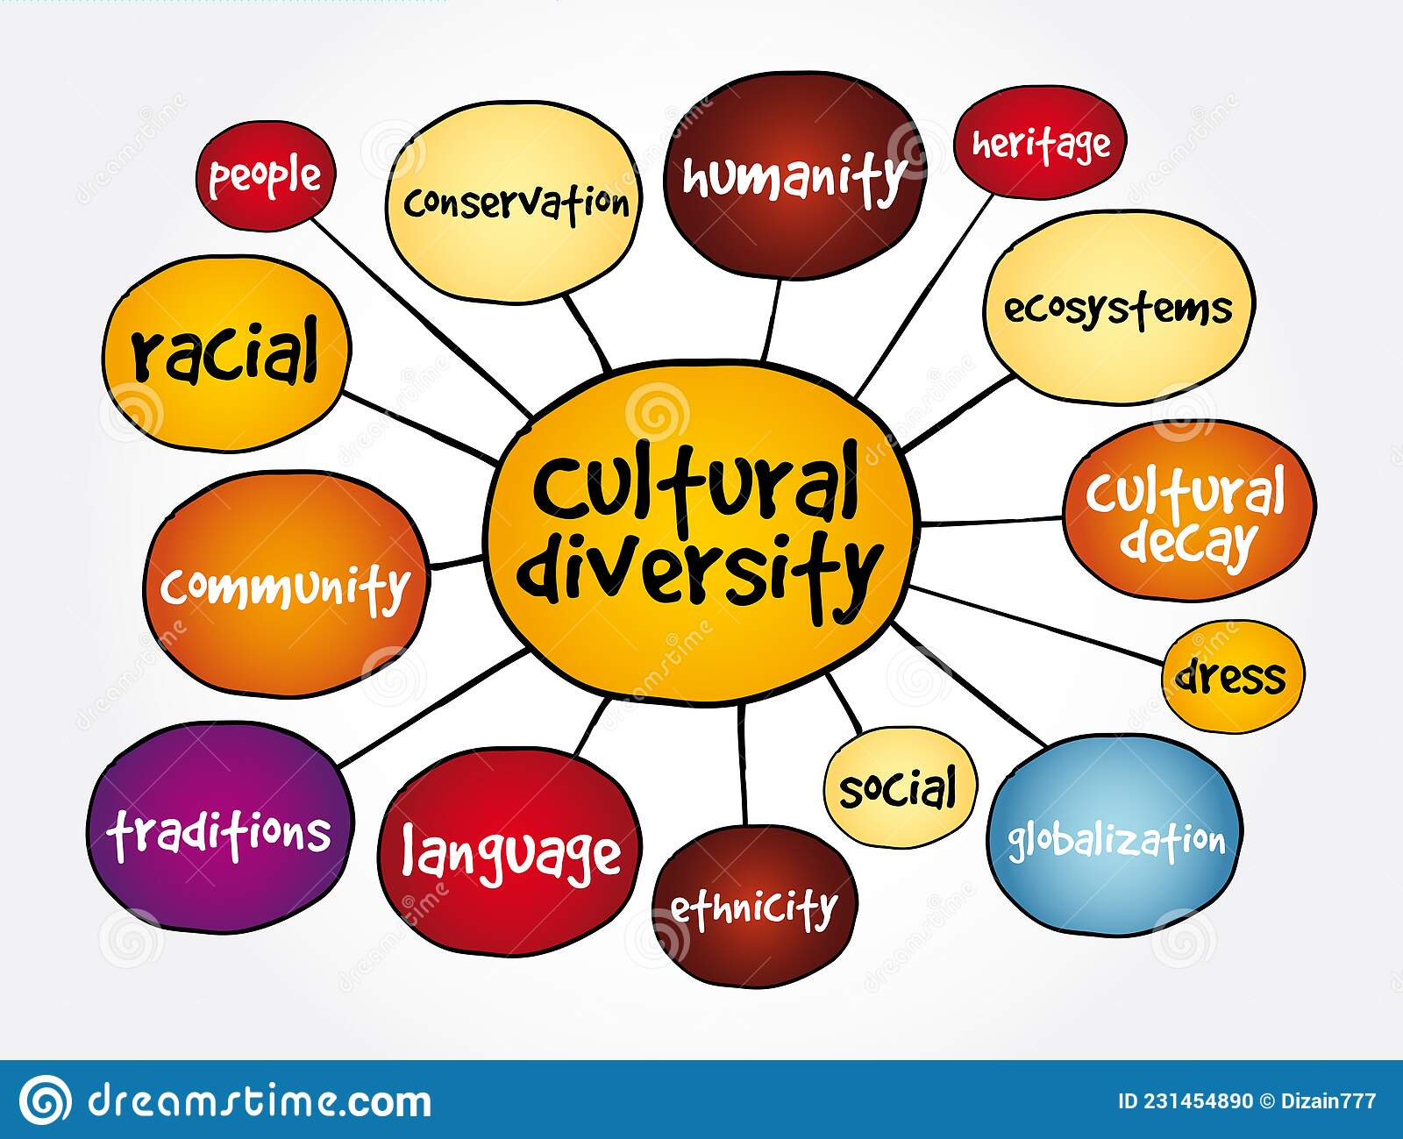
Cultural Diversity
Cultural diversity, also called cultural plurality, means that a variety of cultural patterns coexist within a designated geographic area.

Slide 5
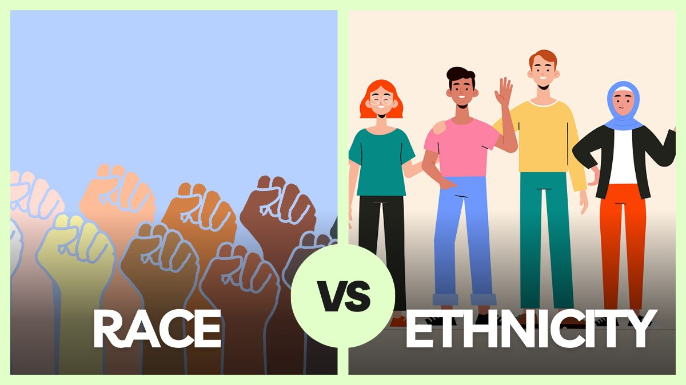

Slide 6
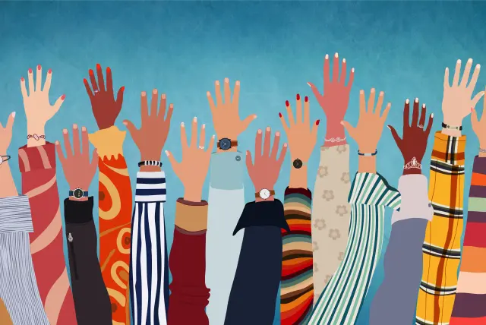
Cultural Diversity
Race:
Biologically designated groups of people whose distinguishing features, such as skin color.
Ethnic group:
Collection of people who have common origins and a shared culture and identity; they may share a common geographic origin, race, language, religion, traditions, values, and food preferences (Spector, 2013).

Slide 7

Question #1
Is the following statement true or false?
“Race and ethnicity are interchangeable terms”.

Slide 8

Answer to Question #1
False
Rationale: Race refers to biologically designated groups of people whose distinguishing features are inherited. Ethnicity refers to a group of qualities that mark a person’s association with a particular ethnic group or who share cultural and/or physical characteristics.

Slide 9
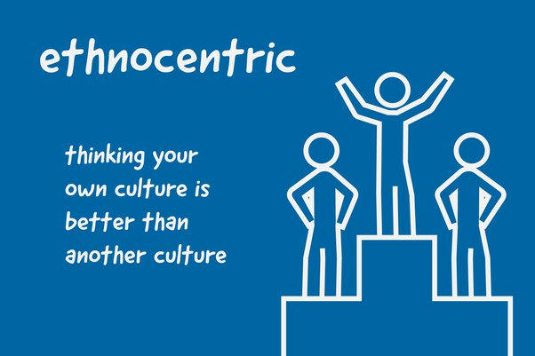
Ethnocentrism
Ethnocentrism:
Bias that person’s own culture is best, and others are wrong or inferior
Can block effective communication by creating biases and misconceptions about human behavior.
This can cause serious damage to interpersonal relationships and interfere with the effectiveness of nursing interventions

Slide 10
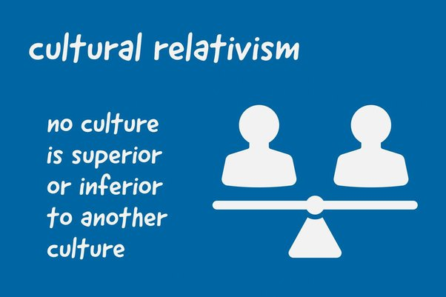
Ethnorelativism
Seeing all behavior in a cultural context.

Slide 11
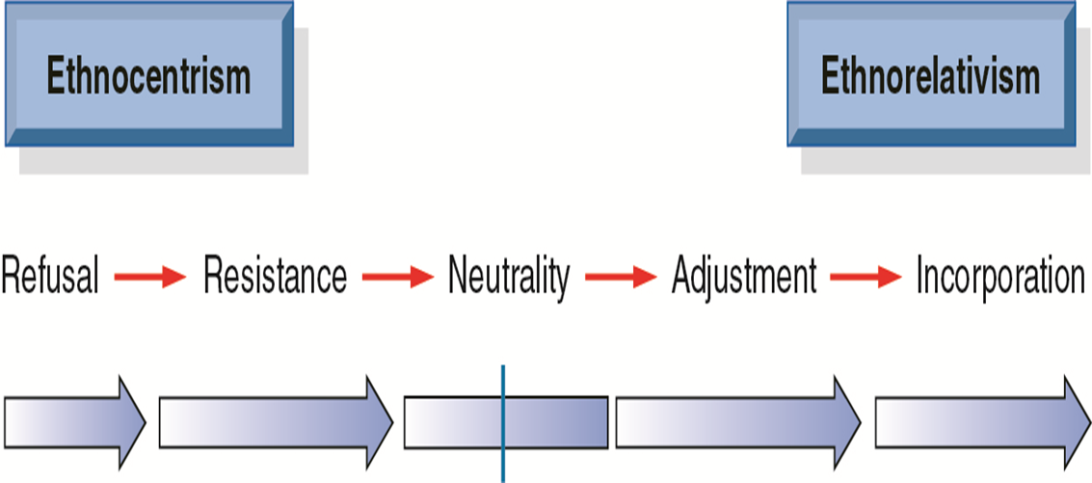
Cultural Sensitivity Continuum
Cross-cultural sensitivity continuum. Being extremely ethnocentric (left of midpoint) and totally ethnorelative (far right) are reflected in the diagram.
The steps toward ethnorelativism begin at the most ethnocentric view, with refusal and resistance. Neutrality is midpoint, and adjustment and incorporation bring the person to an ethnorelative perspective.

Slide 12

Characteristics of Culture
1. Culture is Learned
Patterns of cultural behavior are acquired, not inherited or genetically determined.
Each person learns about culture through socialization with the family or significant group, a process called enculturation.

Slide 13
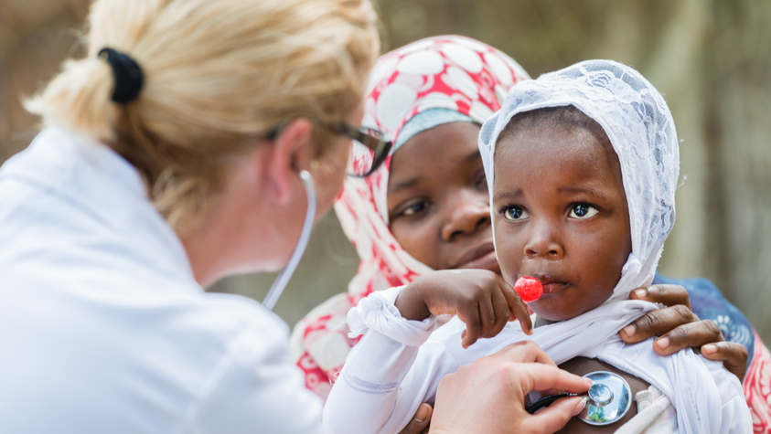
Characteristics of Culture
2. Culture is integrated
All parts of a culture are interrelated and interdependent.
The various components of a culture (social mores or religious beliefs), perform separate functions but come into relative harmony with each other to form an operating and cohesive whole.
Any examples??
Parents who are Jehavo’s Witnesses may refuse a blood transfusion for their child. This choice represents behavior consistent with their cultural values and standards. The single behavior of refusing blood transfusions, when viewed in context, is seen to be part of a larger religious belief system and a basic component of the parents’ culture.

Slide 14

Characteristics of Culture
3. Culture is Shared
Individuals practice a culture, phenomena shared by all members of the group and is transmitted from generation to generation.

Slide 15

Characteristics of Culture
4. Culture is Generally Tacit
Culture provides a guide for human interaction that is tacit—unexpressed and at the unconscious level.
Culture provides an implicit set of cues for behavior, not a written set of rules.
It is like a memory bank in which knowledge is stored for recall when the situation requires it.
Any examples??
Culture teaches
how close to stand when talking with someone
how one should appropriately respond to older adults.

Slide 16

Characteristics of Culture
5. Culture is Dynamic
Culture undergoes change; none is entirely static.
Some members generate innovations, see advantages in doing things differently and are willing to adopt new practices.
When this adaptation does not occur, the cultural group may face serious difficulty.
The lack of familiarity can result in conflicting feeling that have been termed Culture shock

Slide 17

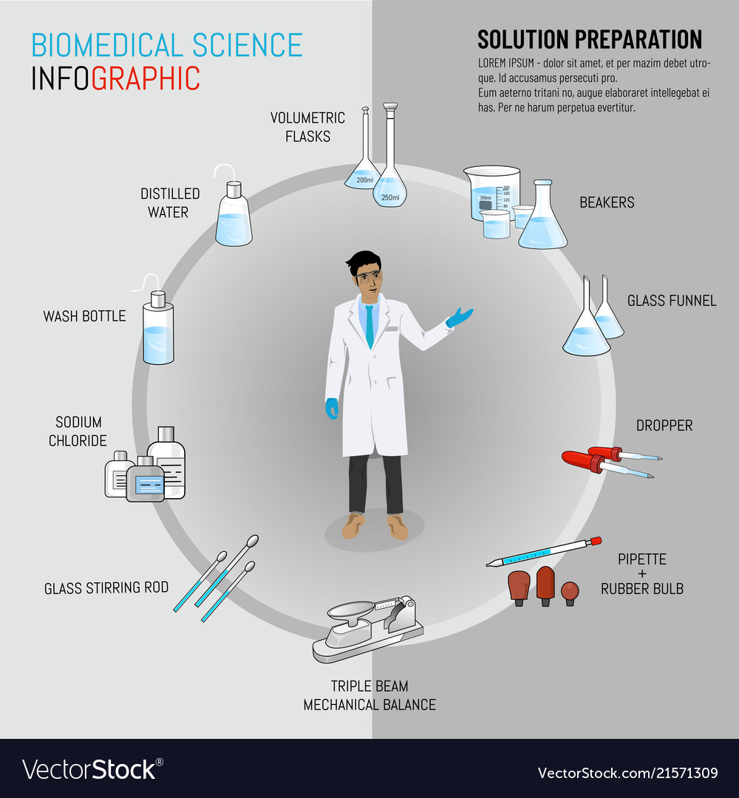
World community
Beliefs about the causes and effects of illness, health practices, and health-seeking behaviors are all influenced by a person’s, a group’s, or a community’s perception of what causes illness and injury and what actions can best treat or cure the health problem.
The three major views in the world community are:
Biomedical.
Magicoreligious.
Holistic health beliefs

Slide 18
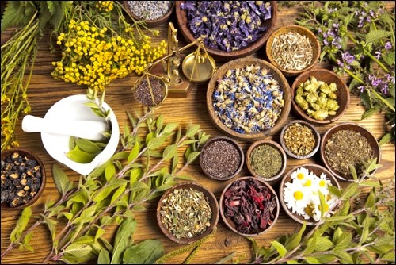

World community
  Other views
  Folk medicine and home remedies
  Herbalism
  Prescription and over-the-counter drugs

Slide 19

Biomedical
Relies on scientific principles and sees diseases and injuries as life events controlled by physical and biochemical processes that can be manipulated through medication, surgery, and other treatments.
Ex. Disease causes illness, which has a specific cause and a set of treatment requirements.

Slide 20

Magicoreligious
Magicoreligious focus on the control of health and illness by supernatural forces.
Diseases occur as a result of “committing sins” or “going against God’s will.”
Good health is a gift from God, and illness is a form of punishment that affords an opportunity to be forgiven and to realign oneself with God.

Slide 21
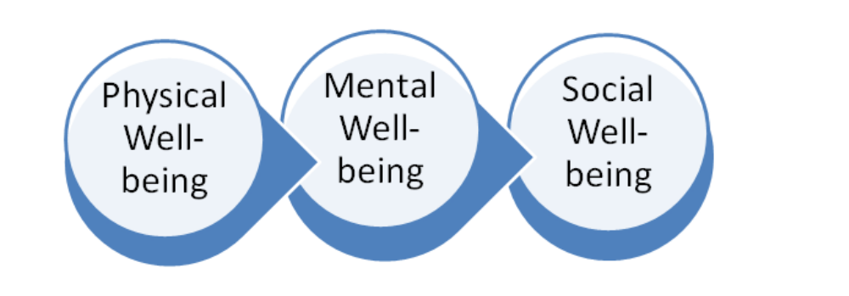
Holistic
View the world as being in harmonious balance. imbalance of natural forces can create chaos and disease.
For an individual to be healthy, all facets of the individual’s nature—physical, mental, emotional, and spiritual—must be in balance.
Ex. Considering that infectious disease such as tuberculosis is not only caused by an organism but also by the environment, malnutrition, and poverty

Slide 22
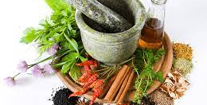
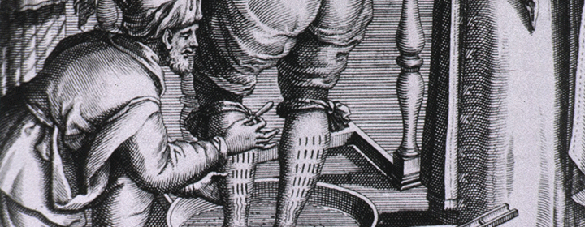
Folk medicine and home remedies
Folk medicine is a body of preserved treatment practices that has been handed down verbally from generation to generation.
Exists as a first line of treatment.
Any examples??
“Taping coins over a newborn’s umbilical area to prevent hernias”

Slide 23

Herbalism
Herbs are not regulated as drugs and are not risk free.
Dosages are not standardized and are left to the individual.
Quality of the product may be suspect.
Herbs must be used only in moderation and with caution, preferably with guidance by a health care practitioner.

Slide 24

Prescription and over-the-counter drugs
OTC are not risk free.
The safety and efficacy of medications must be assessed.

Slide 25

Question #2
Which would characterize a culture?
  Inherited
  Static
  Individualized
  Tacit

Slide 26

Answer to Question #2
D. Tacit
Rationale: Culture is learned, integrated, shared, mostly tacit, and dynamic.

Slide 27

Activity:
Select a Cultural Community and discuss the following:
  Population characteristics and culture
  Health problems
  Health beliefs and practices

Slide 28
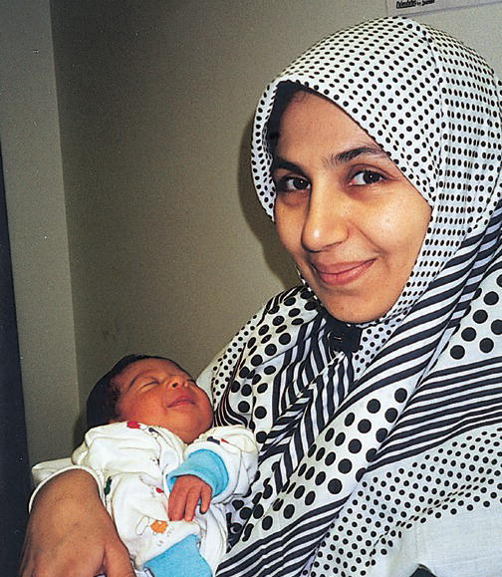
Example:
Arab Populations and Muslims

Slide 29

Population Characteristics and Culture: A common language (Arabic). Arabs are largely Christian or Muslim, although some Arabs may be Jews or Druze. Arabs generally value Western medicine, trust health care workers, and do not generally postpone seeking medical care Many Arabic women stay at home and are not in the workforce. Families impose stricter rules for girls than for boys. After menarche, teenage girls may not socialize with boys. The adolescent female also begins to cover her head and perhaps wears a hajab, which takes the form of a modest dress and veil designed to diminish attractiveness and appeal to the opposite sex. Some Arab groups take this mode of dress to extremes, not even allowing a woman’s eyes to show out of the hajab. Modesty is one of the core values for Arabs; it is expressed by both genders, although more evidently by females. All sexual contacts outside the marital bond are considered illegal.

Slide 30
Health Problems
Health problems among Middle Easterners are most frequently lifestyle related. These include poor nutritional practices, resulting in obesity, especially among women; smoking among men; and lack of physical exercise
In some rural areas, especially in Saudi Arabia, men and women chew tobacco, and an increase of oral cancers is seen.
Major public health concerns for most Arabs are related to motor vehicle accidents, maternal–child health, TB, malaria, trachoma, typhus, hepatitis, typhoid fever, dysentery, and parasitic infection.
Most social restrictions are directed toward women and can affect their health. pregnancy can be complicated by genital mutilation, with infections and difficult deliveries.
Childbearing continues up until menopause. There is often a desire to have more sons than daughters, and this may result in very large families and closely spaced pregnancies—often without the benefit of family planning.
Abortion and infanticide are not accepted.

Slide 31
Health Beliefs and Practices
Traditional medicine is practiced in spite of the growth of Western medical services in some of the richer Arab nations.
Traditional health care practices are much more common in the poorer Middle Eastern countries and in rural areas of all Arabic countries.
Muslims believe in predestination—that life is determined beforehand—and they attribute the occurrence of disease to the will of Allah. However, this does not prevent people from seeking medical treatment.
Islamic law prohibits the use of illicit drugs, which include alcohol. Users of such substances are liable to trial, and those convicted of smuggling substances into an Arab country can be sentenced to death in some cases.
Sharaf, or honor, is an important concept in Arab American beliefs, and drug addiction, mental illness, or unwed pregnancy of a family member brings shame to the entire family. Conversely, when a member does something good or is recognized for an achievement, that honor is reflected on the family as a whole.

Slide 32
Health Beliefs and Practices
Cleanliness is paramount and ritualistic, especially before prayers and after sexual intercourse. The bodies of both genders are kept free of axillary and pubic hair. The left hand is used for cleaning the genitals and the right one is reserved for eating, hand shaking, and other hygienic activities.
Muslims fast during Ramadan from sunrise to sunset, and this can include abstinence from all things (including medications or intravenous fluids). Illness can be an exception to this rule, but public health nurses should consult with a family elder or Muslim leader to encourage the client to continue with any necessary treatments.
Also, Muslims pray several times daily, facing toward Mecca. Home visits should be planned so that prayers are not interrupted.
When caring for Arabs in clinics or at home, a nurse of the same sex as the client should be assigned. It is important to note that only women may discuss many topics (e.g., menstruation, family planning, pregnancy, and childbirth), and men are not included in these discussions.

Slide 33
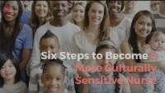
Guidelines for nurses working with groups

Slide 34
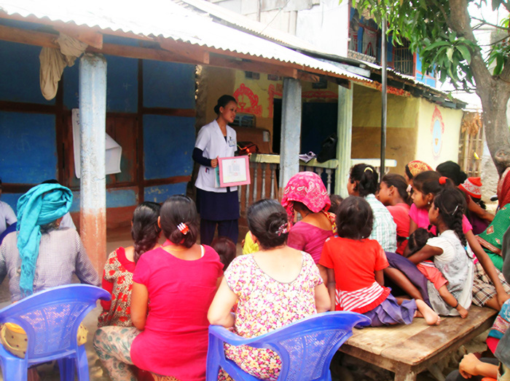
Guidelines for nurses working with groups
Make no assumptions about a client’s understanding of health care issues.
Permit more time for interviewing; allow time to evaluate beliefs and provide appropriate interventions.
Provide educational programs to correct any misconceptions about health issues; this can occur in clinics, mosques, schools, or homes.
Provide an appropriate interpreter to improve communication with people who do not speak English or Arabic well.

Slide 35
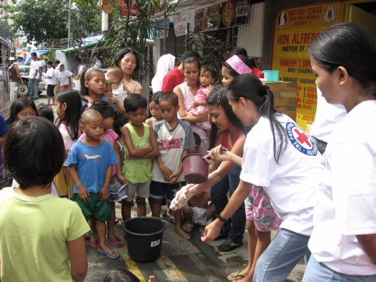
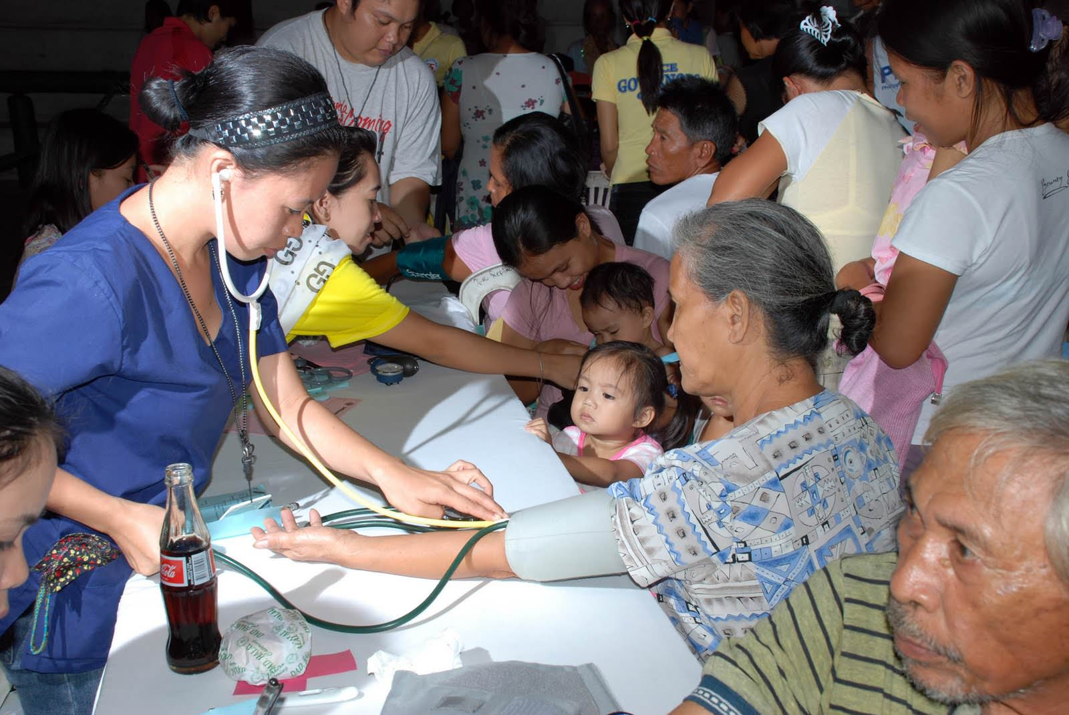

TRANSCULTURAL COMMUNITY HEALTH NURSING PRINCIPLES

Slide 36

Transcultural Nursing Principles
Develop cultural self-awareness.
Cultivate cultural sensitivity.
Assess the client group’s culture.
Show respect and patience while learning about other cultures.
Examine culturally derived health practices.

Slide 37

Develop Cultural Self-Awareness
Recognizing the values, beliefs, and practices that make up one’s own culture.
To gain skill in understanding their own culturally based behavior, nurses can complete a cultural self-assessment by analyzing their own:
  Influences related to racial background
  Verbal and nonverbal communication patterns
  Values and norms (expected cultural practices or behaviors)
  Beliefs and practices

Slide 38
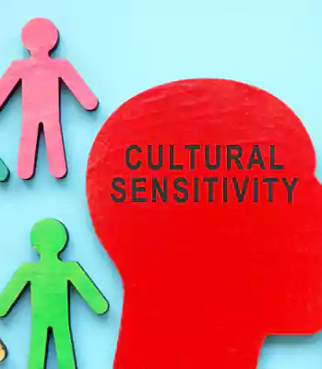
Cultivate Cultural Sensitivity
Cultural sensitivity requires recognizing that culturally based values, beliefs, and practices influence people’s health and lifestyles and need to be considered in plans for service.

Slide 39
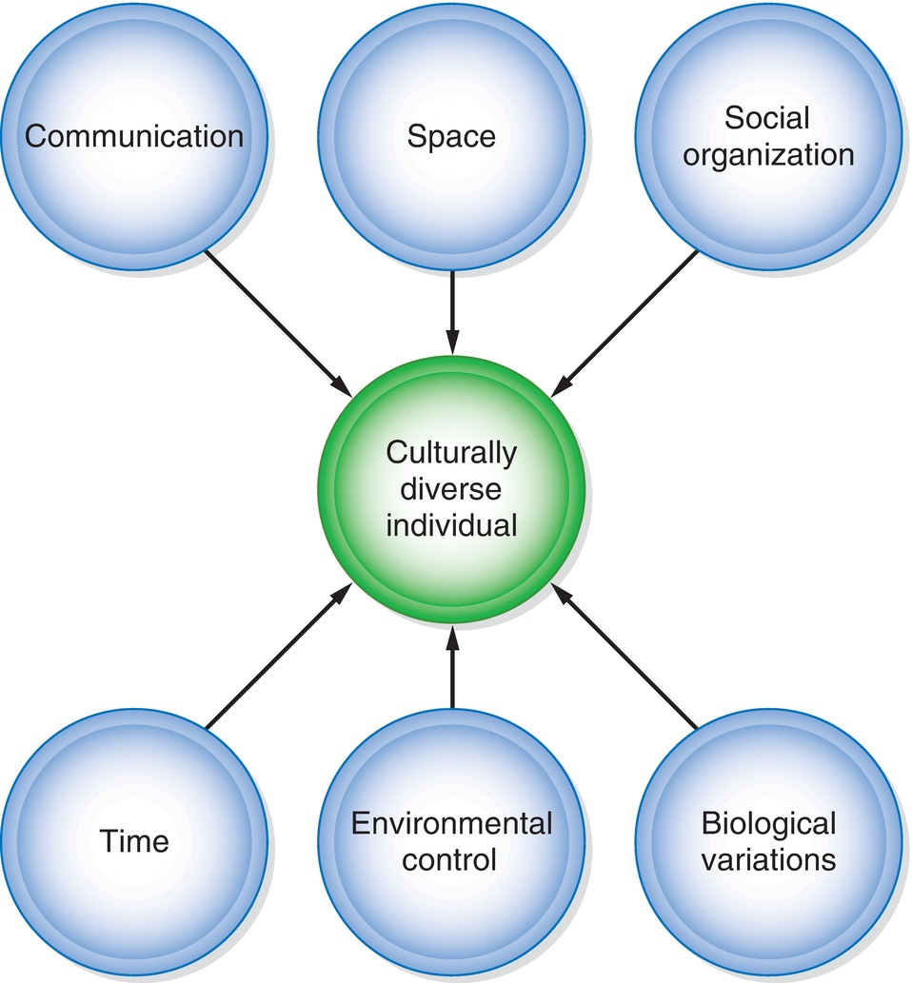
Assess the Client Group’s Culture
Transcultural Assessment Model showing the culturally diverse individual through communication, space, social organization, time, environmental control, and biologic variations. (Adapted from Giger, J. M. (2017).

Slide 40

Cultural Assessment
Ethnic/racial background
Language and communication patterns
Cultural values and norms
Biocultural factors
Religious beliefs and practices
Health beliefs and practices

Slide 41

Show Respect and Patience While Learning About Other Cultures
Attentive listening is a way to show respect and to learn about a client’s culture.

Slide 42
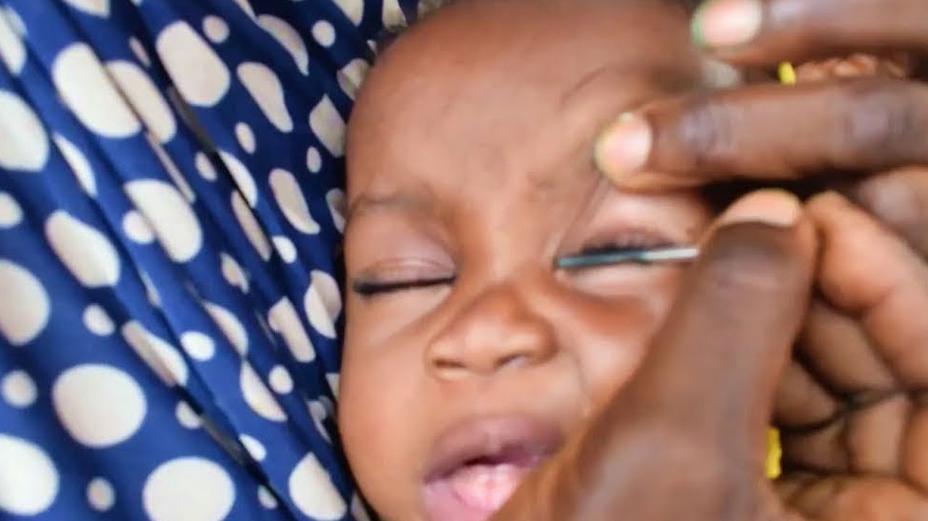
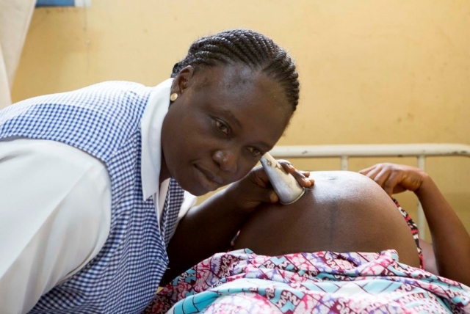
Examine Culturally Derived Health Practices
Examine the cultural practices affecting health
Are these behaviors preserving or enhancing the group’s health
A cultural practice can be modified or continued while respecting the culture is maintained.

Slide 43
Dominant Values
Dominant values – the beliefs and sanctions of the dominant or majority culture
In the US, the majority culture is non-Hispanic Whites; dominant values have largely included the work ethic, thrift, success, independence, initiative, privacy, cleanliness, attractive appearance, and a focus on the future
Awareness of dominant values matters in nursing – it helps explain why some client behaviors are accepted by health professionals and others are not, and why persuading clients to adopt new ways of thinking can be difficult
Dominant values can and do change as demographics shift – the US is projected to become a majority–minority nation by mid-century as current minority groups grow in population

Slide 44
Subcultures & Microcultures
Subcultures
Smaller cultural groups within a larger society, developed and preserved to meet the unique needs, values, and beliefs of their members
Distinguished by shared characteristics such as ethnicity, occupation, socioeconomic status, religion, geographic area, age, gender, or sexual preference
Microcultures
Even smaller groups who share specific experiences or special cultural knowledge unique to the subgroup (e.g., recent refugees sharing resources, third-generation immigrants sharing food and traditions)
Also include groups on the margins of mainstream culture with their own ways of coping (e.g., migrant farm workers, urban homeless families, gangs)
Related Concepts
Intraethnic variations – differences within a microculture due to social class, socioeconomic status, age, or degree of acculturation
Minority group – part of a population that differs from the majority and often receives different and unequal treatment

Slide 45
Key Transcultural Concepts
Transcultural (cross-cultural) nursing – providing culturally sensitive nursing service to people of an ethnic or racial background different from the nurse's
Cultural relativism – recognizing and respecting alternative viewpoints and understanding values, beliefs, and practices within their own cultural context
Cultural brokering – mediating or building connections between people from different cultural backgrounds to promote change
Cultural conflict – a perceived threat arising from a misunderstanding of expectations between clients and nurses when either group is unaware of cultural differences
Cultural adaptation – the successful adjustment to cultural changes, often following a period of culture shock

Slide 46
Cultural Diversity & Immigration in the US
Immigration has been a major driver of cultural diversity in the US, from early Indigenous peoples and European settlers to enslaved Africans and generations of refugees and immigrants
Key immigration laws shaped current diversity – medical/economic inspections (1891), the Immigration Act of 1924 (limited immigration by national origin), the 1965 Act (ended quotas, endorsed family migration), the Immigration Reform and Control Act of 1986, and the Immigration Act of 1990
Current trends – a large undocumented population, rapid growth of multiracial and Asian populations, and fast-growing Hispanic/Latino communities
Ongoing issues – ambivalence toward accepting refugees, family separation at the border, and increased border enforcement continue to shape the social climate for immigrants

Slide 47
Integrated Health Care & CAM
Complementary and alternative medicine (CAM) – a broad, multibillion-dollar array of healing resources used to promote comfort, health, and well-being
Therapies – juice diets, fasting, coffee enemas, biofeedback
Exercise activities – T'ai chi, yoga, dance
Exposure – aromatherapy, music therapy, light therapy
Manipulation – acupuncture, acupressure, chiropractic, cupping, reflexology
Integrated health care – combining complementary therapies with Western medicine (e.g., for pain relief in labor or to improve sleep in the ICU); nurses stay informed, remain objective, and weigh pros and cons when a therapy conflicts with medical advice

Slide 48
Role & Preparation of the C/PHN
To be an effective advocate, the nurse must:
Speak knowledgeably about health care practices and choices
Assess the client or family adequately to know what belief system motivates their choices
Teach clients about the limits and benefits of cultural health care practices
Individualize assessment and caregiving within the client's culture, rather than generalizing based on group norms
Nurses can prepare by:
Performing a cultural self-assessment to identify their own beliefs and biases
Learning from peers from the same cultural group as their clients
Attending workshops or conferences on transcultural nursing and cultural ethics
Reading about ethnocultural and alternative health care practices, talking with clients about their views, and attending community cultural events

Slide 49
Cross-Cultural Guidelines for Practice
Know your own belief system and values, and acknowledge that cultural differences may exist
Build a basic understanding of other cultures without stereotyping or assuming you understand what any one person thinks or feels
Show genuine interest, suspend judgment, and work to establish trust
Respect power imbalances, status hierarchy, and gender and age differences within the family or group
Improve cross-cultural communication skills – use clear, simple language and avoid jargon or slang
Attend to unspoken communication and appropriate body language; practice active listening
Don't assume understanding – clarify and seek feedback to confirm the message was understood
Apologize for cultural mistakes and show willingness to learn
Use trained interpreters and deliver information in the client's preferred language whenever possible
Assess immigration history, refugee stress or trauma, acculturation gaps, and experiences of discrimination

Slide 50
Harmful vs. Helpful Cultural Practices
Some traditional practices promote physical and psychological health (customary diet, birth rituals, certain folk remedies)
Other practices are neither harmful nor health-promoting but are important for preserving cultural identity and security
Some traditional practices can be directly harmful, such as relying solely on herbal poultices to treat an infected wound instead of antibiotics, “burning” the abdomen to compensate for heat loss from diarrhea, or using Greta or Azarcon (lead-containing Hispanic remedies for stomach discomfort)
Harmful practices are best addressed by discussing concerns with group leaders and healers, while respecting the group's norms for authority and decision-making

Slide 51

Question #3
Is the following statement true or false?
“The first step that a nurse does when applying transcultural nursing principles is to cultivate cultural sensitivity”

Slide 52
Answer to Question #3
False
Rationale: The nurse first develops cultural self-awareness and then cultivates cultural sensitivity.

Slide 53

Thank you

