Slide 1

Working with Vulnerable People: Clients with Chronic Diseases or Disabilities
Chapter 23 & 24
2025-2026

Slide 2
Objectives
Describe the term “vulnerable populations
Discuss the Models and Theories of Vulnerability
Describe the term “ Disability”
Explain the socioeconomic gradient in health.
List the most common factors related to vulnerability
Describe types of health disparities.
Identify strategies to solicit and evaluate input from vulnerable populations when planning health care programs and services.
Discuss the role of community/ public health nurse with vulnerable population.

Slide 3
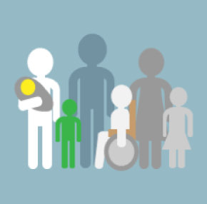
Vulnerability
The concept of vulnerability is an important one for nurses because of its implications for health, no matter where they practice. Is being susceptible to neglect or harm or being at risk of poor social, psychological, and physical Health out come (Aday2001).

Slide 4
Vulnerable Populations
Subpopulations such as ethnic or racial minorities, the uninsured, those with HIV/AIDS, children, the elderly the poor and those who are homeless (Shi & Stevens, 2011).
These subpopulations may have:
risk of adverse health outcomes
higher mortality rates
less access to health care; disparities in quality of care
uninsured or underinsured
lower life expectancy
overall diminished quality of life

Slide 5
Models and Theories of Vulnerability
1- Vulnerable Populations Conceptual Model – Flaskerud & Winslow (1998)
2- Behavioral Model for Vulnerable Populations – Gelberg, Andersen, & Leake (2000)
3- Differential Vulnerability Hypothesis – Kessler (1979)
4- Social Capital

Slide 6
Models and Theories of Vulnerability
1- Vulnerable Populations Conceptual Model – Flaskerud & Winslow (1998)
Flaskerud & Winslow (1998) developed a popular conceptual framework of vulnerability that contains three related concepts:
Resource Availability, Relative Risk, and Health Status.
The model provides evidence of the link between poor health status and socioeconomic resource availability through the loss of income, jobs, and health insurance

Slide 7
1- Vulnerable Populations Conceptual Model – Flaskerud & Winslow (1998)
Lack of resources (e.g., socioeconomic and environmental) increases a population's exposure to risk factors and reduces individuals' ability to avoid illness
Socioeconomic resources include human capital (e.g., jobs, income, housing, education), social connectedness or integration (e.g., social networks or ties; social support or the lack of it, characterized by marginalization), and social status (e.g., position, power, role)
Environmental resources deal mostly with access to health care and the quality of that care.
Relative risk refers to exposure to risk factors identified by a substantial body of research as lifestyle, behaviours and choices (e.g., diet, exercise, use of tobacco, alcohol and other drugs, sexual behaviours), use of health screening services (e.g., mammogram, colonoscopy), and stressful events (e.g., crime, violence, abuse, firearm use).
Health Status:
This is the result — it shows how healthy or unhealthy the person is. Poor resources and higher risk usually lead to poor health status.

Slide 8
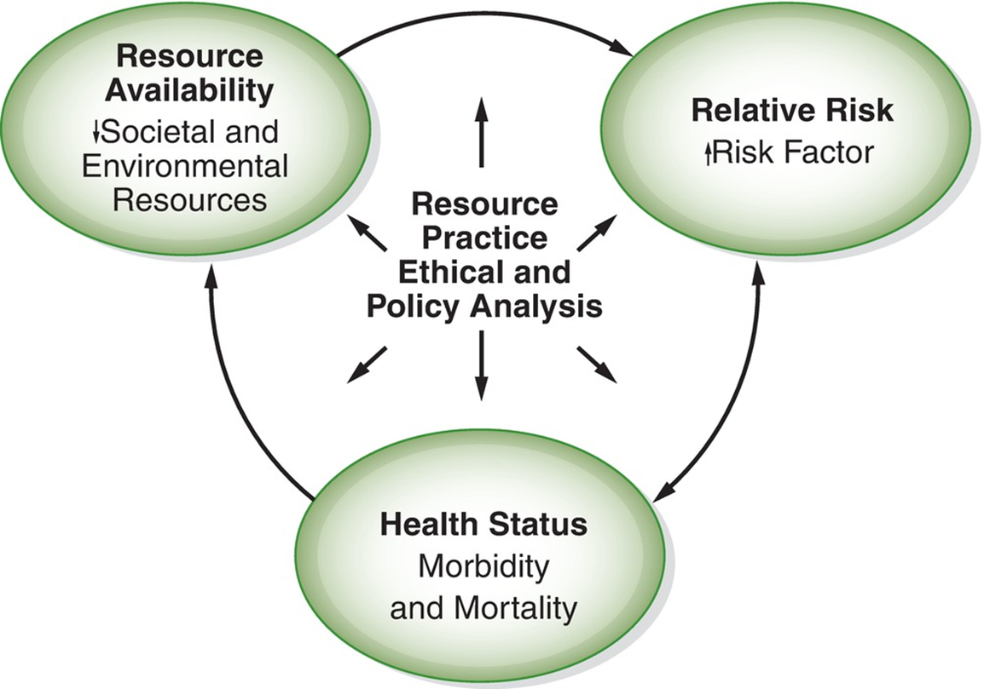
1- Vulnerable Populations Conceptual Model – Flaskerud & Winslow (1998)
A community’s health status can be observed by noting disease prevalence along with morbidity & mortality rates.
The central point of the model demonstrates the importance of nursing research & practice, along with ethical & policy analysis, in affecting resources, relative risk, & health status

Slide 9
2- Behavioral Model for Vulnerable Populations – Gelberg, Andersen, & Leake (2000)
This model looks at population characteristics (predisposing and enabling factors and needs) as an explanation for health behaviors and eventual health outcomes (Burg & Oyama, 2016). The following concepts are supported by this model:
Predisposing factors included demographic variables (e.g., gender, age, marital status), social variables (e.g., education, employment, ethnicity, social networks), and health beliefs (e.g., values and attitudes toward health and health care services, knowledge of disease).
Enabling factors: Personal/family resources and community resources (income, insurance, social support, region, health services, transportation).

Slide 10
2- Behavioral Model for Vulnerable Populations – Gelberg, Andersen, & Leake (2000)
Need factors: Perceived health needs, population health conditions, health behaviors (diet, exercise, tobacco use, self-care, adherence).
The use of health services (e.g., ambulatory and inpatient care, long-term care, alternative health care) and personal health practices (e.g., hygiene, unsafe sexual behaviors, food sources) combined with the other factors to produce outcomes such as perceived and evaluated health and general satisfaction with health care service.
The model has been used in research with homeless adults (Doran et al., 2014).

Slide 11
3. Differential Vulnerability Hypothesis – Kessler (1979)
Kessler’s differential vulnerability hypothesis states that there is a relationship between social status and psychological distress; a person’s psychological distress is determined by the impact of the stressor event as influenced by social status (this includes class, sex, marital status, and rural vs. urban).

Slide 12
3. Differential Vulnerability Hypothesis – Kessler (1979)
Psychological distress is the result of varying exposure to environmental stress events or situations (S) acting on individuals who possess varying vulnerabilities to stress (V); (a) represents the residual influence of constitutional makeup of the mental health of person (i) independent of any environmental stresses he/she might experience”. The hypothesis has been used in research with racial inequity (Roxburgh & MacArthur, 2014; Wickrama, Bae & Walker, 2016).
Stress–vulnerability model of psychological distress
Psychological distress = S (stress) × [V (vulnerability) + a (constitutional makeup)]

Slide 13
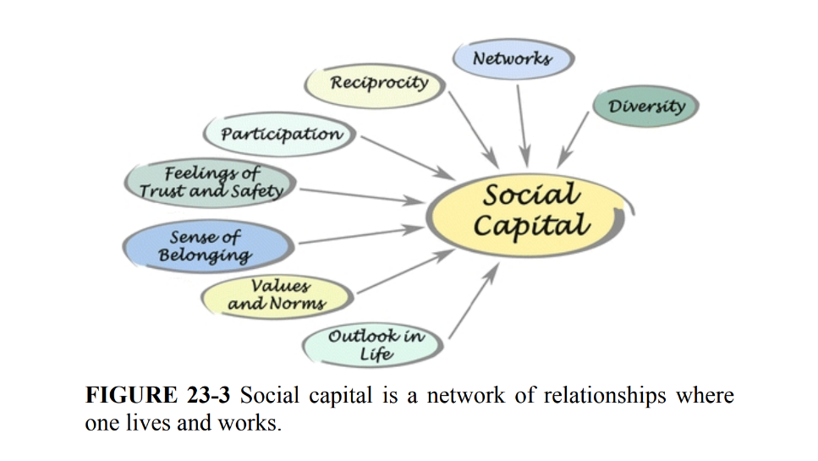
4- Social Capital
The importance of social connections, support, and trust.
Having friends, family, or a close confidante can buffer stress and improve psychological and social health.
Social isolation increases risk for morbidity, mortality, and poor health outcomes.
Nurses should be aware of patients’ social capital and provide extra support if needed.

Slide 14
Socioeconomic Gradient of Health
The direct relationship between social class or income and health has been termed the socioeconomic gradient (Hajizadeh, Mitnitski, & Rockwood, 2016). It has been found in populations around the world, although not always unfailingly, and has been related to Poor health outcomes regarding cardiovascular disease in European countries (Lenhart, Wiemken, Hanlon, Perkett, & Patterson, 2017). Cancer incidence, mortality, and survival in Western countries (Olver & Roder, 2017).

Slide 15
Injury rates, such as blunt and penetrating injuries (Chikani et al., 2015) Increased burden of chronic illness among Kenyan, South African, and Indian citizens (Mendenhall, Kohrt, Norris, Ndetei, & Prabhakaran, 2017).
Outcomes of adult asthma, chronic obstructive pulmonary disease, and rhinitis (Torres-Duque, 2017) Behaviors, such as smoking, that are highest among those who are fromthe working class and who have low-income and low educational levels(Psaltopoulou et al., 2017)

Slide 16
Who is considered vulnerable?

Slide 17
Who is considered vulnerable?
Factors and vulnerable population
Income and Education
Age and Gender
Race and ethnicity
Disability
HIV/AIDS
Mental illness and disability
Alcohol and substance
Familial abuse
Homelessness
Suicide and homicide risk
High-risk mother and infants
Immigrants
Chronic illness

Slide 18
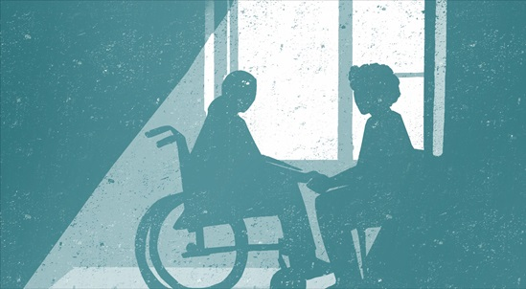
Disability

Slide 19
Do you know someone living with a disability?
Have you cared for a patient living with a disability?
What have you learned about their lives?
What does the word disability mean to you?

Slide 20
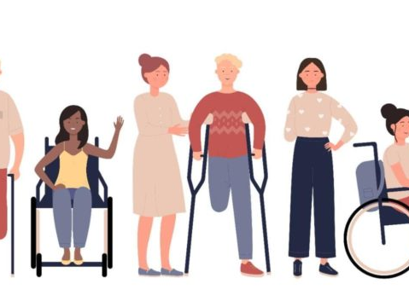
Disability
Disability refers to the negative aspects of the interaction between individuals with a health condition (such as cerebral palsy and depression) and personal and environmental factors (such as negative attitudes, inaccessible transportation and public buildings, and limited social supports)” (WHO, 2011)

Slide 21
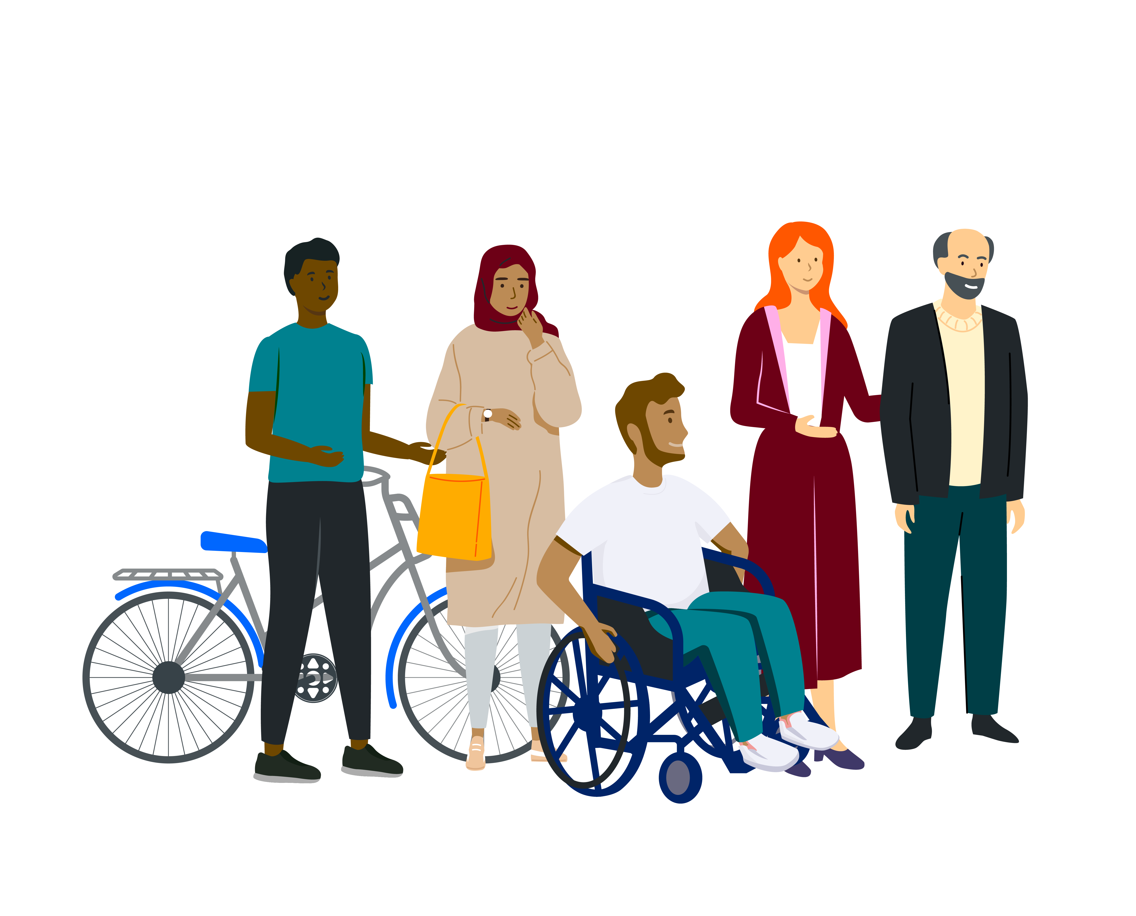
Disability is the incapacity to do something because of a handicap- Physical, mental etc.
Disability is linked to inability, which is defined as “the lack of ability to do something, whatever the reason, but usually through incompetence, weakness, lack of training”.
Disability is part of human life, and an impairment or condition does not define individuals, their health, or their talents and abilities.

Slide 22
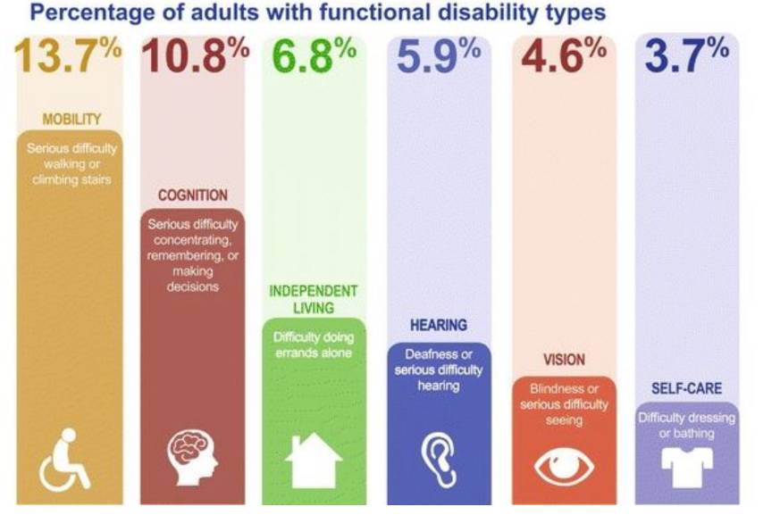

Slide 23
Causes of Disabilities
Congenital:
Genetic/hereditary factors
Non-hereditary
Acquired:
Infectious
Non-infectious (chronic diseases, malnutrition, addiction, age related)
Accidents

Slide 24

Types of Disabilities
Mobility/ Locomotor
Intellectual
Developmental
Cognitive/Mental
Hearing
Visual
Speech

Slide 25
Chronic diseases
Diseases that are of long duration, progress slowly, and are generally not curable but manageable.
These include noncommunicable diseases (NCDs) such as cardiovascular diseases, diabetes, chronic respiratory diseases, and cancer.
They often lead to significant health burdens, reduced quality of life, and increased healthcare costs.

Slide 26
Key characteristics of chronic diseases
Prolonged Duration: Lasting months to years.
Complex Etiology: Often caused by a combination of genetic, physiological, environmental, and behavioral factors.
Impact on Quality of Life: They can impair daily functioning and productivity.
Management Focus: Emphasis is on prevention, early detection, and effective management rather than a cure.

Slide 27
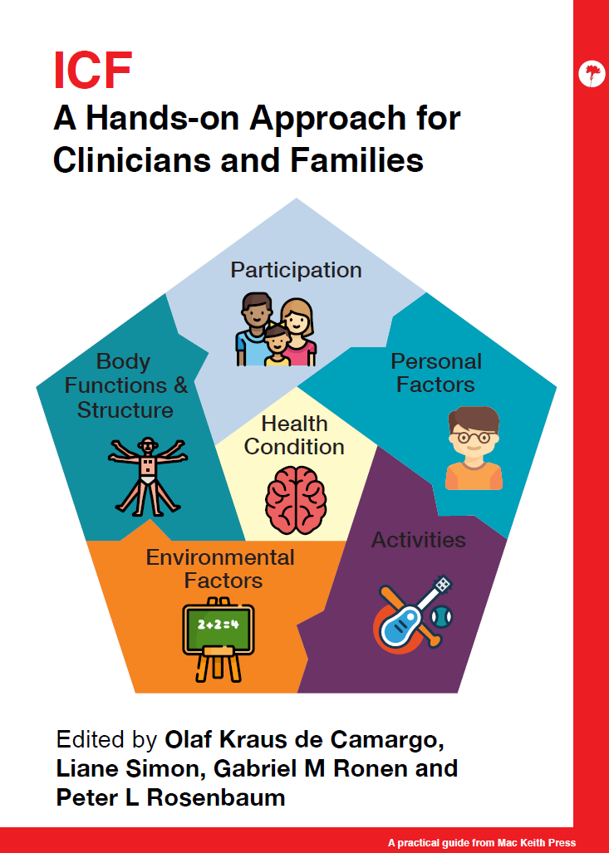
The International Classification of Functioning, Disability, and Health (ICF)
The International Classification of Functioning, Disability, and Health (ICF) is a framework and classification system developed by the World Health Organization (WHO) in 2001.
It provides a standardized and internationally accepted way of describing and organizing information about health, disability, and health-related domains.

Slide 28

The key aims of the ICF are the following:
Provide a scientific basis for understanding and studying health and health-related states, outcomes, and determinations.
Establish a common language for describing health and health-related states to improve communication between different users.
Permit comparison of data across countries, health care disciplines, services, and time.
Provide a systematic coding scheme for health information systems.

Slide 29
International Classification of Functioning, Disability, and Health
Is a universal classification system using standardized language
that views the domains of health from a holistic viewpoint.
(approach for assessing people with disabilities).
The following concepts:
Body functions: physiologic functions of body
Body structure: anatomic parts of the body
Impairments: problems in body function or structure
Activity: task or action
Participation: to be involved in a life situation
Activity limitations: difficulty an individual may have with an activity
Participation restrictions: limitations in involvement
Environmental factors: the physical and social environments where people live and conduct their lives

Slide 30
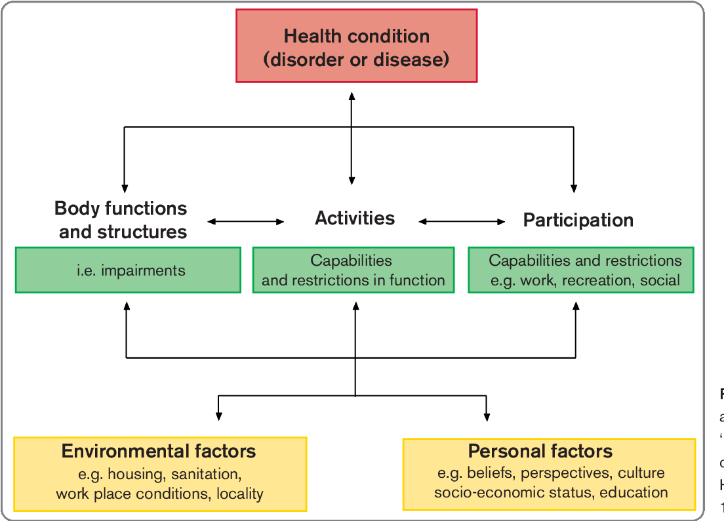

Slide 31
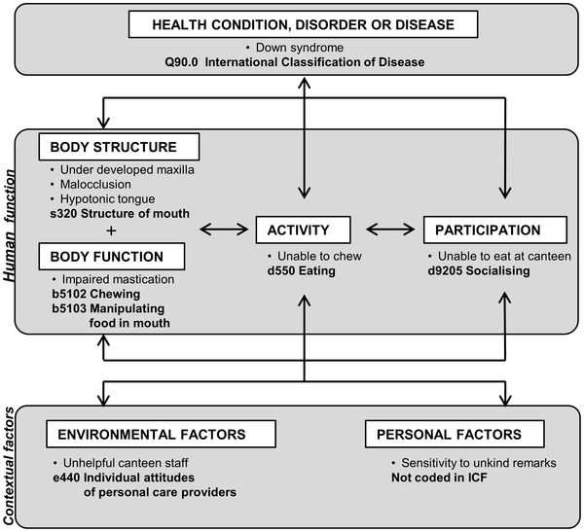

Slide 32

Definition:
Persons with disabilities include those who have long-term physical, mental, intellectual or sensory impairments which in interaction with various barriers may hinder their full and effective participation in society on an equal basis with others
Purpose of the convention:
To promote, protect and ensure the full and equal enjoyment of all human rights and fundamental freedoms by all persons with disabilities, and to promote respect for their inherent dignity.

Slide 33
The United Nations Convention on the Rights of Persons with Disabilities
Respect for inherent dignity and individual autonomy
Nondiscrimination
Full and effective participation and inclusion in society
Respect for difference and acceptance of persons with disabilities as part of human diversity and humanity
Equality of opportunity
Accessibility
Equality between men and women
Respect for evolving capacities of children with disabilities and the right of children with disabilities to preserve their identities

Slide 34
Health Promotion and Prevention Needs of the Disabled and Chronically ill
Misconceptions Impeding Improvement:
All people with disabilities have poor health.
Public health activities need to focus only on preventing disability.
There is no need for a clear definition of “disability” or “people with disabilities” in public health practice.
Environment does not play a significant role in the disability process.

Slide 35
Missed Opportunities
Focus of health care delivery system: increasingly skewed toward secondary and tertiary prevention; limited emphasis on health promotion
Areas of secondary and tertiary prevention that may be unique to persons with disabilities or chronic illnesses that are completely ignored
Disability or illness usually as the initial reason for care; often drives selection of prevention efforts to the possible exclusion of other equally important issues
Health care disparities and discrimination

Slide 36
MISSED OPPORTUNITIES EXAMPLE
A 60-year-old woman, blind since birth, self-sufficient, and active all of her life, has developed severe arthritis. She encounters a health care system that far too often focuses on her “disabilities” and not her “abilities” .The focus is placed squarely on her tertiary health promotion needs, often at the expense of health-promoting or lifestyle-enhancing needs. The result is a failure to recognize that the “disability” of arthritis is likely no less and no more an issue for her than for a sighted person. She receives the same medication therapy as does a sighted person but may not be offered a physical therapy program because of her disability. Her need for physical therapy is no less important, but locating an appropriate, safe, and easily accessible program requires some additional work on the part of her provider. The issue is that options potentially discussed with a sighted person are more apt to be omitted completely, which may negatively affect the client’s overall health and well-being.

Slide 37
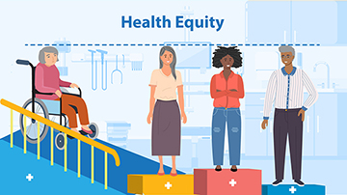
Health Care Disparities and Discrimination
When an individual receives unequal, inappropriate, or limited services compared with those received by others, this is categorized as discrimination.
The incidence of unequal and inappropriate practices can be reduced with education and training of health care providers, agency staff, and insurance carriers.

Slide 38
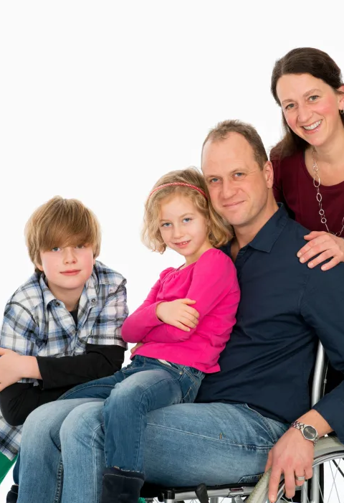
Families with a Disabled or Chronically Ill Member
Family’s role in advocacy
families face many challenges like
They navigate a health care system that they may know little about .
They serve as advocates for their (child, spouse, or parent) and may become exhausted or frustrated with their efforts.
Many demand assistance from health care agencies, social services, or transportation sources/ or open their home to others (e.g., community/public health nurses, social workers) .
Families may also have little understanding of what services they are entitled to because of language barriers, difficult agency policies, or disjointed service delivery.

Slide 39

The PHN must earn the trust and confidence of the family by:
Practicing consistency
Following through with promised actions,
Always being truthful.

Slide 40
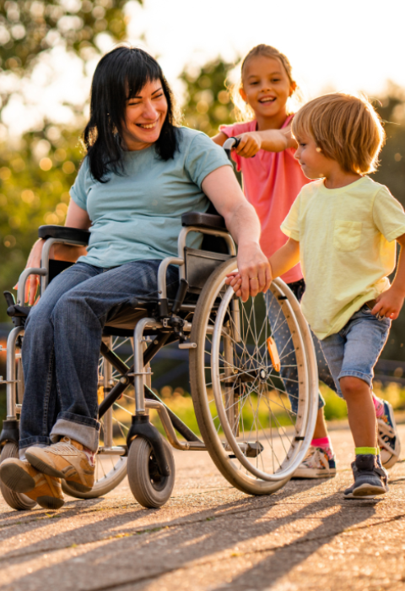
The impact of caregiving on families
The Impact on the family:
High level of anxiety, stress, depression, social isolation, illness and financial burden.
Obstacles, such as assistive devices and technology and financing, respite care, entitlements, loss of work, caregiver health, and mental health status.
The PHN is in an optimal position to:
Interpret health care systems to the families and to advocate for the needed care, services, and equipment.
View the family holistically,
Recognize additional needs that may develop as a result of the situation currently faced.
Include an assessment of caregiver and family work patterns when caring for families with a disabled or chronically ill family member.

Slide 41
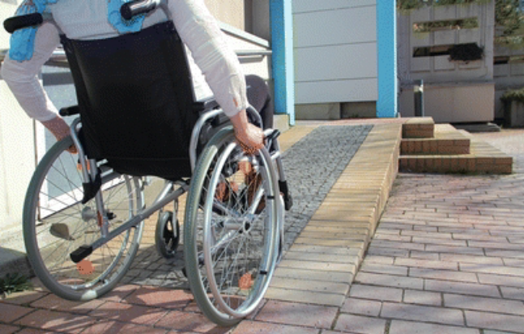

UNIVERSAL DESIGN
Is the concept of purposely creating environments in a way that they are accessible to all without the need for modifications
Ramps are needed for those using wheelchairs
to gain access to buildings.
Handicap access shower

Slide 42

THE ROLE OF THE
COMMUNITY/PUBLIC HEALTH
NURSE
Advocate for health care needs for disabled and chronically ill need for broad and holistic practice.
Creativity, tenacity, honesty, and knowledge to make needed changes at the individual, family and community level to improve their lives.
Involvement in wide-ranging, multiple roles, collaborate with other professionals and at different levels
Community based intervention that help support disabled population with self management skills, improve health behaviors, and prevent secondary disabilities.

Slide 43


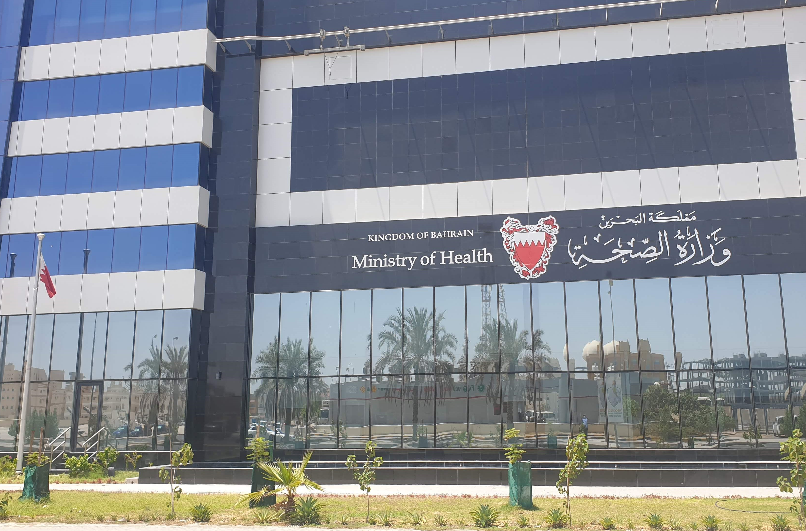
Services Available in Kingdom of Bahrain
Ministry of Health
Ministry of Social Development
Ministry of Education
The Private Sector
NGO’s
The Supreme Council for Youth and Sports
Other Services

Slide 44
Ministry of Health
Preventative &Early detection services:
Newborns screening for hereditary blood diseases and hearing impairments
Baby friendly hospitals
Periodic child screening/well baby clinics
Extended immunization program
Antenatal, Postnatal and family planning services
Premarital counseling program
School health program
Combating blindness program
Retinal examination for all diabetic patients.
Dental services
Specialized clinics: diabetic, chronic disease, obesity, mental health
Community health nurses' services
Social services
Health education
Elderly mobile units

Slide 45
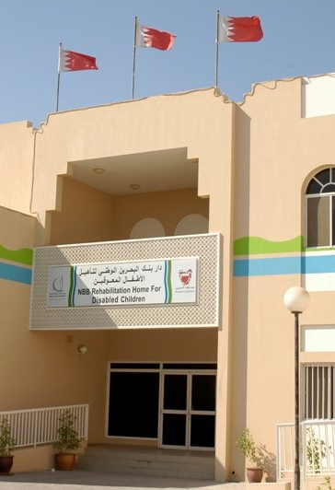
Ministry of Health
Rehabilitative centers provide remedial, rehabilitative, occupational, educational and entertainment services.
The centers are:
NBB Rehabilitation Home For Disabled Children (moderate-severe mental retardation, >12 years)
Academic and vocational rehabilitation center(mild –moderate mental retardation,12-15, >15)
BBK rehabilitation center (moderate or severe mental, physical, >16)
Shaikhan Alfarsi Center for Total Communication (auditory, 2.5-8years)
Children day care center (multiple disabilities, 3-12years)

Slide 46
Ministry of Health
The comprehensive disability center:
Provide all types of services under one roof.
It has the following sections:
Diagnosis and assessment center
Physiotherapy section
Psychological and family treatment section
Multiple disability center (auditory and mental)
Cerebral palsy center
Education and training center
Exhibition center for disabled products and equipment related to disability
Medical clinic and laboratory

Slide 47
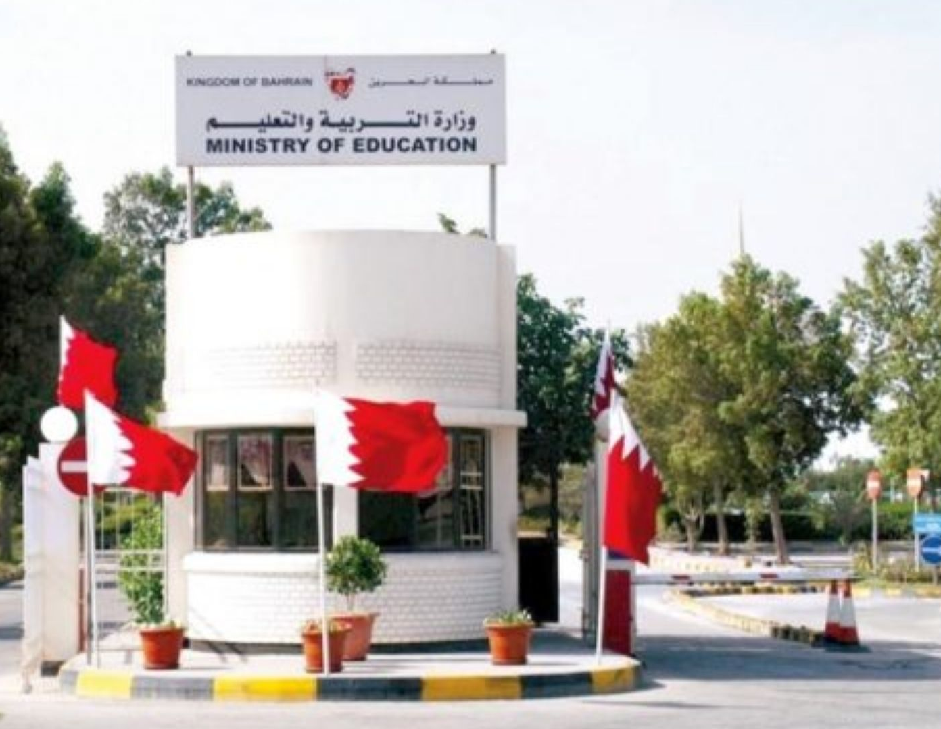
Ministry of Education
The Bahraini constitution states that education is available free of charge for all citizens.
The special education directorate in the ministry determines the cases that can join the governmental schools and supervises all disabled students including those studying abroad.
Integration of persons with disability in the schools: complete Remedial classes for slow learners are available in some schools (physical, visual), partial (down’s, mild MR, learning disabilities).
Modifying the school environment to suit the disabled.
Training of the staff .

Slide 48
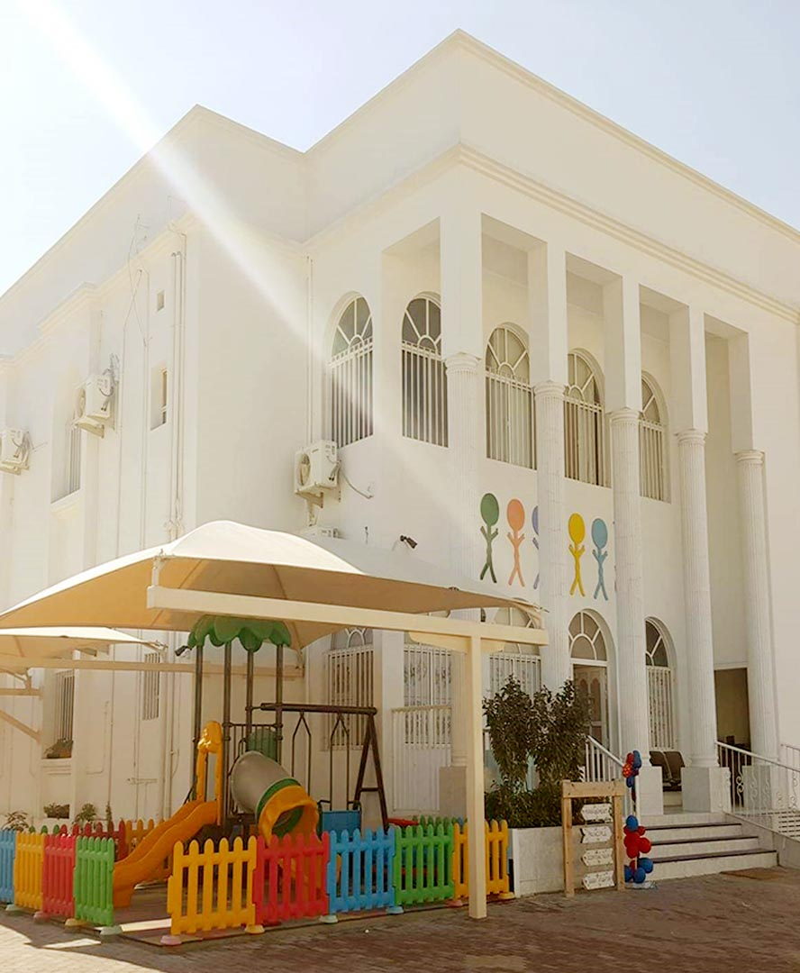
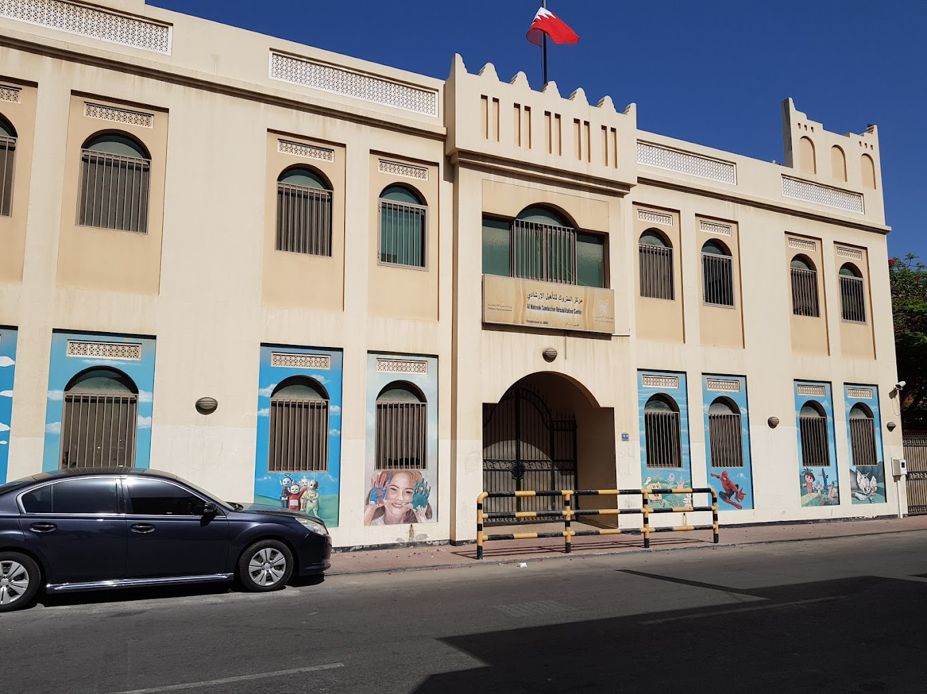
Private Sector
Works closely with Ministry of Social development.
These centers include:
  Bahrain comprehensive center for caring and rehabilitating persons with special needs.
  The Bahraini institution for special education.
  Autism center.
  Partnership with the ministry of social development:
  Al-Matrook center
  The mobile unit project

Slide 49

NGO’ s related to Disability:
Started in 1979
The national institution for disabled services (1992)
Operates: car parking, agricultural center for disabled
Annual financial aids to all related centers and societies
Training workshops.
There are 14 NGO’s and 14 nongovernmental centers

Slide 50
NGO’ s related to Disability
Center for Bahrain Mobility International
Friendship Association for the Blind
The Bahraini union for disabled sports
National Foundation for Disabled Services
Bahrain association for mental retardation
Saudi Bahraini institute for the blind
Bahrain association for Down’s syndrome
Bahrain Society for the parents and friends of the disabled.
Bahrain Society for Children with difficulty in communication and behavior
Society of Friends of cerebral palsy
Cochlear Implant Association
Bahrain association of hearing, speech and vision impairment
Deaf club
Bahrain deaf association

Slide 51
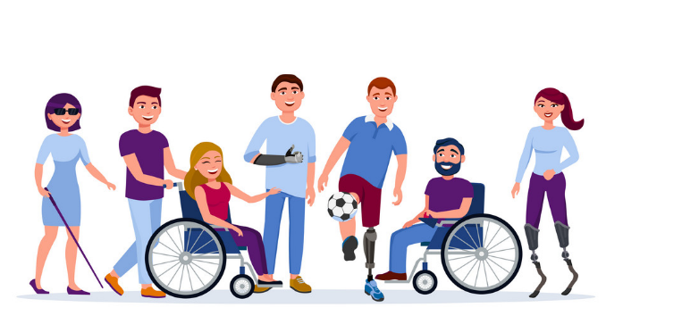
NGO’ s related to Disability:
Bahrain Mobility International (BMI) kindergarten
BMI Nursery
Al-Wafa Center(MR)
Al-Wafa Center (Autism)
Saudi Bahraini Institute for the Blind
Al-Rahma Center
Al-Hidd Center for Rehabilitating the Special Needs Persons
Friendship for the Blind Kindergarten
Al-Rashad Center
Hope Institute for Early Care
Prince Sultan Bin Abdul-Aziz Center for Development of Hearing and Speech
Down’s Syndrome Center
Alia Center for Early Intervention

Slide 52
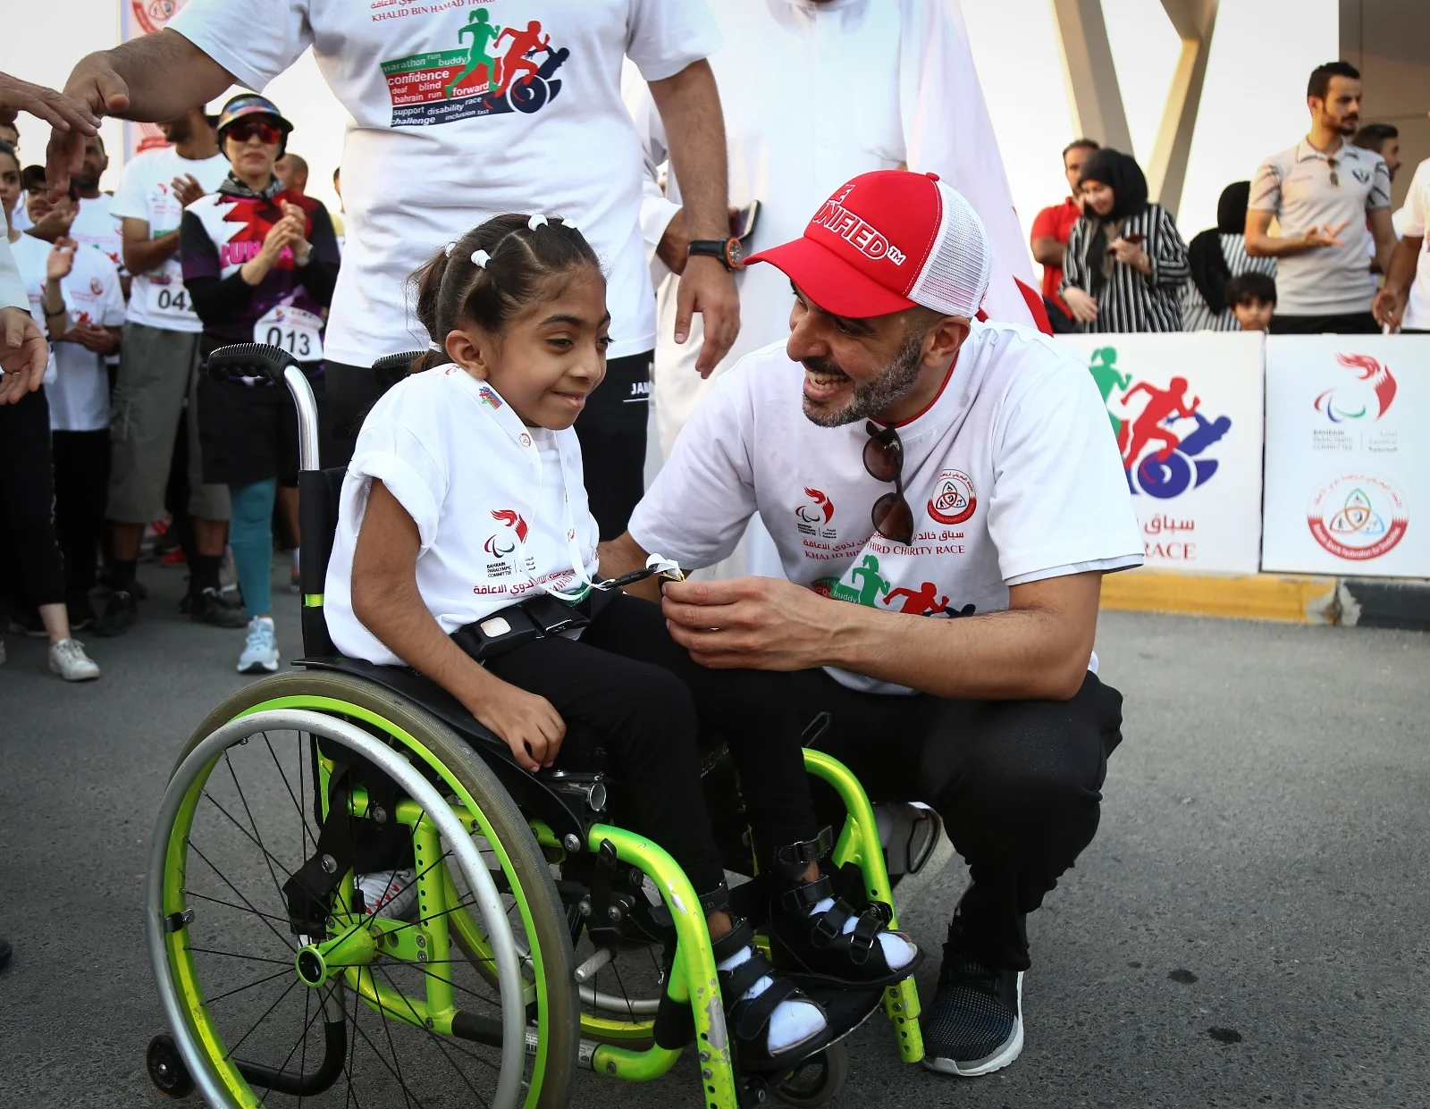
The supreme council for youth and sports
The council provides annual financial aid for the Bahraini Union for disabled sports which was formed in1987.
The union is responsible for organizing competitions locally and participating in regional and international ones.
Training specialists in the field of disabled sports.
Exchange programs with the Mobility International USA (MIUSA)

Slide 53
Other Services
Child development unit in SMC.
Specialized clinics in secondary care
Child and adolescent unit in the psychiatric hospital
Physiotherapy and occupational therapy.
Speech therapy unit.
Cochlear implant program.

Slide 54
Thank You

