Slide 1


School Nursing
College of Health & Sport Sciences
Department of Nursing
NUR 415 (2025-26) – 1st SEM
BSc. Nursing

Slide 2
Objectives
By the end of this session, students will be able to:
Define school health nursing and explain its purpose within the educational and healthcare systems.
Describe the historical development of school nursing, including contributions by Lillian Wald and Lina Rogers.
Identify the core roles and responsibilities of the school nurse as outlined by the American Academy of Pediatrics (AAP, 2016) and the National Association of School Nurses (NASN, 2019).
Explain the key components of the Framework for 21st Century School Nursing Practice and its focus on student-centered, community-based care.
Demonstrate how school nurses manage chronic health conditions (e.g., asthma, diabetes, epilepsy, allergies) through individualized health plans (IHPs) and emergency action plans.

Slide 3
Introduction
Many nursing students are unaware of the diverse career opportunities beyond hospital walls.
Community-based nursing roles—such as public health nursing (C/PHN), school nursing, and correctional nursing—are vital parts of publicly funded health systems.
Remember:
Community nurses share several key characteristics:
Apply the nursing process to populations or groups rather than individuals.
Focus on prevention of disease and disability.
Work with vulnerable populations.
Emphasize population-based care, collaboration, and networking with agencies and professionals (e.g., mental health workers, correctional officers).
Act as advocates for individuals and communities.
Must be autonomous, flexible, creative thinkers, and self-directed in planning and delivering evidence-based care.

Slide 4
Public Health Nursing
Community Settings for Public Health Nursing
C/PHNs can work in diverse settings, such as:
Schools, public health departments, and local government agencies
Environmental health advocacy (e.g., transportation, safety policies)
Global health initiatives (due to globalization and travel)
Home visits and family health education
Geriatric care (home care, assisted living, long-term facilities)
Correctional facilities, promoting healthy lifestyles and disease management during incarceration

Slide 5
Public Health Nursing
Key Functions of the Public Health Nurse
C/PHNs can work in diverse settings, such as:
Focus on the health of populations rather than individuals.
Reflect the needs and priorities of communities.
Build caring and culturally sensitive relationships.
Are grounded in social justice, compassion, and equity.
Integrate understanding of physical, emotional, social, mental, spiritual, and environmental health.
Base their interventions on epidemiologic evidence.
Use collaborative strategies to achieve results.

Slide 6
School Nursing

Slide 7
School Nursing
School Nursing is a specialized practice that supports student well-being, academic success, and lifelong achievement.
School nurses act as a link between school, family, community, and the healthcare system.
School nurses are ethical, evidence-based leaders who bridge health and education, coordinate care, and advocate for student-centered systems that promote individual and community potential.
Historical Background
1902: Lillian Wald’s Henry Street Settlement pioneered school nursing in New York.
Lina Rogers was the first school nurse, conducting home visits to help sick children return to school.
Early school nurses advocated for:
  Hot lunch and breakfast programs
  Better hygiene and health education
  Improved social conditions for families

Slide 8
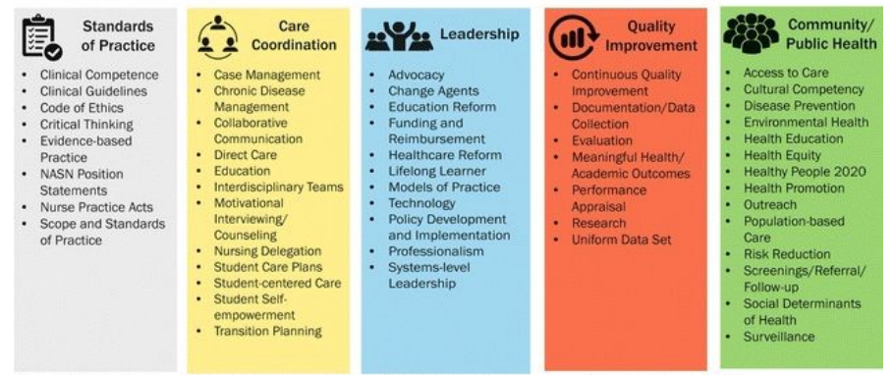
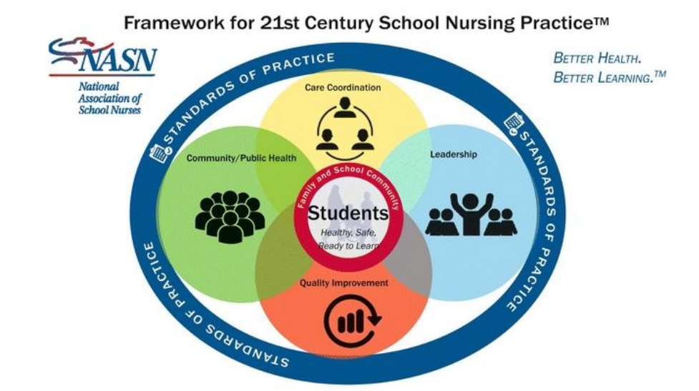
School Nursing

Slide 9
School Nursing
Framework for 21st century school nursing practice; National Association for School Nurses. (NASN, 2019).
Students – Healthy, Safe, and Ready to Learn.
The framework emphasizes a student-centered and family/community-focused approach.
Domain | Key Concepts | Examples of School Nurse Roles/Activities
1. Care Coordination | Case management, chronic disease management, interdisciplinary teams | Collaborating with teachers and families to support students with asthma, diabetes, ADHD, etc.
2. Leadership | Advocacy, policy development, ethical practice, professional development | Leading health initiatives, influencing school health policies
3. Quality Improvement | Data collection, evaluation, evidence-based practice, documentation | Using student health data to improve care outcomes
4. Community/Public Health | Population-based care, screening, health education, emergency preparedness | Conducting vaccination drives, promoting mental health awareness
5. Standards of Practice | Clinical competence, ethical practice, legal compliance | Adhering to national nursing standards and scope of practice

Slide 10
School Nursing
School Nurse Core Responsibilities (AAP, 2016):
Health Promotion: Promote the health and well-being of students, families, and school staff.
Case Management: a) Manage chronic conditions such as asthma, diabetes, epilepsy, and severe allergies. b) Develop individual health plans (IHPs) and emergency action plans.
Immunization Monitoring: Ensure all students are up to date with vaccinations and assist in accessing immunization services.
Special Education Support: Collaborate with teachers, parents, and psychologists to design and implement Individualized Education Plans (IEPs) for students with special needs.
Healthy School Environment: Work with school staff to ensure Safe playgrounds, Proper nutrition and hygiene, Physical activity programs, and Emergency preparedness.

Slide 11
School Nursing
School Nurse Core Responsibilities:
Community Collaboration
  Partner with public health departments, physicians, dentists, social services, and parent associations to meet students’ and families’ needs.
Screening and Health Education
  Conduct regular screenings (vision, hearing, growth, BMI, dental, mental health).
  Promote health and wellness programs for students and staff.
Direct Health Care
  Work with school-based health clinics to provide direct care to children and families.
  Facilitates normal development and promotes positive outcomes through early interventions.
Coordinated School Health Programs
  Lead and support comprehensive programs combining health education, nutrition, counseling, and family/community involvement.

Slide 12

School Nursing
The Whole School, Whole Community, Whole Child (WSCC) Model
Developed by the Centers for Disease Control and Prevention (CDC, 2016)
The WSCC model emphasizes that the child’s health, learning, and development are inseparable — and that the school and community must work together to support every child.

Slide 13
School Nursing
The WSCC framework includes 10 key components that integrate health and education:
Component | Focus
1. Health Education | Teaching students healthy behaviors and prevention strategies.
2. Physical Education & Physical Activity | Promoting movement, exercise, and fitness.
3. Nutrition Environment & Services | Providing healthy meals and nutrition education.
4. Health Services | Delivering screenings, immunizations, and emergency care.
5. Counseling, Psychological & Social Services | Addressing emotional and behavioral needs.
6. Social & Emotional Climate | Fostering a safe, respectful, and supportive atmosphere.
7. Physical Environment | Maintaining clean, safe, and healthy school facilities.
8. Employee Wellness | Supporting the health and well-being of school staff.
9. Family Engagement | Involving families in student learning and health decisions.
10. Community Involvement | Collaborating with community organizations and health agencies.

Slide 14
School Nursing
The School Nurse’s Role within the WSCC Model
The school nurse contributes to the WSCC model by:
Acting as a liaison among school, family, and community health systems.
Promoting comprehensive health education and services.
Coordinating case management for students with chronic illnesses.
Advocating for safe and healthy school environments.
Supporting mental health and wellness initiatives.
Leading or co-leading coordinated school health programs.

Slide 15
School Nursing
Major Chronic Conditions Managed by School Nurses
1. Asthma
The most common chronic disease in children, leading to over 13 million missed school days annually (Everhart et al., 2018).
Symptoms: Wheezing, chest tightness, shortness of breath, and fatigue.
Environmental triggers: Mold, allergens, poor air quality, and dust.
School nurse roles:
  Develop and monitor Asthma Action Plans in collaboration with families and physicians.
  Educate students on inhaler use and trigger avoidance.
  Monitor medication adherence and emergency response protocols.
  Train teachers and staff in asthma management and emergency procedures.

Slide 16
School Nursing
Major Chronic Conditions Managed by School Nurses
2. Diabetes
About 208,000 children and adolescents live with diabetes in the U.S. (NASN, 2017).
Types:
  Type 1: Autoimmune, requiring insulin therapy.
  Type 2: Often associated with obesity and sedentary lifestyle.
School nurse responsibilities:
  Develop Diabetes Medical Management Plans (DMMPs).
  Provide care coordination, training, and delegation for diabetes care tasks.
  Educate teachers and classmates to assist in emergencies.
  Identify and respond to hypoglycemia or hyperglycemia immediately.
  Promote healthy lifestyle habits to prevent Type 2 diabetes.

Slide 17
School Nursing
Major Chronic Conditions Managed by School Nurses
3. Seizure Disorders (Epilepsy)
Caused by abnormal brain activity resulting in seizures.
Most cases controlled with medication, surgery, or specialized diets.
School nurse roles:
  Ensure medication compliance and proper documentation.
  Train teachers and peers in first aid for seizures.
  Promote empathy and reduce bullying or stigma.
  Develop Emergency Seizure Action Plans and educate unlicensed assistive personnel (UAP) on safe medication administration (e.g., Diastat, midazolam).

Slide 18
School Nursing
Major Chronic Conditions Managed by School Nurses
4. Food Allergies and Anaphylaxis
Affect approximately 5.9 million school-aged children (FARE, 2018).
Common triggers: Peanuts, tree nuts, shellfish, milk, eggs, soy, wheat, and fish.
School nurse duties:
  Develop Allergy and Anaphylaxis Emergency Plans.
  Ensure availability of epinephrine auto-injectors (EpiPen).
  Train teachers, cafeteria staff, and bus drivers on emergency response.
  Collaborate with families and school staff to minimize allergen exposure.

Slide 19
School Nursing
Major Chronic Conditions Managed by School Nurses
5. Behavioral and Learning Disorders
Emotional, behavioral, and intellectual problems affect 10–15% of children worldwide (NIMH, 2018).
Common conditions:
  ADHD, Oppositional Defiant Disorder, Bipolar Disorder, and early-onset Schizophrenia.
School nurse responsibilities:
  Early identification and referral to mental health services.
  Advocate for counseling, behavioral therapy, and medication monitoring.
  Work with teachers and families to develop supportive learning environments.
  Educate staff and students on mental health awareness and empathy.

Slide 20
References
Rector, C. L. (2018). Community Health Nursing: Promotion & Protecting the Public’s Health. 9th ed. Philadelphia: Wolters Kluwer Lippincott Williams and Wilkins.
Robinson, M., Coehlo, D. P., & Smith, P. S. (2022). Family health care nursing : theory, practice, and research (7th edition). F.A. Davis Company.

Slide 21
Thank you

