Slide 1

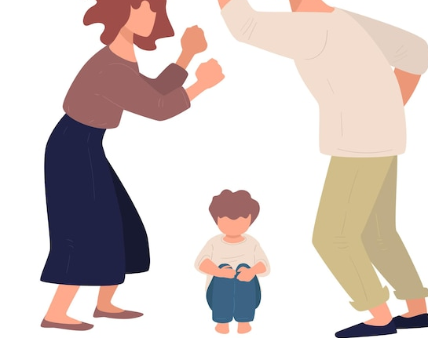
Violence &
Abuse
College of Health & Sport Sciences
Department of Nursing
NUR 415 (2025-26) – 1st SEM
BSc. Nursing

Slide 2
Objectives
By the end of this session, students will be able to:
Define key concepts related to violence and crisis, including WHO and CDC definitions.
Describe the types and forms of violence encountered across the lifespan (child abuse, intimate partner violence, elder abuse, etc.).
Differentiate between risk factors and protective factors influencing violence at individual, relationship, community, and societal levels.
Recognize the signs and symptoms of physical, emotional, sexual, and neglect-related abuse in children and vulnerable populations.
Explain the cycle of violence in intimate partner relationships and its health implications.
Identify the nursing roles in the primary, secondary, and tertiary prevention of violence and crisis.

Slide 3
Introduction
Violence is a global public health issue.
It is not limited by sociodemographic or geographic factors—anyone may experience violence or abuse at any point in one's lifetime.
Acts of violence may occur once or multiple times and involve a single perpetrator or a group of perpetrators who may or may not be known to the person experiencing violence.
Violence and abuse may occur in any setting—at home, in public, at work, or at school.

Slide 4
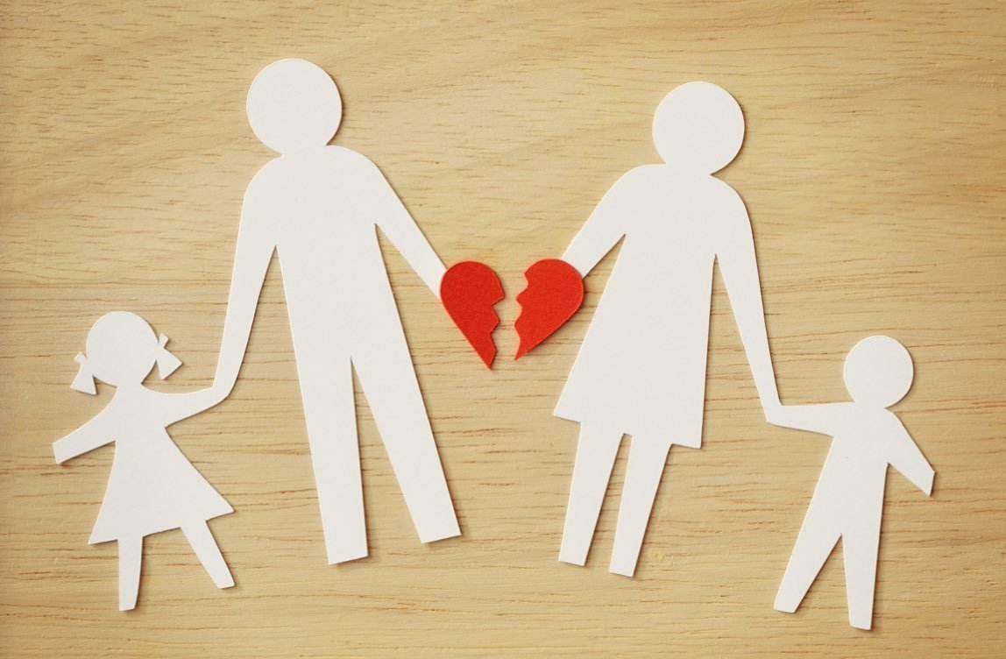
Definitions
Violence:
The World Health Organization defines violence as “the intentional use of physical force or power, threatened or actual, against oneself, another person, or a group or community, that either results in or has a high likelihood of resulting in injury, death, psychological harm, maldevelopment, or deprivation.”
Crisis:
Stressful/disruptive event(s) that disturb the equilibrium of an individual, family, or community. Can occur with or without warning

Slide 5
Dynamics and characteristics of a crisis
Each person is a dynamic system living within a given environment under the circumstances unique to that person alone.
Occurs when an internal or external force disrupts an individual’s balance, affecting functioning.
Individual attempts to restore equilibrium using available resources.
Inability to cope effectively = crisis (Boyd, 2018).
Typically resolved within 4–8 weeks (Kanel, 2019).
Long-term biopsychosocial effects may persist, especially after violence or trauma.

Slide 6
Types of Crisis
Type | Characteristics | Examples
Developmental Crisis | Part of normal growth; gradual onset; related to life transitions and societal expectations | Adolescence, marriage, retirement
Situational Crisis | Unexpected disruption in normalcy; event jeopardizes physical/psychological well-being; internal or external origin | Illness (cancer), job loss
Traumatic Crisis | Sudden, overwhelming, unusual event; affects individual or group; causes death, injury, or destruction | Natural disasters, acts of violence, terrorism

Slide 7
Overview of violence across the life cycle
Violence can occur from birth to death, in chronic or sudden forms:
Chronic: Long-term abuse, neglect, or maltreatment
Situational: Unexpected, acute events
Types of violence encountered by C/PHNs:
Child abuse and neglect
Youth violence, bullying, gang violence
Intimate partner violence (IPV) and dating violence
Sexual violence
Elder abuse and neglect
Multiple types of violence can occur within a single household, community, or neighborhood, affecting people at different stages in life.

Slide 8
Overview of violence across the life cycle
Different types of violence are interconnected. For example:
People who experience one form of violence are likely to experience other forms of violence.
People who use violence in a context are likely to use it in another context.
Different types of violence share common short-and long-term biopsychosocial health effects that may contribute to chronic health conditions such as cardiovascular disease, lung disease, and diabetes.
Shared risk and protective factors exist across different types of violence.

Slide 9
Overview of violence across the life cycle
  Understanding trauma improves trauma-informed care
  Many victims are revictimized or misunderstood due to lack of knowledge about normal trauma responses
  Reactions to trauma are highly individual—no “one-size-fits-all” response
  Extraneous factors (substance use, past trauma, neurological patterns) influence responses
Trauma-informed practices:
  Improve nurse interviews and anticipation of support they need for coping with the physiological and psychological impact of traumatic experience
  Enhance linkage to community resources
  Focus on physiological and psychological impacts

Slide 10
Risk Factors and Protective Factors for Violence
Risk factors: Increase likelihood of experiencing or using violence
Protective factors: Reduce likelihood or enhance resilience after violence
Individual experiences and characteristics can act as either

Slide 11
Overview of violence across the life cycle
  Examples from CDC (2020c)
Protective Factors:
Community: Coordinated services and services among community agencies, mental health/substance abuse access, social connectedness
Relationship: Family support, caring adult relationships, prosocial peer connections, school attachment
Individual: Nonviolent problem-solving skills

Slide 12
Overview of violence across the life cycle
  Examples from CDC (2020c)
Risk Factors:
Societal: Cultural norms supporting aggression, violent media, income inequity, harmful gender norms
Community: Neighborhood poverty, high alcohol availability, community violence, unemployment, poor cohesion
Relationship: Social isolation, poor parent–child relationships, family conflict, delinquent peer associations
Individual: Low education, poor behavioral control, impulsivity, prior victimization, mental health/substance issues

Slide 13
Overview of violence across the life cycle
What are some of the risk factors and protective factors in your community?

Slide 14
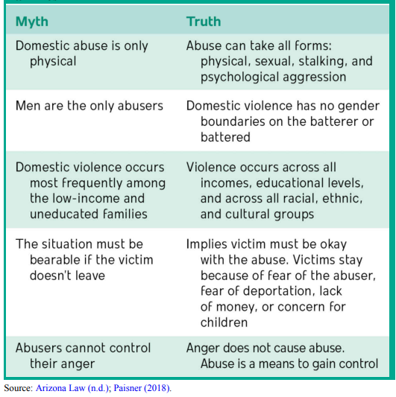
Myths and Truths About Violence and Abuse

Slide 15
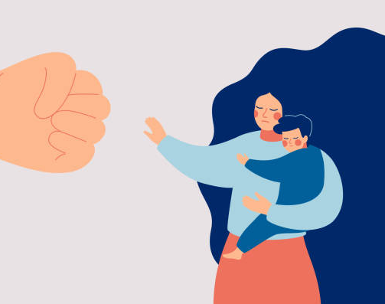
FAMILY VIOLENCE AGAINST CHILDREN

Slide 16
FAMILY VIOLENCE AGAINST CHILDREN
Child abuse (CAPTA, 2019):
Any act or failure to act by a parent/caregiver resulting in death, serious harm, sexual abuse, or an imminent risk of serious harm.
Child maltreatment (WHO, 2020):
All forms of abuse and neglect toward children under 18 that result in actual or potential harm to health, development, or dignity within a relationship of responsibility, trust, or power.
Global Perspective
25% of adults report physical abuse in childhood.
36% report emotional abuse; 16.3% report neglect.

Slide 17
Major Types of FAMILY VIOLENCE AGAINST CHILDREN
Child Neglect
Physical Abuse
Sexual abuse
Emotional/ Psychological abuse
Specific Abusive Situations:
1- Abusive Head Trauma (Shaken Baby Syndrome)
2. Munchausen Syndrome by Proxy
3. Parental Filicide (Child Murder by Parent)
4- Internet and Technology-Facilitated Crimes
5. Child Abduction
6. Abuse by Babysitters or Caretakers
7. School Violence

Slide 18
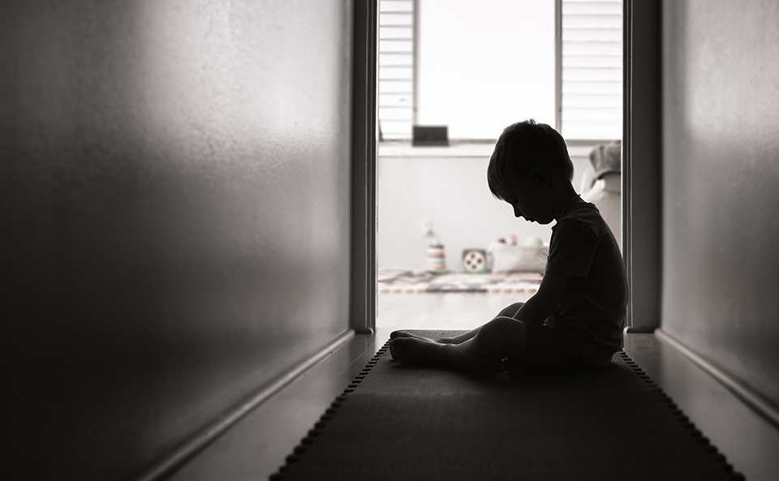
FAMILY VIOLENCE AGAINST CHILDREN
Major Types of Child Abuse A- NEGLECT
Failure to provide basic physical, emotional, medical, or educational needs.
Types:
Physical neglect: Poor hygiene, lack of food or shelter.
Medical neglect: Not providing necessary health care.
Educational neglect: Frequent absence, not enrolled in school.
Emotional neglect: Lack of affection, excessive or inappropriate demands.

Slide 19
FAMILY VIOLENCE AGAINST CHILDREN
Major Types of Child Abuse A- NEGLECT
Examples:
Parents may refuse to buy eyeglasses for a child who needs them or to access dental care for severely decayed teeth (medical neglect).
An 8-year-old may get to school only 3 days a week, possibly without breakfast and no lunch money or packed lunch (educational neglect).
A family with three children may live in a sparsely furnished apartment with very little food available and only intermittent heat and multiple people coming and going in the residence, while the children may appear at school unwashed and without coats in winter weather (general neglect).
Emotional neglect may be seen when demands placed on a child are excessive or inappropriate for his or her development, or the caretaker berates or verbally humiliates a child frequently and without reason.

Slide 20
FAMILY VIOLENCE AGAINST CHILDREN
Major Types of Child Abuse A- NEGLECT
Signs and Symptoms:
Poor hygiene, malnutrition, inappropriate clothing.
Lack of medical/dental care or immunizations.
Poor supervision, unsafe home environment.
Sleepy, hungry, failure to thrive.
Nursing Considerations (C/PHN Role):
Assess causes (lack of knowledge, finances, or access).
Link families to support: WIC (Women, Infants, and Children Program), health insurance, education programs.
Remember: Neglect often discovered during investigations of other abuse.

Slide 21
FAMILY VIOLENCE AGAINST CHILDREN
Major Types of Child Abuse A- NEGLECT
Signs and Symptoms:
Poor hygiene, malnutrition, inappropriate clothing.
Lack of medical/dental care or immunizations.
Poor supervision, unsafe home environment.
Sleepy, hungry, failure to thrive.
Nursing Considerations (C/PHN Role):
Assess causes (lack of knowledge, finances, or access).
Link families to support: WIC (Women, Infants, and Children Program), health insurance, education programs.
Remember: Neglect often discovered during investigations of other abuse.

Slide 22
FAMILY VIOLENCE AGAINST CHILDREN
Major Types of Child Abuse B- Physical Abuse
Intentional harm to a child by another person that results in pain, physical injury, or death.
Common Injuries:
Bruises, burns, fractures, bite marks, head trauma.
Injuries inconsistent with child’s developmental stage.
Delayed medical attention.

Slide 23
FAMILY VIOLENCE AGAINST CHILDREN
Major Types of Child Abuse B- Physical Abuse
Signs and Symptoms:
Frequent emergency department visits
Caregiver blames child for injuries
Delay in seeking health/medical care or changes provider frequently
Explanation changes, doesn't match the child's developmental ability, or contradicts injuries

Slide 24
FAMILY VIOLENCE AGAINST CHILDREN
Major Types of Child Abuse B- Physical Abuse
Signs and Symptoms:
Has unexplained injuries, explanation does not match the injury, or injuries are inconsistent with medical diagnosis. such as Injuries may include bruises, bite marks, abrasions, lacerations, head injuries, internal injuries, and fractures
Bruising from defensive injuries to forearms
Burns from cigarettes, ropes, or immersion into hot water or hot grid
Traumatic alopecia with possible hematoma area and is tender to touch
Trauma to ear
Appears depressed, withdrawn, anxious, or aggressive
Appears scared of parent and does not want to go home

Slide 25
FAMILY VIOLENCE AGAINST CHILDREN
Major Types of Child Abuse B- Physical Abuse
Behavioral Indicators:
Attempts to hide injuries; child wears excessive layers of clothing, especially in hot weather.
Frequently absent from school or misses physical education classes.
Fearful, clingy, anxious, withdrawn, hypervigilant, or aggressive.
The child is apprehensive when other children cry.
Wary of physical contact with adults.
Exhibits drastic behavioral changes in and out of parental/caretaker presence.
The child suffers from seizures or vomiting.
Exhibits depression, self-mutilation, suicide attempts, substance abuse, or sleeping and eating disorders.
Fearful of going home.

Slide 26
FAMILY VIOLENCE AGAINST CHILDREN
Major Types of Child Abuse C- Sexual Abuse
Sexual abuse of children includes acts of sexual assault or sexual exploitation of a minor and may consist of a single incident or many acts over a long period.
Rape, molestation, prostitution, and human trafficking of minors are included in the definition.
Care for children who have been sexually abused varies, as the duration of the molestation, the age, and symptoms of the child will influence their care measures. Parents may also need counseling and support following the investigation and proceedings involving their child's victimization.

Slide 27
FAMILY VIOLENCE AGAINST CHILDREN
Major Types of Child Abuse C- Sexual Abuse
Incest is sexual abuse among family members who are related by blood (e.g., parents, grandparents, older sibling).
Intrafamilial sexual abuse refers to sexual activity involving family members who are not related by blood (e.g., stepparents, partner of a parent).
Commercial Sexual Exploitation (CSEC): Use of a child for sexual purposes in exchange for money, food, shelter, or protection. Includes child trafficking, pornography, and early forced marriage.

Slide 28
FAMILY VIOLENCE AGAINST CHILDREN
Major Types of Child Abuse C- Sexual Abuse
Signs and Symptoms:
Physical Signs
Sexually transmitted infections.
Trauma to the perineal area including bleeding, bruising, or pain.
Blood may be seen on sheets or undergarments.
Discharge from genitals or anus.
Pain during bowel movements or urination.

Slide 29
FAMILY VIOLENCE AGAINST CHILDREN
Major Types of Child Abuse C- Sexual Abuse
Signs and Symptoms:
Behavioral Signs
Enuresis and/or fecal soiling in bed when behavior has been outgrown
Inappropriate sexual behavior for age
Not wanting to be left alone with certain people or fearful to leave parent or caregiver
Refuses to remove clothing
Has money, gifts, or toys unexpectedly
Self-injury/suicide attempts
Sexually promiscuity in teens
Substance use

Slide 30
FAMILY VIOLENCE AGAINST CHILDREN
Major Types of Child Abuse C- Sexual Abuse
Signs and Symptoms:
Emotional Signs
Nightmares or fear of being left alone at night
Extreme worry or fear
Sexually explicit language or explicit knowledge about sexual
topics beyond age of child
Mood changes

Slide 31
FAMILY VIOLENCE AGAINST CHILDREN
Major Types of Child Abuse D- Emotional / Psychological Abuse
Emotional abuse of children involves psychological mistreatment or neglect, which impairs a child's self-worth and sense of security and being loved.
Types of psychological abuse includes rejection, scorn, terrorism, isolation, exploitation, lack of emotional response, exposure to domestic violence, and verbal threats or void of loving comments.
Emotional abuse alone is rarely reported because it is another hidden form of abuse.
Indicators:
Extremes in behavior (passive, aggressive, overly compliant).
Depression, low self-esteem, developmental delays.
Inability to form emotional bonds.

Slide 32
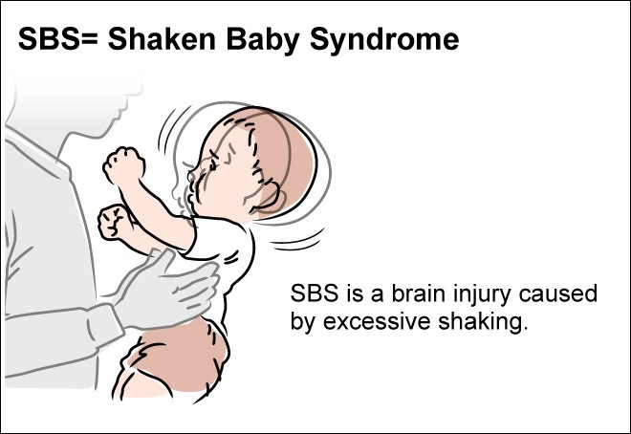

FAMILY VIOLENCE AGAINST CHILDREN
Major Types of Child Abuse E- Specific Abusive Situations
E1: Abusive Head Trauma (Shaken Baby Syndrome)
Intentional abusive action of violently shaking an infant or toddler.
Occurs in infants <2 years; leading cause of death from physical abuse.
Symptoms: seizures, respiratory distress, retinal hemorrhage, brain injury.
Outcome: 80% of survivors suffer lifelong disabilities.
E2: Munchausen Syndrome by Proxy
A diagnosis applied to parents and other caregivers who intentionally feign, exaggerate, and/or induce illness or injury in a child to get attention from health professionals and others.
Caregiver induces or fabricates illness in a child for attention.
Often perpetrated by the biological mother.
Clues: unexplained illnesses, symptoms only in caregiver’s presence.

Slide 33
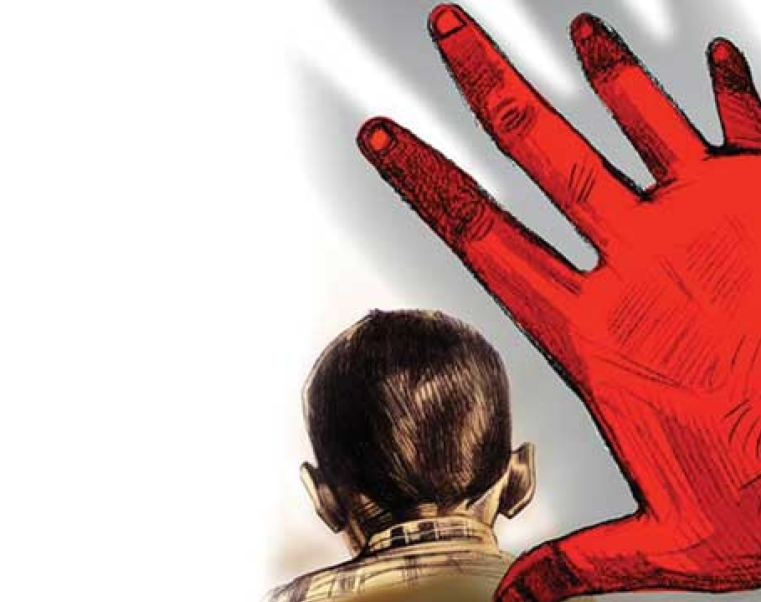

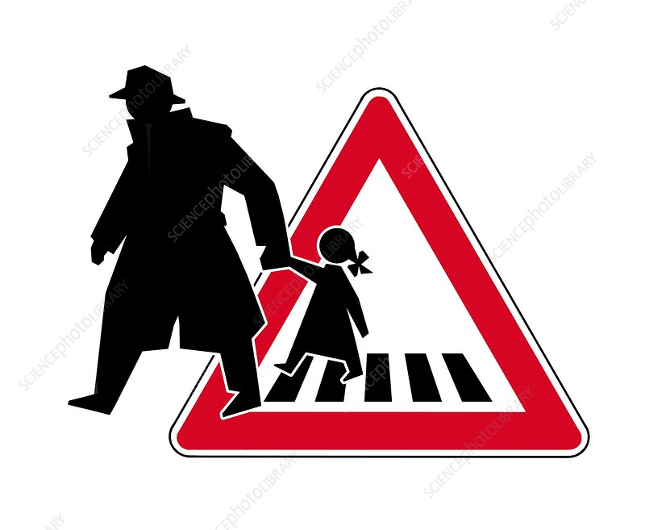
FAMILY VIOLENCE AGAINST CHILDREN
Major Types of Child Abuse E- Specific Abusive Situations
E3: Parental Filicide (Child Murder by Parent)
Includes infanticide (under 1 year) and neonaticide (within 24 hours).
Risk factors: teen mothers, depression, poverty, isolation, lack of support.
E4: Internet and Technology-Facilitated Crimes
Online grooming, sextortion, child pornography, cyberbullying.
E5: Child Abduction
Child abduction by family members or intimate partners, such as a divorced mother, father, boyfriend, or grandparents, is more common.

Slide 34
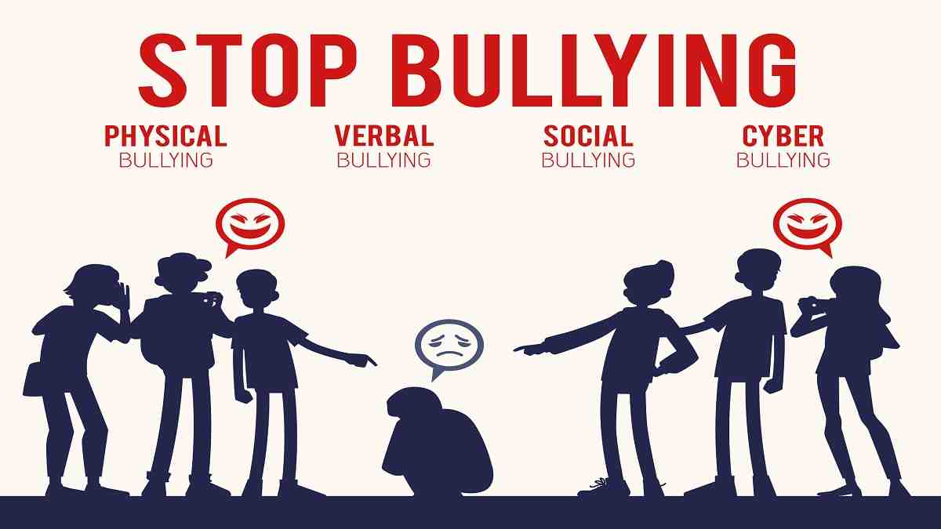
FAMILY VIOLENCE AGAINST CHILDREN
Major Types of Child Abuse E- Specific Abusive Situations
E6: Abuse by Babysitters or Caretakers
Parents should verify references, licenses, and monitor childcare environments.
Red flags: unexplained injuries, fear of caregiver, neglect signs.
E7: School Violence
Includes bullying, physical assaults, and mass shootings.
Risk factors: rejection, bullying, poor parental supervision, delinquency, poverty.
Statistics:19% bullied at school; 15% bullied electronically.6.7% missed school due to feeling unsafe.3.8% carried weapons to school.

Slide 35
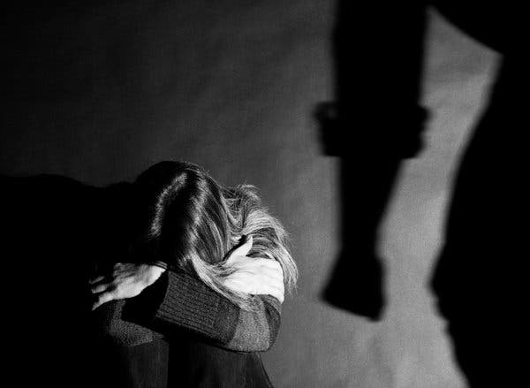
INTIMATE PARTNER VIOLENCE

Slide 36
INTIMATE PARTNER VIOLENCE
Abuse or aggression that occurs within a close relationship — either current or former partners (CDC, 2019).
Domestic violence is “a pattern of abusive behavior in any relationship that is used by one partner to gain or maintain power and control over another intimate partner”; it may be emotional, economic, physical, psychological, or sexual in nature.
IPV is a major cause of morbidity, mortality, and human rights violations globally.
Main Types of IPV:
Physical violence – hitting, slapping, choking, beating, etc.
Sexual violence – forced or coerced sexual acts.
Stalking – repeated unwanted attention or harassment causing fear.
Psychological aggression – verbal or emotional abuse, humiliation, control, or threats.

Slide 37
INTIMATE PARTNER VIOLENCE
Prevalence and Statistics (CDC, 2019; WHO, 2017)
1 in 4 women and 1 in 10 men experience physical/sexual violence or stalking.
1 in 5 women and 1 in 7 men experience severe physical violence.
1 in 5 women and 1 in 12 men experience sexual violence.
16% of all homicides are committed by an intimate partner.
43 million women and 38 million men have experienced psychological aggression
35% of women worldwide have experienced IPV or non-partner sexual violence.
30% of women have been physically abused by a partner.
38% of murdered women were killed by an intimate partner.
IPV is a major cause of morbidity, mortality, and human rights violations globally.

Slide 38
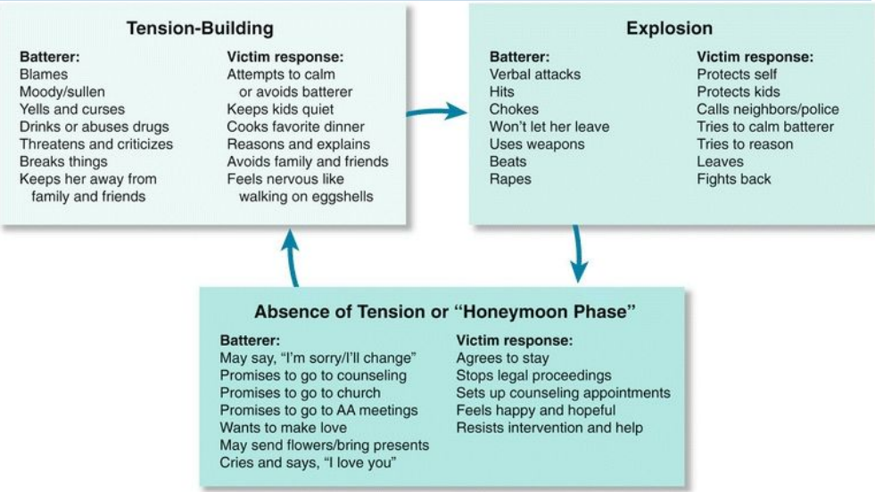
INTIMATE PARTNER VIOLENCE
The Cycle of Violence

Slide 39
INTIMATE PARTNER VIOLENCE
The Cycle of Violence
A. Tension-Building Phase
Longest phase — may last for weeks.
The abuser becomes irritable, controlling, and verbally abusive.
The victim feels anxious, cautious (“walking on eggshells”), and tries to appease the abuser to prevent escalation.
Minor incidents of abuse may occur.
Emotional stress increases as tension grows.

Slide 40
INTIMATE PARTNER VIOLENCE
The Cycle of Violence
B. Acute Explosion Phase (Crisis Phase)
Shortest phase — usually 1–2 days.
Most violent period as tension is released.
Abuse may be physical, sexual, emotional, or verbal.
Often triggered by an external event or the abuser’s emotional state.
The abuser blames the victim for the violence.
The victim may fight back, flee, or submit to calm the situation.

Slide 41
INTIMATE PARTNER VIOLENCE
The Cycle of Violence
C. Honeymoon Phase
The abuser feels remorse or shame and may apologize or justify their behavior.
Promises to change (e.g., quit drinking, be more attentive).
May display affection and generosity (gifts, flowers, romantic gestures).
The victim forgives and hopes the abuse will stop.
Temporary calm and emotional closeness return—then tension starts again.

Slide 42
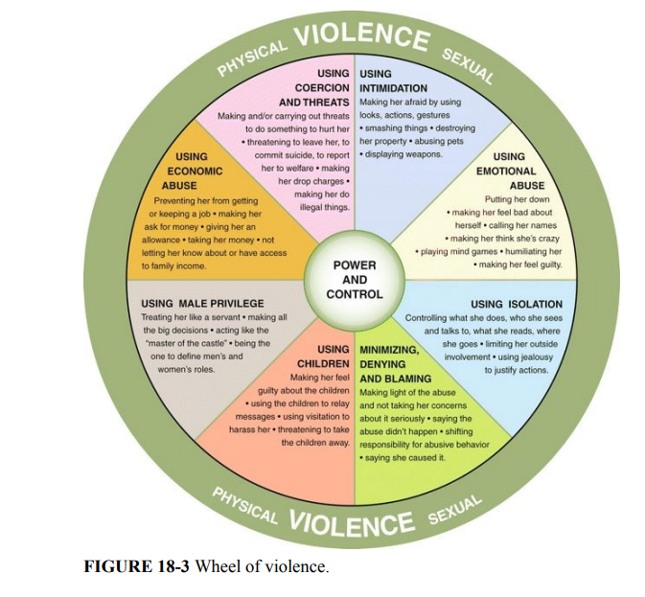
INTIMATE PARTNER VIOLENCE
The Wheel of Violence
Eight Components of the Wheel
1- Using Coercion and Threats
2- Using Intimidation
3- Using Emotional Abuse
4- Using Isolation
5- Minimizing, Denying, and Blaming
6- Using Children
7- Using Male Privilege
8- Using Economic Abuse

Slide 43
INTIMATE PARTNER VIOLENCE
Violence in Special Populations – Teens and Pregnant Women
1. Teen Dating Violence: A pattern of physical, sexual, psychological, or stalking behaviors between teens in a current or former dating relationship.
Can occur in person or electronically (e.g., social media, texting; CDC, 2019)
2. Stalking: A pattern of repeated, unwanted attention, harassment, or contact that causes fear in the victim.
Forms of Cyberstalking include Online harassment or threats, Unauthorized sharing of private photos or messages, Impersonation or social media abuse.
3. Violence During Pregnancy: Intimate partner violence (IPV) during pregnancy includes physical, sexual, or emotional abuse directed toward a pregnant woman.
Severe outcomes include Depression, anxiety, and low self-esteem, Preterm labor and low birth weight, Intrauterine growth retardation and neonatal complications.

Slide 44
Batterer Characteristics
INTIMATE PARTNER VIOLENCE
Batterer and Victim Characteristics
Low income
Low self-esteem
Low academic achievement
Heavy alcohol and drug use
Depression
Anger and hostility
Personality disorders
Prior history of being physically abusive
Having few friends and being isolated from other people
Unemployment
Emotional dependence and insecurity
Belief in strict gender roles (e.g., male dominance and aggression in relationships)
Desire for power and control in relationships
Being a victim of physical or psychological abuse

Slide 45
Victim Characteristics
INTIMATE PARTNER VIOLENCE
Batterer and Victim Characteristics
A prior history of IPV
Being female
Young age, especially if pregnant
From low-income household
Witnessing or experiencing violence as a child
Lower education level
Unemployment
Single parent with children or separated/divorced/previously widowed
Having a greater education level than their partner
For women, being disabled
For women, having a verbally abusive, jealous, or possessive partner

Slide 46
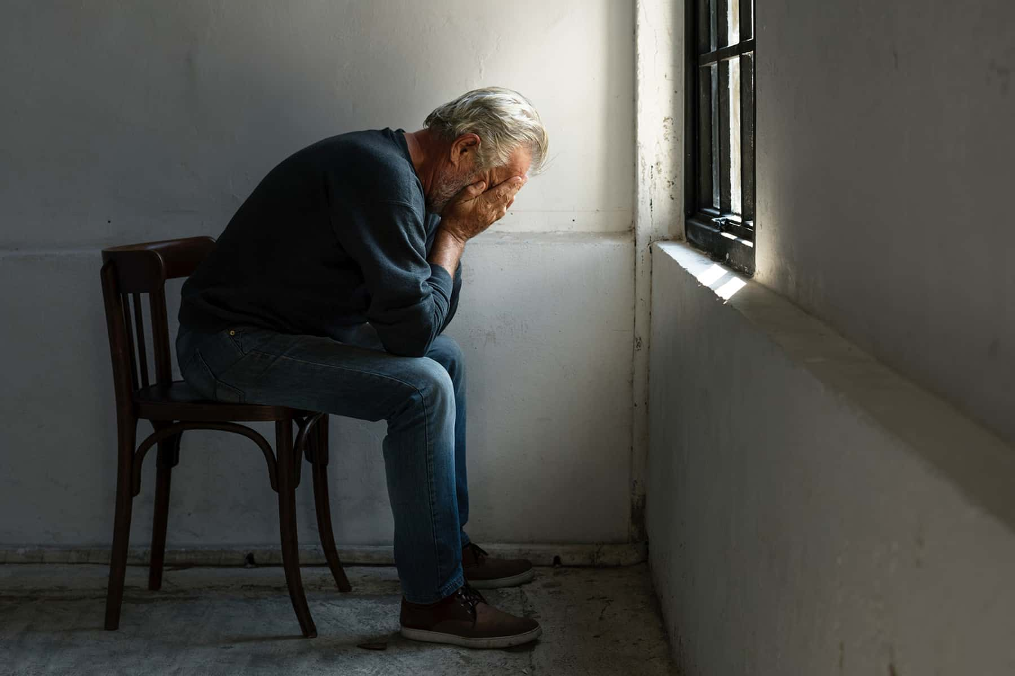
Elder Abuse and Maltreatment of Older Adults

Slide 47
Elder Abuse and Maltreatment of Older Adults
“An intentional act or failure to act by a caregiver or another person in a relationship involving an expectation of trust that causes or creates a risk of harm to an older adult.” (CDC, 2019)
Types of Elder Abuse include Physical Abuse, Sexual Abuse, Emotional/Psychological Abuse, Neglect, Passive Neglect, Financial/Material Exploitation, and Confinement or Willful Deprivation

Slide 48
Elder Abuse and Maltreatment of Older Adults
Prevalence:
1 in 10 adults over age 65 experience some form of abuse.
(USDOJ, 2018a)
1 in 6 adults over age 60 globally experience abuse.
(WHO, 2020b)
About two-thirds of victims are women.
Nearly half of victims have dementia.
Neglect is the most commonly reported form, followed by financial exploitation and emotional abuse.

Slide 49

LEVELS OF PREVENTION:
CRISIS INTERVENTION AND FAMILY AND INTIMATE PARTNER (IP)
VIOLENCE

Slide 50
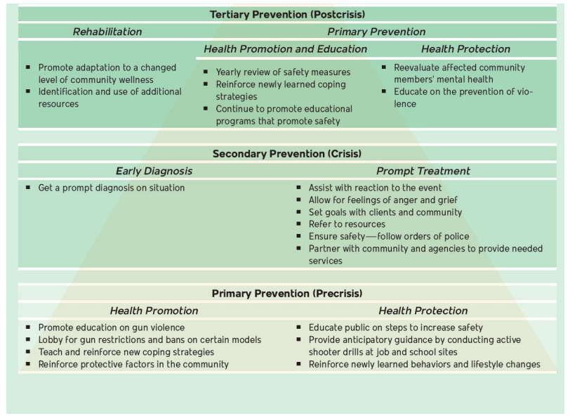
LEVELS OF PREVENTION

Slide 51
LEVELS OF PREVENTION
A) Primary Prevention – Stop Violence Before It Starts
Goal: Prevent violence from occurring.
Focus: Promote health, prevent crises, and strengthen individuals/families.
Nursing Role:
Promote positive relationships, parenting, and communication skills.
Build self-esteem and empower families to reduce stressors (e.g., poverty).
Conduct home visiting programs (e.g., Nurse Family Partnership) to support at-risk mothers and prevent child abuse.
Foster healthy neighborhoods and community empowerment for safety.

Slide 52
LEVELS OF PREVENTION
B) Secondary Prevention – Early Detection & Rapid Response
Goal: Minimize harm and prevent further violence.
Focus: Early diagnosis, prompt intervention, and crisis resolution.
Nursing Role:
Build rapport and assess for lethality.
Apply crisis intervention process (James & Gilliland, 2017):
  Establish rapport, Assess problem and lethality, Identify major problems, Deal with feelings, Explore coping strategies, Develop action plan, Follow up and plan for future crises
Report suspected abuse (child, elder, or vulnerable adult) — mandated by law.
Maintain confidentiality, validate experiences, and refer to community services.
Promote a culture of safety (QSEN standards).

Slide 53
LEVELS OF PREVENTION
C) Tertiary Prevention – Healing and Rehabilitation
Goal: Restore health, prevent recurrence, and promote recovery.
Focus: Long-term rehabilitation and family growth after violence.
Nursing Role:
Support victims, families, and even offenders as appropriate.
Provide counseling, rehabilitation, and social reintegration services.
Continue referrals started during secondary prevention.
Address family stress due to incarceration or separation.
Support children and caregivers in managing ongoing emotional or legal challenges.
Understand the complex dynamics of victim–perpetrator relationships.

Slide 54
References
Rector, C. L. (2018). Community Health Nursing: Promotion & Protecting the Public’s Health. 9th ed. Philadelphia: Wolters Kluwer Lippincott Williams and Wilkins.
Robinson, M., Coehlo, D. P., & Smith, P. S. (2022). Family health care nursing : theory, practice, and research (7th edition). F.A. Davis Company.

Slide 55
Thank you

