Slide 1
Introduction
Notes:
IBM Analytics © 2016 IBM Corporation
1
Last update based on Spark 2.0 done on July 29, 2016.

Slide 2
Agenda
Why Spark?
IBM’s commitment to Spark
Spark background
Spark details

Slide 3

Why

Slide 4
Key Reasons for the Interest in Spark
Beware of the hype!
Performant
In-memory architecture greatly reduces disk I/O
Anywhere from 20-100x faster for common tasks
Productive
Concise and expressive syntax, especially compared to prior approaches
Single programming model across a range of use cases and steps in data lifecycle
Integrated with common programming languages – Java, Python, Scala, R
New tools continually reduce skill barrier for access (e.g. SQL for analysts)
Leverages existing investments
Works well within existing Hadoop ecosystem
Improves with age
Large and growing community of contributors continuously improve full analytics stack and extend capabilities
Notes:
Note that this is a marketing slide. We can correct some of the perception it gives.
Performance:
The 20-100x faster is not qualified: faster than what?
It turns out that this information comes from the home page of the Apache Spark site. It is compared to Hadoop MapReduce.
We should not set this type of expectation since this is one very specific benchmark that is highly iterative.
We don’t need to sell Spark. What is important is to demonstrate our commitment to Spark. It would be much better to
Tell customers that they should see performance improvements compared to MapReduce but never support those multipliers.
Productivity:
One of the reason for increased productivity is the fact that Spark comes with a set of classes and methods that
allow a programmer to get to the desired result faster. MapReduce did not have those pre-built capabilities.
Note that having pre-built capabilities does not remove the learning curve to become competent with the product.
Finally, mentioning “SQL” as part of new tools speaks to the state of open-source projects: they are mainly for technologists (programmers). A lot more needs to be done to make it easy to use.
Leverage existing investment: You can still use your Hadoop (BigInsights) environment.
Improves with age:
Spark is the largest and most active Apache project. As we’ll see later, the product has evolved quickly and will
certainly continue to do so for quite a while.
IBM Analytics © 2015 IBM Corporation
4

Slide 5





Motivation for Apache Spark
Traditional Approach: MapReduce jobs for complex jobs, interactive query, and online event-hub processing involves lots of (slow) disk I/O
HDFS Read
Iteration 1
HDFS Write
HDFS Read
Iteration 2
HDFS Write
Input
CPU
Memory
CPU
Memory
Result
Notes:
The single most defining attribute of Spark is its departure from slow I/O operations against spinning disks and hard drives. For traditional Hadoop/MapReduce, the slow performance of disks for frequent read and write operations is a significant, speed-hampering bottleneck. MapReduce jobs are very much dependent on high throughput of read & write requests; every time the system needs to perform a look-up or a commit to a spinning disk, there is some latency associated with that process. Over time, the cumulative effect of this bottleneck on performance can be significant; more importantly, it limits the types of use cases and data streams that traditional Hadoop distributions have been able to work with.
To illustrate this example, let's consider a complex MapReduce job that first performs an HDFS look-up from a spinning disk. Every job, task, or "iteration"– we can use each of these terms interchangeably –begins with a read from Hadoop (HDFS) storage. That data is transferred over the network and is swapped between the cluster's CPU(s) and memory (RAM) while the MapReduce product is calculated. At the conclusion of the job, this result MUST be written back to disk: an HDFS write operation is performed, incurring the I/O penalty we just described.
Note that every Iteration requires an HDFS read and HDFS write step. One thing you may have noticed is that we could look at one Iteration and see the same pattern of operations as may be required to "chain" together multiple Iterations.
5

Slide 6

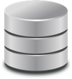

Motivation for Apache Spark
Traditional Approach: MapReduce jobs for complex jobs, interactive query, and online event-hub processing involves lots of (slow) disk I/O
Solution: Keep more data in-memory with a new distributed execution engine
HDFS Read
Iteration 1
HDFS Write
HDFS Read
Iteration 2
HDFS Write
Input
CPU
Memory
CPU
Memory
Result
Zero Read/Write Disk Bottleneck
Chain Job Output into New Job Input
HDFS Read
Iteration 1
Iteration 2
Input
CPU
Memory
CPU
Memory
faster than network & disk
Notes:
Spark's solution is to remove storage on disks from the execution framework altogether. Ultimately, you may want to persist the final product of your computations to disk - or perhaps you won't require this at all. It's up to the determination of the programmer to decide what best fits their use case and whether they wish to persist the results for long-term storage. The key is that the execution & processing framework excludes these performance-hampering reads & writes from spinning disks altogether.
Once data has been loaded into Spark (for example, that initial load we see in the example above, just prior to Iteration 1), data is swapped between the CPU(s) and memory (RAM) as results are calculated. The output of that Iteration, however, does not need to be written back to disk – it can be stored temporarily (cached) in memory! And where Spark is truly unique is its ability to chain together multiple jobs (Iterations) without ever needing to write or read data from disk. The output of Iteration 1 can be piped directly as input into Iteration 2, and so on. This is incredibly powerful, performance, and opens the door to the type of use cases that Spark is able to address: interactive query, micro-batch streaming, and more are now possible, as a result of bypassing Hadoop's disk-dependency.
6

Slide 7
Enterprise-scale data volumes accessible to interactive query for business intelligence (BI)
Faster time to job completion allows analysts to ask the “next” question about their data & business
Data cleaning to improve data quality (missing data, entity resolution, unit mismatch, etc.)
Nightly ETL processing from production systems
Spark Common Use Cases
Interactive Query
Forecasting vs. “Nowcasting” (e.g. Google Search queries analyzed en masse for Google Flu Trends to predict outbreaks)
Data mining across various types of data
Large-Scale Batch
Web server log file analysis (human-readable file formats that are rarely read by humans) in near-real time
Responsive monitoring of RFID-tagged devices
Complex Analytics
Predictive modeling answers questions of "what will happen?"
Self-tuning machine learning, continually updating algorithms, and predictive modeling
Event Processing
Model Building
Notes:
One of the productivity aspects of Spark is its ability to be used in multiple “programming models”.
This slide should be self explanatory but still requires a few comments:
Complex analytics: “Nowcasting” is relative to what people are used to. If people are used to getting results in one hour and now they can get it in 10 minutes, it could be seen as “Nowcasting”.
The event processing is still based on batch processing. It simply uses smaller batches (micro-batches) to achieve a semblance of streaming analytics. Latency is one key criteria to decide if this is appropriate.
Model building refers to the SparkML and SparkMLlib libraries that include multiple popular machine learning algorithms.
IBM Analytics © 2015 IBM Corporation
7

Slide 8
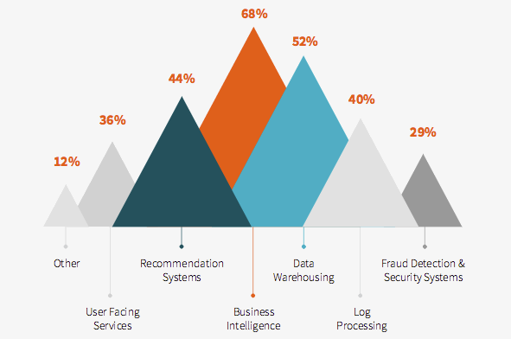
Common Applications for Spark
Spark is implemented inside many types of products, across a multitude of industries and organizations
Source: 2015 Databricks Spark Survey
Notes:
As you can see from the survey results above – the most common use cases for Spark range from business intelligence and data warehousing to provide business insight to even deeper analytics such as building recommendation systems, which often leverage machine learning and log processing for areas like 360 customer view.
Other common uses include using multiple data sources – such as clickstream data, social media data, and customer history to provide real-time customization which provides an online consumer with offers that appeal to their interests.
IBM Big Data & Analytics © 2016 IBM Corporation
8

Slide 9
IBM and

Slide 10
"It's like Spark just got blessed by the enterprise rabbi."
IBM is all-in on Spark
Contribute to the Core
Launch Spark Technology Cluster (STC), 300 engineers
Open source SystemML
Partner with databricks
Ben Horowitz,
Andreessen Horowitz
Foster Community
Infuse the Portfolio
Integrate Spark throughout portfolio
3,500 employees working on Spark-related topics
Spark however customers want it – standalone, platform or products
Educate 1M+ data scientists and engineers via online courses
Sponsor AMPLab, creators and evangelists of Spark
Notes:
In June 2015, IBM made a major announcement related to Spark.
The quote in the upper right corner is important. It shows the impact IBM has when it supports a product.
It gives legitimacy to Spark for the enterprise. Now enterprise customers can use Spark and know that
IBM is behind it. It is appropriate for enterprise software.
Still, IBM wants to make sure it is successful by using this three pronged approach.
One of the main goal being to become the number one contributor to Spark.
IBM Analytics © 2015 IBM Corporation
10

Slide 11

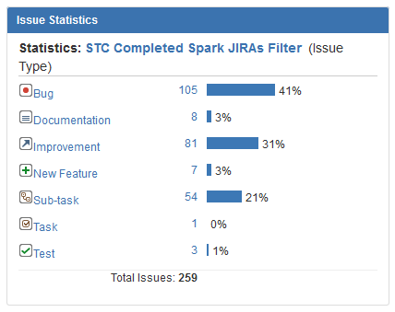
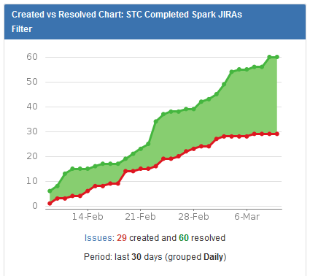
IBM Spark Technology Center – San Francisco, CA
https://issues.apache.org/jira/secure/Dashboard.jspa?selectPageId=12326761
As of March 10, 2016
Fixing lot’s of issues reported by others
See what we’re up to …
IBM Spark Technology Center
http://www.spark.tc/blog/
Notes:
So where our investments in Hadoop are relatively low compared to others, IBM is investing more than anyone in Spark. Again, the URL at the top provides a live view of what we’re doing. 72% of the work of the STC is for Bugs and Improvements. More importantly – look at how many issues the STC is resolving vs. the number of issues reported. We are fixing many problems reported by others and this translates into true value for the community. Further, we have many exciting projects happening at the STC and you can find out more at sparc.tc/blog
IBM Analytics © 2015 IBM Corporation
11

Slide 12
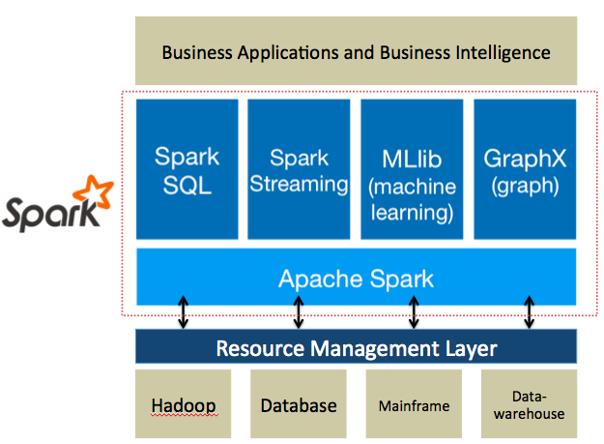
IBM | SPARK – The Analytics Operating System “Enabling New Classes of Intelligent Applications Embedded with Analytics”
Spark unifies data, enabling real-time insights
Spark processes and analyzes data from any data source
Spark is complementary to Hadoop, but faster with in-memory performance
Build models quickly. Iterate faster. Apply intelligence .
Notes:
Bottom line, IBM sees Spark a the analytics operating system.
12

Slide 13
Our Use of Spark at IBM and Growing
IBM Cloudant on Bluemix
IBM Dataworks on Bluemix
IBM Commerce Dynamic Pricing
IBM Swift Object Storage
IBM Open Platform on Softlayer
IBM BigInsights on Bluemix
IBM Insights for Twitter Service
IBM Twitter CDE
IBM IoT on Bluemix
Journey Analytics
Mark Down Optimization
Nimbus ETL
Omni Channel Pricing
Apache Spark on Bluemix
IBM SPSS Analytics Server
IBM SPSS Modeler
Notes:
Spark is already infused in multiple IBM offerings.
More on this in the next few slides.
IBM Analytics © 2015 IBM Corporation
13

Slide 14
Leverage the most complete portfolio of data & analytics cloud services on the planet
Notes:
Working with IBM on the cloud, you can also access the richest set of offerings for analytics compared to any other company in the world. As you can see from the list of icons from Bluemix, we have cloud services for pretty much all of the analytics needs of customers. These include relational databases, NoSQL databases, datawarehouse on the cloud, data refinery and integration service, Hadoop, Spark, streaming analytics, geospatial analytics, predictive modeling etc. We even offer our IBM Insights for Twitter service leveraging our partnership with Twitter.
Your data can live where you need it . You can use Spark to analyze it.
14

Slide 15

Core Attributes of the Data Scientist Experience
IBM Data Science Experience
Community
Open Source
IBM Added Value
Find tutorials and datasets
Connect with data scientists
Ask questions
Read articles and papers
Fork and share projects
Code in Scala/Python/R/SQL
Jupyter and Zeppelin* Notebooks
RStudio IDE and Shiny apps
Apache Spark
Your favorite libraries
Data Shaping/Pipeline UI *
Auto-data preparation and modeling*
Advanced Visualizations*
Model management and deployment*
Documented Model APIs*
Spark as a Service *
Powered by IBM DataWorks Platform in the Cloud
* DSX product roadmap items
Notes:
The new offering IBM Data Scientist Experience brings together everything that a data scientist needs today to be more successful. It is based on three things:
Community: A data scientist needs to be updated with the latest news from the Data Science Community. There are plenty of new Open Source packages, libraries, techniques and tutorials available every day. A good data scientist follows the most important sources and shares their opinion and experiments with the community. We are bringing this into the UI of the DSX.
Open Source: Today there are companies that rely on open source for data science. Open source has become so mature that is directly competing with commercial offerings. We provide the best of open source within DSX, such as RStudio and Jupyter.
IBM Value Add: We improve open source by adding some capabilities from IBM. Data Shaping for example takes 80% of the data scientist time. We are providing tools with visual GUI to help users better perform this task. You are also able to execute Spark jobs on our managed Spark Service in Bluemix from within the DSX.
15

Slide 16
background

Slide 17
Spark Background
Started as a research project in 2009, open source in 2010
General purpose cluster computing system
Generalizes MapReduce
Batch oriented processing
Main concept: Immutable Resilient Distributed Datasets (RDDs)
Apache incubator project in June 2013
Apache top level project Feb 27, 2014
Current version 2.0 (July 26, 2016)
Languages supported: Java, Scala, Python, R (Java 7+, Python 2.6+/3.4, R 3.1+)
May need additional libraries for Python ex: numpy
Notes:
Spark started as a research project at UC Berkeley in 2010 and quickly became an open source project.
The project was quite small with round 1600 lines of code.
Spark generated a lot of interests. It became an Apache incubator project in June 2013 and a full Apache project in February 2014.
Note that Spark is evolving quickly as shown by the release scheduled displayed on the right side of the slide. We see that spark releases a minor release roughly
Every month and a major release quarterly. This makes it difficult for vendors to always be at the latest release.
Sparks goal was to provide a general purpose cluster computing system. We can say that it is greatly influenced by Hadoop and MapReduce.
To this point, we can see Spark as a generalization of the MapReduce model. It is still a batch oriented system that is designed
to process large distributed files.
The main concept is the processing of immutable RDDs that can be re-created from their original lineage.
Everything is Spark is based on processing datasets so set operations are the core capabilities of this product.
Basically, Spark provides the set processing framework. The rest is up to the user to program the transformations in Scala, Java, or Python.
It should be noted that using Python and R add overhead to the execution. Both Scala and Java run on a JVM, Python and R do not.
IBM Analytics © 2015 IBM Corporation
17

Slide 18
Spark Community
45 Committers
Contributors
Over 1000 members (Apache Spark github members)
IBM contribution
IBM worked on over 580 issues
Top 3 areas: SQL, ML, PySpark
Databricks | 17 | UC Berkeley | 5
Cloudera | 3 | Yahoo! | 3
IBM | 3 | Intel | 2
Others | 13
Notes:
Sources:
https://cwiki.apache.org/confluence/display/SPARK/Committers
https://github.com/apache/spark/graphs/contributors
https://issues.apache.org/jira/secure/Dashboard.jspa?selectPageId=12326761
IBM has become an important contributor to Spark with focus in important areas for enterprise applications.
18

Slide 19
Libraries Usage¹
Library | 2015 | 2016
SparkSQL | 69% | 88%
DataFrames | 62% | N/A
Streaming | 58% | 71%
MLLib/GraphX | 58% | 71%²
Spark SQL
Spark Streaming
MLlib Machine Learning
GraphX Graphing
Spark Core
¹ From surveys done by Databricks, summer/fall 2015 and 2016
² MLLib only
Notes:
Taken from a presentation from Matai Zaharia on Nov 2, 2015
The table was updated with the information on the survey results released September 27, 2016:
http://go.databricks.com/2016-spark-survey
Note that DataFrames are a datasets that make the data look like relational tables. From that, we can conclude that SQL access to data is the most popular interface used. Some would say it is ironic considering all the NoSQL hoopla of the last several years. This points to the fact that people want
More productivity through the use of simpler interfaces. The SQL approach has that advantage and also potentially removes many performance burdens
from a programmer.
19

Slide 20
Spark Programming Languages
Scala
Functional programming
Spark written in Scala
Scala compiles into Java byte code
Java
New features in Java 8 makes for more compact coding (lambda expressions)
Python
Always a bit behind Scala in functionality
R
Language | 2014 | 2015 | 2016
Scala | 84% | 71% | 65%
Java | 38% | 31% | 29%
Python | 38% | 58% | 62%
R | unknown | 18% | 20%
Surveys done by Databricks, summer 2015, 2016
This probably means that more “data scientists” are starting to use Spark
Notes:
From Matei Zaharia presentation at IBM on Nov 2, 2015 and Big Analytics Blog Sept 27, 2016.
See: http://go.databricks.com/2016-spark-survey
The Databricks survey also shows that the programming languages usage is changing. This is not to say that Scala is becoming less popular.
It is likely because the type of people adopting Spark are coming more and more from a data science background which favors the use of Python and R.
A word of caution: Spark is written in Scala which is a language that compiles into Java byte code. This means that any functionality added to Spark
Are automatically available in Scala (and likely Java). This is not the same for Python and R. On the bright side, the functionality gap between the
languages is shrinking. We may get to a point where the differences wont matter.
20

Slide 21
Web-Based Notebooks
Notebooks: “interactive computational environment, in which you can combine code execution, rich text, mathematics, plots and rich media”
Zeppelin
Apache incubator project
Current version: 0.5.5 (Nov 18, 2015)
Suport multiple interpreters
Scala, Python, SparkSQL
Jupyter (part of Bluemix Apache Spark Service and DSX)
Based on IPython
Current version: 4.1.0b1
Supports multiple interpreters
Python, Scala
Notes:
Definition taken from: http://ipython.org/notebook.html
The Spark community introduced (re-introduced?) the concept of notebook.
These notebooks provide a much more compelling environment that using, let’s say, the Spark shell.
The leading notebooks appear to be the Apache incubator project Zeppelin and the IPython/Jupyter notebook.
Currently the Bluemix Apache Spark service comes with the Jupyter notebook. The Ipython-based notebooks are popular since they are
Already known by Python users. Still, Zeppelin provides compelling functionality. It is easy to imagine having Spark environments
Where we could have a choice of notebook.
21

Slide 22
details

Slide 23
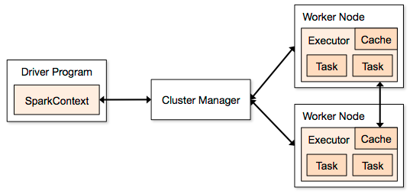
Spark Application Architecture
A Spark application is initiated from a driver program
Spark execution modes:
Standalone with the built-in cluster manager
Use Mesos as the cluster manager
Use YARN as the cluster manager
Standalone cluster on Amazon EC2
Notes:
Spark is not tied to Hadoop. It can be installed as a stand-alone product or be used in conjunction with Mesos and Yarn.
The key to spark processing is still to have a distributed file system so all the file operations, including I/O can be done in parallel.
A Spark application is initiated by a driver program that eventually uses executors to execute tasks that represent the
processing of a directed graph. More on directed graphs in a few slides.
23

Slide 24
Resilient Distributed Dataset (RDD)
RDDs are immutable
Modifications create new RDDs
Holds references to partition objects
Each partition is a subset of the overall data
Partitions are assigned to nodes on the cluster
Partitions are in memory by default
RDDs keep information on their lineage
Partition
Memory
partition
RDD
Array
Partition
Memory
partition
Partition
Memory
partition
Partition
Memory
partition
Notes:
As I said earlier, Spark is based on the concept of a Resilient Distributed Dataset.
This slides shows the main characteristics of an RDD.
An RDD cannot be modified. Any transformation on an RDD will result is a new RDD.
An RDD resilience lies in the fact that it keeps track of where it came from. If an RDD is lost for any reason, it can
Be reconstructed from one of its ancestors. This chain of modifications is referred to as lineage.
The key to parallel processing in Spark is the partitioning of an RDD. For example, if an RDD comes from an HDFS file, it will be partitioned
based on the number of blocks available. There are transformations in Spark that allows to repartition an RDD to improve the overall
Performance by either increasing or even decreasing the number of partition.
In general RDD partitions are kept in memory but parameters can be set to allow for spilling to disk if needed.
In the execution of a Spark application, multiple RDDs are created since RDDs are immutable. This means that the memory
Requirements can be much greater than the size of the input file. For this reason, RDDs can be removed during the processing. If they happen to be
Needed later, they can be recreated from their lineage. To help performance, it is possible to “persist” an RDD so it would not have to be re-created.
24

Slide 25
Spark DataFrames & Datasets
DataFrame API announce in February 2015
Dataset: Generalization of DataFrame
Available in Scala and Java (DataFrame for Python and R)
Distributed collection of data organized in named columns
Conceptually equivalent to a relational table, R/Python data frames
Supported format and sources
Can be created from an SQLContext (SparkSession in 2.0)
From sources such as: JSON, Hive, JDBC, parquet, etc.
Benefits:
Easier manipulation interface (similar to SQL)
Higher abstraction for possible optimization
Notes:
The Dataframe API is closely related to the SQL interface.
This provides an easier way to manipulate data.
Programming guide:
http://spark.apache.org/docs/latest/sql-programming-guide.html
25

Slide 26
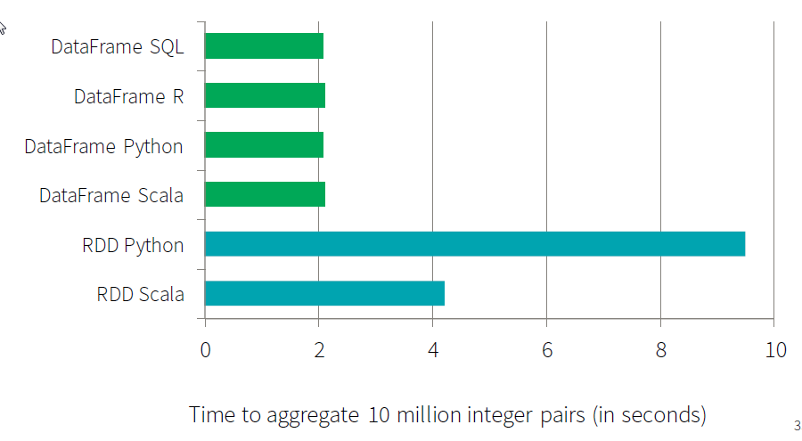
SparkSQL, DataFrames and Datasets
A rich set of functionality that allows “Database-like” processing
Share single optimizer, called “Catalyst”
An open-source extensible query optimizer (!)
Because it is the same engine, it has exactly the same performance for different APIs
And performance is much better than for RDD
Much less code
All SparkSQL, DF, and DataSets are essentially using the same engine
Picture credit: databricks.com

Slide 27
Spark Programming Model
Operations on RDDs (datasets)
Transformation
Action
Transformations use lazy evaluation
Executed only if an action requires it
An application consist of a directed acyclic graph (DAG)
Each action results in a separate batch job
Parallelism is determined by the number of RDD partitions
Each action is a separate job
RDDs could be re-evaluated if not persisted
Job-1
Act1
RDD1
RDD2
RDD3
Act2
Job-2
Notes:
There are two types of operations that can be applied to RDDs. Transformations take an RDD and create a new one.
Actions usually either return something to the application or write data to an output such as a file.
Consider the figure at the bottom of the slide.
A Spark application consists of a directed acyclic graph (DAG) that transform RDDs and eventually lead to an action.
All Spark transformations are lazy. This means that if transformations do not lead to an action, they won’t be executed.
A DAG is converted into tasks that are then executed on nodes of the cluster as the diagram on slide 4 has shown.
We’ll get into more details on the execution shortly but note that one DAG leads to the creation of multiple jobs based on the number
of actions taken. The DAG in the figure here leads to the creation of two jobs.
Note that the fact that, let’s say job-1, created RDD3 does not mean it will be available without re-creation in Job-2.
To insure the evaluation is not done twice, RDD3 should explicitly be persisted (see methods persist and cache)
27

Slide 28
Spark Operations
Transformation operations (set operations)
Convert RDDs into other RDDs
Operations availability depends on the type of RDD processed
Examples of operations:
Action operations
Return a value to the driver
Examples of actions:
++ (union) | aggregate | cache/persist | cartesian
coalesce | count | distinct | filter
flatmap/map | groupby | intersection | reduceByKey
subtract | union | zip
reduce | collect | count | first
take_ | saveAs_ | countByKey | foreach
Notes:
Here are additional details on the Spark operations.
Transformations are set processing operations that operate on an RDD and generate a new one.
We can’t list all the transformations available but this slide shows the main ones. I highlighted
the “persist” operation because it is an important one in improving performance.
Think back about the simple DAG on the previous slide. It generated two jobs.
By default, each job is independent form each other so the processing of each would start from the reading of a given file.
This means that each job would go through the creation of RDD1, RDD2, and RDD3.
Since the actions are based on RDD3, we can “persist” it so the second job would not have to redo the creation of the RDDs.
This results in less I/O, less processing and therefore higher performance.
(The Spark scheduler uses a FIFO algorithm so it is very likely that the second job will execute after the first one has create RDD3)
The slide also shows the major actions available. Note that “take” and “saveAs” are followed by an underscore to indicate that
there are multiple such functions available.
28

Slide 29

Spark Streaming
Component of Spark
Project started in 2012
First alpha release in Spring 2013
Out of alpha with Spark 0.9.0
Discretized Stream (DStream) programming abstraction
Represented as a sequence of RDDs (micro-batches)
RDD: set of records for a specific time interval
Supports Scala, Java, and Python (with limitations)
Fundamental architecture: batch processing of datasets
Notes:
Spark Streaming is an extension of the core Spark API.
The project was started in 2012, released as alpha in the spring of 2013.
It came out of alpha with the Spark 0.9.0 release in February 2014.
It defines a new abstraction: Discretized Streams or DStreams.
A DStream represents a sequence of RDDs where each RDD is a collection or records that accumulated within a specific time interval.
Just like Spark, it supports Scala, Java and, with limitations, Python.
We have to understand that Spark Streaming is a construct that depends on Spark.
Spark Streaming consists of the submissions of Spark jobs at specific intervals.
In this context, as the submission rate increases, it becomes a higher percentage of the overall processing load.
We’ll come back to this as we dig deeper into Spark Streaming.
29

Slide 30
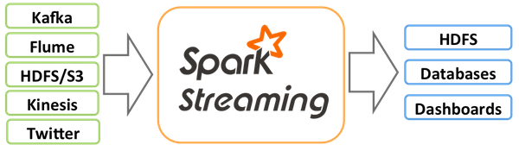
Current Spark Streaming I/O
Input Sources
Kafka, Flume, Twitter, ZeroMQ, MQTT, TCP sockets
Basic sources: sockets, files, Akka actors
Other sources require receiver threads
Output operations
Print(), saveAsTextFiles(), saveAsObjectFiles(), saveAsHadoopFiles(), foreachRDD()
foreachRDD can be used for message queues, DB operations and more
Notes:
Spark Streaming may depend on Spark to do the processing but it needs interfaces to the outside world.
Currently, there are several data sources that are supported as mentioned on the slide.
There is a distinction between basic data sources and other sources.
In the case of a source such as a file, Spark Streaming can read it directly.
For other data sources, an execution thread must be allocated for each instance of them.
The output targets are supported through Spark with a few functions already defined for specific ones and
The foreachRDD that can be used to process each record and send it through a standard programming
Interface.
30

Slide 31
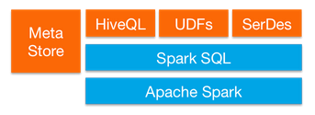
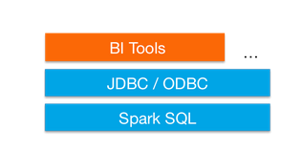
SparkSQL
Provide for relational queries expressed in SQL, HiveQL and Scala
Seamlessly mix SQL queries with Spark programs
DataFrame/Dataset provide a single interface for efficiently working with structured data including Apache Hive, Parquet and JSON files
Leverages Hive frontend and metastore
Compatibility with Hive data, queries, and UDFs
HiveQL limitations may apply
Not ANSI SQL compliant
Little to no query rewrite optimization, automatic memory management or sophisticated workload management
Graduated from alpha status with Spark 1.3
DataFrames API marked as experimental
Standard connectivity through JDBC/ODBC
Notes:
IBM Analytics © 2015 IBM Corporation
31

Slide 32
Spark ML
Spark ML for machine learning library
RDD-based package spark.mllib now in maintenance mode
The primary API is now the DataFrame-based package spark.ml
Parity of spark.ml estimated for Spark 2.2
Provides common algorithm and utilities
Classification
Regression
Clustering
Collaborative filtering
Dimensionality reduction
Leverages iteration and yields better results than one-pass approximations sometimes used with MapReduce

Slide 34
Spark ML
Classification/Regression | Clustering | Feature Extractors
Logistic regression | K-means | TF-IDF
Decision tree classifier | Gaussian mixture | Word2Vec
Random forest (class/reg) | Latent Dirichlet allocation | CountVectorizer
Gradient boosted tree | Bisecting k-means | Feature Transformers
Multilayer perceptron classifier | Collaborative Filtering | Tokenizer
One-vs-rest classifier | Alternating least squares | StopWordRemover
Linear regression | Feature Selectors | N-gram
Generalized linear reg. | VectorSlicer | Binarizer
Naïve Bayes | RFormula | PCA
Decision trees (class/reg) | ChiSqSelector | PolynomialExpansion
Survival regression |  | StringIndexer
Isotonic regression |  | ---- 13 more ---
Notes:
From version 2.0: http://spark.apache.org/docs/latest/mllib-guide.html
34

Slide 35
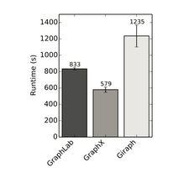
Spark GraphX
Flexible Graphing
GraphX unifies ETL, exploratory analysis, and iterative graph computation
You can view the same data as both graphs and collections, transform and join graphs with RDDs efficiently, and write custom iterative graph algorithms with the API
Speed
Comparable performance to the fastest specialized graph processing systems.
Algorithms
Choose from a growing library of graph algorithms
In addition to a highly flexible API, GraphX comes with a variety of graph algorithms
Notes:
In short GraphX gives you a proper representation
where a you can calculate the shortest path, like the "six degrees" or connections between people on LinkedIn or Facebook.
IBM Analytics © 2015 IBM Corporation
35

Slide 36
Spark R
Spark R is an R package that provides a light-weight front-end to use Apache Spark from R
Spark R exposes the Spark API through the RDD class and allows users to interactively run jobs from the R shell on a cluster.
Goals
Make Spark R production ready
Efforts from AlteryX and DataBricks
Integration with Mllib
Consolidations to the data frame and RDD concepts
Notes:
In Spark 2.0.0, SparkR provides a distributed data frame implementation that supports operations like selection, filtering, aggregation etc.
SparkR also supports distributed machine learning using MLlib.
IBM Analytics © 2015 IBM Corporation
36

