Slide 1
West Hawaiʻi
Heat Stress
Satellite exposure, underwater temperatures,
and a seven-day forecasting test
Drew Baker
ASM54000, October 2026
Notes:
I examine how thermal exposure differed between 2015 and 2019, how satellite SST compared with underwater loggers, and whether random forests improved seven-day SST forecasts.
NOAA Coral Reef Watch via PacIOOS: https://pae-paha.pacioos.hawaii.edu/erddap/griddap/dhw_5km.html
NOAA NCEI: https://www.ncei.noaa.gov/erddap/tabledap/CRCP_Subsurface_Temp_Hawaii.html
NOAA NCCOS habitat: https://products.coastalscience.noaa.gov/collections/benthic/e97hawaii/data2007.aspx
Project results: https://github.com/drwbkr1/West-Hawaii-Heat-Stress-ASM540/tree/main/Analysis

Slide 2
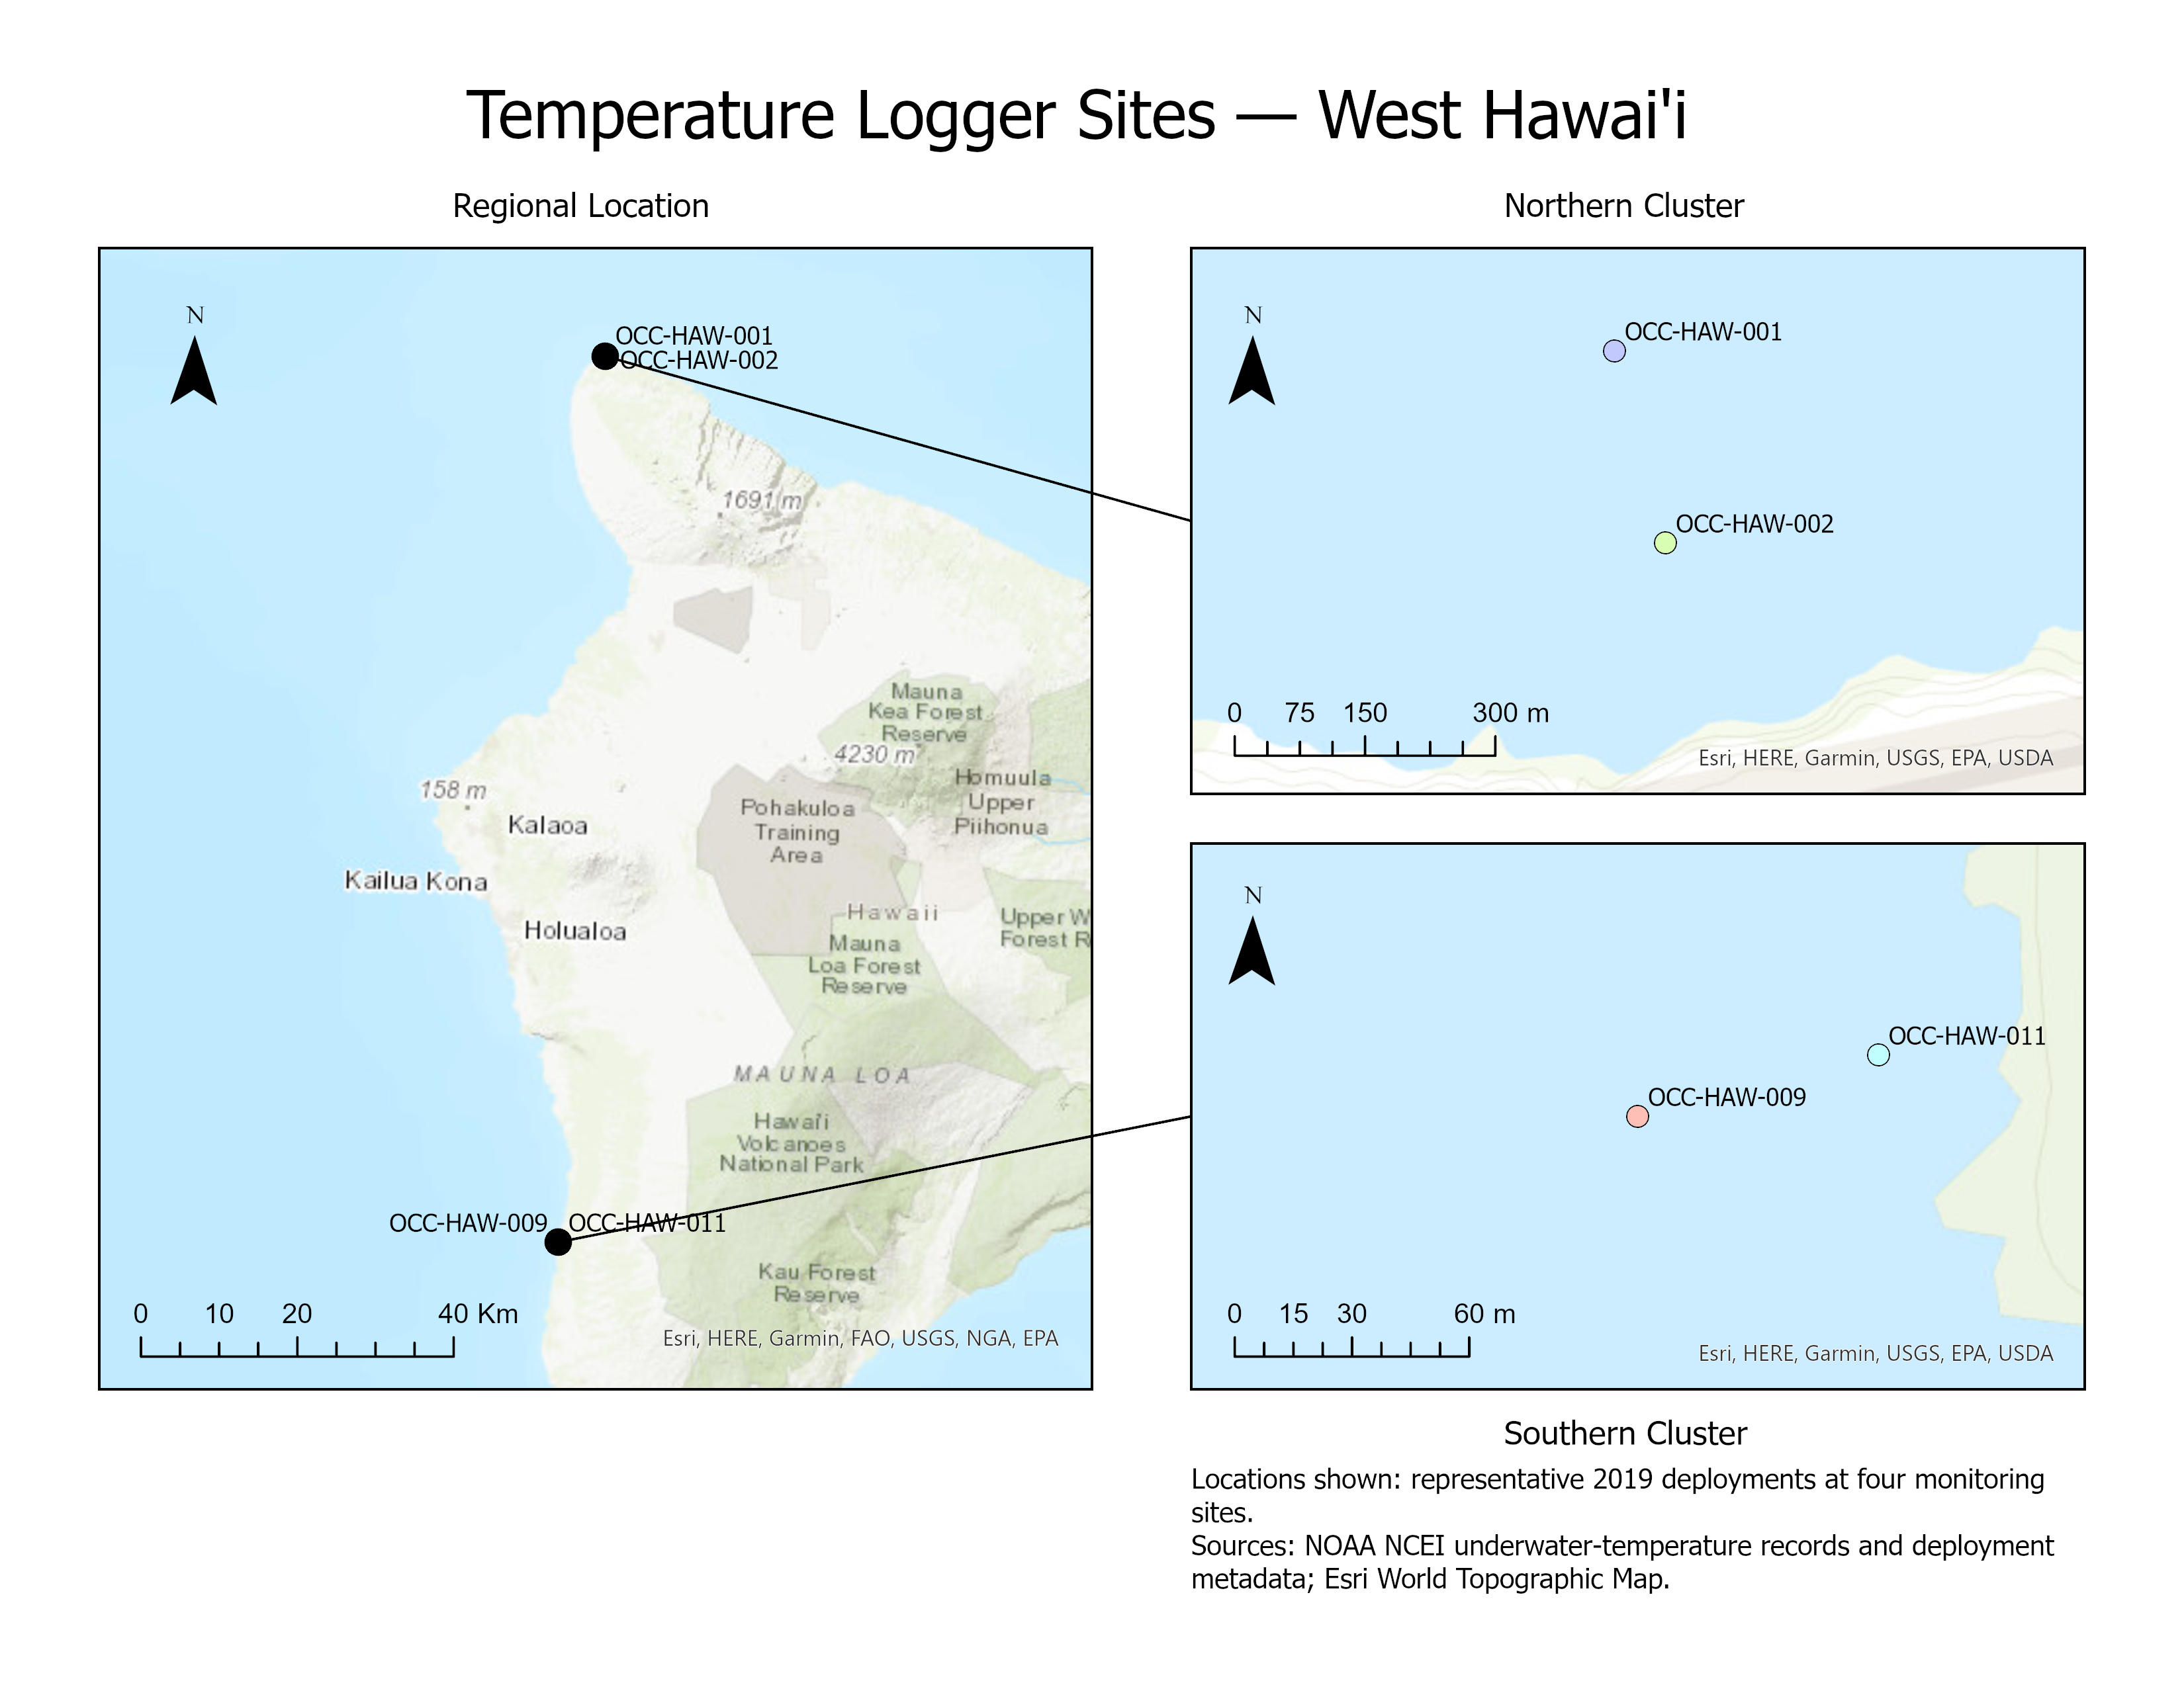
Study area and analytical approach
Regional heat exposure
Match 2015 and 2019 satellite cells. Overlay mapped reef and hardbottom habitat.
Underwater comparison
Match complete nighttime logger records to daily satellite observations.
Forecast test
Compare a random forest with persistence and seasonal averages at three cells.
Notes:
Regional comparisons use 135 paired cells with complete annual DHW coverage. Q2 uses matching January–June and August–November seasonal windows. Q3 uses chronological model development through 2014 and held-out evaluation for 2015–2025.
NOAA Coral Reef Watch via PacIOOS: https://pae-paha.pacioos.hawaii.edu/erddap/griddap/dhw_5km.html
NOAA NCEI: https://www.ncei.noaa.gov/erddap/tabledap/CRCP_Subsurface_Temp_Hawaii.html
NOAA NCCOS habitat: https://products.coastalscience.noaa.gov/collections/benthic/e97hawaii/data2007.aspx
Project results: https://github.com/drwbkr1/West-Hawaii-Heat-Stress-ASM540/tree/main/Analysis

Slide 3
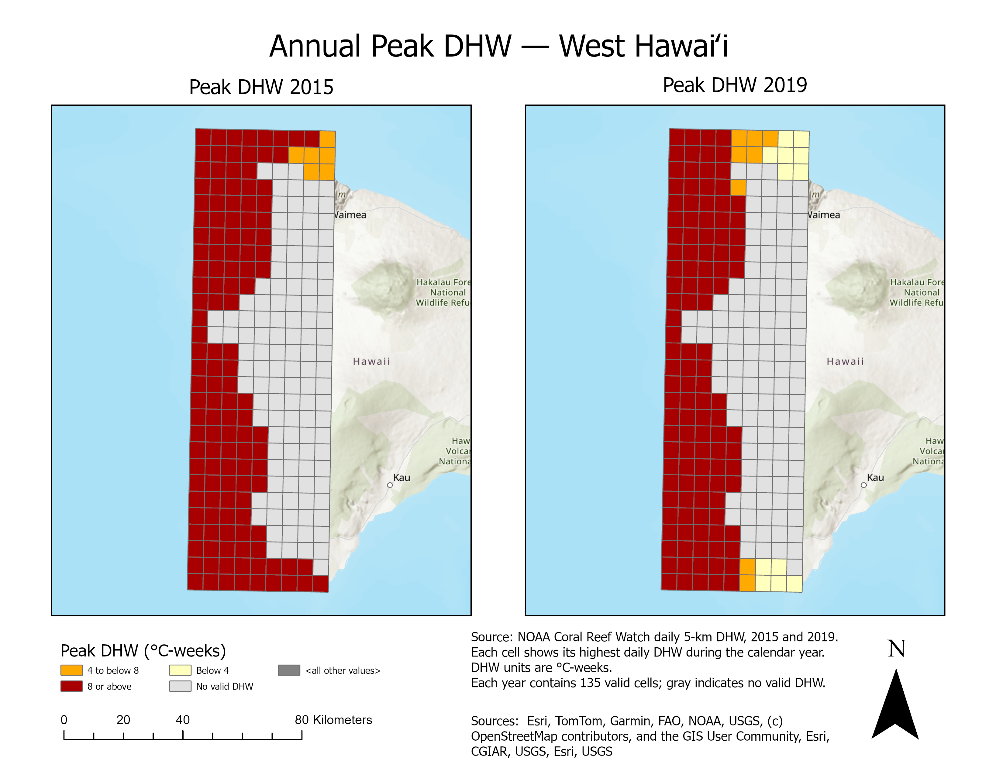
2015 had greater accumulated heat stress
Median peak DHW
11.64 in 2015
10.39 in 2019
°C-weeks
Reef area reaching DHW ≥8
4,731 ha in 2015
3,612 ha in 2019
971 ha of mapped habitat lacked valid satellite DHW.
Notes:
Median peak DHW uses the 135 paired valid water cells. Habitat area refers to mapped reef and hardbottom. Assessed habitat totals 4,731.23 ha from 5,702.29 ha mapped. Thermal exposure does not measure coral mortality. The higher median annual mean SST in 2019 does not contradict lower accumulated DHW.
NOAA Coral Reef Watch via PacIOOS: https://pae-paha.pacioos.hawaii.edu/erddap/griddap/dhw_5km.html
NOAA NCEI: https://www.ncei.noaa.gov/erddap/tabledap/CRCP_Subsurface_Temp_Hawaii.html
NOAA NCCOS habitat: https://products.coastalscience.noaa.gov/collections/benthic/e97hawaii/data2007.aspx
Project results: https://github.com/drwbkr1/West-Hawaii-Heat-Stress-ASM540/tree/main/Analysis

Slide 4
Satellite and underwater temperatures differ
August–November RMSD (°C)
Monitoring site | 2015 | 2019
OCC-HAW-001 | 0.741 | 0.334
OCC-HAW-002 | 0.566 | 0.290
OCC-HAW-009 | 0.317 | 0.210
Satellite and nighttime logger temperatures agreed more closely in 2019 at these sites.
The small monitoring network cannot isolate a causal depth effect.
Notes:
RMSD is the square root of the mean squared satellite-minus-logger temperature difference. These August–November comparisons use 122 complete nights per site and year. Nighttime means use 00:00 to before 06:00 HST with 72 five-minute or 360 one-minute observations.
NOAA Coral Reef Watch via PacIOOS: https://pae-paha.pacioos.hawaii.edu/erddap/griddap/dhw_5km.html
NOAA NCEI: https://www.ncei.noaa.gov/erddap/tabledap/CRCP_Subsurface_Temp_Hawaii.html
NOAA NCCOS habitat: https://products.coastalscience.noaa.gov/collections/benthic/e97hawaii/data2007.aspx
Project results: https://github.com/drwbkr1/West-Hawaii-Heat-Stress-ASM540/tree/main/Analysis

Slide 5
Persistence wins the forecast test overall
Held-out test
2015–2025
11,754 forecasts
3 selected cells
RF skill varied by cell and year. Strong heat-stress years exposed larger forecast errors.
Seven-day SST forecast MAE (°C)
Notes:
Forecast target: satellite SST seven days ahead. Train 2003–2013, validation 2014, then refit on eligible pre-2015 examples. A frozen random forest with 300 trees, depth 16, leaf size 20 and seed 540 evaluates 2015–2025. Target-date DHW only groups evaluation results and never serves as a predictor. Persistence copies current SST. Seasonal averages use earlier data around the target day of year. Lower MAE is better.
NOAA Coral Reef Watch via PacIOOS: https://pae-paha.pacioos.hawaii.edu/erddap/griddap/dhw_5km.html
NOAA NCEI: https://www.ncei.noaa.gov/erddap/tabledap/CRCP_Subsurface_Temp_Hawaii.html
NOAA NCCOS habitat: https://products.coastalscience.noaa.gov/collections/benthic/e97hawaii/data2007.aspx
Project results: https://github.com/drwbkr1/West-Hawaii-Heat-Stress-ASM540/tree/main/Analysis

Slide 6
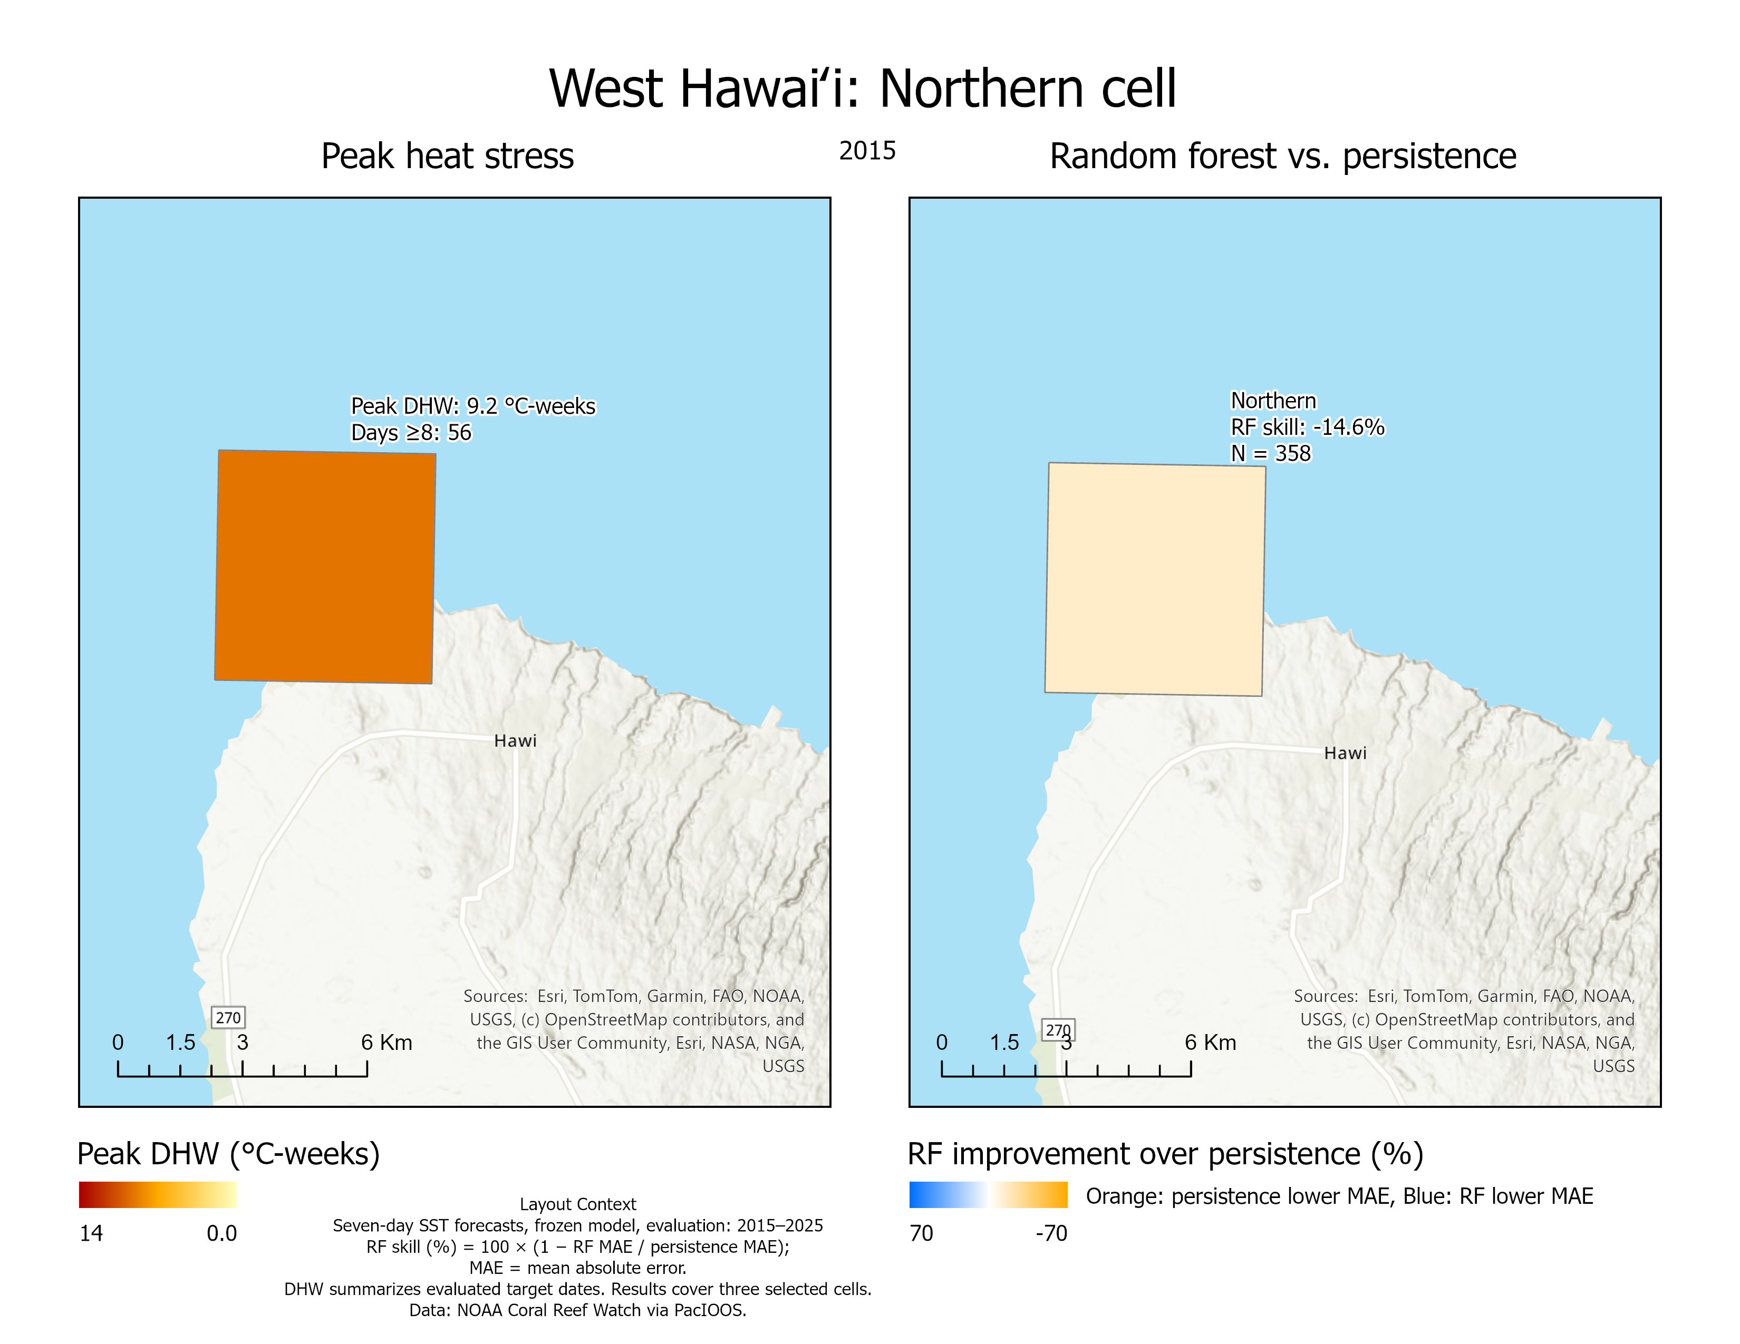
What the results support
Heat duration matters alongside temperature. The 2015–2019 contrast depends on the metric.
Local loggers help interpret satellite records. Monitoring coverage limits regional conclusions.
A simple baseline remains essential. Future work could test anomaly-focused models and transfer to Florida.
Process log and Python notebook
github.com/drwbkr1/West-Hawaii-Heat-Stress-ASM540
Notes:
The project evaluates thermal exposure and satellite temperature forecasting. It does not establish bleaching or mortality, causation by depth, or transferability beyond the three forecast cells. A transfer to another region is proposed future work.
StoryMap: https://storymaps.arcgis.com/stories/7e6551719d15418a997e2517c2bc24cc
NOAA Coral Reef Watch via PacIOOS: https://pae-paha.pacioos.hawaii.edu/erddap/griddap/dhw_5km.html
NOAA NCEI: https://www.ncei.noaa.gov/erddap/tabledap/CRCP_Subsurface_Temp_Hawaii.html
NOAA NCCOS habitat: https://products.coastalscience.noaa.gov/collections/benthic/e97hawaii/data2007.aspx
Project results: https://github.com/drwbkr1/West-Hawaii-Heat-Stress-ASM540/tree/main/Analysis

