Slide 1


Kelly Tao
2024.5.3

Slide 2
What Does Doner DO?
Doner is a game engine made for visual novels!
With Doner in hand, users should be able to create any 2D scene they want with the material they have in their hand!
As a game engine, the part of making a game should also be part of the function. Doner will support preview of the game, visualization of the storyline and data the user sets, with support of all visual novel game functions such as save, load, skip and etc.

Slide 3
What Is the Goal?
It’s goal is to provide a tool for anyone —— even with zero programming knowledge —— to make game.
This project is designed to be light and easy, meaning that it should not take effort to learn and use.
This application will act as a engine, meaning the user’s can to add, edit, and delete elements with their action.
Users should come up with visual novel games in the end, and since the extreme friendly Doner should be, users should be able to export their work with just a click on the button into a game.

Slide 4
Why Choose Doner?
Ability wise, even though there are areas in this project that I’ve never faces before, but it is a opportunity for me to find how much I can do, how far I can go. Thankfully, I am very familiar with what this project needs, where I do not have to spend much time designing the functions themselves, but focusing more on only programming wise.
Personally, I am a player and a reader. I’ve played good games and read good books. Especially for stage plays, I tend to shape out how it will look in games as I read. I believe there are people like me, and people who want to make this come to truth, and the only thing stoping them is their lack of computer knowledge. With Doner, I wish to see more indie games with brand new great stories.

Slide 5
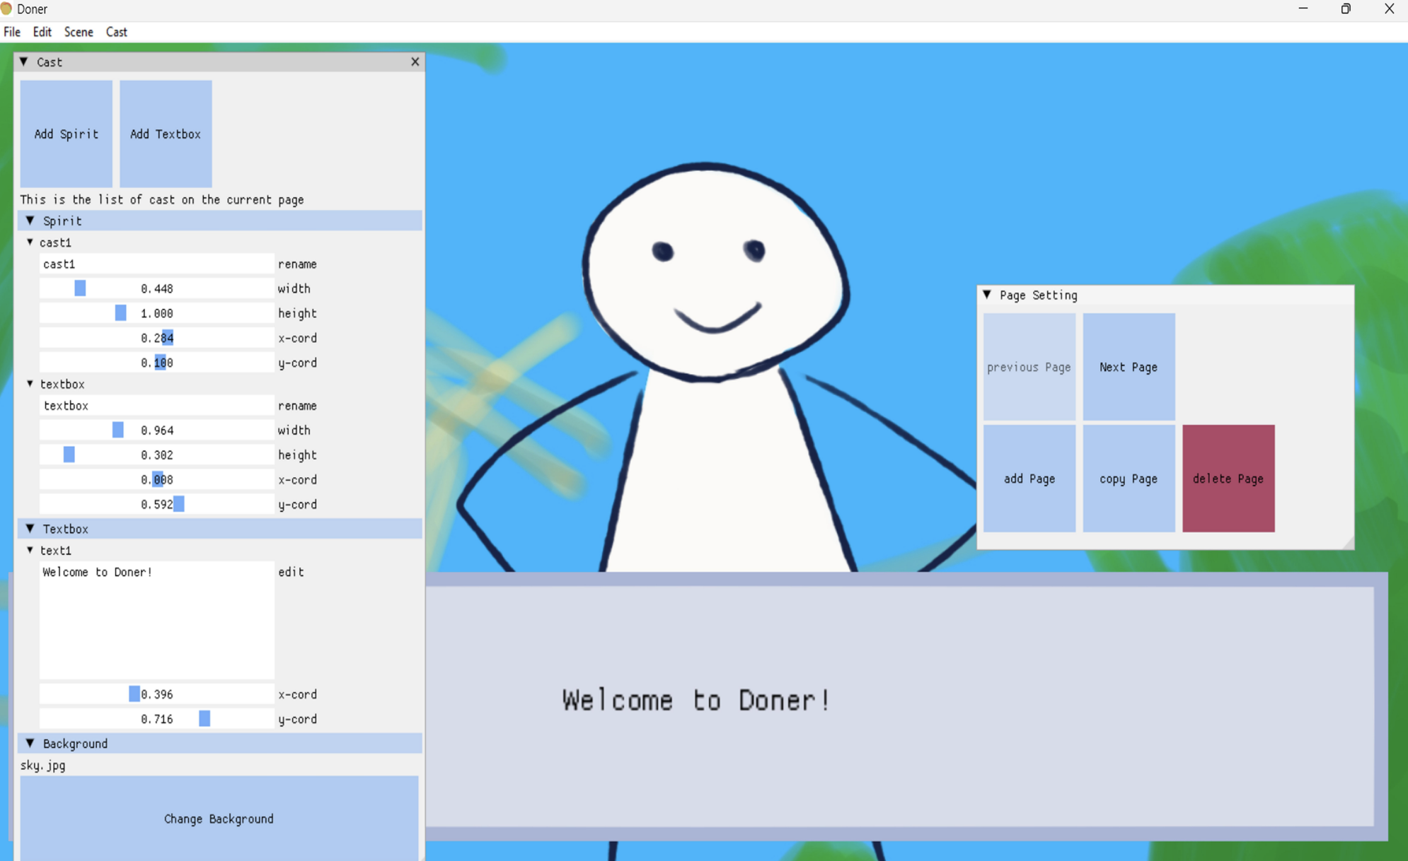
User Operation
With the goal of making the project easy to understand, all functions are presented in the panels given with drag bars and buttons.
To make sure the user have their best experience, all windows are made movable and resizable.
The background refreshes every frame, making the change shows instantly.

Slide 6
Challenges
Memory Leak:
Since this project is made by C++, memory managing becomes one of the most important factor while reviewing code. In fact, since the first time this project could run, it could never hold itself for over five minutes before it crash. During the debugging phase, the picture loaded, including background and elements inserted, start disappearing randomly after one minute, and the whole program will run the computer’s memory out within two minutes, causing the whole computer to froze, so debugging is really a pain. The project itself is too large, and the picture loading process are happening among four classes, so every tryout on debug requires a change in eight different files (head file and cpp file), where most of the time the changes won’t even work. Finally, I figured out among a large amount of watched variable that the picture was loaded for way more than need, but no where could I found where it is saved to. In the end, I have to restructure the whole picture loading function to enlighten its effect.

Slide 7
Challenges
Windows VS ImGui:
Even though ImGui could be used in Windows C++ program, the way they render are different. Windows uses WM_PAINT, while ImGui packed it up in their own DrawList function. Thus, while trying to draw on the host window, it turns to me that doing so is much harder with ImGui. The DrawList reader are within the main loop, but some of the ImGui elements are not allowed to change inside the loop. The painting on host window are very little for ImGui, so I have to figure out everything on my own step by step.
Fortunately, I managed to find some way to draw. I grabbed directly the directX11 values to move around the ImGui limitation, and render with windows directly. DirectX11’s API names looks tough, but by actually using them, it turns out to be okay. In the end, they are all for human to use.

Slide 8
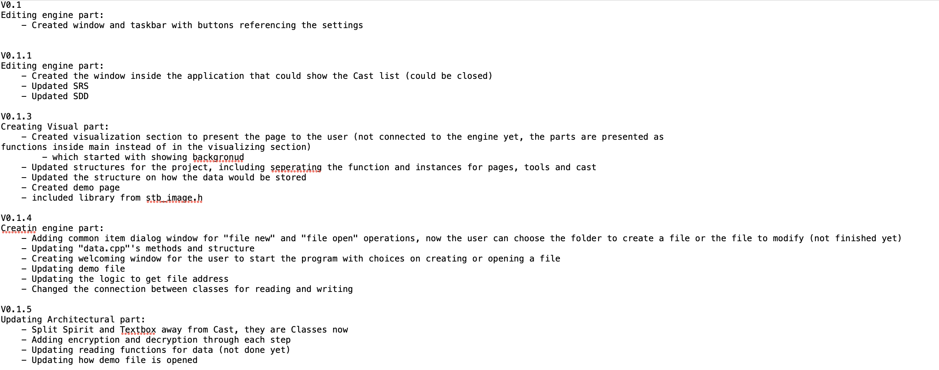
Status Update
All the updates are written in the update file, so I figure I could just show them

Slide 9
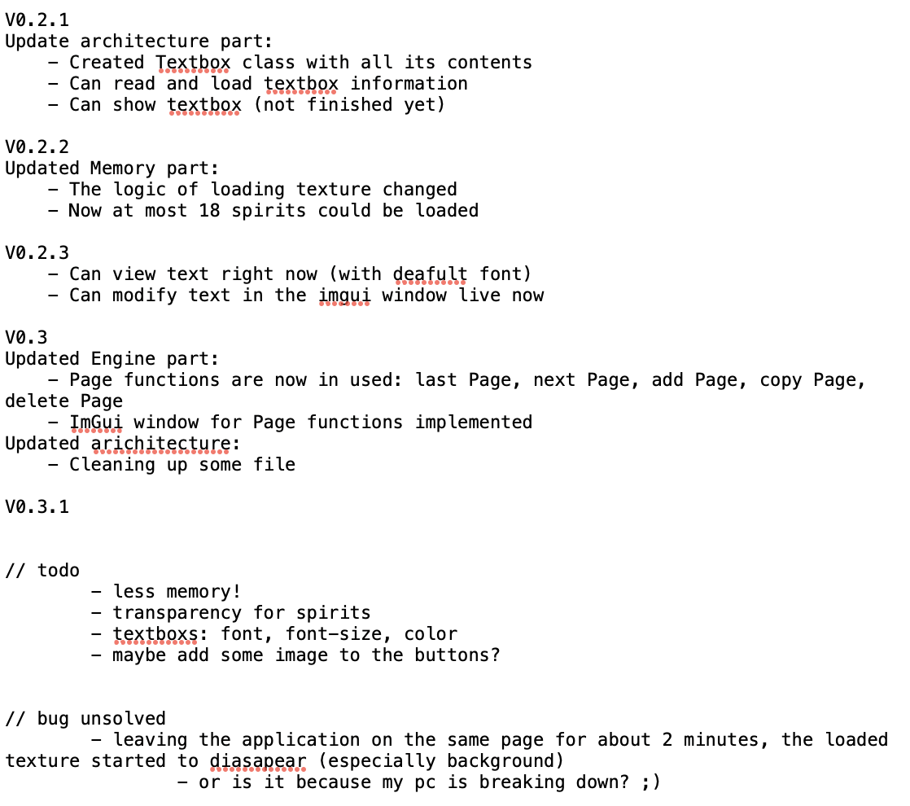
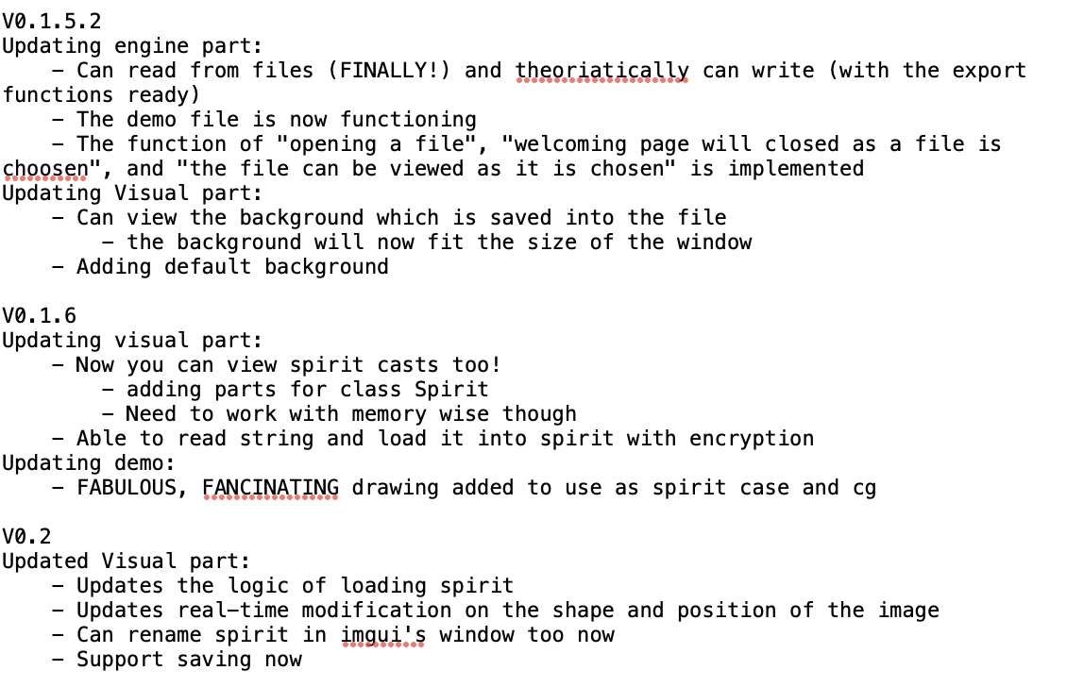
Status Update
All the updates are written in the update file, so I figure I could just show them

Slide 10
Thank you!

