Slide 1
Basics of
Machine Learning
Dmitry Ryabokon, github.com/dryabokon

Slide 2
Basics of Machine Learning
Summary
Intro
Environments
Data manipulation
Data visualization
Feature engineering
Statistical ML
Bayesian approach
Regression methods
Confidence intervals for regression methods
Parametrical ML methods

Slide 3
Basics of Machine Learning
Summary
11. Non parametrical ML methods
12. Unsupervised Learning
13. Non-Bayesian approaches
14. Dimension reduction
15. Ensemble learning: RF
16. Ensemble learning: XGB, Adaboost
17. Benchmarking
18. Time Series
19. Introduction to Deep Learning

Slide 4
Basics of Machine Learning
Summary
21. Transformers and Attention mechanism
22. BERT
23. Topic modelling
24. BLUE score

Slide 5


Overview
Lesson 01: Intro
Introduction
Goals
Overview of the course
Prerequisites
Data engineering vs Data Science vs Machine Leaning
Overview of practical assignments
Collaboration and feedback
https://www.mygreatlearning.com/blog/top-artificial-intelligence-interview-questions/?highlight=interview

Slide 6

Overview
Lesson 02: Environments
Installing Python
Virtual environments
Using docker
Jupyter notebook
Google Collab
IDEs
Code repositories
Datasets
Example: vanilla classification problem
https://habr.com/ru/company/edison/blog/480408/

Slide 7

Overview
Lesson 03: Data Manipulation
Numpy
  Data inspection
  Combining data
  Insert and delete
  Reshape
  Slicing
  Sorting
  Aggregating
Pandas
  Creation
  Inspection
  Sorting
  Slicing
  Grouping

Slide 8

Overview
Lesson 04: Data Visualization
Pairwise analysis
Regression analysis
Density chart
Feature importance
Confidence level
Highcharts
https://www.machinelearningplus.com/plots/top-50-matplotlib-visualizations-the-master-plots-python/

Slide 9

Overview
Lesson 05: Feature Engineering
Handling Outliers
Handling Missing Values
Imputation
Encoding
Imbalanced dataset
Sampling

Slide 10
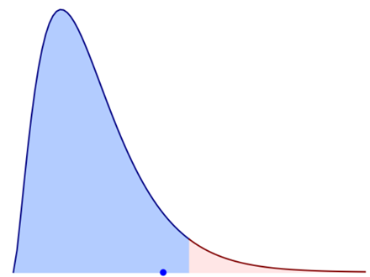
Overview
Lesson 06: Statistical ML
P Value and null hypothesis significance testing
Chi-squared test statistical hypothesis test
Consistency check: KS value
Feature importance
Numerical and categorical features
Multi collinearity and Variance Inflation Factor

Slide 11

Overview
Lesson 07: Bayesian approach
Bayesian decision model
Bayesian risk
Decision strategy
Example: TBD
Homework: TBD

Slide 12
Overview
Lesson 08: Regression methods
Linear discrimination
Linear regression for data prediction
Logistic regression for data classification
https://www.w3schools.com/python/python_ml_multiple_regression.asp
https://medium.com/codex/step-by-step-guide-to-simple-and-multiple-linear-regression-in-python-867ac9a30298

Slide 13
Overview
Lesson 09: Confidence intervals for regression methods
Coding session
Confidence interval evaluation
Out-of-box solutions

Slide 14
Overview
Lesson 10: Supervised Learning parametrical methods
Naive Bayes classifier
Gaussian classifier
SVM

Slide 15

Overview
Lesson 11: Supervised Learning non-parametrical methods
KNN: K-nearest-neighbors
Decision tree
Bias vs Variance tradeoff

Slide 16

Overview
Lesson 12: Unsupervised Learning
K-means
EM algorithm
dbscan

Slide 17
Overview
Lesson 13: Non-Bayesian Approach
Error Type I
Error Type II
Neyman-Pearson approach
Minimax approach
Example: TBD
Homework: TBD

Slide 18
Overview
Lesson 14: Dimension Reduction
PCA
tSNE
umap

Slide 19
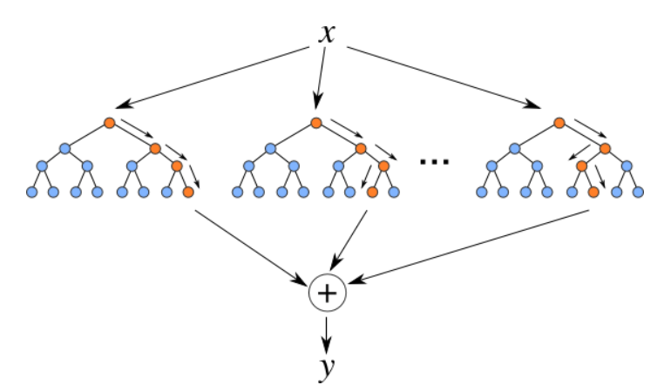
Overview
Lesson 15: Ensemble learning - RF
Bagging
Boosting
Bootstrapping
Random Forest

Slide 20
Overview
Lesson 16: Ensemble learning - Adaboost and XGB
Adaboost
XGB

Slide 21
Overview
Lesson 17: Benchmarking
Accuracy
Precision
Recall
F1 score
ROC curve
PR curve

Slide 22

Overview
Lesson 18: Time series
Stationarity, Trends, Seasonality
Regression approaches
Regularization with Ridge regression
ARIMA
Gated Recurrent Units (GRU)

Slide 23

Overview
Lesson 19: Introduction to Deep Learning
Basic operations
CNNs out of box
Convolution in details
Transfer learning
Engineering CNN with tensorflow.keras
Visualization of layers and kernels

