Slide 1
Basics of
Machine Learning
Dmitry Ryabokon, github.com/dryabokon

Slide 2


Lesson 05
Feature Engineering

Slide 3
Feature Engineering
Goals
Prepare dataset by addressing constraints/limitations of ML algorithms
Enhance performance of ML models

Slide 4
Feature Engineering
Techniques
Handling Outliers
Imputation for Missing values
Encoding
Scaling: MinMax, Standard Scaler or Z Score
Handling imbalanced data
Dimensionality reduction
Binning
Log transform (Box-Cox, Yeo-Johnson)
Grouping operations
Feature split
Visualization
Univariate
Bivariate
Multivariate

Slide 5
Outliers

Slide 6
Feature Engineering
Outliers
A data point that is considerably distant from the other similar data points. There are some methods to deal with outliers :
Extreme Value Analysis
Isolation Forest
Minimum Covariance Determinant
Local Outlier Factor
One-Class SVM
https://machinelearningmastery.com/model-based-outlier-detection-and-removal-in-python/
https://scikit-learn.org/stable/modules/outlier_detection.html

Slide 7
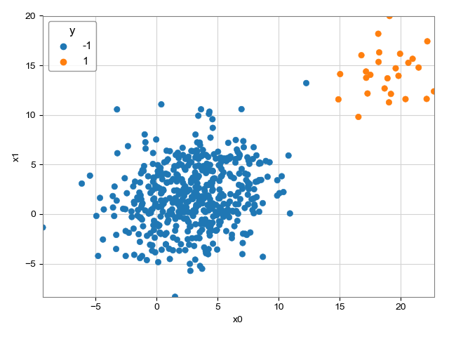
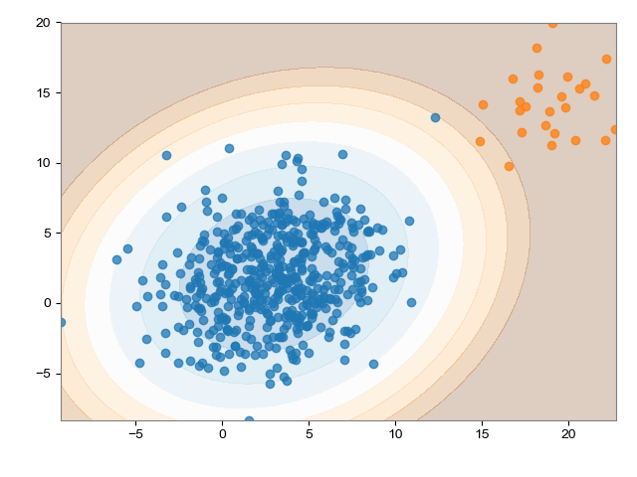
Feature Engineering
Outliers: GT

Slide 8

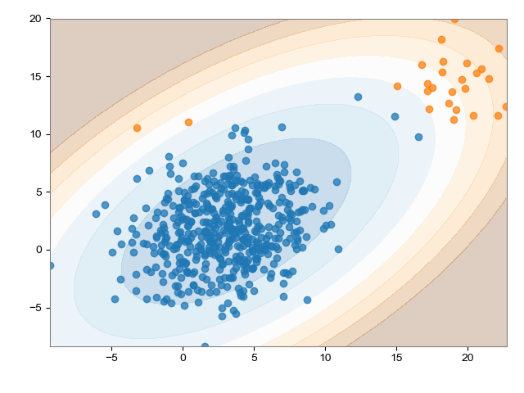
Feature Engineering
Outliers: Normal distribution estimation

Slide 9

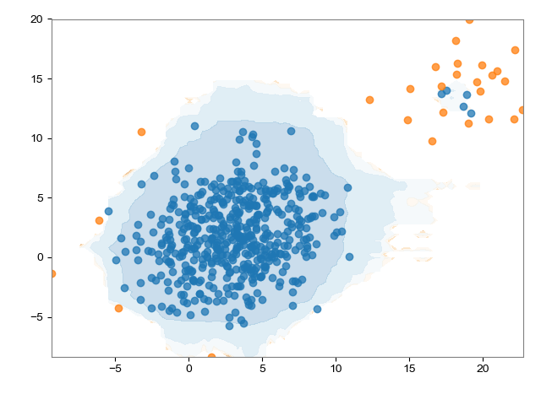
Feature Engineering
Outliers: Isolation Forest

Slide 10

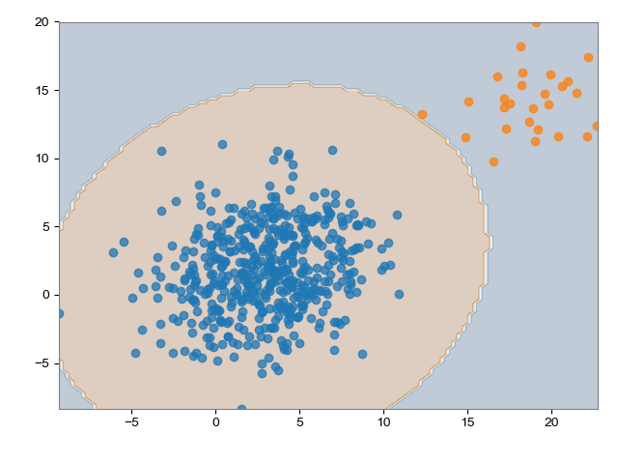
Feature Engineering
Outliers: Elastic Envelope

Slide 11
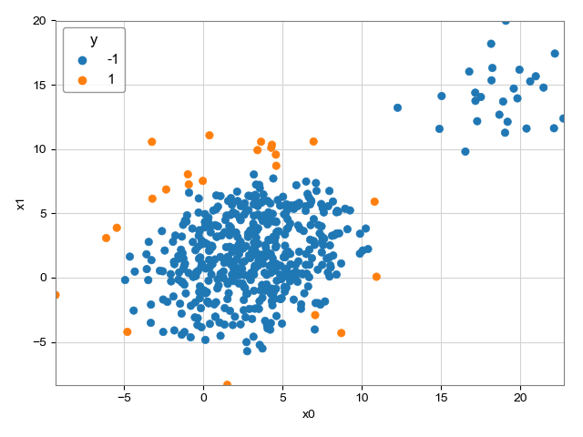
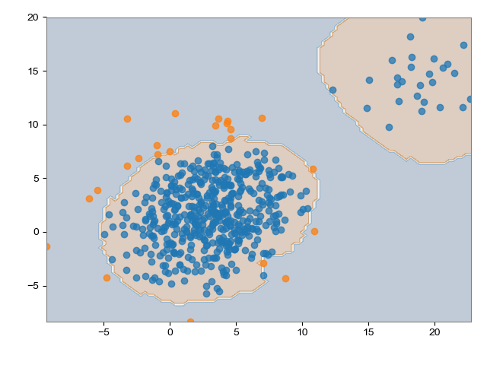
Feature Engineering
Outliers: Local Outlier Factor

Slide 12
Imputation

Slide 13
Feature Engineering
Imputation
Imputation is the process of replacing missing data with substituted values. There are several ways to handle it
Do Nothing
Mean/Median
Most Frequent or Constant (e.g. Zero)
Nearest (KNN)
Extrapolation and Interpolation
Stochastic regression
Encoding (e.g. HotDeck)
https://towardsdatascience.com/6-different-ways-to-compensate-for-missing-values-data-imputation-with-examples-6022d9ca0779

Slide 14
Feature Engineering
Missing values
df_dummy = pd.DataFrame(numpy.array([[5,9,-5,999,3], [7,numpy.NaN,0,1,0], [9,numpy.NaN,25,-1,numpy.NaN]]).T)
0 1 2
0 5.0 7.0 9.0
1 9.0 NaN NaN
2 -5.0 0.0 25.0
3 999.0 1.0 -1.0
4 3.0 0.0 NaN
[[False False False]
[False True True]
[False False False]
[False False False]
[False False True]]
A = (df.isnull()).to_numpy() cv2.imwrite(folder_out + 'nans_1.png', 255 * A) print(df) print() print(A)

Slide 15
Feature Engineering
Imputation: replace
df_dummy = pd.DataFrame(numpy.array([[5,9,-5,999,3], [7,numpy.NaN,0,1,0], [9,numpy.NaN,25,-1,numpy.NaN]]).T)
dct_replace = {numpy.NaN: 999.0} print(df) print() df.replace(dct_replace, inplace=True) print(df)
0 1 2
0 5.0 7.0 9.0
1 9.0 NaN NaN
2 -5.0 0.0 25.0
3 999.0 1.0 -1.0
4 3.0 0.0 NaN
0 1 2
0 5.0 7.0 9.0
1 9.0 999.0 999.0
2 -5.0 0.0 25.0
3 999.0 1.0 -1.0
4 3.0 0.0 999.0

Slide 16
Feature Engineering
Imputation: SimpleImputer
df_dummy = pd.DataFrame(numpy.array([[5,9,-5,999,3], [7,numpy.NaN,0,1,0], [9,numpy.NaN,25,-1,numpy.NaN]]).T)
strategies = ['mean', 'median', 'most_frequent', 'interpolate'] for strategy in strategies: if strategy == 'interpolate': B = df.iloc[:,[idx_column]].interpolate() else: imp = SimpleImputer(missing_values=numpy.nan,strategy=strategy) B = pd.DataFrame(data=imp.fit_transform(df.iloc[:,[idx_column]]), index=df.index,columns=[df.columns[idx_column]])
original mean median most_frequent interpolate
0 7.0 7.0 7.0 7.0 7.0
1 NaN 2.0 0.5 0.0 3.5
2 0.0 0.0 0.0 0.0 0.0
3 1.0 1.0 1.0 1.0 1.0
4 0.0 0.0 0.0 0.0 0.0

Slide 17
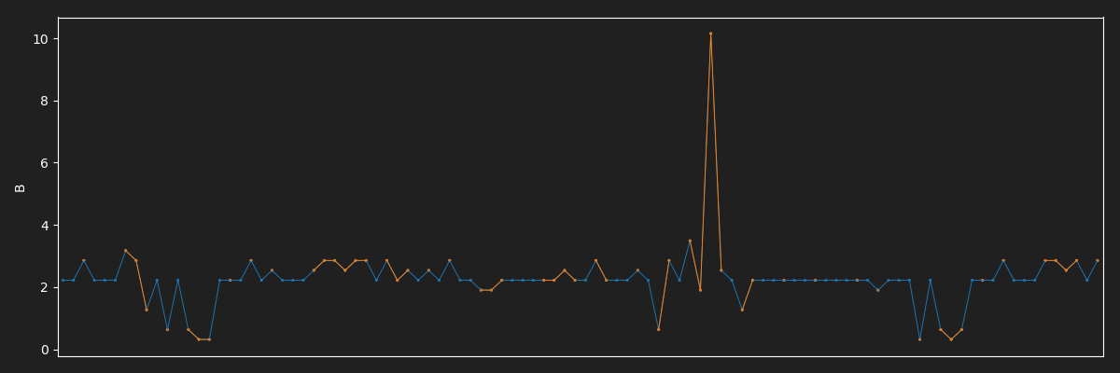

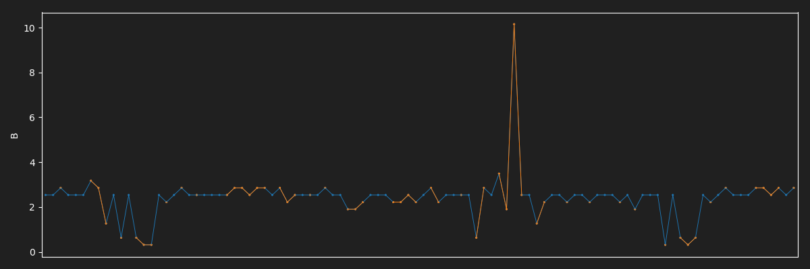
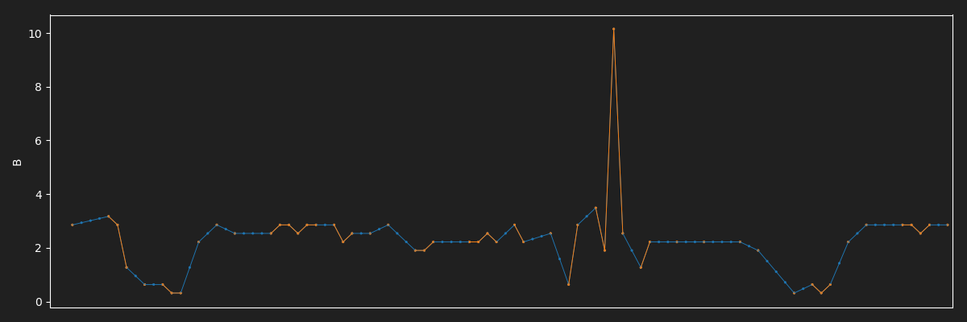
Feature Engineering
Imputation: SimpleImputer
most frequent
mean
median
interpolate

Slide 18
Encoding

Slide 19

Feature Engineering
Encoding
Apply One-Hot Encoding when:
Categorical feature is not ordinal (e.g. countries)
small number of categorical features
Apply Label Encoding when:
Categorical feature is ordinal (e.g. Jr. kg, Sr. kg, Primary school, high school)
Large number of categories

Slide 20

Feature Engineering
One-Hot Encoding: Dummy Variable Trap
Dummy Variable Trap is a scenario in which variables are highly correlated to each other. The outcome of one variable can easily be predicted with the help of the remaining variables. It leads to the multicollinearity issue. in order to overcome this, one of the dummy variables has to be dropped.

Slide 21
Feature Engineering
Ordinal Encoding:
sex blood_type edu_level
0 M O- medium
1 M O- high
2 F O+ high
3 F AB low
4 F B+ nan
sex blood_type edu_level
0 M O- 2.0
1 M O- 0.0
2 F O+ 0.0
3 F AB 1.0
4 F B+ 3.0
df = pd.DataFrame(numpy.array([['M', 'O-', 'medium'], ['M', 'O-', 'high'], ['F', 'O+', 'high'], ['F', 'AB', 'low'], ['F', 'B+', numpy.nan]])) df.columns = ['sex', 'blood_type', 'edu_level'] encoder = OrdinalEncoder() print(df) print() df.iloc[:,2] = encoder.fit_transform(df.iloc[:, 2].values.reshape((-1, 1))) print(df) # drawback: missing value is encoded as a separate class # drawback: order of data is not respected

Slide 22
Feature Engineering
Ordinal Encoding: ordering
sex blood_type edu_level
0 M O- medium
1 M O- high
2 F O+ high
3 F AB low
4 F B+ nan
sex blood_type edu_level
0 M O- 1
1 M O- 2
2 F O+ 2
3 F AB 0
4 F B+ -1
df = pd.DataFrame(numpy.array([['M', 'O-', 'medium'], ['M', 'O-', 'high'], ['F', 'O+', 'high'], ['F', 'AB', 'low'], ['F', 'B+', numpy.nan]])) df.columns = ['sex', 'blood_type', 'edu_level'] print(df) print() cat = pd.Categorical(df['edu_level'], categories=['missing', 'low', 'medium', 'high'], ordered=True) cat.fillna('missing') labels, unique = pd.factorize(cat, sort=True) df.edu_level = labels print(df)

Slide 23
Feature Engineering
OneHot Encoding:
sex blood_type
M O-
M O-
F O+
F AB
F B+
F M AB B+ O+ O-
0 1 0 0 0 1
0 1 0 0 0 1
1 0 0 0 1 0
1 0 1 0 0 0
1 0 0 1 0 0
df = pd.DataFrame(numpy.array([['M', 'O-'], ['M', 'O-'], ['F', 'O+'], ['F', 'AB'], ['F', 'B+']])) df.columns = ['sex', 'blood_type'] onehot = OneHotEncoder(dtype=numpy.int, sparse=True) df2 = pd.DataFrame(onehot.fit_transform(df[['sex', 'blood_type']]).toarray()) df2.columns = numpy.unique(df['sex']).tolist() + numpy.unique(df['blood_type']).tolist() print(df.to_string(index=False)) print() print(df2.to_string(index=False)

Slide 24
Imbalanced data

Slide 25
Feature Engineering
Imbalanced dataset: general approaches
Using class weights
Collect more data to even the imbalances in the dataset
Sampling: resample the dataset to correct for imbalances
Choosing loss functions like Focal Loss
Try a different algorithm altogether on your dataset

Slide 26
Feature Engineering
Imbalanced dataset: Sampling
Under Sampling: delete or select a subset of examples from the majority class
Over Sampling - up-sample the Minority class and thus solve the problem of information loss, however, we get into the trouble of having Overfitting.
https://machinelearningmastery.com/smote-oversampling-for-imbalanced-classification/
https://medium.com/james-blogs/handling-imbalanced-data-in-classification-problems-7de598c1059f
https://cluster-over-sampling.readthedocs.io/en/latest/auto_examples/plot_cluster_oversampler.html

Slide 27
Feature Engineering
Imbalanced dataset: Sampling
Cluster-Based Over Sampling – In this case, the K-means clustering algorithm is independently applied to minority and majority class instances. This is to identify clusters in the dataset. Subsequently, each cluster is oversampled such that all clusters of the same class have an equal number of instances and all classes have the same size
Synthetic Minority Over-sampling Technique (SMOTE) – A subset of data is taken from the minority class as an example and then new synthetic similar instances are created which are then added to the original dataset. This technique is good for Numerical data points.

Slide 28
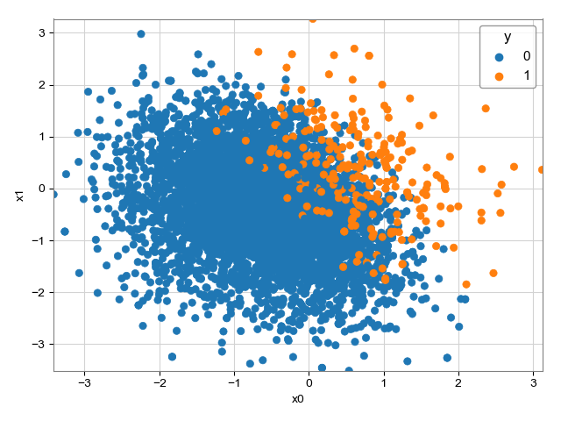
Feature Engineering
Imbalanced dataset: original

Slide 29
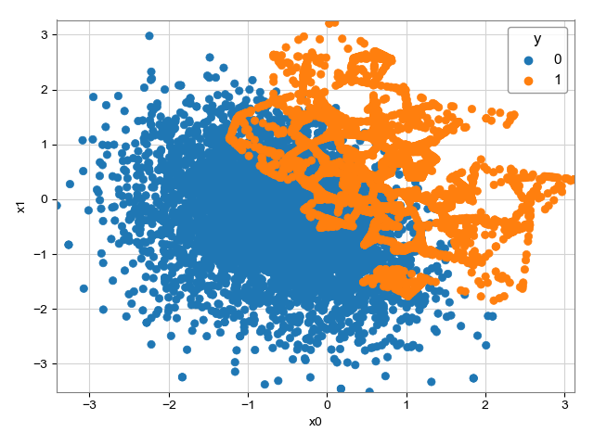
Feature Engineering
Imbalanced dataset: SMOTE

Slide 30
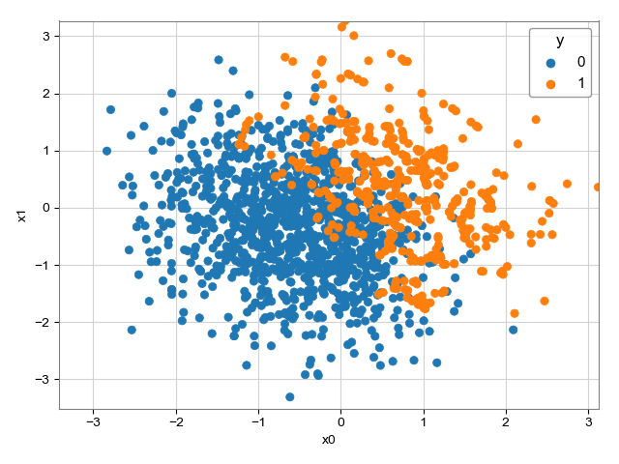
Feature Engineering
Imbalanced dataset: SMOTE + Undersample

Slide 31
Feature Engineering
Stratified Sampling
In stratified sampling, researchers divide subjects into subgroups called strata based on characteristics that they share (e.g., race, gender, educational attainment, etc).
Once divided, each subgroup is randomly sampled using another probability sampling method (so every member of the target population has a known chance of being included in the sample).

Slide 32
Cross Validation

Slide 33
Cross Validation
Main types of cross validation techniques
K fold
Stratified k fold
Leave one out
Bootstrapping
Holdout
K-fold
Leave one out

Slide 34
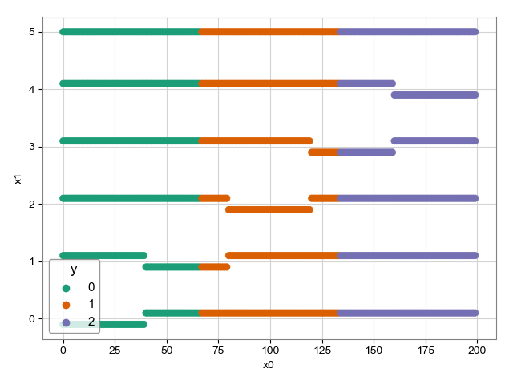
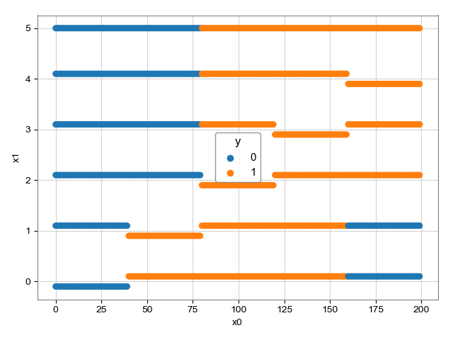
Cross Validation
K-Fold

Slide 35
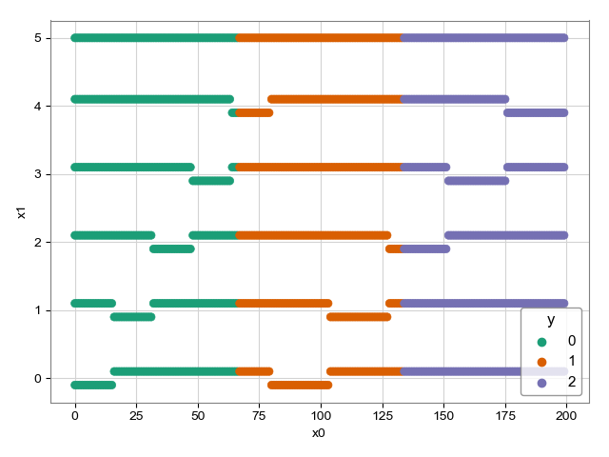
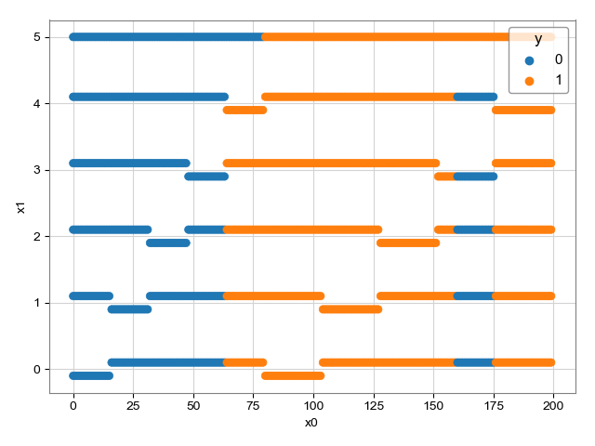
Cross Validation
Stratified K-Fold

Slide 36
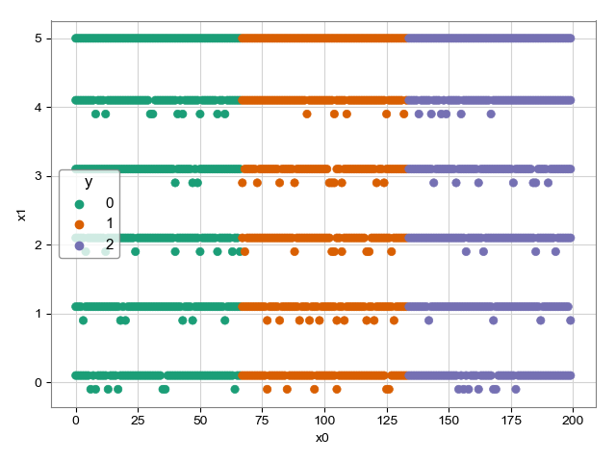
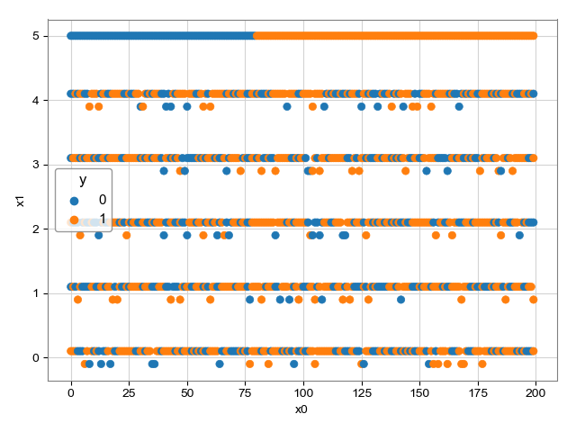
Cross Validation
Shuffle

Slide 37
Cross Validation
Learning curve
A learning curve, sometimes called a training curve, shows how the prediction score of training and validation sets depends on the number of training samples.
You can use learning_curve to get this dependency, which can help you find the optimal size of the training set, choose hyperparameters, compare models, and so on.

Slide 38
Loss functions

Slide 39
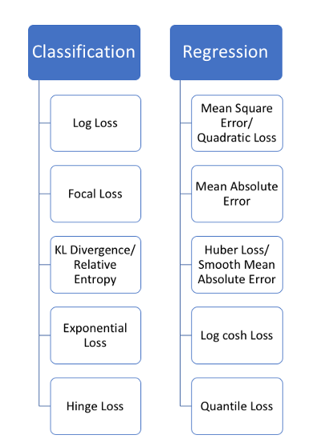
Loss functions
Types of loss
https://heartbeat.fritz.ai/5-regression-loss-functions-all-machine-learners-should-know-4fb140e9d4b0

Slide 40
More

Slide 41
Feature Engineering
Normalization and Standardization
Normalization and Standardization are the two very popular methods used for feature scaling.
Normalization refers to re-scaling the values to fit into a range of [0,1].
Standardization refers to re-scaling data to have a mean of 0 and a standard deviation of 1 (Unit variance).
Normalization is useful when all parameters need to have the identical positive scale however the outliers from the data set are lost. Hence, standardization is recommended for most applications.

Slide 42
Feature Engineering
Distributions
The most popular distribution curves are as follows
Bernoulli Distribution
Uniform Distribution
Binomial Distribution
Normal Distribution
Poisson Distribution
Exponential distribution

Slide 43
Feature Engineering
Bernoulli Distribution
A
Check if a team will win a championship or not
A newborn child is either male or female
You either pass an exam or not, etc.
B

Slide 44
Feature Engineering
Uniform Distribution
Fixed number of outcomes with uniform probability
Rolling a single dice

Slide 45
Feature Engineering
Binomial Distribution
P = 0.2 , N= 15
Number heads in series of a coin toss

Slide 46
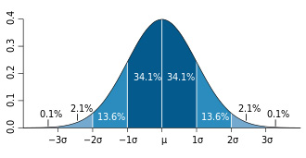
Feature Engineering
Normal Distribution
Symmetric distribution where most of the observations cluster around the central peak.
The values further away from the mean taper off equally in both directions.
An example would be the height of students in a classroom.

Slide 47
Feature Engineering
Poisson Distribution
Probability of a given number of events occurring in a fixed time/space interval
events occur with a known constant mean rate
events occur independently of the time since the last event.
It can be used to make e.g. forecasts about the number of customers on certain days and allows them to adjust supply according to the demand.

Slide 48
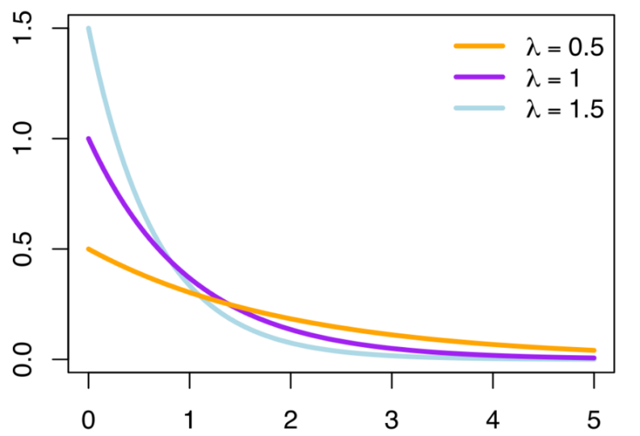
Feature Engineering
Exponential Distribution
Concerned with the amount of time until a specific event occurs.
For example, how long a car battery would last, in months

Slide 49
Feature Engineering
How to measure correlation of categorical data?
Chi square test can be used for doing so.
It gives the measure of correlation between categorical predictors.
https://datascience.stackexchange.com/questions/893/how-to-get-correlation-between-two-categorical-variable-and-a-categorical-variab

