Slide 1
Basics of
Machine Learning
Dmitry Ryabokon, github.com/dryabokon

Slide 2

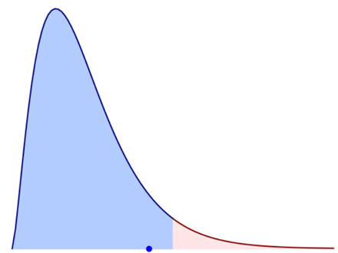
Lesson 06
Statistical ML

Slide 3
Statistical ML
Summary
P- Value and null hypothesis significance testing
Chi-squared test
T-test
Feature importance
Feature correlation
Hashing
Variance Inflation Factor

Slide 4
Statistical ML
Tutorials
ex_06a_test_chi2.py
ex_06a_test_normality.py
ex_06a_test_student_one_var.py
ex_06a_test_student_two_vars.py
ex_06b_feature_correlation.py
ex_06b_feature_importance.py

Slide 5
Hypothesis testing

Slide 6
Hypothesis testing
Statistical significance
The result/value has statistical significance
if it is unlikely to occur under hypothesis H
significance level α is probability of false rejecting
the hypothesis H (while it was true)

Slide 7
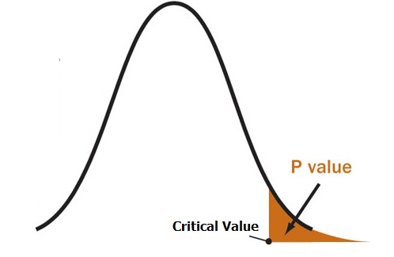
Hypothesis testing
P-Value: probability value or asymptotic significance
how likely your data/experiment is occurred under hypothesis H
A p-value is an area in the tail of a distribution
that tells you the probability of a result happening by chance

Slide 8
Hypothesis testing
P-Value: probability value or asymptotic significance
how likely your data/experiment is occurred under hypothesis H
The p-value gives us the probability of observing what we observed,
given a hypothesis is true
Small p-value has significance, it tells that hypothesis does not explain the experiment
If (p_value <= α)
reject H
data is statistically significant.
else:
accept H

Slide 9
Hypothesis testing
P-Value: probability value or asymptotic significance
how likely your data/experiment is occurred under hypothesis H
Example: p-value == 0.05 => the experiment has 5% or lower chance of occurring under hypothesis H
p-value | significance | How likely experiment data is occurred under hypothesis H
[0 .. 0.01] | High significance | Highly unlikely to occur
[0.01 .. 0.05] | Strong significance
[0.05 .. 0.10] | Marginal significance
[0.10 .. | Low significance | Very likely to occur

Slide 10
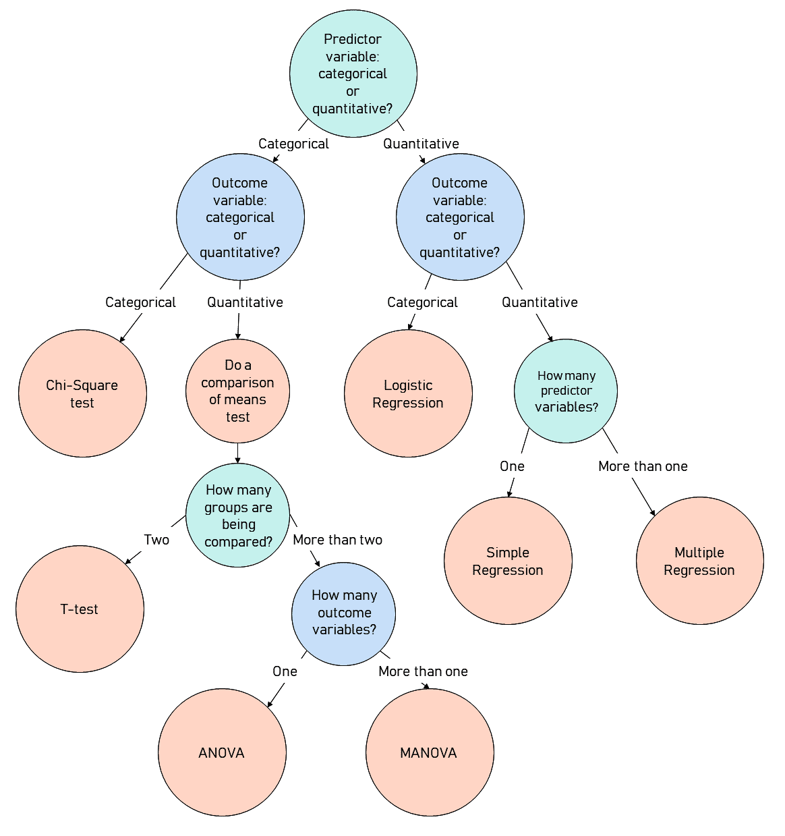
Hypothesis testing
P-Value: probability value or asymptotic significance
p-value depends on the statistical test you are using to test your hypothesis
There are four main test statistics you can use in a hypothesis test.
Z-Test
T-Test
ANOVA
Chi-Square Test

Slide 11
Chi2 test

Slide 12
Hypothesis testing
Chi-Square Test
Pearson’s Chi-Square test for independence between categorical variables
Goal: conclude if two variables are related to each other
X² = ∑ [(observed-expected)² / expected]

Slide 13
Hypothesis testing
Chi-Square Test
Если гипотеза о согласии наблюдаемых и ожидаемых частот верна, то, при большом количестве наблюдений, выражение
имеет стандартное нормальное распределение
(observed-expected) / sqrt(expected)
нормальность будет проявляться только при достаточно больших частотах. В статистике принято считать, что общее количество наблюдений (сумма частот) должна быть не менее 50 и ожидаемая частота в каждой группе должна быть не менее 5. Только в этом случае величина, показанная выше, имеет стандартное нормальное распределение.

Slide 14
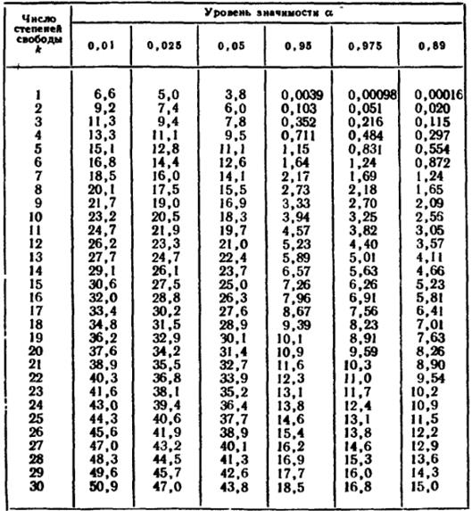
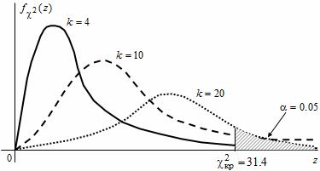
Hypothesis testing
Chi-Square Test

Slide 15
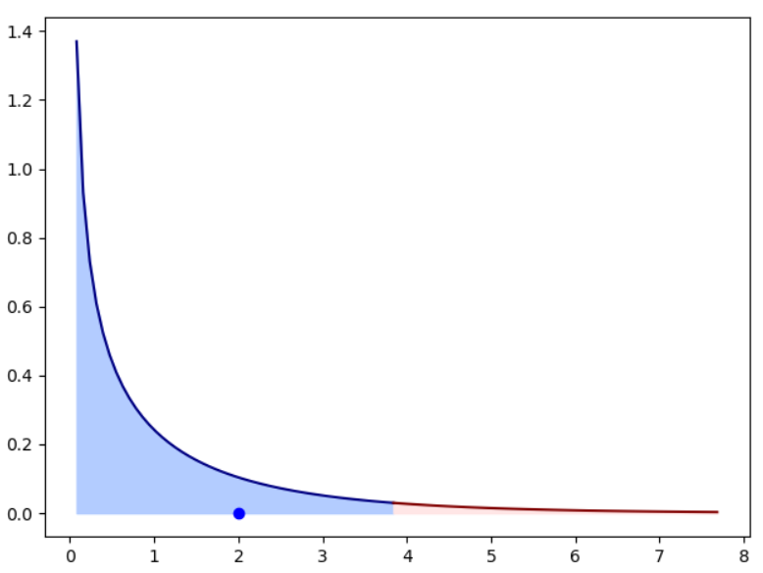
Hypothesis testing
Chi-Square Test
X_obs = [110, 90] X_exp = [100, 100]

Slide 16
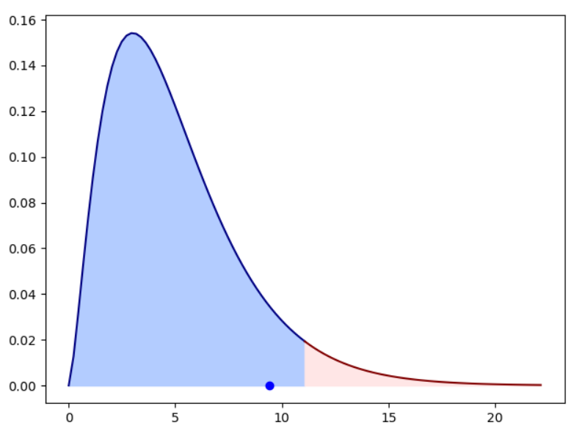
Hypothesis testing
Chi-Square Test
X_obs = [8, 12, 13, 7, 12, 18] X_exp = [10, 10, 10, 10, 10, 10]

Slide 17
T-test

Slide 18
Hypothesis testing
T-Test
Статистический метод, который позволяет сравнивать средние значения двух выборок и на основе результатов теста делать заключение о том, различаются ли они друг от друга статистически или нет.
Для проведения теста, необходимо, чтобы данные выборок имели распределение близкое к нормальному.
Для этого существуют методы оценки, которые позволяют сказать, допустимо ли в данном случае полагать, что данные распределены нормально или нет. Например график квантилей (qqplot) или тест Шапиро-Уилка

Slide 19
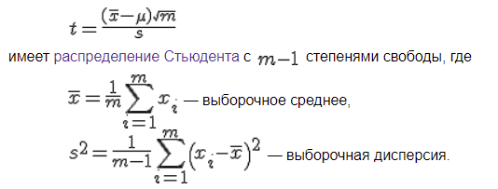
Hypothesis testing
T-Test: one sample test
сравнение выборочного среднего с заданным значением

Slide 20
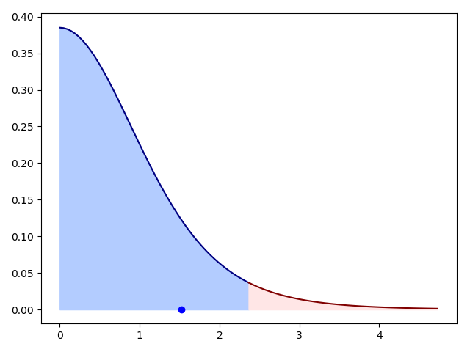



Hypothesis testing
T-Test: one sample test
17%
2%
X_obs = [0, 1, 1, 1, 1, 1, 1, 0]
mean_exp = 0.5
X_obs = [0, 1, 1, 1, 1, 1, 1, 1]
mean_exp = 0.5

Slide 21
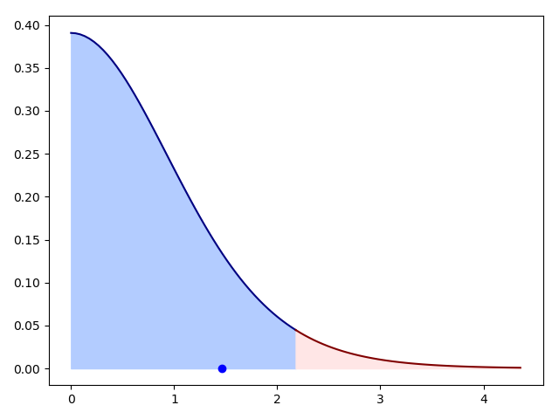
Hypothesis testing
T-Test: two samples test
18%
X_obs = [0, 1, 1, 1, 1, 1, 1, 1]
X_exp = [0, 0, 0, 1, 1, 1]

Slide 22
Shapiro-Wilk W Test
Anderson-Darling Test
Martinez-Iglewicz Test
Kolmogorov-Smirnov Test
D’Agostino Skewness Test
Normality test

Slide 23
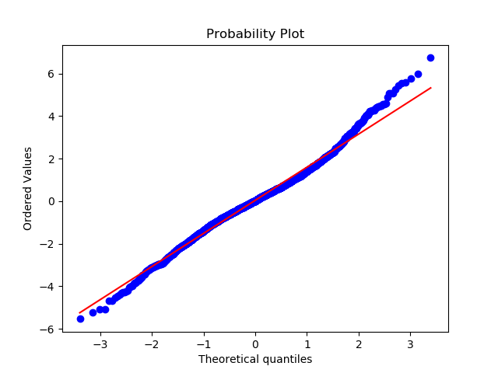
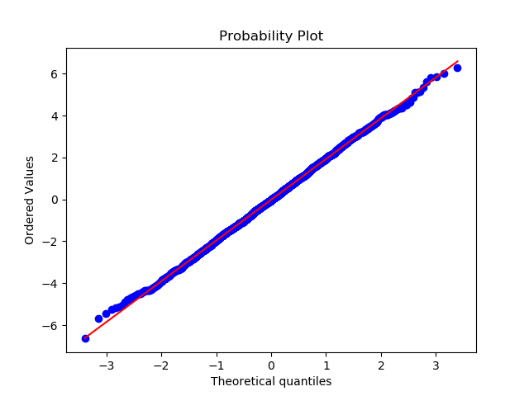
Hypothesis testing
Normality test

Slide 24
Feature Selection

Slide 25


Feature Selection
F-test
F-Test does a hypothesis testing against models X and Y. It tells you if X is significantly better than Y, with respect to a p-value
- X is a model created by just a constant
- Y is the model created by a constant and a feature
The least square errors in both models are compared and checks if the difference in errors between model X and Y are significant or introduced by chance
The goal of the F-test is to provide significance level. If you want to make sure the features your are including are significant with respect to your pp-value, you use an F-test.
If you just want to include the kk best features, you can use the correlation only
https://stats.stackexchange.com/questions/204141/difference-between-selecting-features-based-on-f-regression-and-based-on-r2

Slide 26
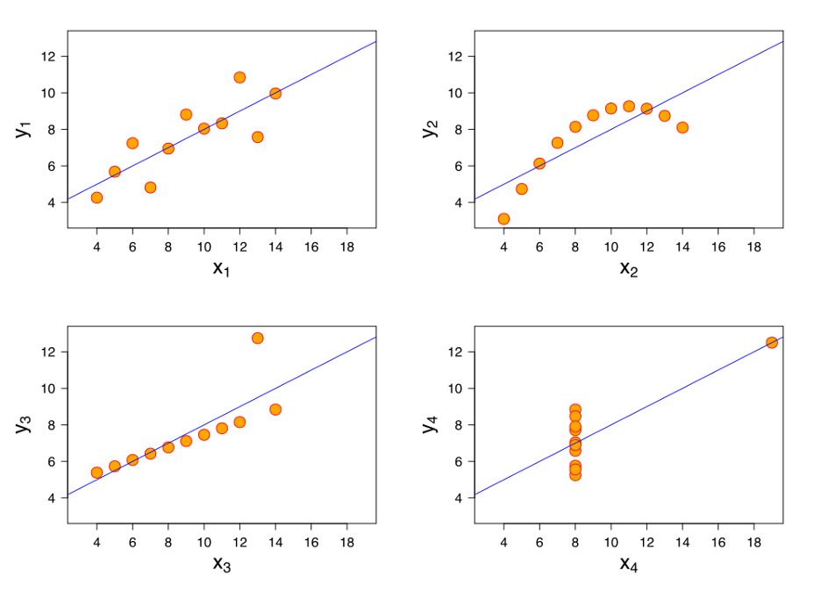
Feature Selection
F-test: drawbacks
F-Test checks for and only captures linear relationships between features and labels.
A highly correlated feature is given higher score and less correlated features are given lower score.

Slide 27
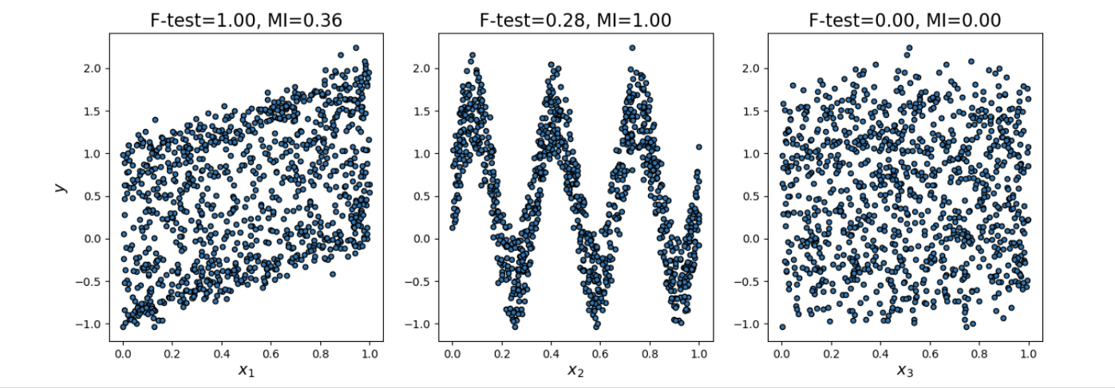
Feature Selection
Mutual information

Slide 28
Variance Inflation
Factor

Slide 29
Variance Inflation Factor
Multicollinearity
Multicollinearity is problem that you can run into when you’re fitting a regression model, or other linear model. It refers to predictors that are correlated with other predictors in the model. Unfortunately, the effects of multicollinearity can feel murky and intangible, which makes it unclear whether it’s important to fix.
Moderate multicollinearity may not be problematic. However, severe multicollinearity is a problem because it can increase the variance of the coefficient estimates and make the estimates very sensitive to minor changes in the model. The result is that the coefficient estimates are unstable and difficult to interpret. Multicollinearity saps the statistical power of the analysis, can cause the coefficients to switch signs, and makes it more difficult to specify the correct model
Upon correlation matrix - remove high correlated variables (eg above 75%).
In addition, calculate VIF (variance inflation factor) to check the presence of multicollinearity. VIF value <= 4 suggests no multicollinearity whereas
a value of >= 10 implies serious multicollinearity.

