Slide 1
Basics of
Machine Learning
Dmitry Ryabokon, github.com/dryabokon

Slide 2


Lesson 07
Bayesian Approach

Slide 3
Bayesian Approach
Summary
Approaches for ML
Bayesian approach
Classifying the independent binary features

Slide 4
Approaches for ML
Maximum Likelihood
features and
states
domain for k
input
The model is parametrized by
output

Slide 5
Approaches for ML
Maximum Likelihood

Slide 6


Approaches for ML
Maximum Likelihood: example
46
46
37
37
37
45
36

Slide 7
Approaches for ML
Maximum Likelihood: example
46
46
37
37
37
45
36

Slide 8
Approaches for ML
Bias in training data
features and
states
domain for k
input
The model is parametrized by
output

Slide 9
Approaches for ML
Bias in training data: example

Slide 10
Approaches for ML
Bias in training data: example
center of the circle that
holds all the points from X1

Slide 11
Approaches for ML
ERM: Empirical risk minimization
features and
states
domain for k
penalty function
decision strategy is parametrized by

Slide 12
Approaches for ML
ERM: Empirical risk minimization
decision strategy is parametrized by

Slide 13
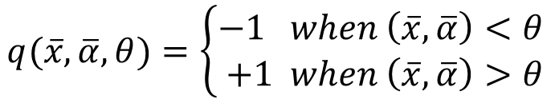
Approaches for ML
ERM: Empirical risk minimization
$$q(\overline{x},\overline{α},θ)=\left\{\begin{aligned}−1 when \left(\overline{x},\overline{α}\right)<θ \\ +1 when \left(\overline{x},\overline{α}\right)>θ\end{aligned}\right.$$
Number of errors

Slide 14
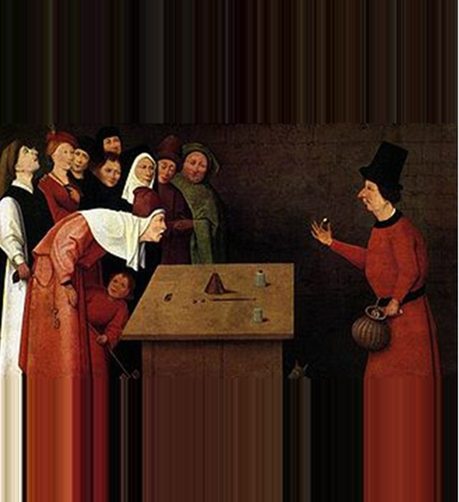
Bayesian approach

Slide 15
Bayesian approach
Definitions
feature
state (hidden)
joint probability
penalty function
decision strategy

Slide 16
Bayesian approach
The problem
feature
state (hidden)
input
joint probability
penalty function
decision strategy
output

Slide 17
Bayesian approach
Some basics
joint probability
law of total probability
Bayes' theorem
p(k) prior probability
p(k|x) posterior probability
p(x|k) conditional probability of x, assuming k
p(x) probability of x

Slide 18

Bayesian approach
Example
time
К = {1-revision, 2-free_ride}

Slide 19

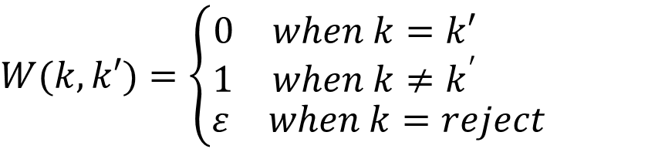
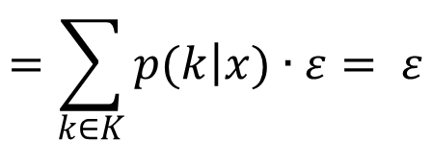
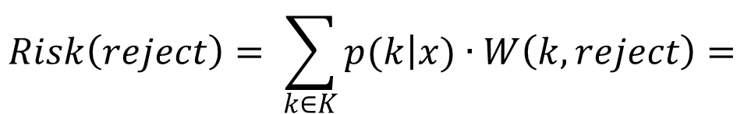
Bayesian approach
Flexibility to not make a decision
$$W(k,k′)=\left\{\begin{aligned}\begin{matrix}0 & when k=k′\end{matrix} \\ \begin{matrix}1 & when k≠k^{′} \end{matrix} \\ \begin{matrix}ε & when k=reject\end{matrix} \end{aligned}\right.$$
$$Risk\left(reject\right)= \sum_{k∈K}{p(k\left|x)∙W\left(k,reject\right)=\right.}$$
$$=\sum_{k∈K}{p(k\left|x)∙ε= ε\right.}$$

Slide 20
Bayesian approach
Flexibility to not make a decision
if
if
then
then
else
reject
else
reject

Slide 21
Bayesian approach
Decision strategies for different penalty functions
median
average
the most probable sample
center of the most probable section Δ

Slide 22
Classifying the independent binary features

Slide 23
Classifying the independent binary features
The problem
feature – a set of independent binary values
Few states are possible
Decision strategy

Slide 24
Classifying the independent binary features
The problem

Slide 25
Classifying the independent binary features
Decision rule

Slide 26
Classifying the independent binary features
Example

Slide 27
Classifying the independent binary features
Example
1/4
2/4
3/4
2/4
1/4
3/4
3/4
1/4

Slide 28
Classifying the independent binary features
Example
1/4
2/4
3/4
2/4
(1/4)x(1/4) < (2/4)x(3/4)
1/4
3/4
3/4
1/4

Slide 29
Classifying the independent binary features
Example
1/4
2/4
3/4
2/4
(1/4)x(3/4) > (2/4)x(1/4)
1/4
3/4
3/4
1/4

Slide 30
Classifying the independent binary features
Example
1/4
2/4
3/4
2/4
(3/4)x(1/4) < (2/4)x(3/4)
1/4
3/4
3/4
1/4

Slide 31
Classifying the independent binary features
Example
1/4
2/4
3/4
2/4
(3/4)x(3/4) > (2/4)x(1/4)
1/4
3/4
3/4
1/4

Slide 32
Classifying the independent binary features
Example

Slide 33
Classifying the independent binary features
Example

Slide 34
Classifying the independent binary features
Another example
5/9
4/8
4/9
4/8
5/9
4/8
4/8
4/8

Slide 35
Classifying the independent binary features
Another example
(4/9)x(4/9) < (4/8)x(4/8)

Slide 36
Classifying the independent binary features
Another example

Slide 37
Classifying the independent binary features
Another example

