Slide 1
Basics of
Machine Learning
Dmitry Ryabokon, github.com/dryabokon

Slide 2

Lesson 08
Regression methods

Slide 3
Linear regression

Slide 4
Linear Regression
Variable importance
Before starting linear regression check assumptions
Linear relationship
Multivariate normality
No or little multicollinearity
No auto-correlation
Homoscedasticity

Slide 5
Linear Regression
Variable importance
Following are the methods of variable selection you can use:
Remove the correlated variables prior to selecting important variables
Use linear regression and select variables based on p values
Use Forward Selection, Backward Selection, Stepwise Selection
Use Random Forest, Xgboost and plot variable importance chart
Use Lasso Regression
Measure information gain for the available set of features and select top n features accordingly.

Slide 6
Logistic regression

Slide 7
Logistic regression
Target function: empirical risk = number of errors
margin<0
margin<0

Slide 8
Logistic regression
Target function: upper bound
log(1+exp(-margin))
[margin<0]
1
0
margin

Slide 9
Logistic regression
Relationship with P(y|x)
model

Slide 10
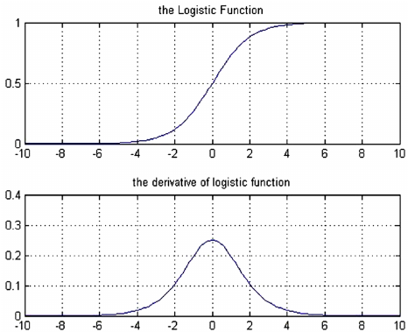
Logistic regression
Logistic function: the sigmoid

