Slide 1
Basics of
Machine Learning
Dmitry Ryabokon, github.com/dryabokon

Slide 2


Lesson 11
Non-parametrical
ML methods

Slide 3
Supervised Learning
Summary
Decision tree
KNN
Bias vs Variance tradeoff

Slide 4
Decision Tree

Slide 5
Decision tree
F1 F2 F3 Target
A A A 0
A A B 0
B B A 1
A B B 1
H(0,0,1,1) = ½ log(½) + ½ log(½) = 1

Slide 6
Decision tree
F1 F2 F3 Target Attempt split on F1
A A A 0 0
A A B 0 0
B B A 1 1
A B B 1 0
Information Gain = H(0011) - 3/4 H(001) - 1/4 H(1) = 0.91

Slide 7
Decision tree
F1 F2 F3 Target Attempt split on F2
A A A 0 0
A A B 0 0
B B A 1 1
A B B 1 1
Information Gain = H(0011) - 1/2 H(00) - 1/2 H(11) = 1

Slide 8
Decision tree
F1 F2 F3 Target Attempt split on F3
A A A 0 0
A A B 0 0
B B A 1 1
A B B 1 1
Information Gain = H(0011) - 1/2 H(01) - 1/2 H(01) = 0

Slide 9
Decision tree
F1 F2 F3 Target
A A A 0
A A B 0
B B A 1
A B B 1

Slide 10
Decision tree: pruning

Slide 11
Decision tree: pruning
58% = (7x7 + 3x3)/100
50%
58% = (3x3 + 7x7)/100
50% x 58% + 50% x 58% = 58%
58% > 50% OK

Slide 12
Decision tree: pruning
58%
58%
55.5%
62.5%
50% x 58% + 50% (60% x 55.5% + 40% x 62.5%) = 50% x 58% + 50% x 58.3 = 58.16%
58.16% > 58% this is small improvement

Slide 13

Decision tree: pruning
58%
58%
55.5%
62.5%

Slide 14
Decision tree: pruning
58%
58%
62.5%
50%
50% x 58% + 50% (80% x 62.5% + 20% x 50%) = 50% x 58% + 50% x 60% = 59%
59% > 58% OK

Slide 15
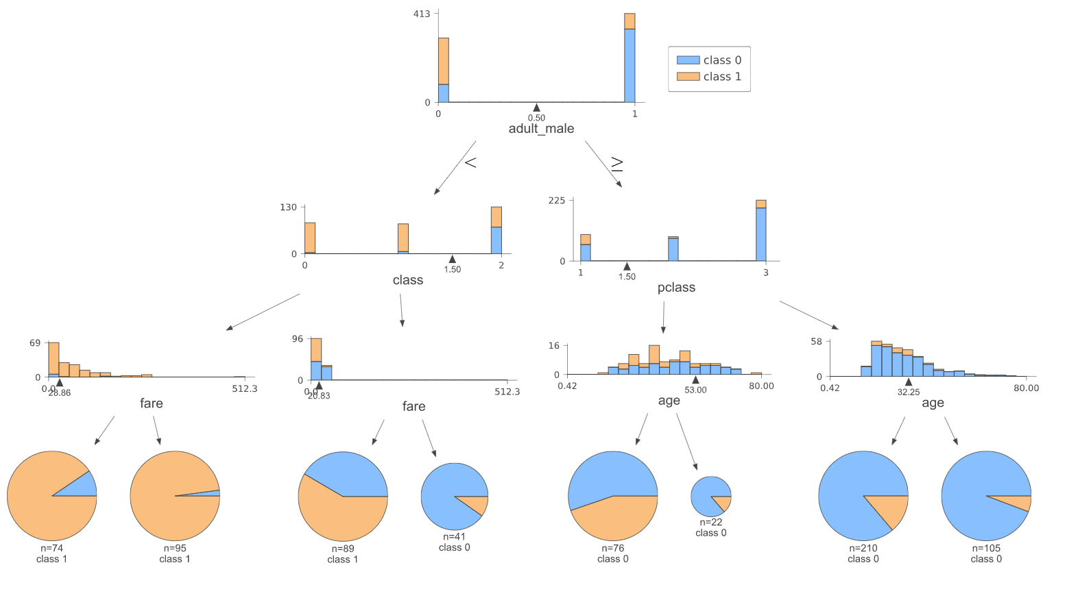
Decision tree: pruning
Example: Titanic

Slide 16
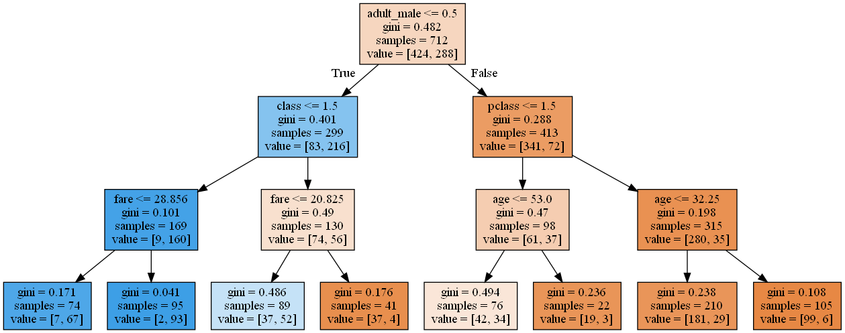
Decision tree: pruning
Example: Titanic

Slide 17
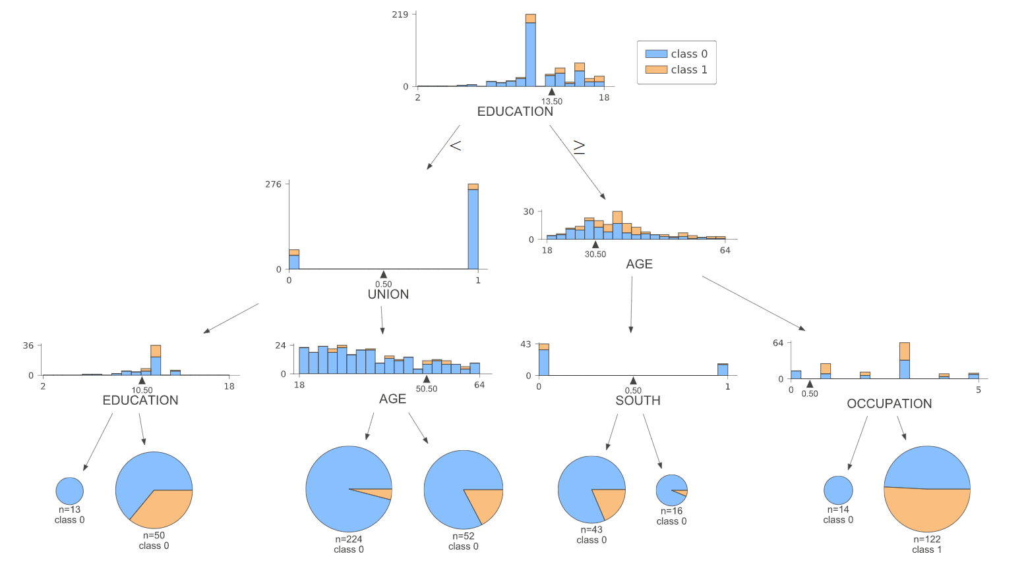
Decision tree: pruning
Example: wages

Slide 18
Bias vs Variance tradeoff
https://www.cs.cmu.edu/~wcohen/10-601/bias-variance.pdf

Slide 19
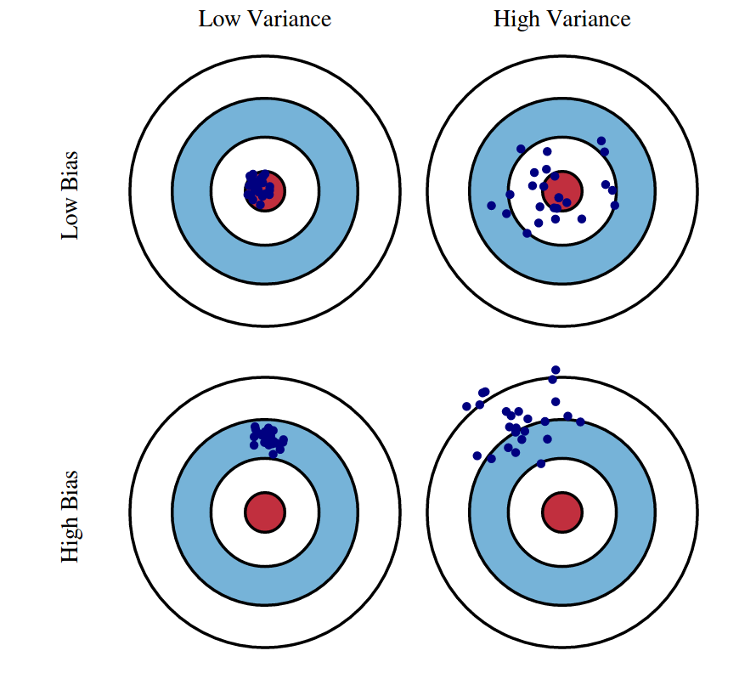
Bias vs Variance
Definitions
Bias is an error from wrong assumptions in the learning algorithm
High bias can cause underfit: the algorithm can miss relations between features and target
The variance is an error from sensitivity to small fluctuations in the training set.
High variance can cause overfit: the algorithm can model the random noise in the training data, rather than the intended outputs
https://www.cs.cornell.edu/courses/cs4780/2018fa/lectures/lecturenote12.html

Slide 20

Bias vs Variance
Definitions
Bias
Big Variance
Variance
Overfit

Slide 21
Bias vs Variance
Definitions
Variance
Big Bias
Bias
Underfit

Slide 22
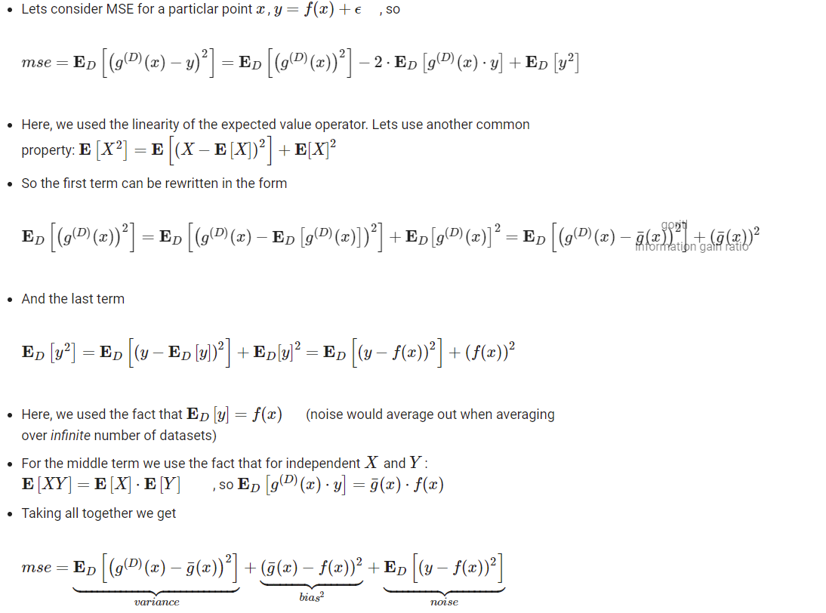
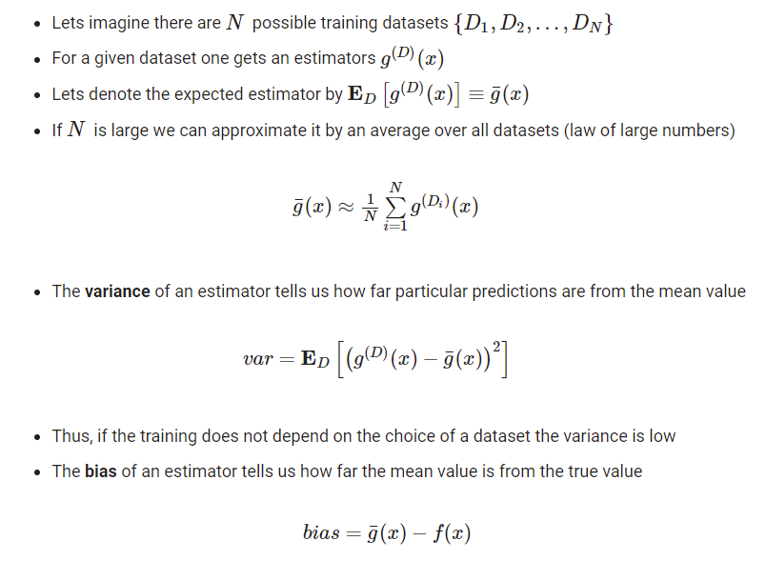
Bias vs Variance
Decomposition

Slide 23
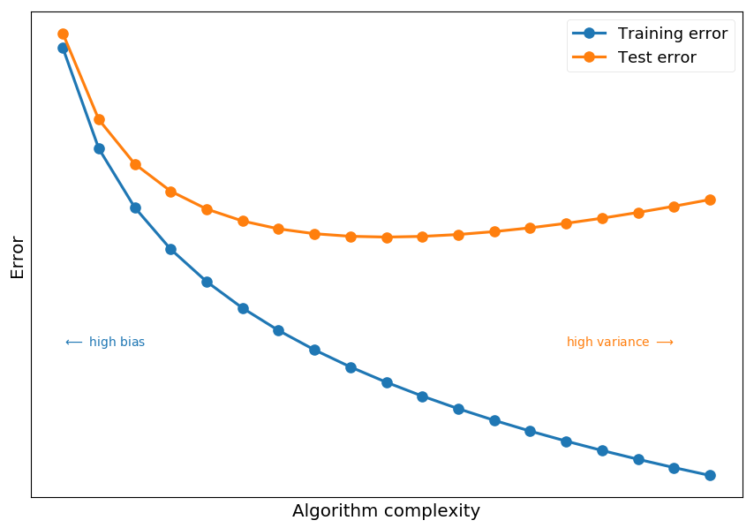
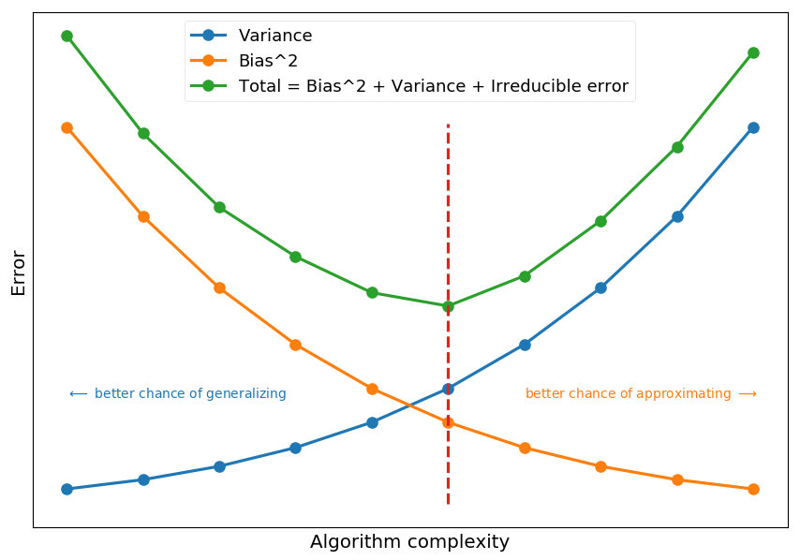
Bias vs Variance
Model complexity
https://tomaszgolan.github.io/introduction_to_machine_learning/markdown/introduction_to_machine_learning_02_dt/introduction_to_machine_learning_02_dt/

Slide 24
Bias vs Variance
How to avoid overfit (high variance)
Keep the model simpler, reduce model complexity
Do cross-validation (e.g. k-folds)
Use regularization techniques (e.g. LASSO, Ridge)
Use top n features from variable importance chart
Use bagging

Slide 25
Bias vs Variance
How to avoid underfit (high bias)
Make model more complex
Add features
Use boosting

Slide 26
Bias vs Variance
Regularization: when # of variables > # of observation
In such high dimensional data sets, we can’t use classical regression techniques, since their assumptions tend to fail. When p > n, we can no longer calculate a unique least square coefficient estimate, the variances become infinite, so OLS (Ordinary Least Squares) cannot be used at all.
To combat this situation, we can use penalized regression methods like lasso, LARS, ridge which can shrink the coefficients to reduce variance. Precisely, ridge regression works best in situations where the least square estimates have higher variance.

Slide 27
Bias vs Variance
Regularization: ridge (L2) and lasso (L1)
Regularization becomes necessary when the model begins to ovefit / underfit. This technique introduces a cost term for bringing in more features with the objective function. Hence, it tries to push the coefficients for many variables to zero and hence reduce cost term. This helps to reduce model complexity so that the model can become better at predicting (generalizing).
The key difference between these techniques is that Lasso shrinks the less important feature’s coefficient to zero thus, removing some feature altogether. So, this works well for feature selection in case we have a huge number of features. Traditional methods like cross-validation, stepwise regression to handle overfitting and perform feature selection work well with a small set of features but these techniques are a great alternative when we are dealing with a large set of features.
In presence of many variables with small / medium sized effect, use ridge regression. Conceptually, we can say, lasso regression (L1) does both variable selection and parameter shrinkage, whereas Ridge regression only does parameter shrinkage and end up including all the coefficients in the model. In presence of correlated variables, ridge regression might be the preferred choice. Also, ridge regression works best in situations where the least square estimates have higher variance.

Slide 28

Supervised Learning
References
https://mljar.com/blog/visualize-decision-tree/

