Slide 1
Basics of
Machine Learning
Dmitry Ryabokon, github.com/dryabokon

Slide 2


Lesson 12
Unsupervised Learning

Slide 3
Supervised Learning
Summary
EM Algorithm
K-means

Slide 4
EM algorithm

Slide 5
Unsupervised learning
EM algorithm
Learning
Learning
Supervisor

Slide 6
Unsupervised learning
EM algorithm

Slide 7
Unsupervised learning
EM algorithm

Slide 8
Unsupervised learning
EM algorithm

Slide 9
Unsupervised learning
EM algorithm

Slide 10
Unsupervised learning
EM algorithm

Slide 11
K-Means

Slide 12
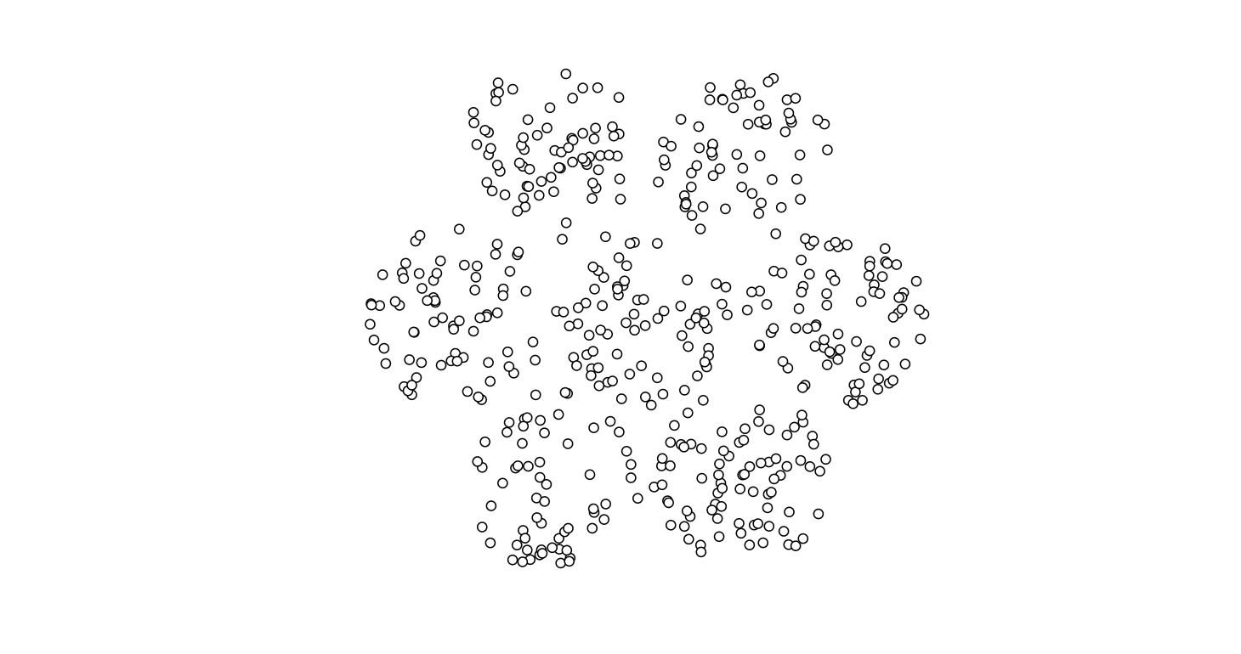
Unsupervised learning
K-means
K-means is an unsupervised clustering algorithm
Do not confuse with KNN classification (or regression) algorithm which classifies an unlabeled observation based on its k surrounding neighbors.
https://www.naftaliharris.com/blog/visualizing-k-means-clustering/
http://stanford.edu/class/ee103/visualizations/kmeans/kmeans.html

Slide 13
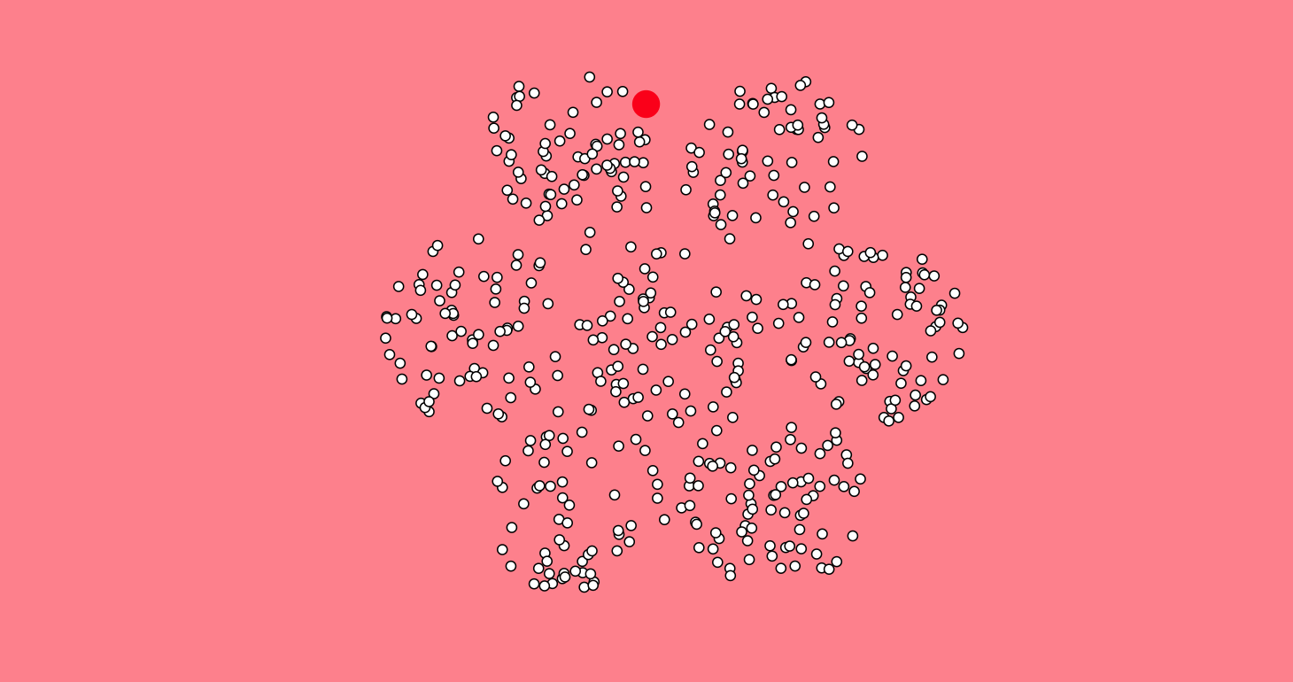
Unsupervised learning
K-means

Slide 14
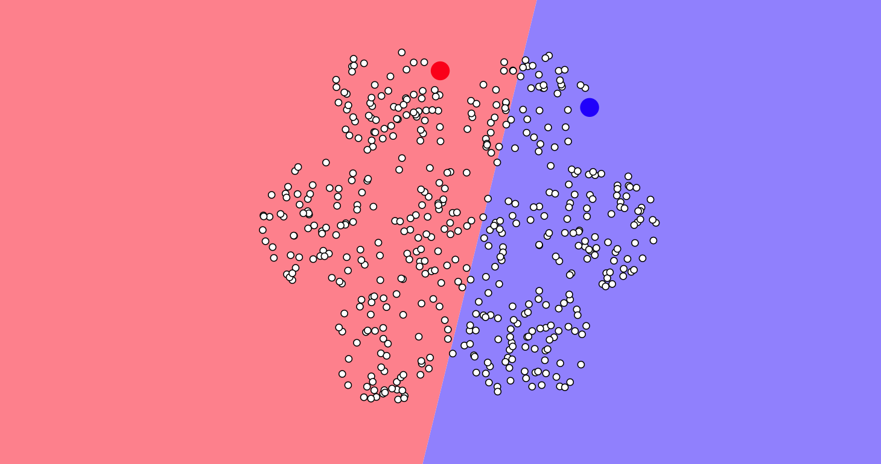
Unsupervised learning
K-means

Slide 15
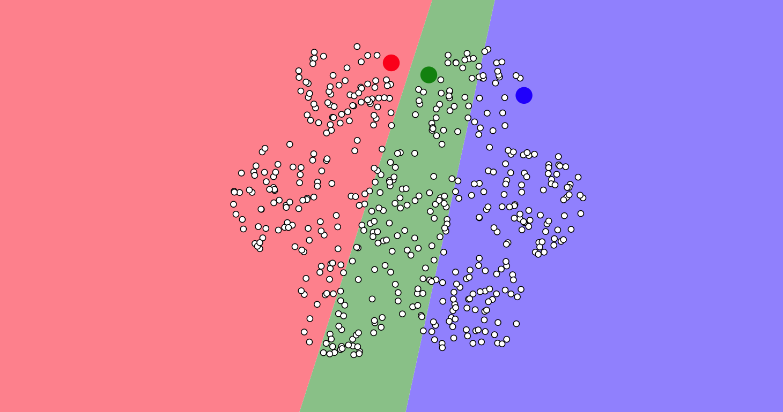
Unsupervised learning
K-means

Slide 16
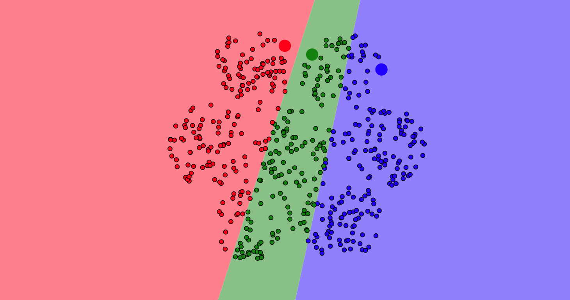
Unsupervised learning
K-means

Slide 17
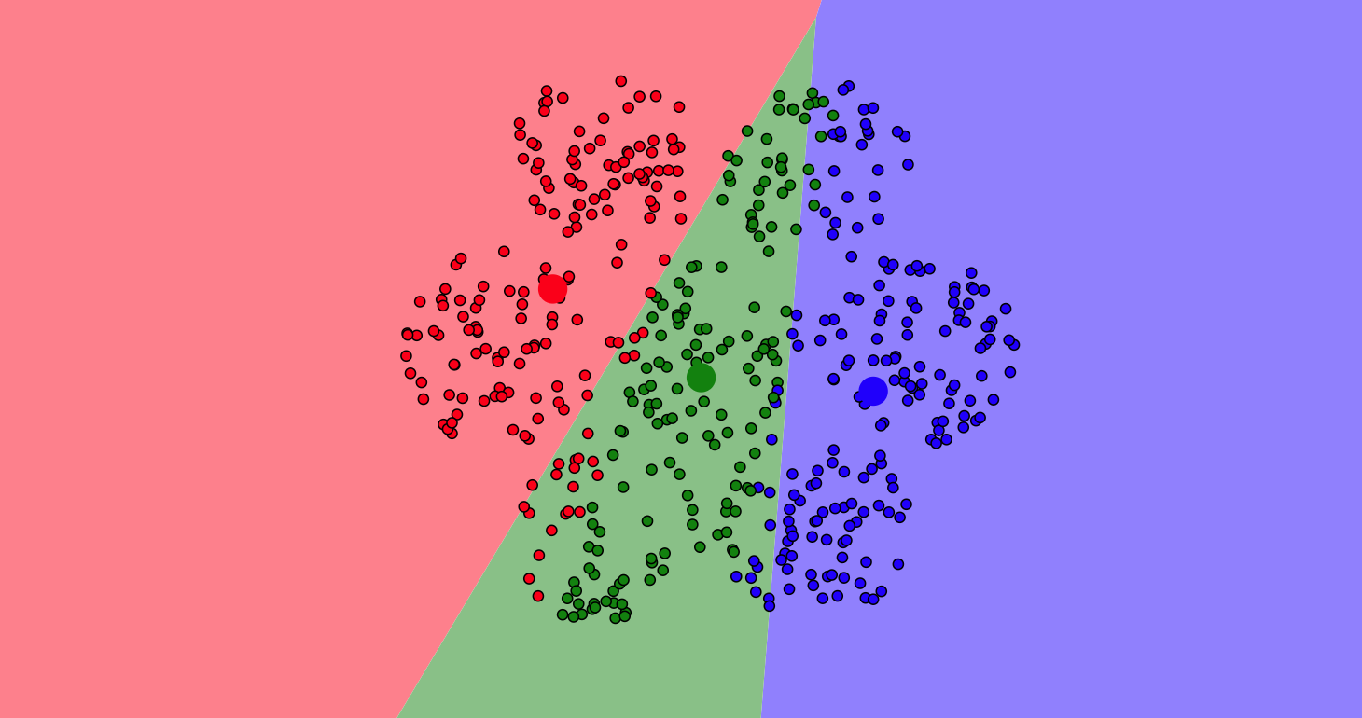
Unsupervised learning
K-means

Slide 18
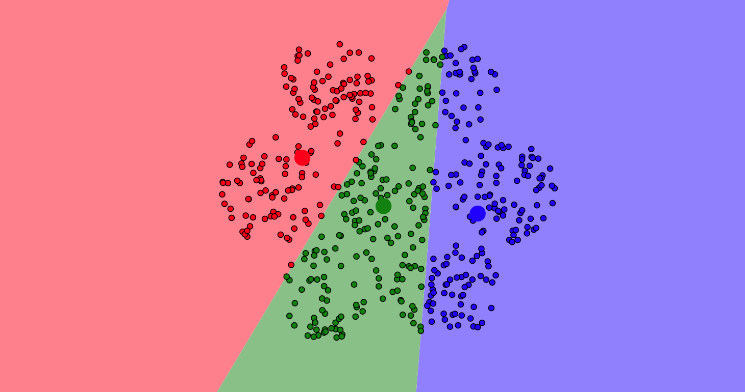
Unsupervised learning
K-means

Slide 19
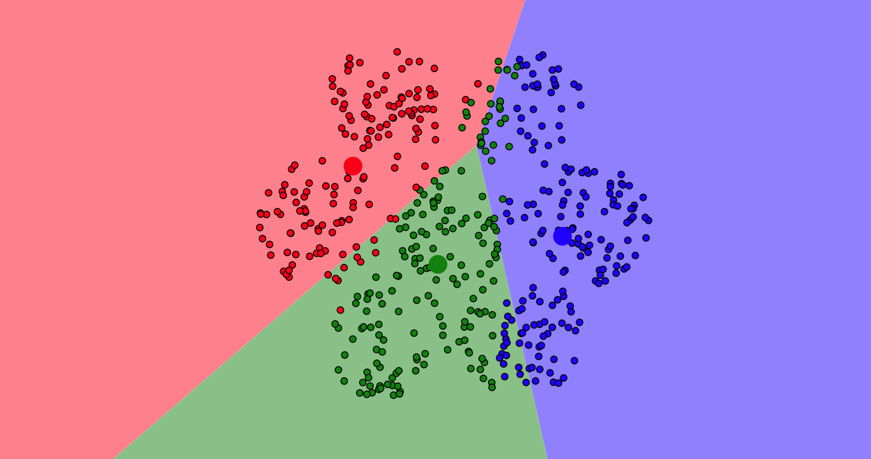
Unsupervised learning
K-means

Slide 20
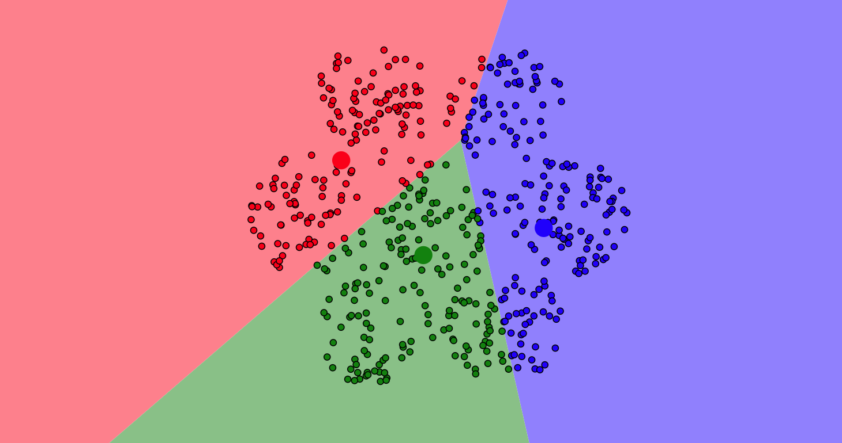
Unsupervised learning
K-means

Slide 21
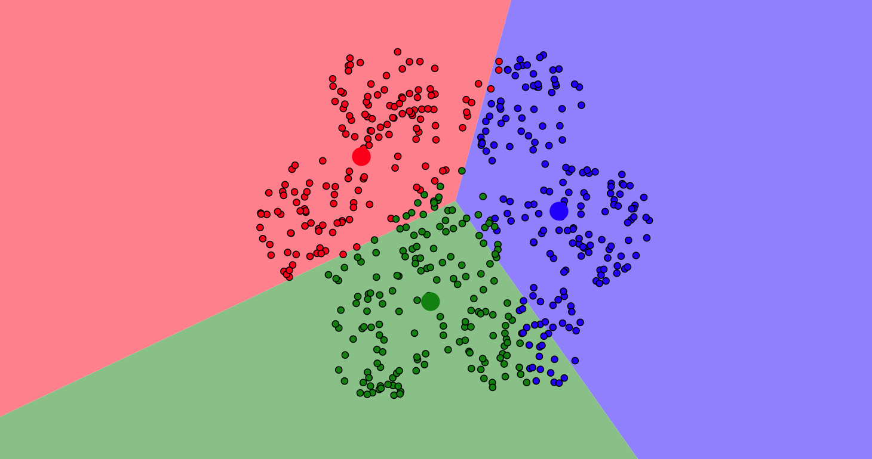
Unsupervised learning
K-means

