Slide 1
Basics of
Machine Learning
Dmitry Ryabokon, github.com/dryabokon

Slide 2

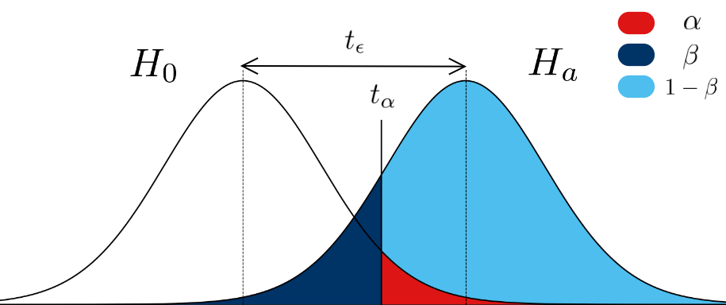
Lesson 13
Non Bayesian Approach

Slide 3
Non Bayesian Approach
Summary
Limitations of the Bayesian approach
Type I error
Type II error
Neyman-Pearson approach
Minimax approach

Slide 4
Neyman-Pearson approach
Limitations of the Bayesian approach
feature
hidden state
conditional probability to expose x by state k
priory probability of the state
penalty function

Slide 5
Neyman-Pearson approach
Limitations of the Bayesian approach
feature
hidden state
conditional probability to expose x by state k
priory probability of the state
penalty function

Slide 6
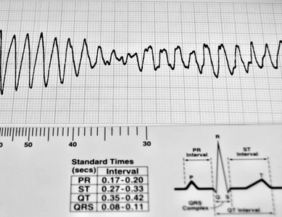
Neyman-Pearson approach
Limitations of the Bayesian approach: example
heartbeat
state: normal, sick
distribution of the heartbeat for
normal and sick
???
W(normal, sick)
W(sick, normal)
???

Slide 7
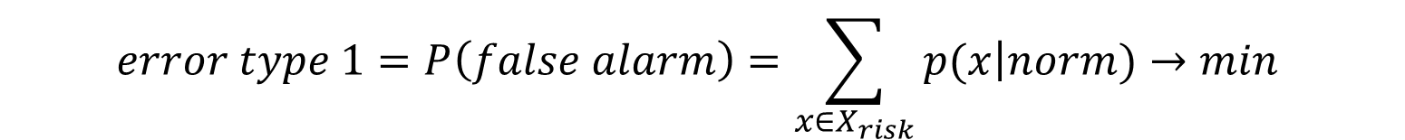




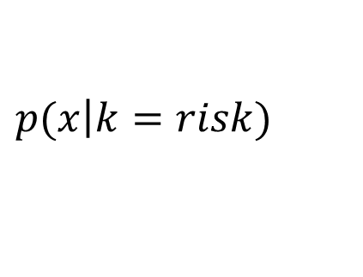
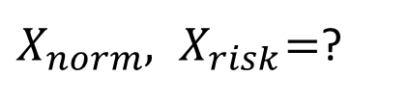
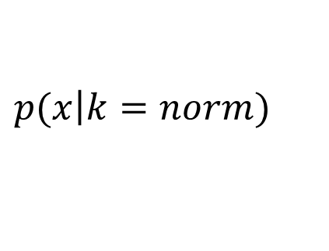

Neyman-Pearson approach
The problem
$$x∈X$$
$$k∈K=\left\{nornal, risky\right\}$$
$$p(x\left|k=norm\right.)$$
$$X_{norm}∪{ X}_{risk}=X$$
input
$$p(x\left|k=risk\right.)$$
$$X_{norm}∩{ X}_{risk}=0$$
$$error type 1=P\left(false alarm\right)=\sum_{x∈X_{risk}}{p(x\left|norm\right.)}→min$$
$$error type 2=P\left(miss the risk\right)=\sum_{x∈X_{norm}}{p(x\left|risk\right.)}≤ε$$
output
$X_{norm},{ X}_{risk}=$?

Slide 8


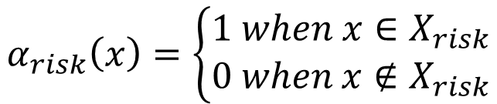
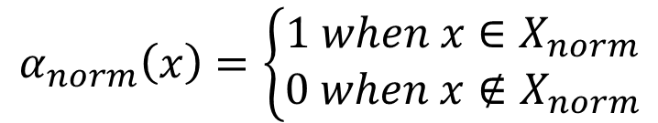
Neyman-Pearson approach
The problem
$$x∈X$$
$$k∈K=\left\{nornal, risky\right\}$$
$$α_{norm}\left(x\right)=\left\{\begin{aligned}1 when x∈X_{norm} \\ 0 when x∉X_{norm}\end{aligned}\right.$$
$$α_{risk}\left(x\right)=\left\{\begin{aligned}1 when x∈X_{risk} \\ 0 when x∉X_{risk}\end{aligned}\right.$$

Slide 9
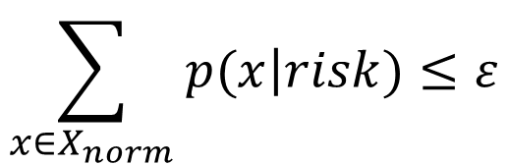
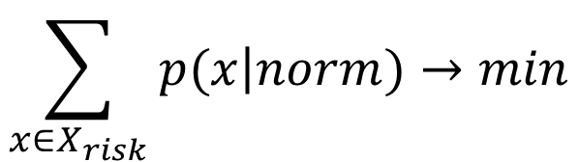
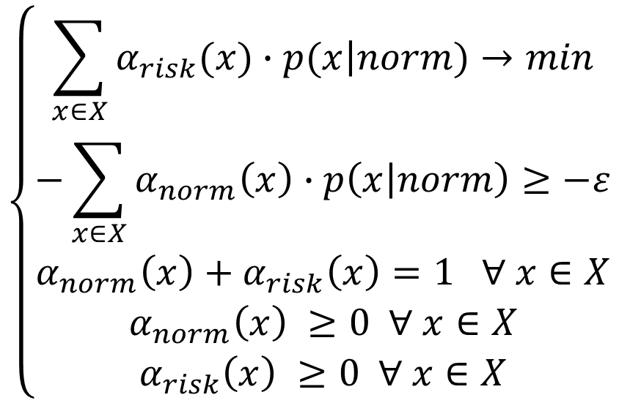
Neyman-Pearson approach
The problem
$$\left\{\begin{aligned}\sum_{x∈X}{α_{risk}(x)∙p(x\left|norm\right.)→min} \\ \begin{matrix}−\sum_{x∈X}{α_{norm}\left(x\right)∙p\left(x\left|norm\right.\right)≥−ε} \\ α_{norm}\left(x\right)+α_{risk}\left(x\right)=1 ∀ x∈X\end{matrix} \\ \begin{matrix}α_{norm}\left(x\right) ≥0 ∀ x∈X \\ α_{risk}\left(x\right) ≥0 ∀ x∈X\end{matrix}\end{aligned}\right.$$
$$\sum_{x∈X_{risk}}{p(x\left|norm\right.)}→min$$
$$\sum_{x∈X_{norm}}{p(x\left|risk\right.)}≤ε$$

Slide 10
Neyman-Pearson approach

Slide 11
Neyman-Pearson approach

Slide 12
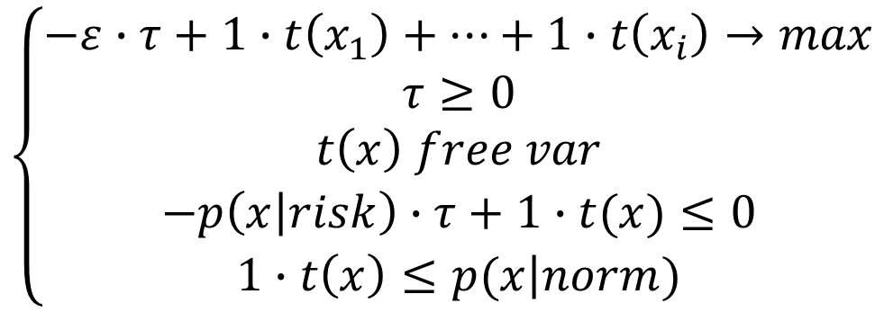
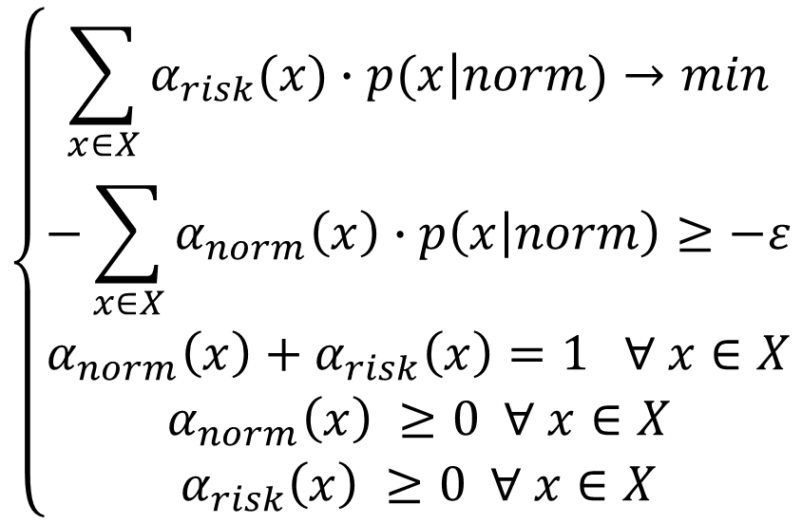
Neyman-Pearson approach
Solution
$$\left\{\begin{aligned}\sum_{x∈X}{α_{risk}(x)∙p(x\left|norm\right.)→min} \\ \begin{matrix}−\sum_{x∈X}{α_{norm}\left(x\right)∙p\left(x\left|norm\right.\right)≥−ε} \\ α_{norm}\left(x\right)+α_{risk}\left(x\right)=1 ∀ x∈X\end{matrix} \\ \begin{matrix}α_{norm}\left(x\right) ≥0 ∀ x∈X \\ α_{risk}\left(x\right) ≥0 ∀ x∈X\end{matrix}\end{aligned}\right.$$
$$\left\{\begin{aligned}−ε∙τ+1∙t\left(x_{1}\right)+…+1∙t\left(x_{i}\right)→max \\ \begin{matrix}τ≥0 \\ t\left(x\right) free var\end{matrix} \\ \begin{matrix}−p\left(x\left|risk\right.\right)∙τ+1∙t(x)≤0 \\ 1∙t\left(x\right)≤p(x\left|norm\right.)\end{matrix}\end{aligned}\right.$$

Slide 13


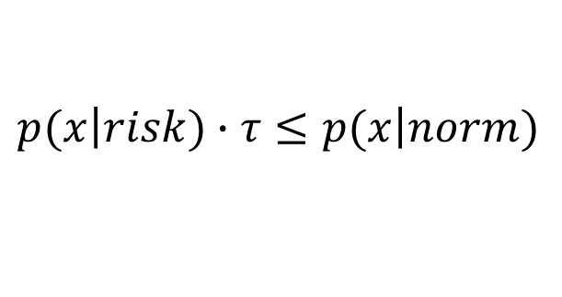

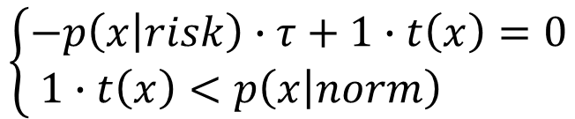
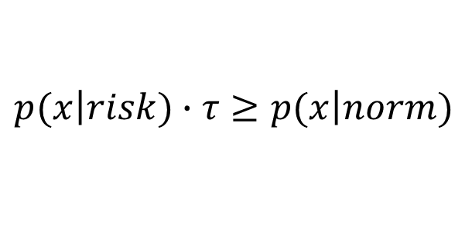

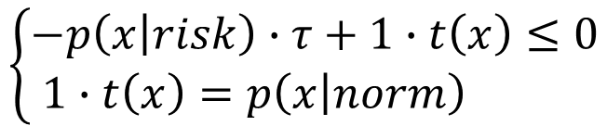


Neyman-Pearson approach
Solution
$$\left\{\begin{aligned}−p\left(x\left|risk\right.\right)∙τ+1∙t\left(x\right)=0 \\ 1∙t\left(x\right)<p\left(x\left|norm\right.\right) \end{aligned}\right.$$
$$x∈X_{norm} ⇒ α_{norm}\left(x\right)=1,α_{risk}\left(x\right)=0$$
$$⇒$$
$$⇒$$
$$⇒$$
$$p(x\left|risk\right.)∙τ≤p(x\left|norm\right.)$$
$$x∈X_{risk} ⇒ α_{norm}\left(x\right)=0,{ α}_{risk}\left(x\right)=1$$
$$⇒$$
$$\left\{\begin{aligned}−p\left(x\left|risk\right.\right)∙τ+1∙t\left(x\right)≤0 \\ 1∙t\left(x\right)=p\left(x\left|norm\right.\right) \end{aligned}\right.$$
$$⇒$$
$$⇒$$
$$p(x\left|risk\right.)∙τ≥p(x\left|norm\right.)$$

Slide 14
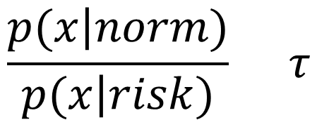
Neyman-Pearson approach
Solution
norm
$$\frac{p(x\left|norm\right.)}{p(x\left|risk\right.)} τ$$
>
<
risk

Slide 15
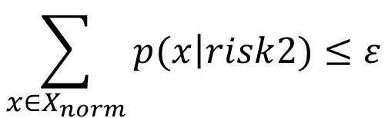
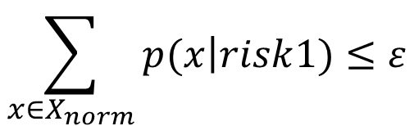
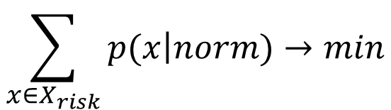
Neyman-Pearson approach
Some Variations: two risky states
$$\sum_{x∈X_{risk}}{p(x\left|norm\right.)}→min$$
$$\sum_{x∈X_{norm}}{p(x\left|risk\right.1)}≤ε$$
$$\sum_{x∈X_{norm}}{p(x\left|risk\right.2)}≤ε$$

Slide 16
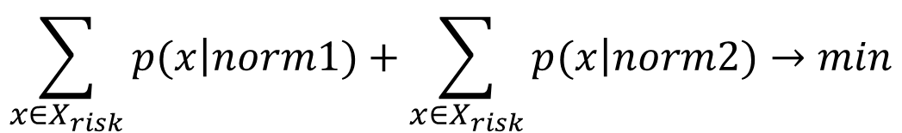
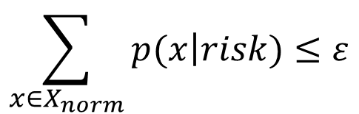
Neyman-Pearson approach
Some Variations: two normal states
$$\sum_{x∈X_{risk}}{p(x\left|norm1\right.)}+\sum_{x∈X_{risk}}{p(x\left|norm2\right.)}→min$$
$$\sum_{x∈X_{norm}}{p(x\left|risk\right.)}≤ε$$

Slide 17
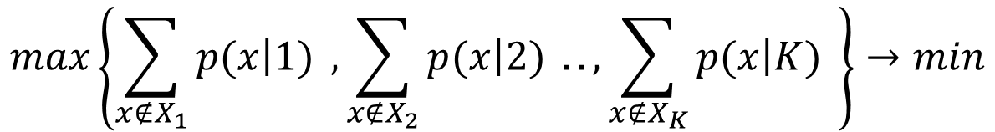
Neyman-Pearson approach
Minimax problem
$$max\left\{\sum_{x∉X_{1}}{p(x\left|1\right.)} ,\sum_{x∉X_{2}}{p(x\left|2\right.)} ..,\sum_{x∉X_{K}}{p(x\left|K\right.)} \right\}→min$$

