Slide 1
Basics of
Machine Learning
Dmitry Ryabokon, github.com/dryabokon

Slide 2

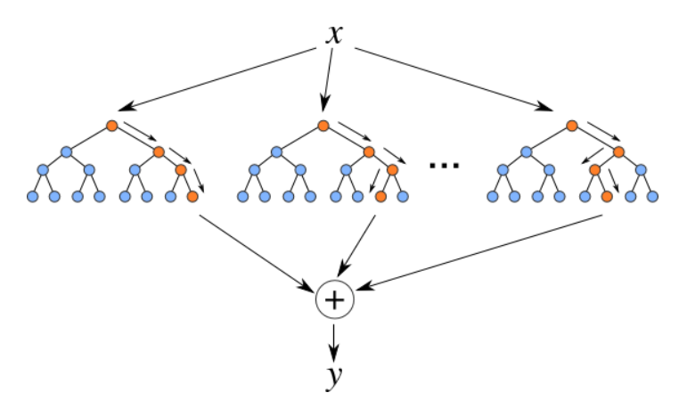
Lesson 15
Ensemble Learning

Slide 3
Supervised Learning
Summary
Bootstrapping
Bagging
Boosting
Random Forest

Slide 4
Ensemble Learning
Bootstrapping: random sampling with replacement
bootstrap set 1
Pick up, clone, put back
bootstrap set 2
bootstrap set 3

Slide 5
Ensemble Learning
Bagging: Bootstrap Aggregation
Classifier 1
Classifier 2
Voting / Aggregation
decision
Classifier 3

Slide 6
Ensemble Learning
Boosting: weighted average of multiple weak classifiers

Slide 7
Ensemble Learning
Boosting: weighted average of multiple weak classifiers

Slide 8
Ensemble Learning
Boosting: weighted average of multiple weak classifiers

Slide 9
Ensemble Learning
Boosting: weighted average of multiple weak classifiers

Slide 10
Ensemble Learning
Bagging Boosting
Aims to decrease variance - Aims to decrease bias
Aims to solve over-fitting problem
In bagging technique, a data set is divided into n samples using randomized sampling. Then, using a single learning algorithm a model is build on all samples. Later, the resultant predictions are combined using voting or averaging.
Bagging is done in parallel.
In boosting, after the first round of predictions, the algorithm weighs misclassified predictions higher, such that they can be corrected in the succeeding round. This sequential process of giving higher weights to misclassified predictions continue until a stopping criterion is reached.

Slide 11
Random Forest
https://www.youtube.com/watch?v=J4Wdy0Wc_xQ

Slide 12
Random forest
Original dataset
F1 F2 F3 Target
A A A 0
A A B 0
B B A 1
A B B 1
Bootstrapped dataset
F1 F2 F3 Target
A B B 1
A A B 0
A A A 0
A B B 1

Slide 13
Random forest
Bootstrapped dataset
F1 F2 F3 Target
A B B 1
A A B 0
A A A 0
A B B 1
candidate
candidate
Determine the best root node out of randomly selected sub-set of candidates

Slide 14
Random forest
Bootstrapped dataset
F1 F2 F3 Target
A B B 1
A A B 0
A A A 0
A B B 1
root

Slide 15
Random forest
Bootstrapped dataset
F1 F2 F3 Target
A B B 1
A A B 0
A A A 0
A B B 1
candidate
candidate
Build tree as usual, but considering a random subset of features at each step

Slide 16
Random forest
Bagging: do aggregate decisions against the bootstrapped data

Slide 17
Random forest
Validation: run aggregated decisions against out-of-bag dataset
Original dataset
F1 F2 F3 Target
A A A 0
A A B 0
B B A 1
A B B 1
Bootstrapped dataset
F1 F2 F3 Target
A B B 1
A A B 0
A A A 0
A B B 1
out-of-bag

Slide 18
Random forest
The process
Build random forest
Estimate
Train / Validation error
Adjust RF parameters
# of variables per step, regularization params, etc

Slide 19
RF vs GBM
RF uses bagging technique to make predictions.
GBM uses boosting techniques to make predictions.
Random forest improves model accuracy by reducing variance (mainly). The trees grown are uncorrelated to maximize the decrease in variance.
On the other hand, GBM improves accuracy by reducing both bias and variance in a model.
Random forests are a significant number of decision trees pooled using averages or majority rules at the end. Gradient boosting machines also combine decision trees but at the beginning of the process unlike Random forests. Random forest creates each tree independent of the others while gradient boosting develops one tree at a time. Gradient boosting yields better outcomes than random forests if parameters are carefully tuned but it’s not a good option if the data set contains a lot of outliers/anomalies/noise as it can result in overfitting of the model.Random forests perform well for multiclass object detection. Gradient Boosting performs well when there is data which is not balanced such as in real time risk assessment.

Slide 20
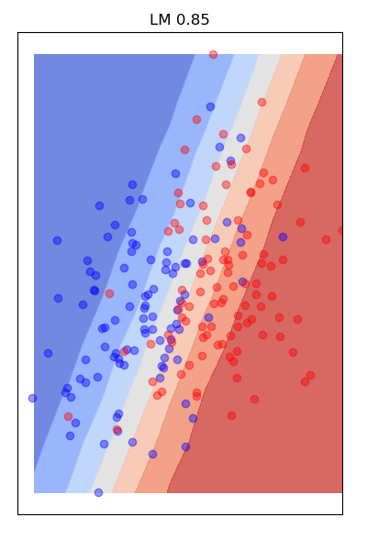
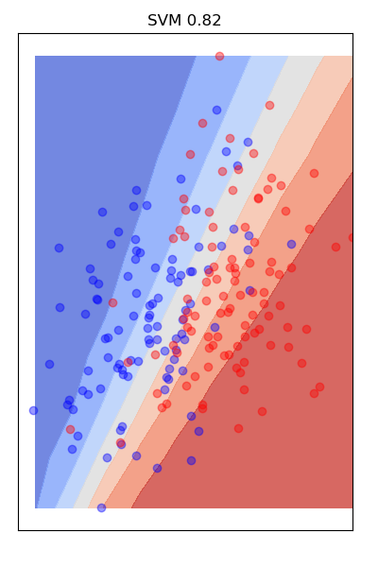
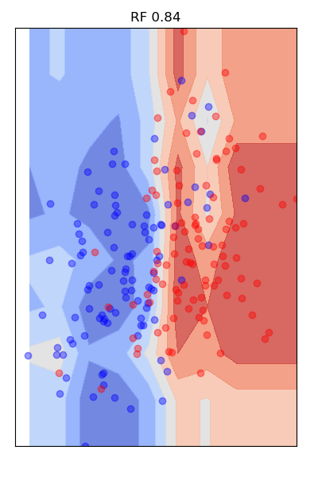
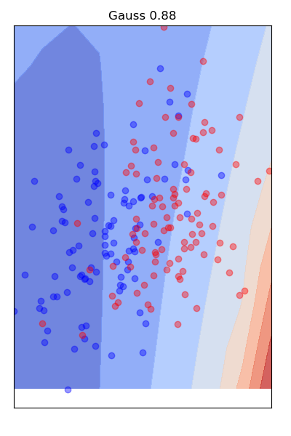
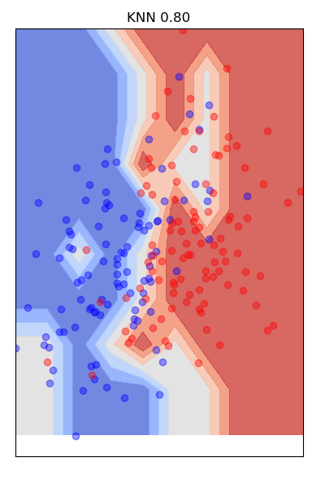
Classification examples: 2D data, 2 classes
https://github.com/dryabokon/ML/blob/master/ex_02_01_train_test_2_classes.py

Slide 21
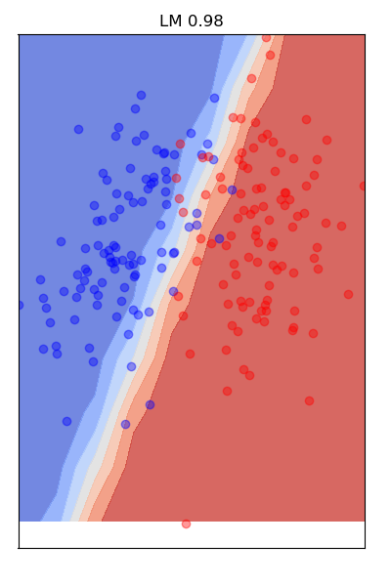
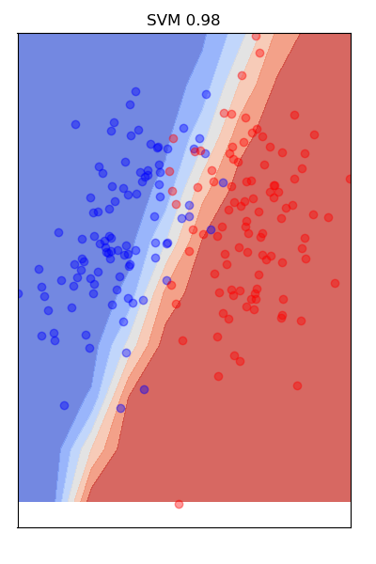
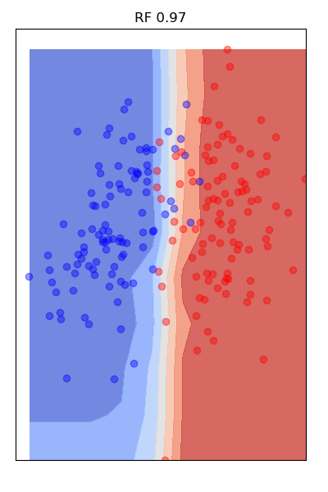
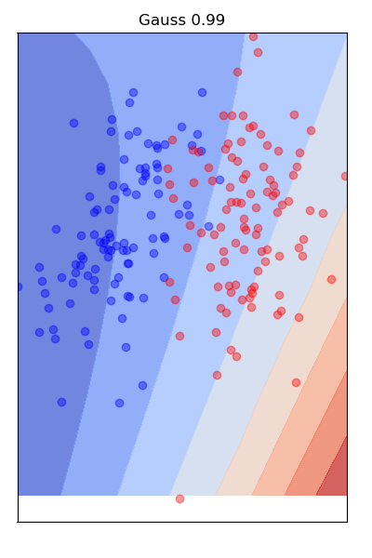
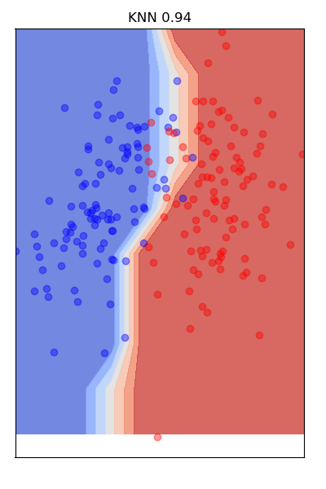
Classification examples: 2D data, 2 classes
https://github.com/dryabokon/ML/blob/master/ex_02_01_train_test_2_classes.py

