Slide 1
Basics of
Machine Learning
Dmitry Ryabokon, github.com/dryabokon

Slide 2

Lesson 17
Benchmarking

Slide 3
Benchmarking
Summary
ROC Curve
PR-Curve
Benchmarking the classifiers

Slide 4
ROC curve
https://github.com/dryabokon/ML/blob/master/ex_03_01_ROC.py

Slide 5
ROC curve
%
TN
TP
FN
FP
score (confidence level)

Slide 6
ROC curve
Error types
Positive
Negative
Actual

Slide 7
ROC curve
Error types
Actual
true pos
TP: 2/3
FP: 2/7
false pos
false neg
FN: 1/3

Slide 8
ROC curve
TP
TP: 0/3
FP: 0/7
FN: 3/3
FP

Slide 9
ROC curve
TP
TP: 1/3
FP: 0/7
FN: 2/3
FP

Slide 10
ROC curve
TP
TP: 2/3
FP: 1/7
FN: 1/3
FP

Slide 11
ROC curve
TP
TP: 2/3
FP: 2/7
FN: 1/3
FP

Slide 12
ROC curve
TP
TP: 2/3
FP: 4/7
FN: 1/3
FP

Slide 13
ROC curve
TP
TP: 3/3
FP: 7/7
FN: 0/3
FP

Slide 14
ROC curve
TP
TP: 3/3
FP: 7/7
FN: 0/3
FP

Slide 15
ROC curve
AUC: area under ROC curve
TP
target
FP

Slide 16
ROC curve
Example: Naive Bayesian classifier
1/6
3/9
4/6
3/9
1/6
3/9
1/6
4/6
1/6
4/9
2/9
3/9

Slide 17
ROC curve
Example: Naive Bayesian classifier
1/6
3/9
4/6
3/9
1/6
3/9
1/6
4/6
1/6
4/9
2/9
3/9
(0,0) (1,0) (2,0) (2,0) (0,1) (0,1) (1,1) (1,1) (1,1) (1,1) (2,1), (0,2) (0,2) (1,2) (2,2)
0.19 1.50 0.25 0.25 0.75 0.75 6.00 6.00 6.00 6.00 1.00 0.19 0.19 1.50 0.25

Slide 18
ROC curve
Example: Naive Bayesian classifier
TP
FP
6.00 6.00 6.00 6.00 1.50 1.50 1.00 0.75 0.75 0.25 0.25 0.25 0.19 0.19 0.19

Slide 19
ROC curve
The task: compare accuracy of two strategies
Strategy 1:
63 81 23 54 10 17 29 5 34 21
Strategy 2:
86 98 18 42 21 23 37 18 74 27

Slide 20
Precision-Recall

Slide 21
Precision - Recall
Precision: #TP / (#TP + #FP)
Recall: #TP / (#TP + #FN)
Accuracy: (#TP + #TN) /Total
F1-score: 2 x Precision x Recall / (Precision+ Recall)
mean harmonic (!)

Slide 22
Precision - Recall
Precision
TP: 0
FP: 0
Precision: 0/0
FN: 3
Recall
Recall: 0/3

Slide 23
Precision - Recall
Precision: TP / (TP+FP) = 1
Recall: TP / (TP+FN)
Precision
#TP: 1
#FP: 0
Precision: 1/1
#FN: 2
Recall
Recall: 1/3

Slide 24
Precision - Recall
Precision: #TP / (#TP+#FP) = 2 / (2 + 1) =2/3
Recall: #TP / (#TP+#FN)
Precision
#TP: 2
#FP: 1
Precision: 2/3
FN: 1
Recall
Recall: 2/3

Slide 25
Precision - Recall
Precision
TP: 2
FP: 2
Precision: 1/2
FN: 1
Recall
Recall: 2/3

Slide 26
Precision - Recall
Precision
TP: 2
FP: 4
Precision: 2/6
FN: 1
Recall
Recall: 2/3

Slide 27
Precision - Recall
Precision
TP: 2
FP: 5
Precision: 2/7
FN: 1
Recall
Recall: 2/3

Slide 28
Precision - Recall
Precision
TP: 3
FP: 7
Precision: 3/10
FN: 0
Recall
Recall: 1

Slide 29
Precision - Recall
Precision
TP: 3
FP: 7
FN: 0
Recall
Recall: 1

Slide 30
Precision - Recall
Precision
TP: 0
FP: 0
Precision: 0
FN: 3
Recall
Recall: 0

Slide 31
Precision - Recall
Precision
TP: 1
FP: 0
Precision: 1
FN: 2
Recall
Recall: 1/3

Slide 32
Precision - Recall
Precision
TP: 2
FP: 0
Precision: 1
FN: 1
Recall
Recall: 2/3

Slide 33
Precision - Recall
Precision
TP: 2
FP: 1
Precision: 2/3
FN: 1
Recall
Recall: 2/3

Slide 34
Precision - Recall
Precision
TP: 2
FP: 2
Precision: 2/4
FN: 1
Recall
Recall: 2/3

Slide 35
Precision - Recall
Precision
TP: 3
FP: 2
Precision: 2/5
FN: 0
Recall
Recall: 1

Slide 36
Precision - Recall
Precision
TP: 3
FP: 4
Precision: 3/7
FN: 0
Recall
Recall: 1

Slide 37
Precision - Recall
Precision
TP: 3
FP: 4
Precision: 3/7
FN: 0
Recall
Recall: 1

Slide 38
Benchmarking the classifiers
github.com/dryabokon/ML/blob/master/ex_03_03_benchmark_classifiers_k2.py
github.com/dryabokon/ML/blob/master/ex_03_03_benchmark_classifiers_multi_class.py

Slide 39
Benchmarking the Classifiers
Regression
Naive Bayes
Gaussian
SVM
Nearest Neighbors
Decision Tree
Random Forest
AdaBoost
xgboost
Neural Net

Slide 40
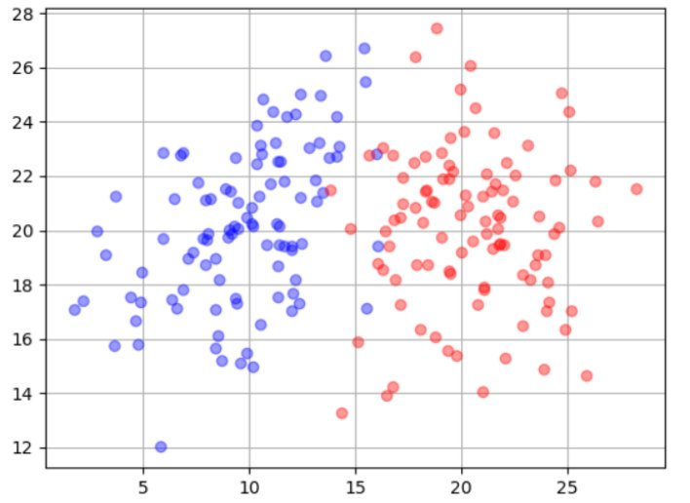
Benchmarking the Classifiers
Gaussian distribution

Slide 41
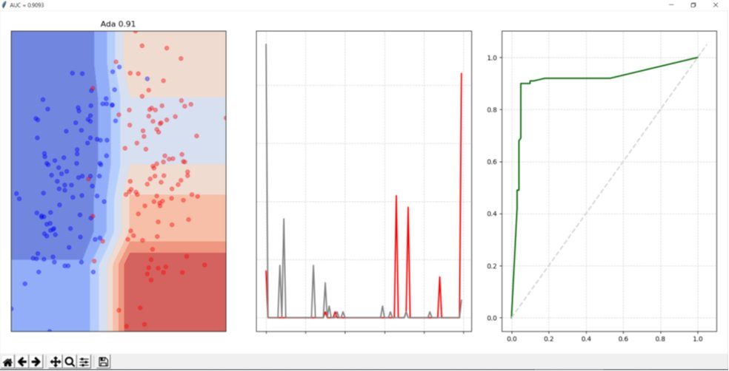
Benchmarking the Classifiers

Slide 42
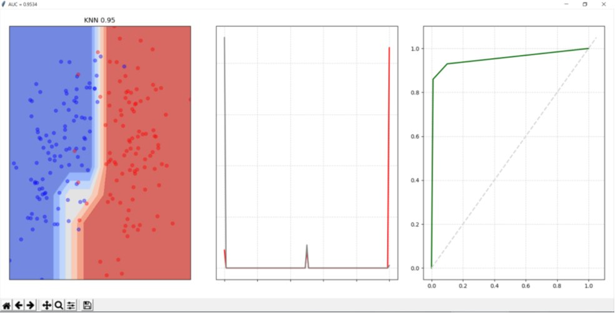
Benchmarking the Classifiers

Slide 43
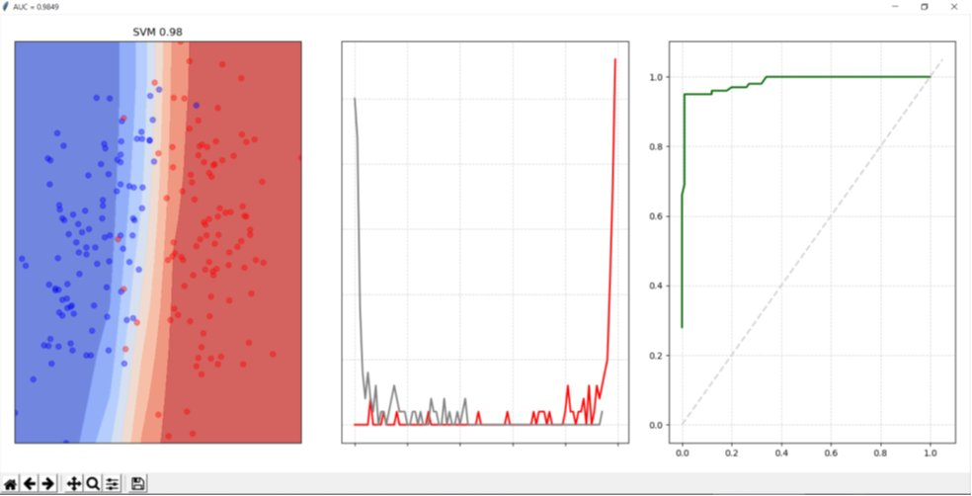
Benchmarking the Classifiers

Slide 44
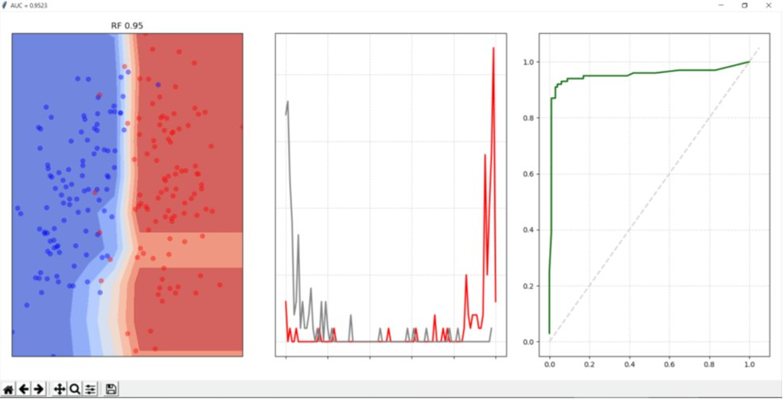
Benchmarking the Classifiers

Slide 45
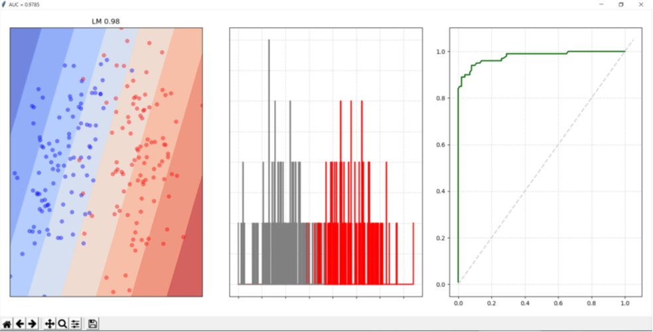
Benchmarking the Classifiers

Slide 46
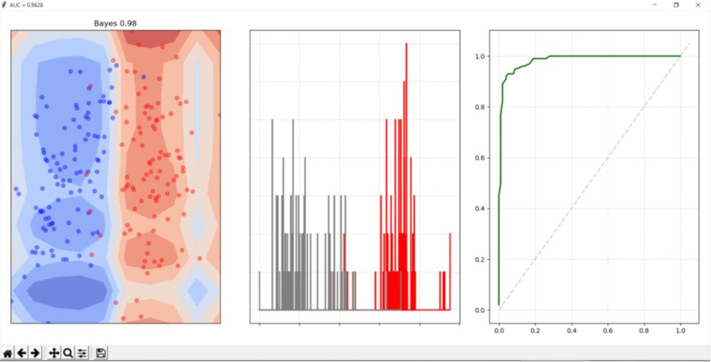
Benchmarking the Classifiers

Slide 47
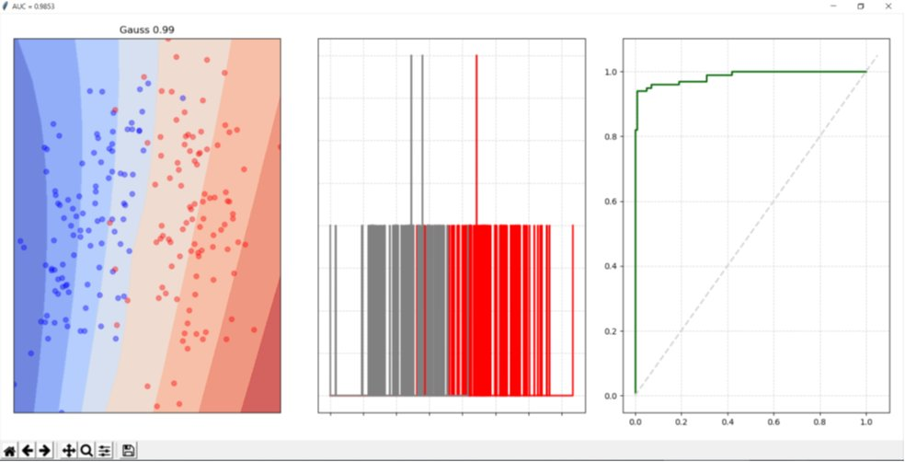
Benchmarking the Classifiers

Slide 48
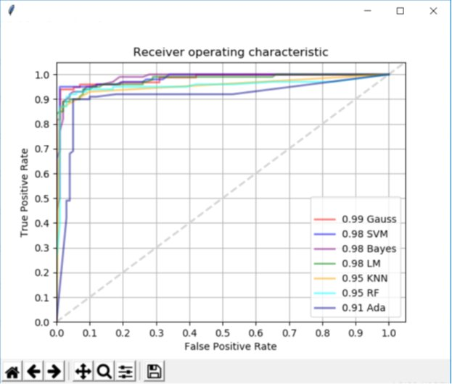
Benchmarking the Classifiers

Slide 49
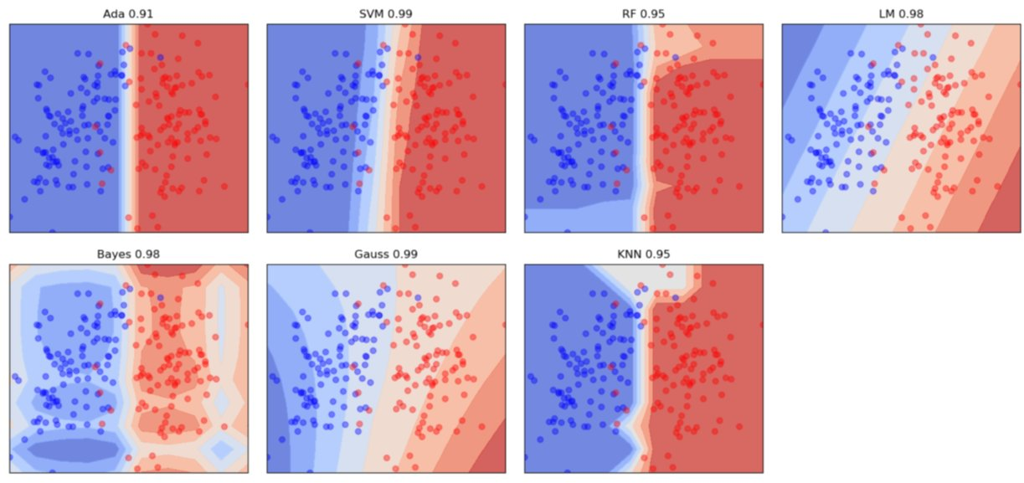
Benchmarking the Classifiers

Slide 50
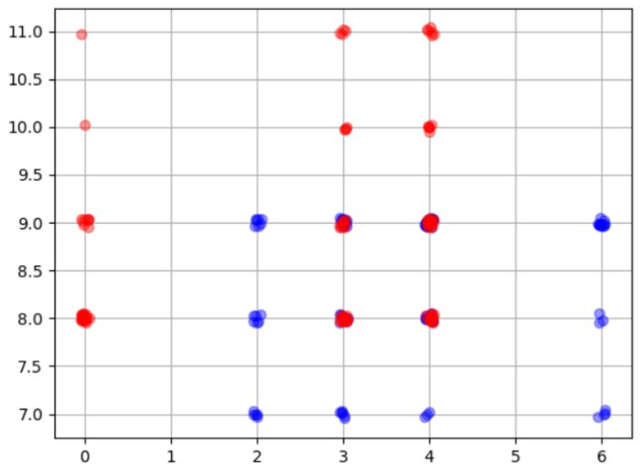
Benchmarking the Classifiers
Non-gaussian distribution

Slide 51
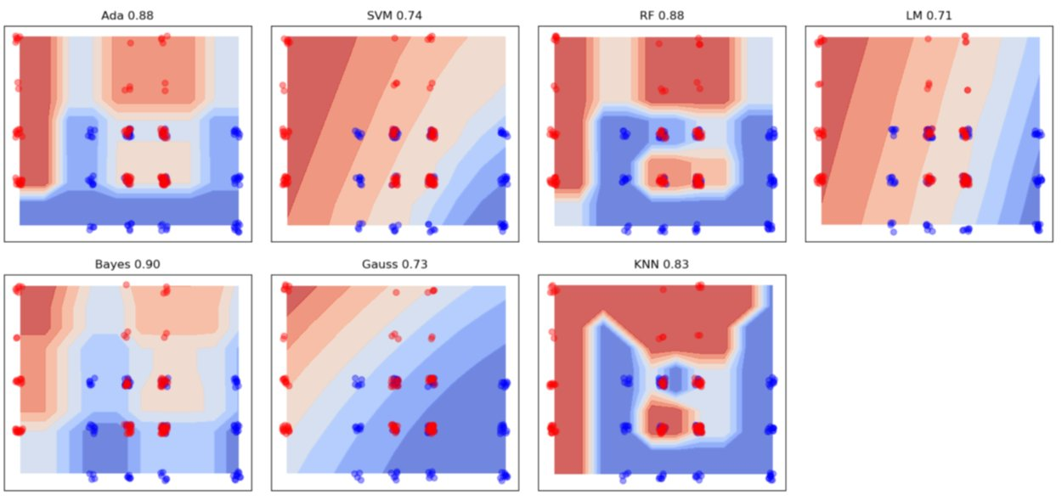
Benchmarking the Classifiers

Slide 52
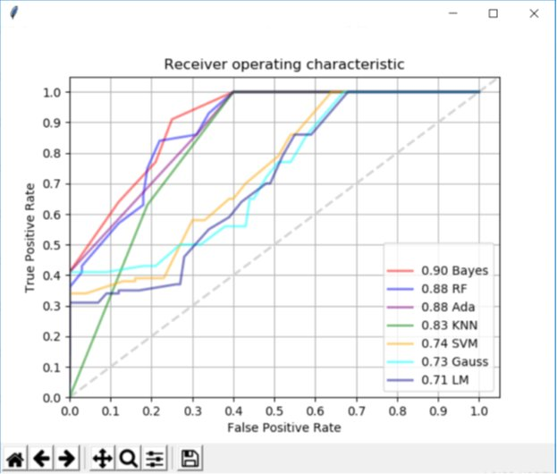
Benchmarking the Classifiers

