Slide 1
Basics of
Machine Learning
Dmitry Ryabokon, github.com/dryabokon

Slide 2


Lesson 18
Time Series

Slide 3
Benchmarking
Summary
Key definitions
Stationarity, Trends, Seasonality
Univariate vs Multivariate
Exogeneous variables
Approaches
Gated Recurrent Units (GRU)
https://www.machinelearningplus.com/time-series/arima-model-time-series-forecasting-python/
https://github.com/jbrownlee/Datasets
https://www.kaggle.com/prashant111/complete-guide-on-time-series-analysis-in-python
https://www.kaggle.com/kashnitsky/topic-9-part-1-time-series-analysis-in-python

Slide 4
Key definitions

Slide 5
Key definitions
Univariate vs Multivariate time series
Univariate time series
Only one variable is varying over time.
For example, data collected from a sensor measuring the temperature of a room every second. Therefore, each second, we have a one-dimensional value, which is the temperature.
Multivariate time series
Multiple variables are varying over time.
For example, a tri-axial accelerometer. There are three accelerations, one for each axis (x,y,z) and they vary simultaneously over time.

Slide 6
Key definitions
Endogenous vs Exogenous variables
An input variable is endogenous if it is affected by other variables in the system and the output variable depends on it.
An input variable is an exogenous if it is independent of other variables in the system and the output variable depends upon it.
Typically, a time series forecasting problem has endogenous variables and may or may not have exogenous variables.

Slide 7
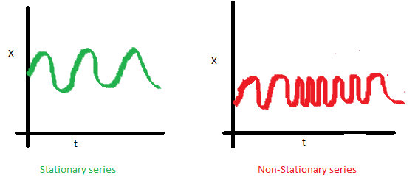
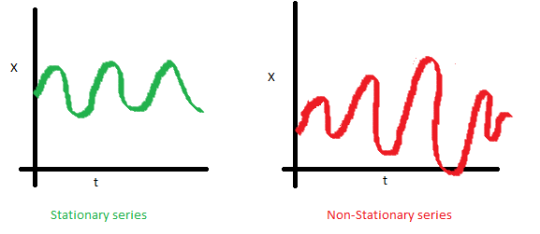
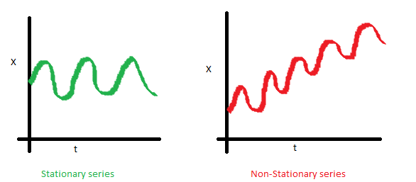
Key definitions
Stationarity

Slide 8
Key definitions
Stationarity
Reasons to convert a non-stationary series into a stationary one
Forecasting a stationary series is relatively easy and the forecasts are more reliable.
An important reason is, autoregressive forecasting models are essentially linear regression models that utilize the lag(s) of the series itself as predictors.
We know that linear regression works best if the predictors (X variables) are not correlated against each other. So, stationarizing the series solves this problem since it removes any persistent autocorrelation, thereby making the predictors(lags of the series) in the forecasting models nearly independent.

Slide 9
Key definitions
Seasonality
Additive time series:
Value = Base Level + Trend + Seasonality + Error
Multiplicative Time Series:
Value = Base Level x Trend x Seasonality x Error

Slide 10
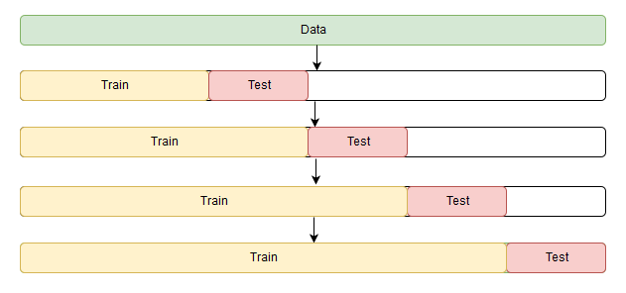
Key definitions
Cross Validation for Time Series

Slide 11
Forecasting approaches

Slide 12
Forecasting Approaches
Classic approaches
 | Multivariate | Trend | Seasonality | Exogenous vars
Autoregression (AR) | - | - | - | -
Moving Average (MA) | - | - | - | -
Autoregressive Moving Average (ARMA) | - | - | - | -
Autoregressive Integrated Moving Average (ARIMA) | - | + | - | -
Seasonal Autoregressive Integrated Moving-Average (SARIMA) | - | + | + | -
SARIMA with Exogenous Regressors (SARIMAX) | - | + | + | +
Vector Autoregression (VAR) | + | - | - | -
Vector Autoregression Moving-Average (VARMA) | + | - | - | -
Vector Autoregression Moving-Average with Exogenous Regressors (VARMAX) | + | - | - | +
Simple Exponential Smoothing (SES) | - | - | - | -
Holt Winter’s Exponential Smoothing (HWES) | - | + | + | -
https://machinelearningmastery.com/time-series-forecasting-methods-in-python-cheat-sheet/

Slide 13
Forecasting Approaches
Links
https://medium.com/analytics-vidhya/text-lstm-f1aaceeb5727
https://people.duke.edu/~rnau/411arim.htm
https://people.duke.edu/~rnau/411arim3.htm
https://www.digitalocean.com/community/tutorials/a-guide-to-time-series-forecasting-with-arima-in-python-3
https://towardsdatascience.com/illustrated-guide-to-lstms-and-gru-s-a-step-by-step-explanation-44e9eb85bf21
https://colah.github.io/posts/2015-08-Understanding-LSTMs/
https://github.com/PsiPhiTheta/LSTM-Attention/blob/master/report/main.pdf

